Slide 1

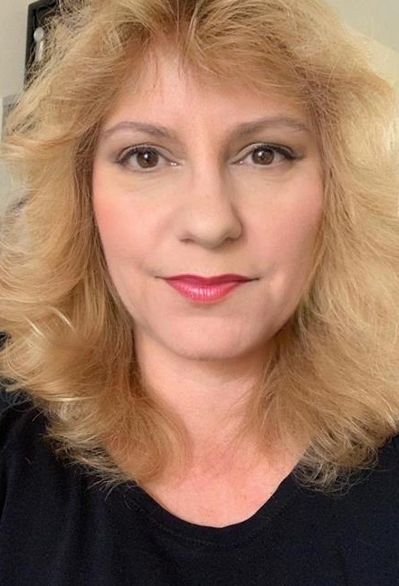
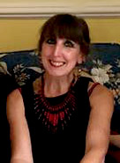
Intro Slide Title 1
AL Disability Champions project (U101) 2022-2024
Lisa Bowers, Elouise Huxor and Theodora Philcox
STEM E&I
February 2024
Notes:
Lisa

Slide 2
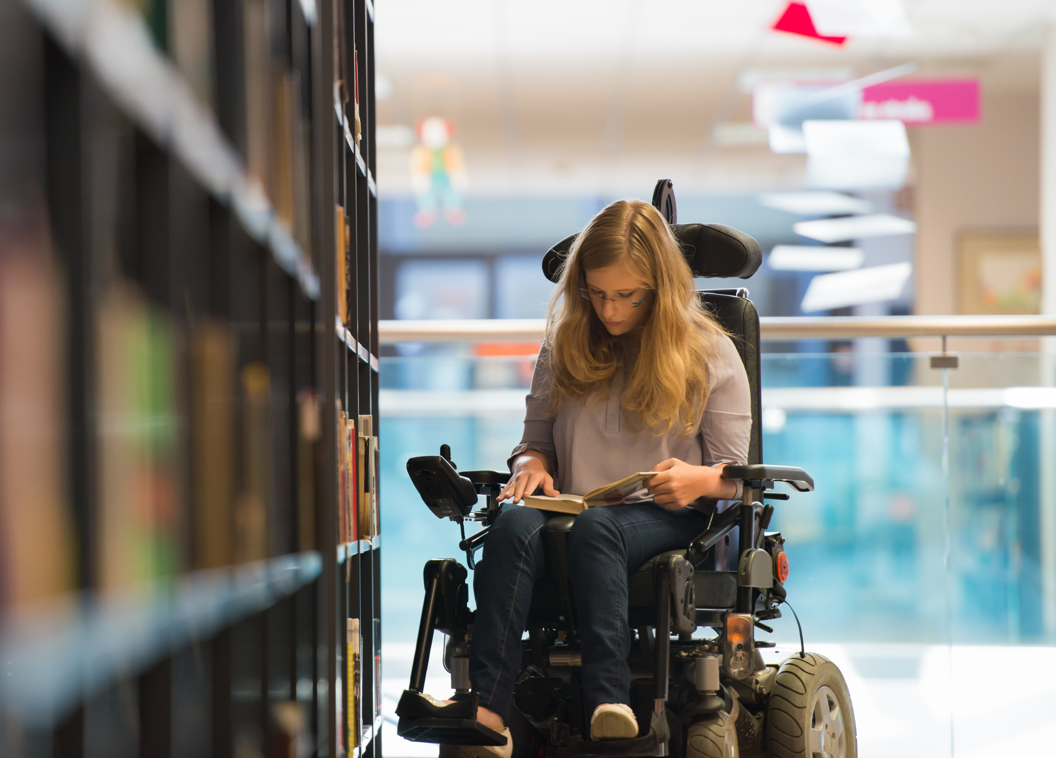
This project originated through E&I staff tutors getting increasing numbers of complex DAR queries.
Difficult to gain accurate and appropriate information from the OU system.
Some ALs were proactive with information, whilst others struggled to find the information to help their students.
We wanted to capitalise on this to create a vehicle for sharing both information and practical strategies to enhance the students’ experience and their potential to succeed.
Notes:
Lisa

Slide 3
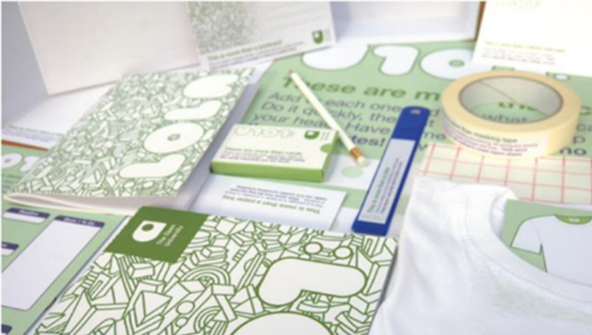
Choosing the starting point:
The pilot trial focused on the first level design module, U101.
U101 presented with an increasing number of DAR students over the last 2 years.
U101 requires specific practical and project management skills that may place barriers to students with DAR records
Notes:
Lisa

Slide 4
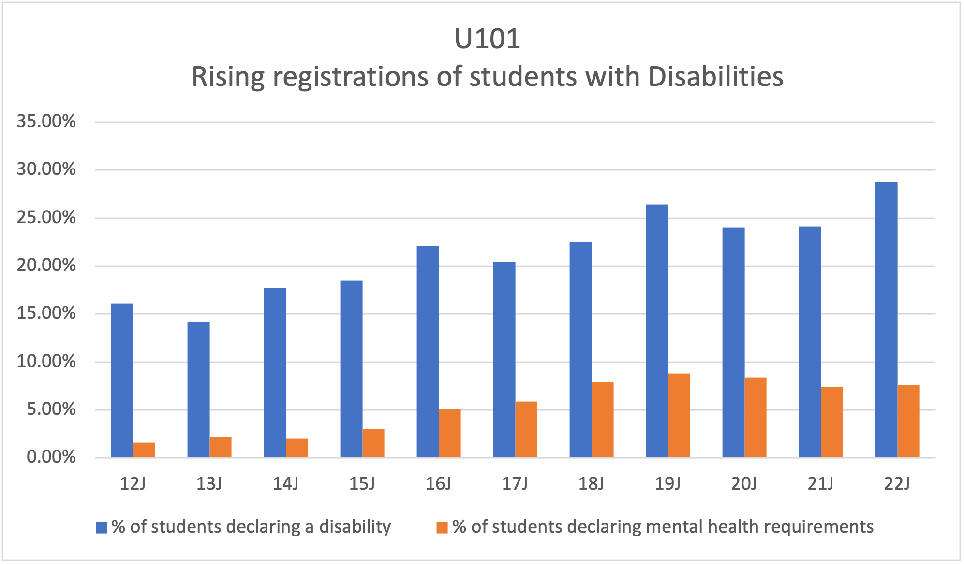
Notes:
Elouise

Slide 5
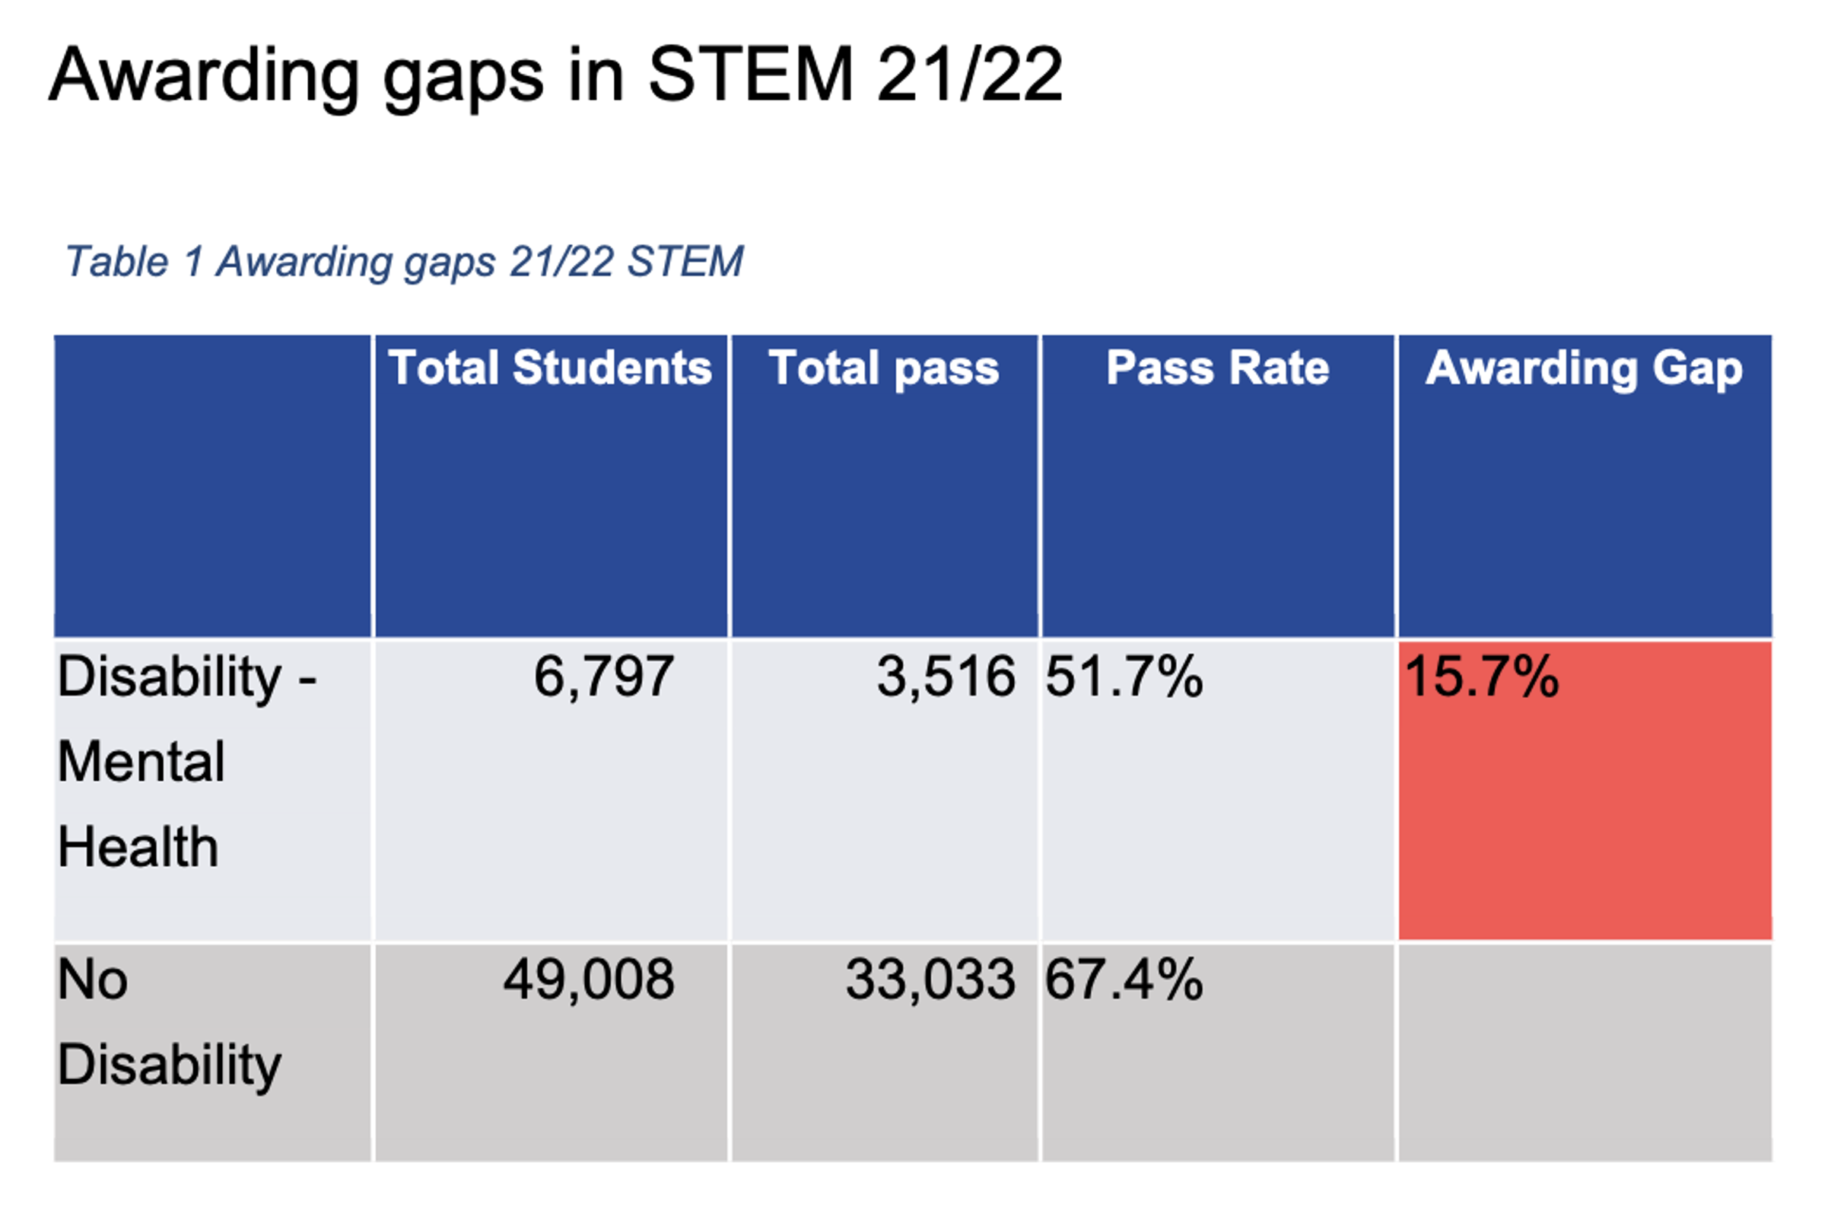
Notes:
Elouise

Slide 6
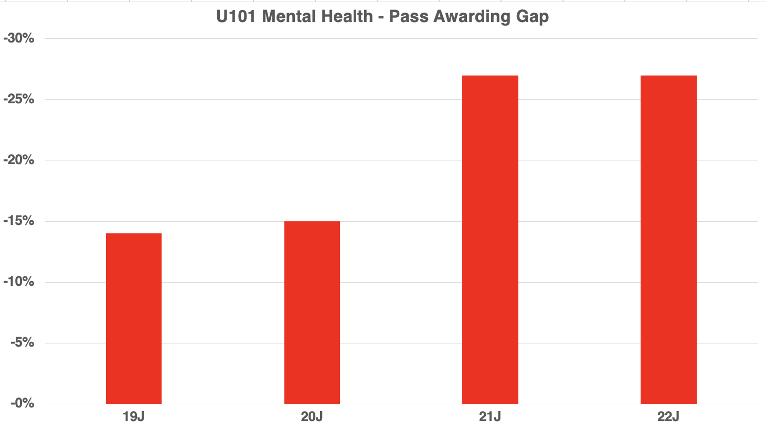
Notes:
Elouise

Slide 7
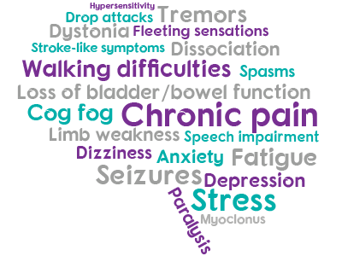

Training and preparation
Through an EOI we recruited a trial group of three Disability Champions (DC’s) from ALs tutoring on the chosen module.
All the DCs and the staff tutors undertook the Mental Health First Aid training course.
The DCs undertook additional training on areas of ability needs where they already had some experience or wanted to build their knowledge.
A Disability Champions Help Desk was set up as a secondary forum alongside the general Module’s Tutor Forum
Notes:
Lisa

Slide 8

Resources and delivery
The Disability Champions manned the Disability Champions Help Desk to answer any incoming queries from ALs on the module. They offered peer-to-peer assistance for disability or mental health teaching inquiries and encouraged other ALs to share strategies that they had found effective in similar circumstances.
The Disability Champions team, along with the Staff Tutors, created a set of resources (the Disability Champions Toolkit) that were easy to access for time poor ALs, within a dedicated VLE.
Notes:
Lisa

Slide 9
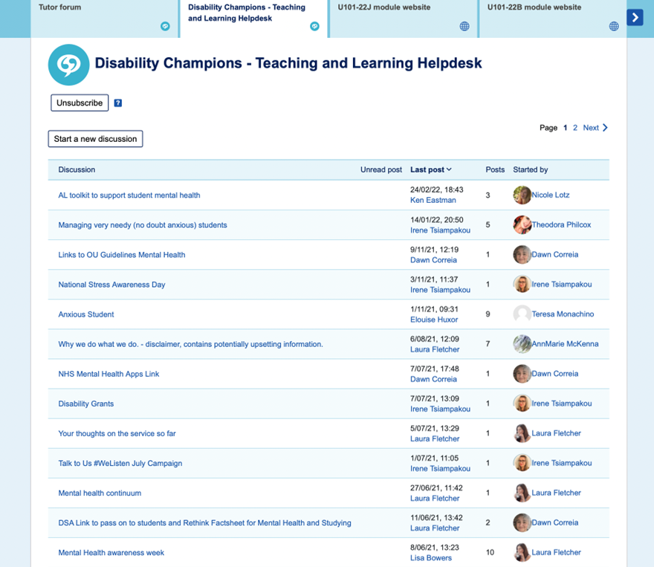
Disability Champions Helpdesk – on U101 tutor site
Notes:
Lisa

Slide 10
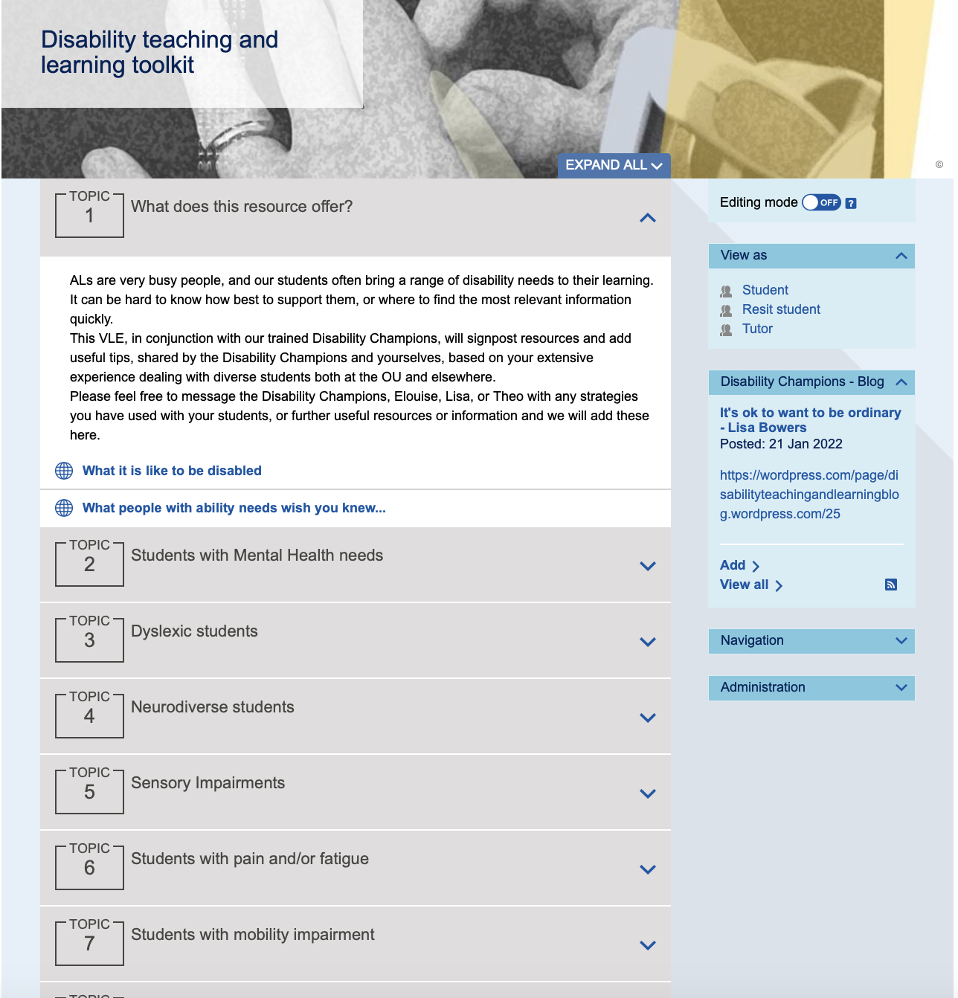
VLE - Disability Champions Toolkit
Notes:
Lisa

Slide 11
Disability Champions Helpdesk - tutor comments:
U101 tutor survey Feb 2021
  ‘I haven't felt that I have a contribution that hadn't already been covered. I must get there sooner and then perhaps I can say something of note’
  ‘I haven't had a situation I've felt I need advice on’
‘No specific need just yet’
  ‘There's lots of supportive and relevant content that I have read and learnt from resulting in not needing to ask the Disability champions’
‘Not had any reason to so far’
Notes:
Elouise

Slide 12
Disability Champions Toolkit – tutor comments
(U101 tutor Survey Feb 2021)
  ‘It is varied through helpful links to wider support alongside shared strategies from tutors that work and helps me understand what we are all experiencing’
‘Looks helpful, some case studies to help us direct students which can help us with the right tone with students would be useful too’
  It is good to see I already do some of these and how I can develop further supportive strategies.’
‘When I last looked, I thought it was great, and good to know about for when I need it”
‘Seems like a good mix of useful ideas and help’
Notes:
Elouise

Slide 13
Future topics suggested by tutors:
Profiles and streamlined case studies – giving precise practical support
Covid related issues and support
How to make tutorials inclusive
Recommended tools and aids – such as Read&Write (Dyslexia) ZoomText (Vision impairment)
A way to share good practice
Notes:
Elouise

Slide 14
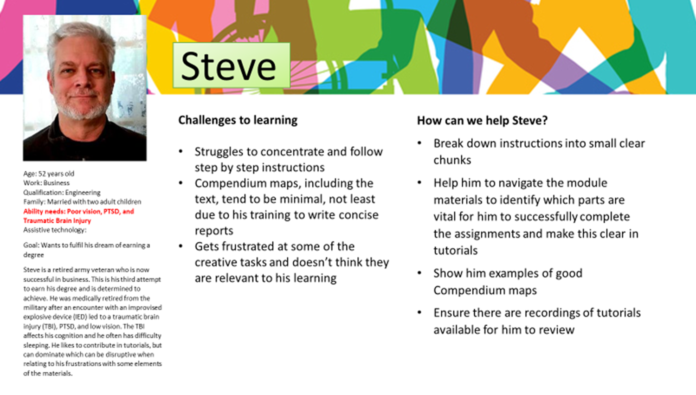
Personas
We created a suite of student personas with strategies to support teaching.
They highlighted a range of ability needs; the challenges they posed to learning, and listed strategies tutors might find useful to help their student.
Notes:
Theo

Slide 15
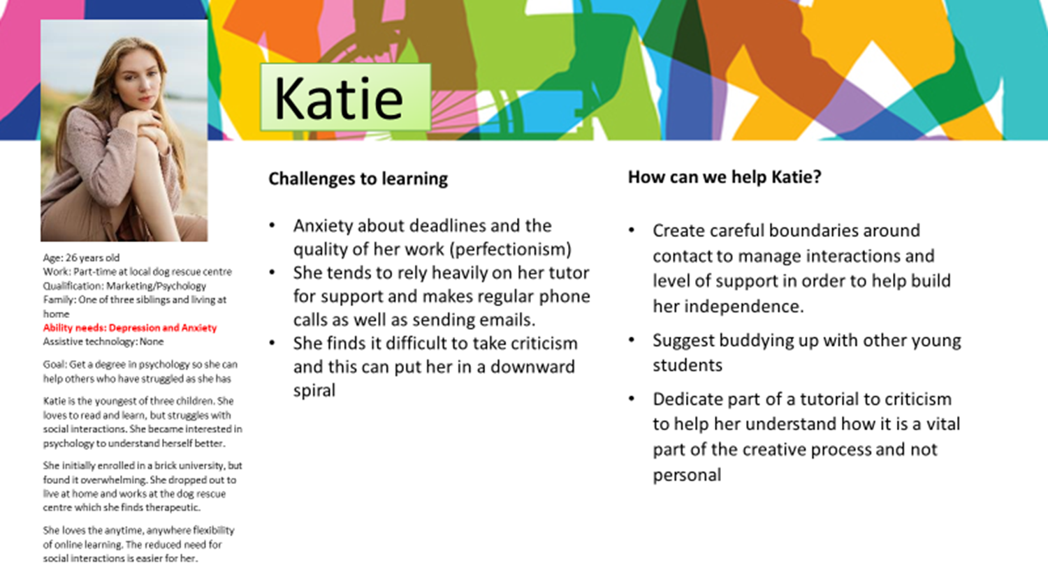
Notes:
Theo

Slide 16
What tutors found helpful from the personas
(U101 tutor survey May 2021)
‘The practical advice on how we, as tutors, help support students with specific needs or barriers to learning’
‘helps us to see the learning from the student's perspective and remind us that this may differ considerably across the cohort’
‘I can identify patterns in my own students’
‘Understanding that many students have very specific issues that can affect their working process and with some simple adjustments to how I communicate, and guide students could make the difference to their confidence’
‘There are strategies that I hadn’t thought about, such as having some form up buddying up system and careful boundaries with Katie’
Notes:
Elouise?

Slide 17
Improvements on the personas suggested by tutors:
Speak to students and ask them to outline what strategies they find useful
Include a resources section, and describe tools that students are successfully using
include a reflective column for tutors to report back with feedback on what worked
Notes:
Elouise?

Slide 18
‘Giving her examples to choose is a great starting point. I think being with her when she does it might give some confidence and calm the panic. Maybe the language is not helping.... find a "problem", linked with the confidence (who am I to find any problem when I have a big one myself... etc) maybe trying to encourage her with: what she does not like. Maybe she can make few observations such as: I don’t like the look of.. I don’t like how it works, I don’t like how it is used, I don’t like the waste it creates, I don’t like how it folds, I don’t like etc.... it is a bit more personal ... and hopefully she will be able to respond better in finding the solution. Hope you will make a breakthrough ☺'
Case study:
A student was struggling to understand the assignment guidelines and the more abstract requirements of design thinking.
She was on the autistic spectrum and recognised this was a barrier to her thinking.
A request was made by her tutor on the forum and a number of tutors responded with very useful ideas to support her.
‘I always suggest that they consider problems personal to them in their own home, then their family, then think about problems locally in their town, then nationally, then globally. Once they start thinking about bigger problems rather than what might be specific to them, it can take the pressure off and can allow them settle down to problem finding. If the problem of global travel could be solved with a personal teleportation machine, how might her anxiety with her shopping locally be manifest in something less science fiction. Sometimes starting with a nonsense notion can bring clarity to more solvable issues.’
‘I do suggest students try and use discussion boards to identify grumbles and gripes - so perhaps Mumsnet? etc. They needn't leave the house.’
Notes:
Theo

Slide 19
Disability Champion advice:
“It very much depends on the level/type of autism - and whether she experiences other learning difficulties alongside this as quite often dyslexia, dyspraxia, ADHD are also additional for the student to negotiate.
She may well hide behind the fact that she is autistic as a way of managing not understanding or knowing how to deal with the learning materials which tbh are not worded with autism in mind. If there is anything in the materials that is open to interpretation even to the slightest amount then it could be making her panic so any guidance you offer has to be very very specific - the fewer words the better and literal responses as the student is likely to take what you say literally.
For example, if you have suggested that she 'go for a walk around the block to look for problems' - she may well be confused and be looking for a block to walk around! And as Slavista mentioned - the word 'problem' is going to confuse her.
So, taking a literal stance might help her e.g. 'go for a walk to the end of the street and back that you live on ...........'
Make sure you know how long the road is though as if she lives on a road that is 10 miles long she would well take you literally and walk the whole 10 miles there and back! You have to pick your wording very carefully and continually ask her to tell you if what you have explained makes sense.”
Notes:
Theo

Slide 20
Was the project successful?
The forum wasn’t as busy as we had expected.
    ALs seemed reluctant to post on the forum, possibly due to concerns about appearing less confident to their peers, or worrying that it might add to their workload.
ALs wanted snappy, relevant, and easy information to apply in practice. We delivered that.
Unknown to us, the OU Disabilities Team was developing its resources to make them more accessible, and also rolled out their own toolkit and personas! However, we didn’t feel our work was wasted, as it specifically targeted issues tutors faced within our particular discipline.
On reflection, we realised that our created resources, drawn on learning gained from our Disability Champions, meant we - as Staff Tutors - had readily available and up-to-date information to share with our ALs.
Notes:
Lisa

Slide 21
Slide Title 6
Summary
Tutors have quick and easy access to information and support in their teaching of students with a wide range of disability needs.
They will be able to gain a deeper understanding of the impact of a range of disabilities on learning through the resources.
Through sharing good practice tutors will gain confidence in their ability to meet the learning needs of students with disabilities of all kinds.
Students will feel more effectively supported which we hope will have an impact on their levels of achievement.
Notes:
Lisa

Slide 22
Dissemination & impact
Developing Disability Champions, 3rd Annual Stem Teaching Conference
March 2022
AL Disability Champions project , 11th eSTEeM Annual Conference: Scholarship Success Stories – Innovation Through Community
May 2022
Disability Champions Pilot Project final report, eSTEeM
August 2023

Slide 23
Slide Title 30
Thank you

