Slide 1


Using learning networks and learning analytics to drive module improvements OU STEM: a practical and conceptual journey eSTEeM project co-leader with Rob Janes, LHCS
Lesley Boyd
PhD researcher (final year)
Institute of Educational Technology
10th eSTEeM conference
1st July 2021

Slide 2
working with learning networks project Phases 1 and 2; eSTEeM project evaluation and impact
Agenda
1. Interdisciplinary PhD project
2. Conceptualisation
conceptualising the unfolding process
navigating across PhD theory and practice contributions
3. Could we do it elsewhere?

Slide 3
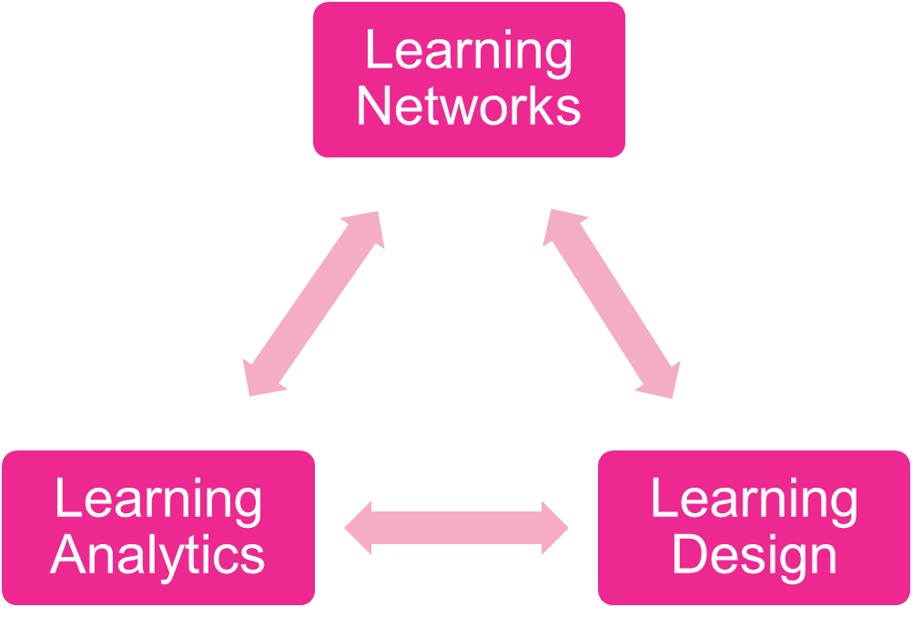
Interdisciplinary practical approach
Phase 2 eSTEeM project

Slide 4
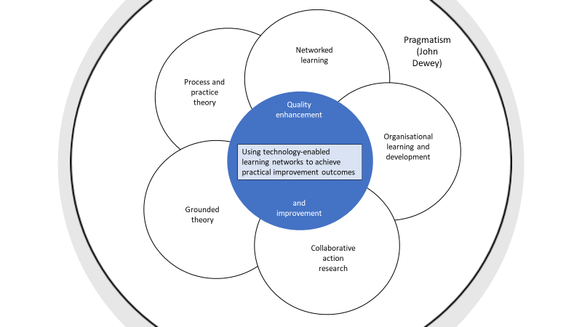
Interdisciplinarity of the research

Slide 5
Guiding thought ….
People (practitioners) need to learn how to improve in challenging and complex practical situations

Slide 6
What’s a learning network?
  Working definition: a process-driven technology-mediated intervention, connecting together individuals of disparate backgrounds to learn how to address a specified outcome or goal; the learning may be formal, informal, social, organisational or creative.
Process-driven (what shall we do next?), but no known right answer
Technology-enabled (in contrast to technology-enhanced)
Collaborative and equitable
Structured
Connecting together disparate practitioners across different contexts and boundaries, eg ALs, module teams, staff tutors, Learning Design
Aiming for a particular practical improvement outcome
Using affordances of collaborative learning technology

Slide 7
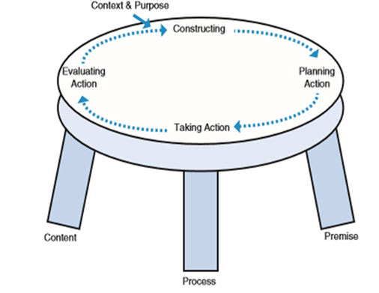
Methodology
Technology-enabled collaborative action research
  Point of departure is that insider action research is one way to develop new organisational capabilities and encourage learning
  Answer a perennial need to close a feedback loop between remote module tutors and campus based teams, to develop a joint understanding of teaching and learning design challenges, and to put tutors as close as possible to the development of solutions. Can learning networks help to achieve this?
Learn together in an unfolding and emergent process
Joint ownership: discussion, action planning, implementation & evaluation
Underpinned by Grounded Theory Method (GTM)
  Exploring a new conceptual framework regarding the unfolding process, and driving round the progressive action research cycles in a structured and rigorous manner.

Slide 8
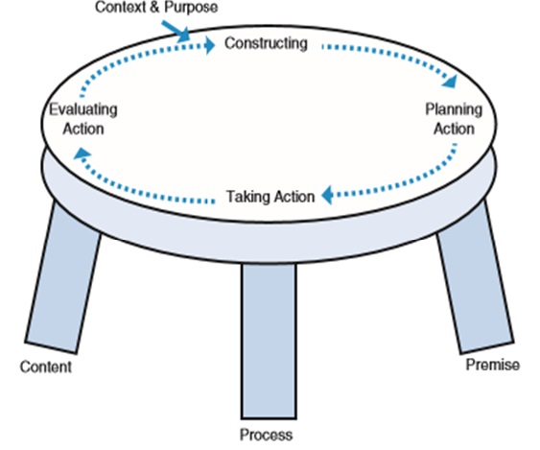
Action research table top model
Source:
Coghlan, D. and Brannick, T. (2014) Doing Action Research in Your Own Organisation, London, Sage.

Slide 9
Brief history of the project
Phase 1 (17J):
learning networks hosted in dedicated VLE sites for three pilot modules on conceptually challenging ‘Tricky Topics’ being experienced by students.
discussion forums and online workshops used to seek feedback from tutors, in order to collaboratively identify Tricky Topics and suggest improvements or produce learning interventions.
tutors designed and recorded four innovative Tricky Topics intervention videos, which have been in use since 17J, shared with other modules and emulated elsewhere.
Phase 2 (18J and 19J; one module):
second cycle of collaborative work building on the analysis from the first cycle. Tutors had identified concerns about pace and volume of material and student preparedness, with a reduction in preparedness apparent year on year. An online workshop and discussion shared and interpreted specialised learning design analytics visualisations with tutors with the aim of identifying areas for further interventions.
the integration of feedback from tutors, the module team and learning design analytics has enabled the synthesis of an innovative ‘signposting’ intervention.
‘signposting’ materials for five ‘pressure point’ Blocks have been developed by a tutor, implemented, promoted to students and evaluated by both students and tutors.
the entire project has been evaluated at personal, module and ‘transferable’ levels.

Slide 10
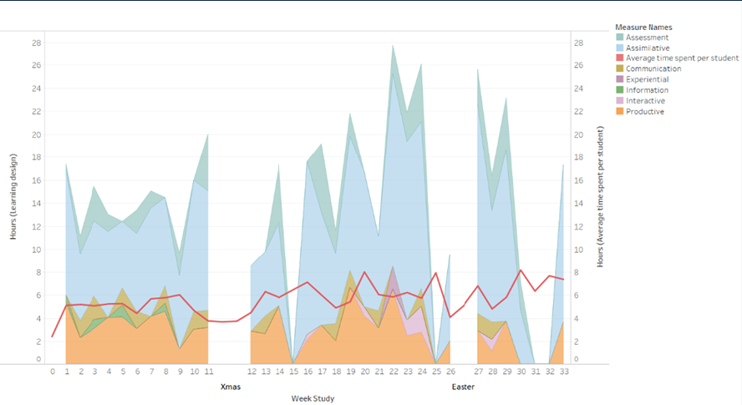
Learning design analytics: ‘Vis 3’
The three visualisations discussed with tutors were:
expected student workload by activity type (Conole, 2012)
comparison of expected student workload and module team advised workload per week
comparison of expected student workload by activity type and average VLE engagement

Slide 11
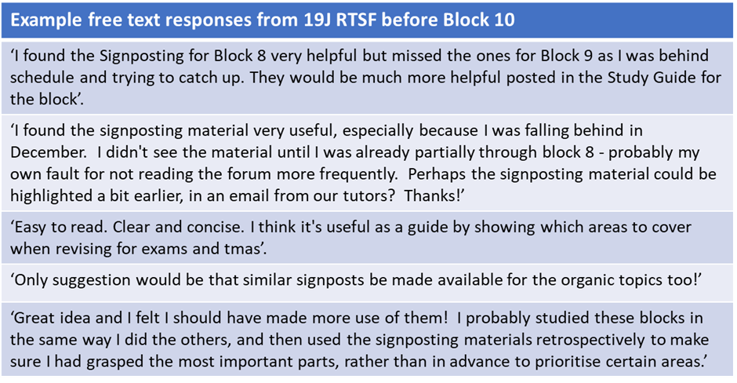
Student evaluation
Example free text responses to the RTSF before Block 10 Module S 19J

Slide 12
Evaluation: feedback examples
Tutor personal reflections:
‘Yes, I participated in the Tricky Topics Workshop and discussions. I found the workshop and discussion a helpful reflective process and an insight into S215 as a whole (from the Module Team, combined AL and analytics perspective), I also found the process collaborative and felt supported in terms of being listened to as an individual and part of the AL team and with the AL suggestions being actioned’.
Module reflections:
‘The signposting through some Block were a great idea and it was helpful to be able to direct students to the videos. I know that both of these interventions were used by my students’.
‘Overall I think that it will have helped in the development of S215 and the forward planning for the course’.
Reflections on wider transferability:
….. ‘I felt ALs, the face of tuition for students, were listened to and involved in the problem-identification and problem-solving process […..] - a welcome collaborative process that is perhaps missing on other modules’ …..
‘I was pleased to be involved and felt part of the 'course team' even though that is not strictly true! The approach taken was inclusive and 'open minded’.
Any other comments?
‘A good project that I found beneficial to participate in, and perhaps more significantly, found being kept up to date with the project and seeing discussions during the workshop implemented and of use to students, welcome’.
‘I think the signposting materials could be useful in future module production as well’ …..
‘As I write this I wonder if we should have an overall signposting document for tutors’ …..

Slide 13
Overall evaluation
Three key aspects to take away from the evaluation feedback are:
the ‘signposting’ materials and the Tricky Topics videos were evaluated as helpful interventions for S215. A further suggestion put forward is the production of an overall signposting document for tutors, to facilitate ongoing targeted and co-ordinated tutor support for ‘struggling’ students using the signposting materials.
tutors welcomed being a part of the collaborative and equitable discussion and problem-solving process followed in the project. They reported both the Tricky Topics and learning design analytics workshops to be very useful. They appreciated being a closer part of the team, being listened to, and being part of formulating and implementing solutions.
there was a perception that more could be done, and that perhaps the project would yield further impact and benefit by continuing. This would harness the collaborative process as a more routine way of working in S215, and potentially provide a model for other modules. The signposting intervention is already of interest to S112.

Slide 14
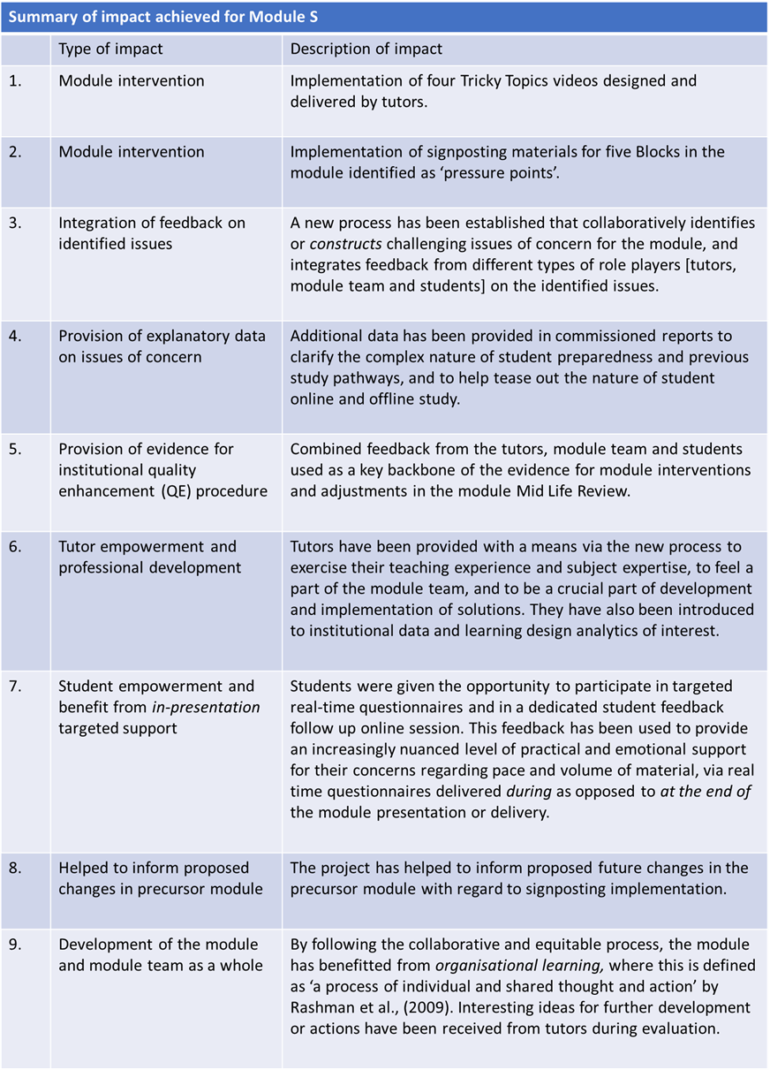
Impact for ‘Module S’ (S215)

Slide 15
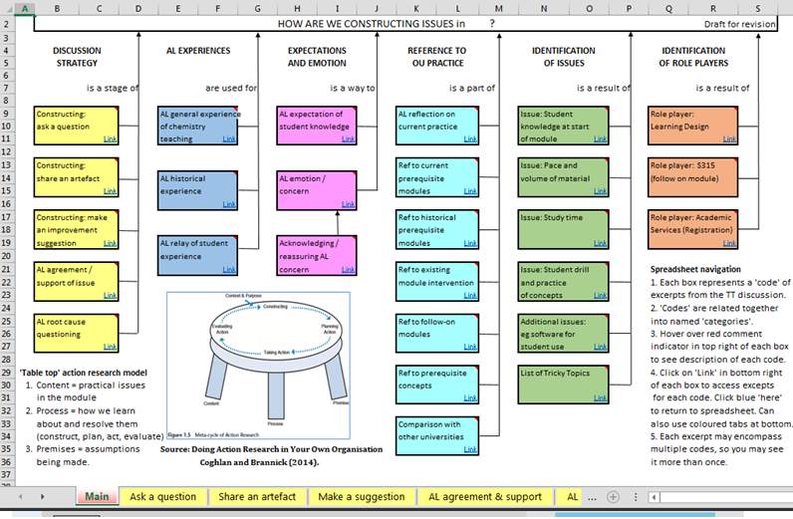
The path to conceptualising …..
Two years of qualitative feedback from the 2017 and 2018 learning network discussion forums, was then represented for both years in an interactive spreadsheet to organise the evidence.
Lesley Boyd, 2021

Slide 16
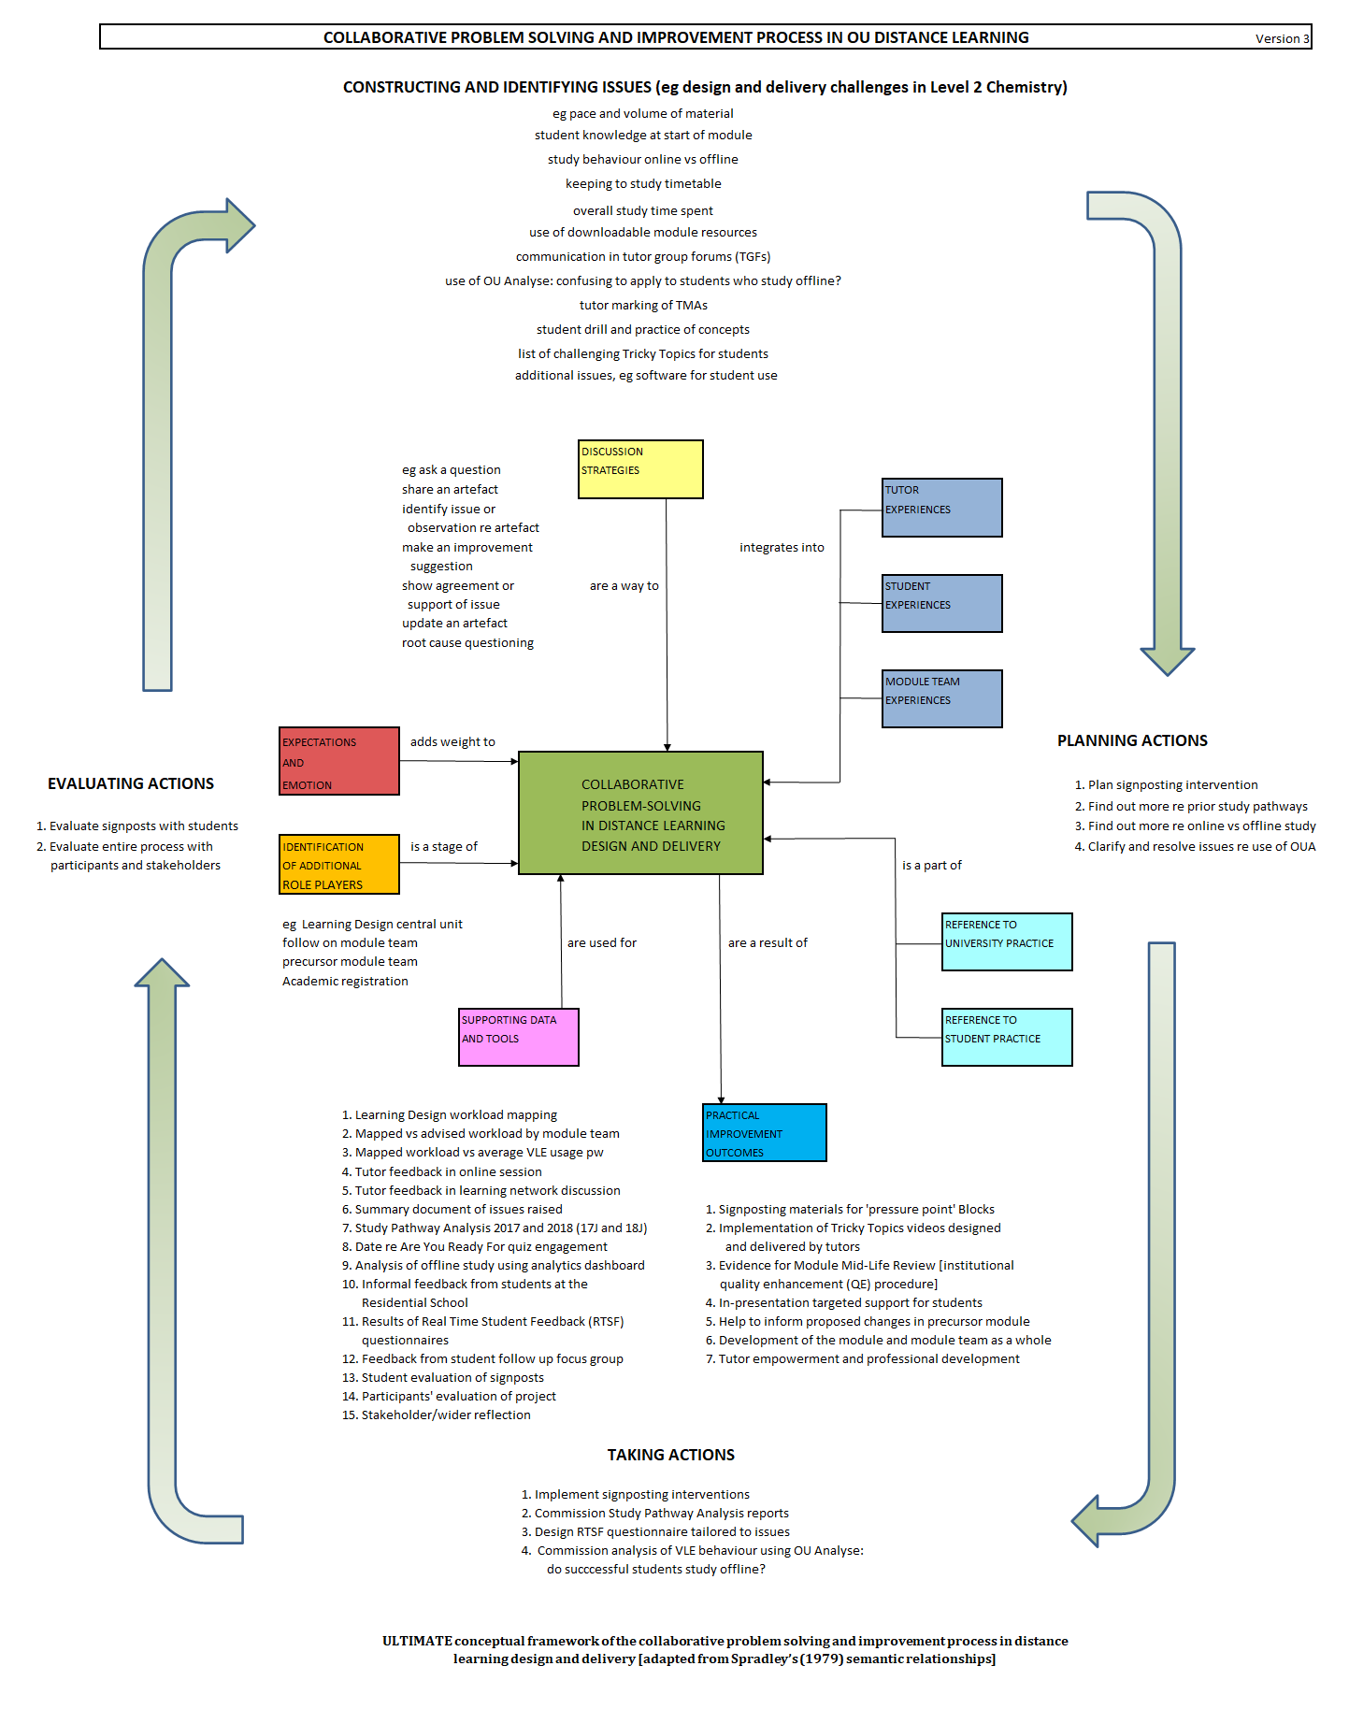
Lesley Boyd, 2021

Slide 17
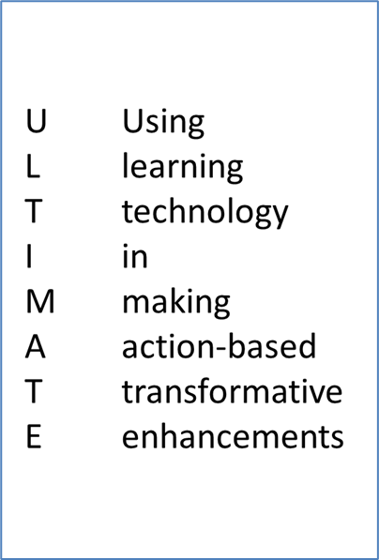

New conceptual framework
Lesley Boyd, 2021

Slide 18
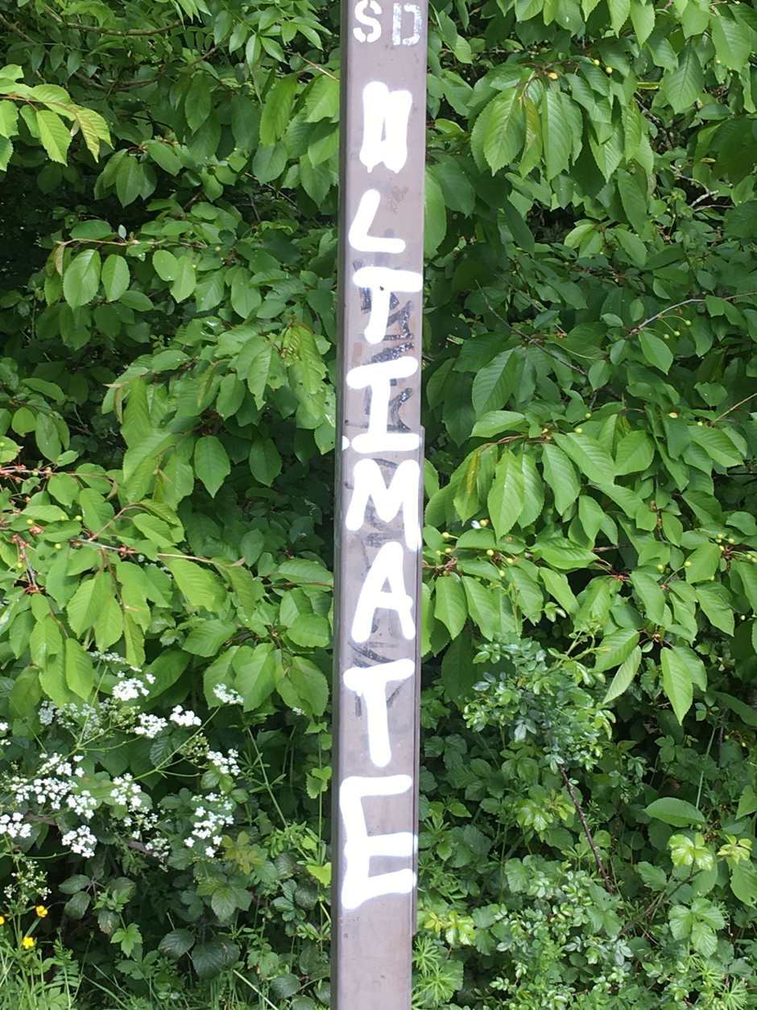
New conceptual framework
ULTIMATE graffiti
Lesley Boyd, 2021

Slide 19
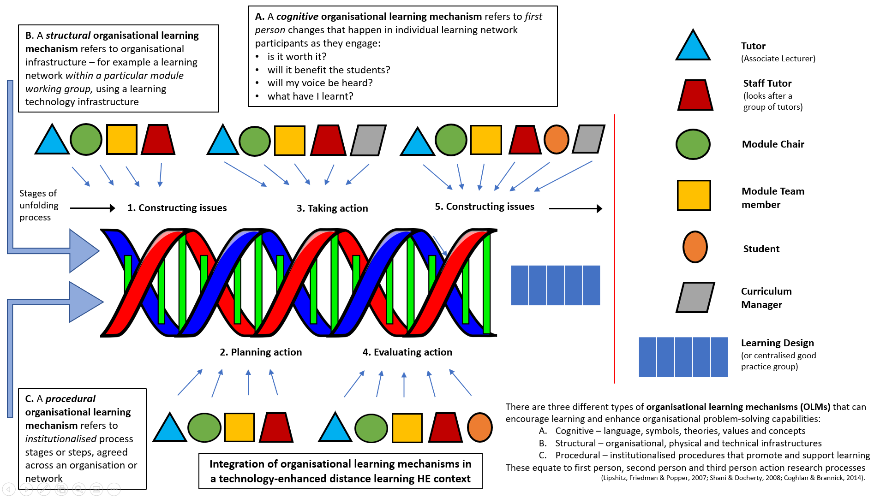
Organisational learning mechanisms
Integration of cognitive, structural and procedural OLMs in a distance learning design and delivery context
Lesley Boyd, 2021

Slide 20
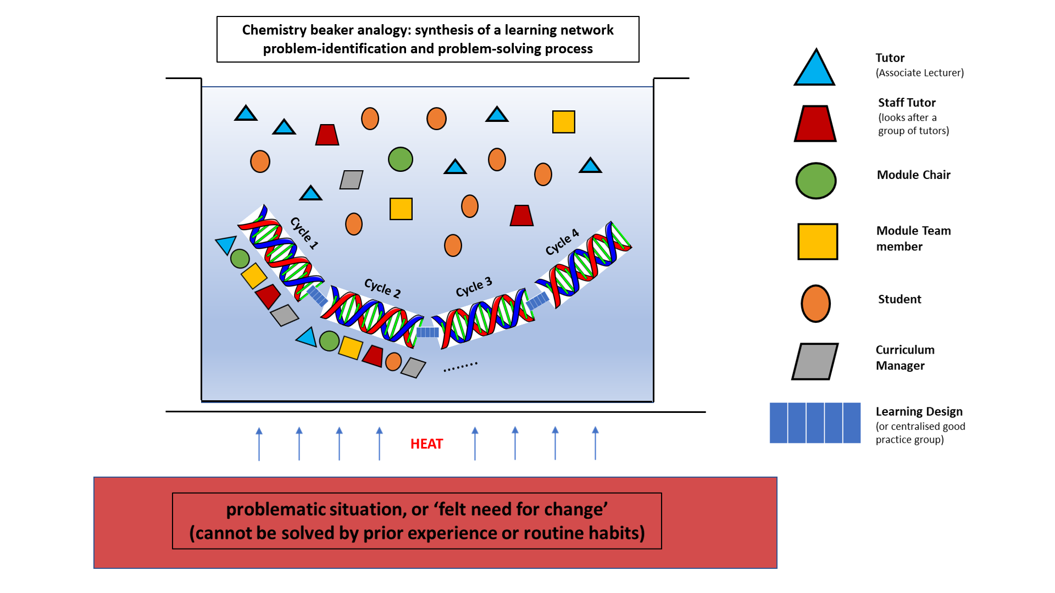
Chemistry beaker analogy
Integration of cognitive, structural and procedural OLMs enables synthesis of a problem-solving process and new solutions
Lesley Boyd, 2021

Slide 21
Recommendations / questions
  Do you work in a module with a complex challenging scenario?
  Do you have a feeling (or unease) that you have a problematic situation that can’t be solved by normal or habitual ways of working?
  Would you like to embrace the experience of tutors, staff tutors, module team, students and learning design in an unfolding, structured but flexible, collaborative improvement process?
  Would you use a VLE site as a space to learn together, use supporting data, and integrate feedback and insights from each participant’s point of view, to together decide what action to take and evaluate?

Slide 22


Alvesson, M. and Sandberg, J. (2014) ‘Habitat and Habitus: Boxed-in versus Box-Breaking Research’, Organization Studies, 35(7), pp. 967–987. doi: 10.1177/0170840614530916.
Boyd, L. (2019) Using Technology-Enabled Learning Networks to Drive Module Improvements in the UK Open University. Journal of Interactive Media in Education, 2019(1), p.16. DOI: http://doi.org/10.5334/jime.529
Chun Tie, Y., Birks, M. and Francis, K. (2019) ‘Grounded theory research: A design framework for novice researchers’, SAGE Open Medicine. DOI: 10.1177/2050312118822927.
Coghlan, D. & Brannick, T. (2014) Doing Action Research in Your Own Organisation, London, Sage.
Conole, G. (2012) Designing for Learning in an Open World. Dordrecht: Springer
Olney, T, Rienties B, & Toetenel, L (2019) Chapter 6: Gathering, visualising and interpreting learning design analytics to inform classroom practice and curriculum design in Lodge, J., Horvath, J. & Corrin (ed) Learning Analytics in the Classroom: Translating Learning Analytics for Teachers, Routledge
Open University. (2018) Teaching and Learning Tricky Topics. Available at https://www.open.edu/openlearn/education-development/learning/teaching-and-learning-tricky-topics/content-section-0?active-tab=description-tab [Last accessed 8 Nov 2020].
Urquhart, C. (2013) Grounded Theory for Qualitative Research: A Practical Guide, London, Sage.
lesley.boyd@open.ac.uk @lesleyboyd

