Slide 1
Using technology-enabled learning networks to drive module improvements in STEM
Lesley Boyd, PhD Researcher, IET
Rob Janes, Module Chair, S215
eSTEeM Induction event, 1st November 2018

Slide 2
What are we intending to do?
Investigate how technology-enabled learning networks can be used in STEM to achieve practical organisational improvement outcomes. Connecting together disparate stakeholders across our different contexts and boundaries, to collaboratively learn how to problem-solve and improve. A collaboration between Lesley’s PhD research and the STEM faculty.
Progressing from a previous eSTEeM project on Tricky Topics, a second cycle of collaborative work will build on the analysis from the first cycle. In the light of expressed concerns about pace and volume of material, a pilot discussion in S215 18J will share and interpret analytics visualisations such as Learning Design mapping and VLE usage data for tutors, seek feedback on its relevance and usefulness, and discuss ideas for in-presentation teaching improvements or adjustments. Facilitated by Tom Olney in STEM.
We will then expand the approach, possibly to cover two further modules in the next stages of the chemistry pathway, to track issues, concerns and Tricky Topics across the qualification.

Slide 3
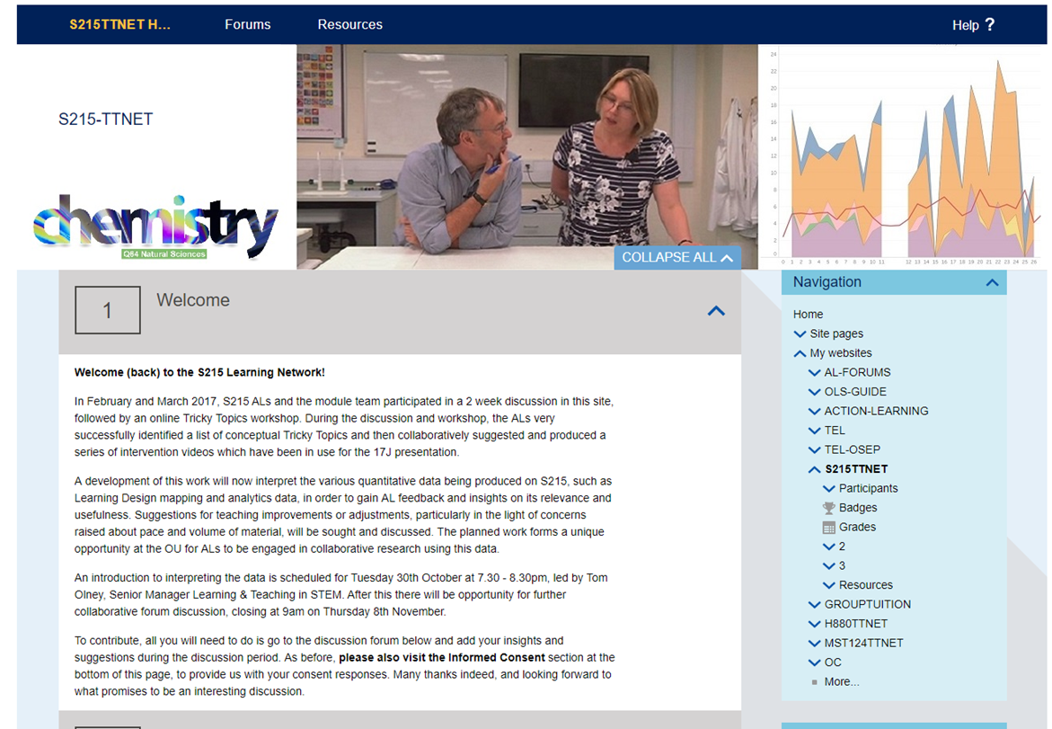
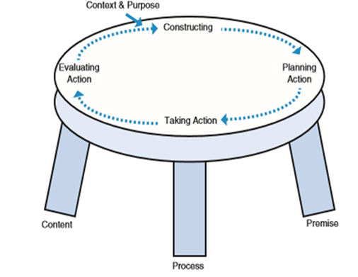
How we’re doing it (methodology)
Technology-enabled participatory action research
Learn together in an unfolding and emergent process
Equitable
Collaborative
Joint ownership: discussion, action planning, implementation & evaluation
Underpinned by Grounded Theory Method (GTM)
Exploring a new conceptual framework regarding the unfolding process, and driving round the progressive action research cycles in a structured and rigorous manner.

Slide 4
What we’re expecting to achieve
The overall improvement outcomes and intended impact for this research will be:
identification of technology-enabled mechanisms for collaborative problem-solving and improvement, or ‘closing the feedback loop’ between different stakeholders
practical interventions identified and implemented to assist with identified issues
intersection of ALs with learning analytics and module mapping data, in conjunction with their own feedback on Tricky Topics, to drive improvements to the student experience and contribute to increased retention
professional development in upskilling ALs in their ability to understand and interpret learning analytics.

Slide 5
Thank you
Any questions?
lesley.boyd@open.ac.uk
rob.janes@open.ac.uk
@lesleyboyd

