Slide 1
Personal profiles in VLE forums: do students use them?
Karen Kear, Frances Chetwynd and Helen Jefferis

Slide 2
Personal profile
An online space where a user can share information about him/herself
Members of online communities can use profiles to learn something about each other
Notes:
…add photographs etc.
…such as LinkedIn and Facebook
…different meanings for ‘user profile’ vs ’member profile’, ‘personal profile’

Slide 3
Aims of the project
This project aimed to discover:
how students use the profile facility in VLE forums
whether profiles contribute to online community

Slide 4
Project context
A new Level 1 Computing & IT module:
My Digital Life (TU100)
Project used two tutor groups from October 2011 - May 2012 presentation
28 students in total

Slide 5
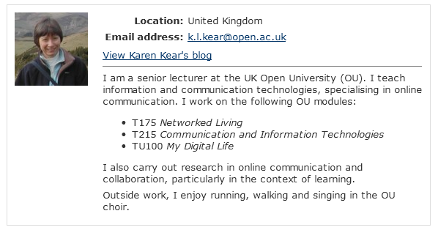
A profile in the VLE (then)

Slide 6
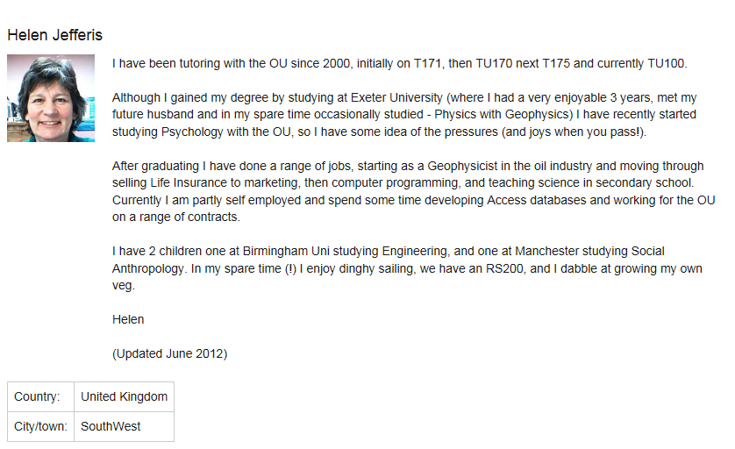
A profile in the VLE (now)

Slide 7
Data gathering
Students’ profiles examined at two stages:
  early in the module presentation
  at the end
Anonymised online survey of students
  early in the module
Two small online focus groups (via Elluminate)
  towards the end
Notes:
This presentation doesn’t discuss observations of profiles because of ethical/consent issues

Slide 8
The online survey
Mix of closed and open questions
Questions on whether, and why, students:
  uploaded an image to their profile
  added information to their profile
  read other students’ profile information
24 respondents out of 28 (86% response rate)
Notes:
Next – details of the survey

Slide 9
Findings from the survey
Two thirds of respondents reported uploading an image
  mostly ‘a photo of me on my own’
Half said they added information to their profile
  some students were confused about the profile facility
60% said they looked at other students’ profiles
Notes:
Next – details of the survey

Slide 10
Students adding material to their profile
Why did they?
Why didn’t they?
Seeing the anonymous image on forum posts against my profile didn't look right
To allow a small insight into my personality
I felt it was sociable to tell people who were interested, who I am and what I do
Security reasons
I have no wish to share private information on these forums
Too busy
Notes:
Others in the same vein were: I wanted to let people know what sort of person I was by listing some basic information about myself; again, not sure, just seemed appropriate

Slide 11
Students reading others’ profiles
Why did they?
Why didn’t they?
To gain a feel for the type of person
Just being nosey or was interested in what they were saying and wanted to find out more about them
Not particularly interested in them
It does not seem like an important or relevant part of my course. more interested in their forum postings
Notes:
Others in the same vein were: I wanted to let people know what sort of person I was by listing some basic information about myself; again, not sure, just seemed appropriate

Slide 12
Examining students’ profiles
Took screenshots of students’ profiles
  early in the module and at the end
Ethics required written consent
  obtained from only 18 students (out of 28)
Looked at
  whether they had added an image
  whether they had added information
  whether they changed anything during the module

Slide 13
Students’ profiles at the start
11 students out of 18 (61%) uploaded an image
  mostly a head shot of the student
  (compare with reported 67% from the survey)
6 students (33%) added information
  3 about their interests
  3 just Skype or MSN IDs
  (compare with reported 48% from the survey)
5 students (28%) hid their email address

Slide 14
Students’ profiles at the end
1 student uploaded a profile photo during the presentation (a head shot)
1 student updated his profile information (about course completion)
2 students added/changed Skype or MSN IDs
6 students hid their email address
1 student made their email address visible

Slide 15
Focus groups
Elluminate focus group for each tutor group
  7 participants in total
  5 men and 2 women
  ages ranged from 36 to 87
Questions about
  whether they had changed their profile
  whether they read other students’ profiles
  how they felt about creating and viewing profiles

Slide 16
Focus group findings: writing profiles
Students did not feel part of an OU community
  so they saw no need to share personal information
  but they found photos useful
Students had privacy concerns
  unwilling to share personal information online
  but felt more comfortable within the OU VLE
  felt more confident after studying the module material about social networking

Slide 17
Focus groups findings: reading profiles
Opinions varied about reading others’ profiles
  Some students found it useful:
  “to see what they are up to and why they are studying”
  Some did not:
  “found out about people by the posts that they made – but the profiles have made no impact at all”

Slide 18
Summary
Findings:
  Most students added a photo to their profile, but not many added information
  The VLE profile facility caused some confusion
  Some students read others’ profiles, and they valued the photos
Methodological issues
  Obtaining consent from students was difficult
  Not many students took part in the focus groups
  Survey findings and information from actual profiles were not always consistent

Slide 19
Conclusions & implications
Profiles can help personalise a VLE - but only for some students
  some feel no need to read or write profiles
  many have concerns about privacy online
Implications
  help students to understand and use profiles
  improve and clarify the profile facility
  help students to feel confident about privacy online
  find ways to build OU community

