Slide 1


Intro Slide Title 1
Understanding the impact of COVID-19 on ethnic minority students’ study experience and awarding gap
A case study of Level 1 C&C Open University Modules
Dhouha Kbaier (Project Lead), Soraya Kouadri Mostéfaoui & Annemarie Kane
Two-year project (Nov 2021 to Nov. 2023)
Funded by the eSTEeM, The Open University, UK
STEMinar Series eSTEeM , The Open University
25/01/2024
Notes:
This Photo by Unknown Author is licensed under CC BY-ND

Slide 2


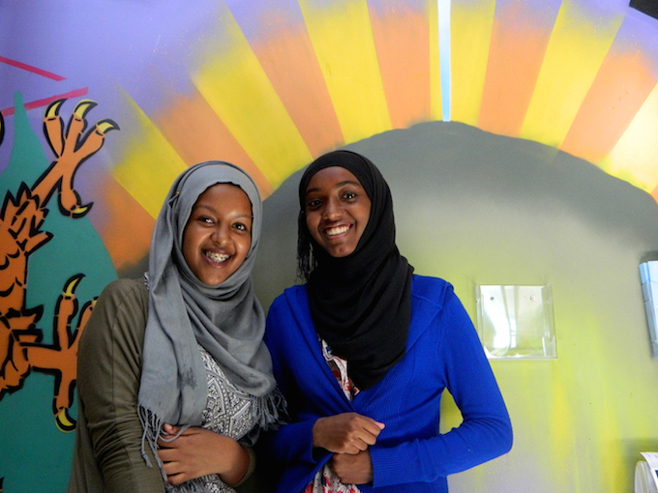
Background
Agenda
COVID-19 pandemic did not create, but rather exacerbated and exposed longstanding ethnic inequalities in health, employment and education in the UK (Solanke, 2020)
Awarding gap
Notes:
This Photo by Unknown Author is licensed under CC BY-SA-NC
This Photo by Unknown Author is licensed under CC BY-NC-ND
This Photo by Unknown Author is licensed under CC BY-SA-NC

Slide 3
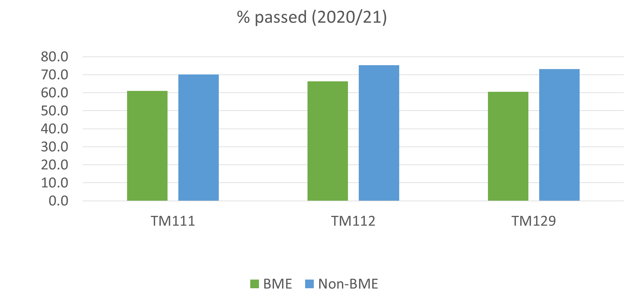
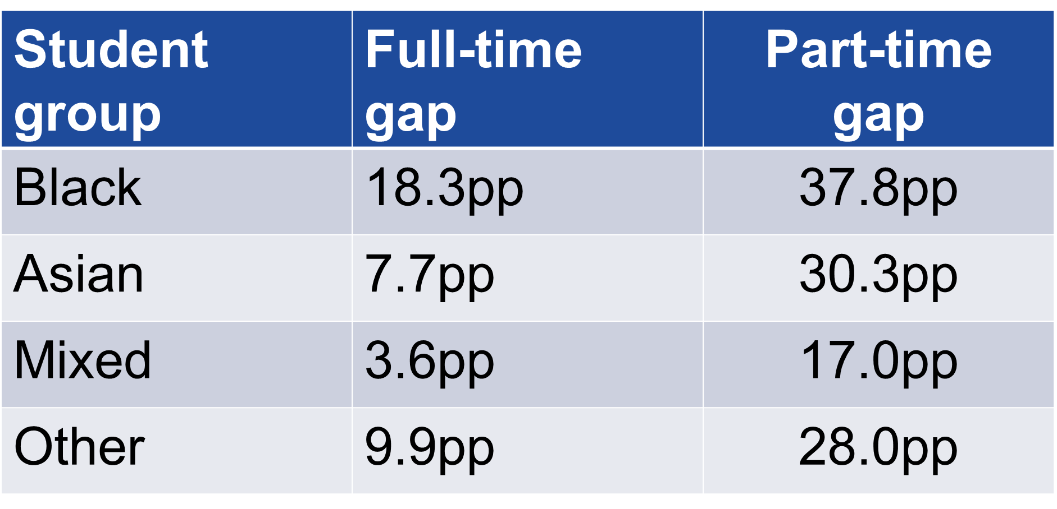
Awarding gap
Source: Office for Students, 2021
Core level 1 OU modules’ pass rate
Notes:
This Photo by Unknown Author is licensed under CC BY

Slide 4

Research aims
Investigate the impact of COVID-19 on the learning experiences and academic performance of ethnic minority students enrolled in Open University Level 1 Computing modules.
Identify the structural and institutional factors influencing the educational experiences and outcomes of these students.
Offer insights and potential solutions to address disparities and create a more inclusive and supportive learning environment.
Notes:
This Photo by Unknown Author is licensed under CC BY-NC-ND
This Photo by Unknown Author is licensed under CC BY-N

Slide 5


More specific goals
Analysing quantitative data related to student performance and completion rates in Level 1 Computing modules.
Conducting qualitative research through focus groups with tutors and key stakeholders to gain insights into the challenges and barriers faced by ethnic minority students.
Examining the overlap between structural and institutional factors affecting students' experiences.
Providing recommendations for targeted interventions, changes in evidence requirements, fostering a sense of community, increasing diversity among staff, improving institutional policies, and addressing unconscious bias.
Notes:
This Photo by Unknown Author is licensed under CC BY-ND
This Photo by Unknown Author is licensed under CC BY-SA-NC

Slide 6



Overall approach
Combination of qualitative quantitative data analytics (mixed method approach)
Quantitative data collected and analysed at the institutional level, cross-faculty, for different levels of study (retention/module performance)
Student Experience on the end of Module Survey data analysed (quantitative survey with open text comments)
Exploratory data analysis to identify patterns, trends, and correlations in the data using statistical techniques such as regression analysis, correlation analysis, and clustering to gain insights into the data
Online Focus groups FG1 with tutors and FG2 with key stakeholders
Comprehensively explore the impact of COVID-19 and other structural and institutional factors on the learning experiences and academic performance of ethnic minority students at the Open University
Notes:
This Photo by Unknown Author is licensed under CC BY
This Photo by Unknown Author is licensed under CC BY-SA-NC
This Photo by Unknown Author is licensed under CC BY-ND

Slide 7
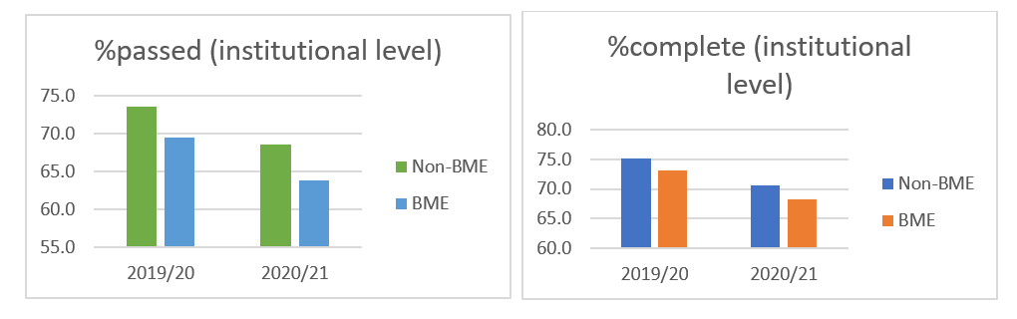
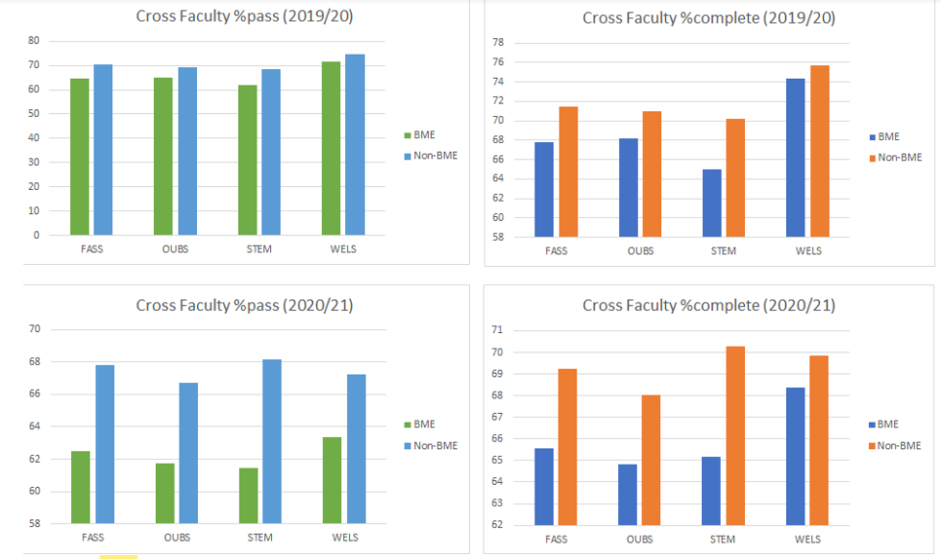
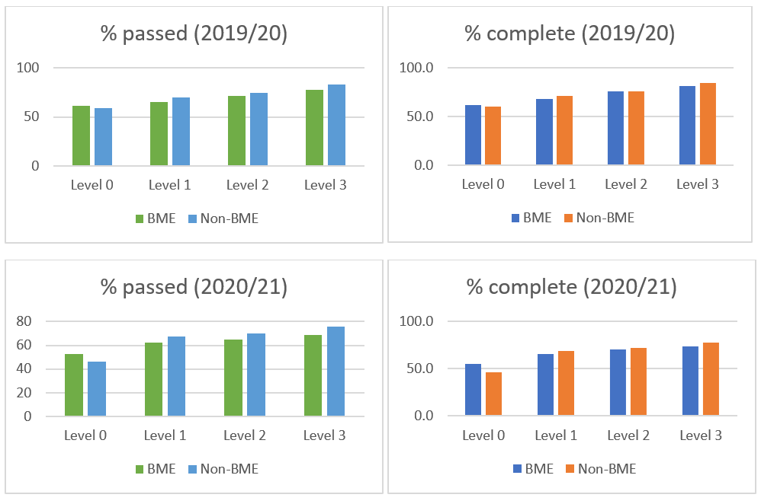
Quantitative analysis
Institutional analysis
Cross-faculty analysis
Level analysis

Slide 8
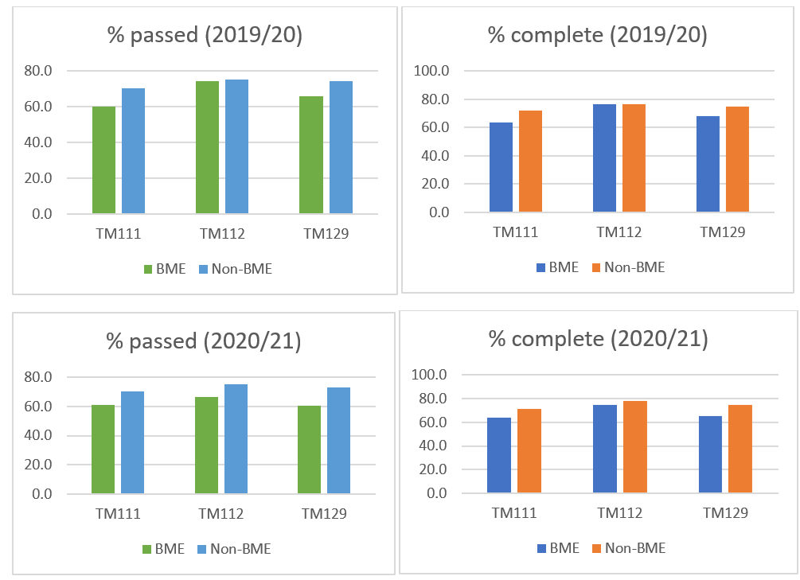
Quantitative analysis
Module analysis
Completion rate and pass rate for Level 1 modules at the OU during the pandemic
Academic year | Level 1 | No. reg @ 25% FLP (aka day 14) | No. complete | % complete | No. passed | % passed
2019/20 | BAME | 7145 | 4871 | 68.2 | 4651 | 65.1
 | Non-BAME | 59449 | 42599 | 71.7 | 41778 | 70.3
2020/21 | BAME | 8506 | 5595 | 65.8 | 5289 | 62.2
 | Non-BAME | 73036 | 50546 | 69.2 | 49173 | 67.3

Slide 9

Qualitative analysis
Notes:
This Photo by Unknown Author is licensed under CC BY-ND

Slide 10




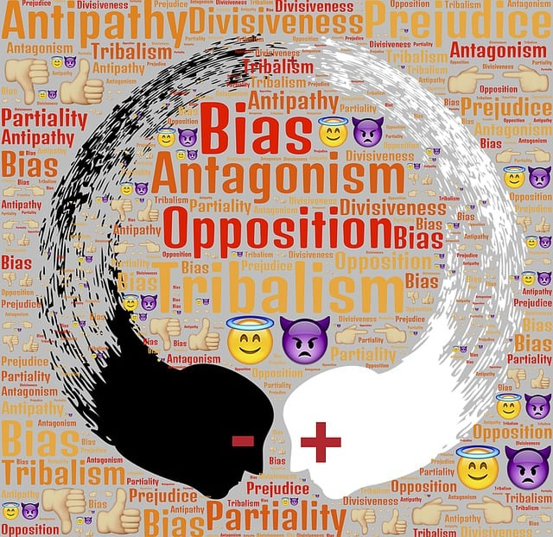

What does the literature search reveal?
BAME students experienced inequalities in relation to the following categories:
Economic disadvantage
Digital divide
Housing
Employment
Racism, discrimination, hate and mental health
Unconscious bias
This Photo by Unknown Author is licensed under CC BY-NC
Notes:
This Photo by Unknown Author is licensed under CC BY-SA
An initial literature search revealed pre-existing structural explanations for higher risks of COVID-19 for BAME individuals and communities which fall under a range of frequently overlapping factors, and that BAME students experienced inequalities in relation to the following categories:

Slide 11
Focus groups
Two FGs conducted to compare OU educators’ perspectives with emerging themes in the literature
FGs discussion was therefore centred around key topics prompted by the themes in the literature
  Whether and in what ways COVID-19 impacted ethnic minority students’ learning experiences and study performance in the modules taught by participants
  The sources and types of support available for students, and the degree to which they were useful in meeting students’ needs
  How the University as an institution could provide a better learning experience and help students from ethnic minority backgrounds perform better in times like COVD-19

Slide 12

Focus groups participants
FG1
Formed of educators who teach on Open University Level 1 computing modules
Criteria: tutors were teaching on OU level 1 computing modules between 2019 and 2021 covering the period of the pandemic
5 tutors: 2 women and 3 men, each of white British/Northern Irish ethnicity
All had considerable experience as Open University tutors
FG2
Formed of EDI (Equality, Diversity and Inclusion) and SST (Student Support Team) stakeholders at the OU
Criteria: participants engaged in an OU STEM educational advisory role or a student supporting role between 2019 and 2021
6 stakeholders participated in FG2: four women and two men. Two were of British BAME background, while four were of white British background
Notes:
This Photo by Unknown Author is licensed under CC BY
Ethics cleared a. IAR reference number is 28-04-117 (date: 03/10/2022) b. SSPP approved, (06/10/2022) c. HREC/4525/Kbaier: HREC approval date: 13/01/2023

Slide 13

Research findings
Structural factors impacting on the learning experiences and study performance of some students, including BAME students:
Poverty
The digital divide
Housing
Employment
Family responsibilities
Mental health issues
Ethnicity was not in itself a significant factor impacting the learning experiences and study performance of ethnic minority students
These impacts were heightened during the pandemic
Notes:
Despite not usually having knowledge of students’ ethnicity, tutors were generally in agreement that ethnicity was not in itself a significant factor impacting the learning experiences and study performance of ethnic minority students.
Tutors were nevertheless keen to emphasise a number of structural factors impacting on the learning experiences and study performance of some students, including BAME students. These were:
Poverty
The digital divide
Housing
Employment
Family responsibilities
Mental health issues
There was consensus amongst participants that these structural conditions had significant impacts on the learning experiences and study performance of affected students, and that these impacts were heightened during the pandemic.
There was a view that it is helpful for tutors to know about some of these circumstances, particularly mental health issues, but that students are often reluctant to declare the latter because of associated stigma.

Slide 14
Research findings
Structural factors identified by FG2:
Poverty
Housing
Family responsibilities
Mental health issues
Safeguarding issues
Vaccine hesitancy
FG1 - Structural factors
Poverty
Employment
Family responsibilities
Mental health issues
Digital divide
Housing
Notes:
Focus Group 2 participants identified structural factors impacting on the learning experiences and study performance of some students, including BAME students. Among the structural factors identified are those which emerged in both the literature review and in FG1. However, as mentioned above, further factors specific to the experience of BAME were also reported. The participants also noted an overlap between structural factors and institutional factors. The latter will be detailed in the section which follows. The structural factors identified by FG2 participants were:
Poverty
Housing
Family responsibilities
Mental health issues
Safeguarding issues (Say something about how this had not emerged in the literature and was pandemic related
Vaccine hesitancy
Safeguarding issues
A category which has not emerged so far in the literature review, nor in FG1, but which emerged in FG2 is that concerning safeguarding. FG2 participants noted that data and feedback showed a significant increase in safeguarding referrals during the COVID pandemic. In particular there was an increase in cases of domestic violence cases being shared, in the changed environment of lockdowns. Furthermore, since COVID there has continued to be an increase in safeguarding referrals to the team, such that the overall safeguarding team has been expanded, and referrals are now first triaged to specialised support teams. However, as noted above, participants commented that hard data which is broken down by ethnicity is not always available, and so available evidence frequently remains anecdotal.
Vaccine hesitancy
A further category which has not yet emerged in the literature review, and was not identified in FG1, is that of vaccine hesitancy. Vaccine hesitancy was identified in FG2 as a significant pressure which particularly impacted BAME students during the pandemic. It was observed in FG2 that anxieties about whether vaccinations could be trusted were expressed by students in discussion forums, and that BAME students felt societal pressure to get on board with the vaccination programme in the context of mistrust within certain ethnic minority communities. It was suggested in FG2 that this pressure was felt negatively and impacted how safe and willing students felt to interact with the support and the communities that exist at the Open University. As noted, the category of vaccine hesitancy as a structural factor specifically impacting BAME students’ learning experience has not, so far, been explored in the literature on BAME students’ study experience. However, mistrust of vaccination programmes within some ethnic minority communities has been discussed in reviews of Covid misinformation on social media during the pandemic. (Kbaier et al, 2022;

Slide 15
Emerging themes – FG2
Support from ALs and SSTs during COVID had often enabled students to progress with their studies successfully
Some tutors went ‘above and beyond’ in providing pastoral support to students
During the years of the pandemic there was significant institutional flexibility in allowing for special circumstances and discretionary postponements
However, institutional factors were also identified as exacerbating negative study experience for BAME students
While the OU espouses social justice values, whether the University takes enough action to fulfil those values is open to question in relation to the following categories:
Systemic racism and unconscious bias
OU institutional policies
Notes:
Nevertheless, it was noted that support from ALs and SSTs during COVID had often enabled students to progress with their studies successfully. It was noted that some tutors went ‘above and beyond’ in providing pastoral support to students. It was also noted that during the years of the pandemic there was significant institutional flexibility in allowing for special circumstances and discretionary postponements. For example, the usual requirements for supporting evidence for special circumstances and discretionary postponements were suspended.
However, institutional factors were also identified as exacerbating negative study experience for BAME students. It was commented that while the OU espouses social justice values, whether the University takes enough action to fulfil those values is open to question in relation to the following categories:
Systemic racism and unconscious bias
OU institutional policies

Slide 16
Tutors’ suggestions for ways to better support the learning experiences and study performance of students
Issue | Response
Lack of collaborative approach to supporting students and variation in level of pastoral tutor support | Introducing a pastoral role similar to the old tutor-counsellor role, but distinct from the academic tutor role
Poverty and the digital divide | Funding of laptops and repair of equipment
Housing and family circumstances | Recognition that online exams may disadvantage students without space in their home, or with family responsibilities, or without family support where this is needed
Notes:
4) Solutions to factors impacting the learning experiences and study performance of students
Tutors had a number of suggestions for ways to better support the the learning experiences and study performance of students.
In response to the issues identified by tutors a number of solutions were suggested:
Lack of collaborative approach to supporting students and variation in level of pastoral tutor support
Tutors thought that introducing a pastoral role similar to the old tutor-counsellor role, but distinct from the academic tutor role, could provide continuity and a collaborative approach throughout a student’s learning experience.
Poverty and the digital divide
Funding of laptops and repair of equipment
Housing and family circumstances
Recognition that online exams may disadvantage students without space in their home, or with family responsibilities, or without family support where this is needed

Slide 17


FG2 - Recommendations
OUSA
Building community and belonging
Lack of diversity
Evidence barriers
Targeted interventions
Data analysis
Individual learning plan
Revisit tuition strategy
Proactive focus on retention by module teams/tutors
Tutors’ access to Voice
Improved HCI
Unconscious bias training
Notes:
This Photo by Unknown Author is licensed under CC BY
4) Solutions to factors impacting the learning experiences and study performance of students
The FG2 participants made a number of recommendations in relation to the following themes and issues:
Targeted interventions
More targeted interventions in relation to ethnic minorities are needed. It was indicated that the institution needs to take more action to overcome barriers to social justice, in particular in relation to awarding gaps.
Evidence barriers
Requirements need to be reconsidered. Current requirements create significant challenges for students. More consideration for exemptions and special circumstances needs to be given.
Building community and belonging
Give students an opportunity to get to know one another and have support of people from the same culture and background. Students have strongly identified this need in feedback. This might include reviving the access and participation plan with its original focus.
Students should have a single point of contact person who stays with them throughout their studies. This would develop a relationship and create a sense of belonging.
More work needs to be done on creating a joined up community of support and joined up systems. For instance, special circumstances and discretionary postponement forms are sent in online but how they are dealt with is often dependent on who is triaging and how the system is managed at that time. Highly sensitive information can go amiss, or there is no follow up or referral made to the support team. This can also create a feeling of isolation. The OU needs to change this.
Lack of diversity
The OU needs to recruit more people from ethnic backgrounds, including more ALs who have a better understanding of BAME students’ experiences and needs. Beyond that there also needs to be more diversity amongst module authors and central academics to address the work of decolonising the curriculum.
OUSA – Student Association
The main OUSA page should make BAME related content and resources more visible.
Data analysis
There needs to be more analysis of hard data in relation to BAME students needs and experiences.
Individual learning plan
While retaining commitment to Open Access, there needs to be space for a conversation with each student about realistic study plans, taking into account the student’s situation and discussing the most relevant support. For example, students should not be allowed to take on too much of a study commitment, or at too high a level. This conversation should lead to an individual learning plan which goes with them throughout their study journey with the OU.
Revisit tuition strategy
It is not working at the moment. Students should be asked what they want, and what will work for them. The strategy needs to encourage BAME students to feel they belong, and to build those personal relationships.
Proactive focus on retention by module teams/tutors
Module teams need to work more closely with tutors to be proactive in reaching out to students who have not contributed to a forum or not submitted TMA01, rather than leaving it to the student support team to send an automated e-mail. While the latter is a fall back, students need to be offered a direct contact and a second chance to submit to help them over the first hurdle.
Tutors’ access to Voice
ALs need access to Voice so that they can see all that is going on for the students in their group, and again be proactive. Otherwise, by the time the tutor is aware that there are problems the student has suddenly withdrawn, and the tutor can no longer make contact.
Improved HCI
The OU website is very good in terms of having so much information on there. However, it needs to be more user friendly, particularly for stage one students who are having to get used to academic study and university level study. The website can sometimes be a barrier in and of itself.
Unconscious bias training
The existing unconscious bias training on the My Learning Centre is not good enough. First of all, unconscious bias needs to given much greater importance. In terms of content, there needs to be an effective person-to-person module completed by everyone who joins the Open University, with the aim of enabling all student facing staff to develop awareness and sensitivity regarding the experiences and needs of BAME students.
Cuts
It is vital that the OU financial and jobs cuts programme does not disadvantage EDI work and the focus on the needs of minority ethnic students.

Slide 18
Key Takeaways
Quantitative data analysis confirms awarding gaps for different ethnic groups at level 1
BAME students face inequalities in economic, digital access, housing, employment, racism, discrimination, unconscious bias, and mental health
Tutors and stakeholders recognise the impact of structural factors on student experiences and performance.
Institutional factors like systemic racism, unconscious bias, policies, lack of diversity, and support influence student experiences
Open University should continue to proactively address these issues for equitable support to BAME students
Notes:
Quantitative data analysis of the awarding gaps for different ethnic groups at level 1 at the OU confirmed the pattern of disparity in outcomes identified in the literature. The literature review and focus group discussions revealed that BAME students faced a range of inequalities and disadvantages in relation to economic disadvantage, digital divide, housing, employment, racism, discrimination, unconscious bias, and mental health. While tutors and stakeholders may not always have direct knowledge of students' ethnicity, they acknowledged the significance of these structural factors in impacting students' learning experiences and study performance, made visible during the pandemic.
Institutional factors, including systemic racism, unconscious bias, institutional policies, lack of diversity, and inconsistent support, were also identified as influencing students' experiences. The Open University needs to take proactive measures to address these factors and ensure equitable support for BAME students.

Slide 19


Opportunities to mitigate inequalities
Universities, including the OU, are vital in addressing societal inequalities
The OU can tackle the digital divide by understanding BAME learners' specific needs and providing appropriate infrastructure
To combat unconscious bias, recognise our capacity for bias and employ strategies in online learning to promote equity
Ensure digitally delivered content doesn't marginalise BAME subjects and can create equitable learning environments
Online environments, when well-designed, reduce anxiety, disrupt stereotypes, and enhance student belonging, leading to improved student success
Notes:
Opportunities to mitigate inequalities
While universities, including the OU, cannot implement alone the structural and societal changes needed to eradicate these inequalities, universities must inevitably be part of the necessary transformation.
In addressing the digital divide and digital poverty, the OU can develop better understanding of the different needs of individual learners from different BAME backgrounds. Data can support early intervention, and provision of the suitable infrastructure and resources to meet those needs (Hutchings and Sheppard, 2021).
To address unconscious bias, “We need to assume we not only have the capacity to be biased, but despite our intellectual capabilities, we do practice unconscious bias” (Singh, 2020). Online learning spaces provide unique opportunities to develop, design, implement, and evaluate strategies for promoting equitable learning environments. As Singh notes, “Unconscious bias results from exposure to negative stereotypes. One way of counteracting this is to ensure that the selection of the range of digitally delivered content does not end up erasing BAME subjects, denying them agency or pathologising them” (Singh, 2020). The OU is particularly well placed to create equitable learning environments. Singh notes that when done well, online environments can reduce anxiety, disrupt stereotypes, and promote the student sense of belonging that bears directly on student attainment and success (Singh, 2020).

Slide 20

Future recommendations
Implement targeted interventions for BAME student-specific barriers
Revisit evidence requirements to reduce support barriers
Foster community and belonging through access and participation plans
Increase staff diversity
Conduct thorough data analysis for evidence-based decision-making
Develop individualised student support plans
Revisit tuition strategies for inclusivity
Provide proactive support and monitoring
Improve unconscious bias training
Preserve focus on equity, diversity, and inclusion in financial challenges
Strive for an inclusive and supportive learning environment for BAME students
Prioritise these efforts for long-term social justice and educational equity
Notes:
Future recommendations
Based on the findings, several recommendations can be made for future interventions and improvements. These include implementing targeted interventions to address specific barriers faced by BAME students, revisiting evidence requirements to reduce barriers to support, fostering a sense of community and belonging through access and participation plans, increasing diversity among staff members, conducting thorough data analysis to inform evidence-based decision-making, developing individualised support plans for students, revisiting tuition strategies to create an inclusive and supportive learning environment, providing proactive support and monitoring, enhancing the user-friendliness of resources, improving unconscious bias training, and preserving a focus on equity, diversity, and inclusion in the face of financial challenges.
By implementing these recommendations, the Open University can strive towards creating a more inclusive and supportive learning environment for BAME students, ensuring that they have equal opportunities to succeed and thrive in their studies. It is crucial to prioritise these efforts not only during times of crisis but also as part of long-term commitments to social justice and educational equity.

Slide 21
List of deliverables
Kbaier, D., Kane A., Kouadri Mostefaoui, S., “Unmasking the Disparities: A Case Study Of Inequality And Disadvantage Experienced By Ethnic Minority Students Made Visible During The COVID-19 Pandemic”, Submitted to International Journal of Learning and Teaching (IJLT), Accepted.
Kbaier, D., Kane A., Kouadri Mostefaoui, S., “Bridging the BAME Divide: Unveiling the Impacts of Covid-19 on Ethnic Minority Students and Empowering Change - A Case Study at the Open University”, Accepted, International Journal of Information and Education Technology (IJIET).
Kbaier, D., Kane A., Kouadri Mostefaoui, S., “Unmasking the Disparities: Investigating the Profound Effects of Covid-19 on Ethnic Minority Students - A Case Study at the Open University”, 7th International conference on Teaching, Learning and Education– ICTLE 2023, Copenhagen, Denmark, 03-05 November 2023. Dhouha Kbaier Spotlights COVID-19's Impact on Ethnic Minority Students at ICTLE 2023
Kbaier, D., Kouadri Mostefaoui, S., Kane A., “Understanding the Impact of Covid-19 on Ethnic Minority Students: A Case Study of Open University Level 1 Computing Modules”, International Higher Education Teaching & Learning Association (HETL) Conference 2023. Re-Imagining Education: Collaboration and Compassion. Aberdeen, 12-14 Jun. 2023. Radiating excellence at the HETL Conference 2023. Dhouha Kbaier and Zoe Tompkins Shine as The Open University Represents at HETL Conference 2023 | eSTEeM

Slide 22




Slide Title 16
q
"Cultivating diversity and promoting equity in education isn't just a responsibility; it's an opportunity to empower a brighter, more inclusive future for all learners."
Dhouha Kbaier
This Photo by Unknown Author is licensed under CC BY-NC-ND
Notes:
This Photo by Unknown Author is licensed under CC BY-ND

Slide 23

Slide Title 4
Thank you!
Q&A session
Floor is open for questions and discussions

