Slide 1

Active learning in synchronous online tuition: increasing student interaction
eSTEeM project by Katrine Rogers, Hilary Holmes and Claudi Thomas

Slide 2
The use of active learning increases scores and pass rates
We need techniques for increasing active learning in online tutorials
There is a tendency to lecture in online tutorials

Slide 3
Interactive techniques
Polling
Number of students engaging
Asking questions
On-screen activities
Time spent on activities
Number of student engagements

Slide 4

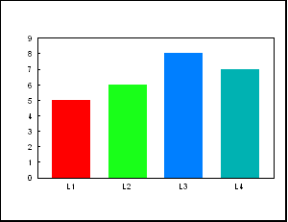

Effectiveness of techniques
Quantitative data
Tutor perceptions
Student perceptions

