Slide 1
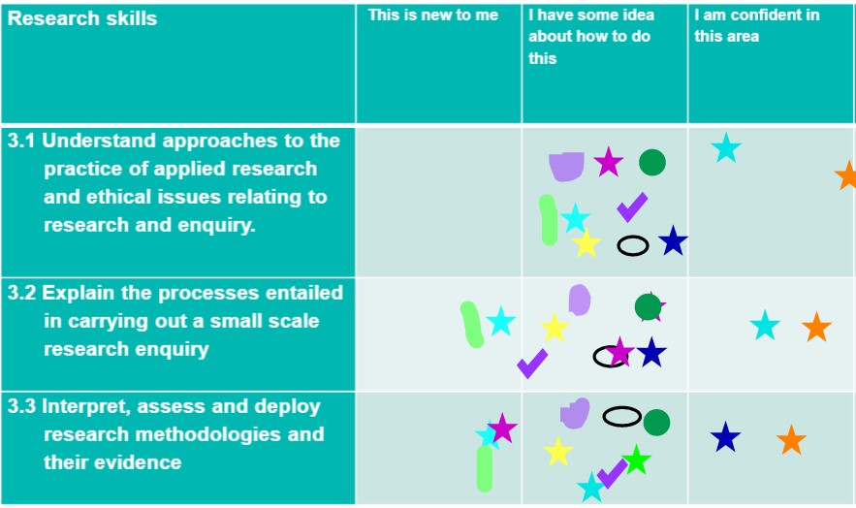
A review of the use of Office 365 and Adobe Connect
for active learning by Associate Lecturers tutoring in computing
Dr Katharine Jewitt
Associate Lecturer WELS and STEM
22 March 2023

Slide 2
Session overview
Slide Title 2
Aims and methods
Findings
Highlights of best practice - AL strategies for active learning
Impact and tangible deliverables
Recommendations

Slide 3
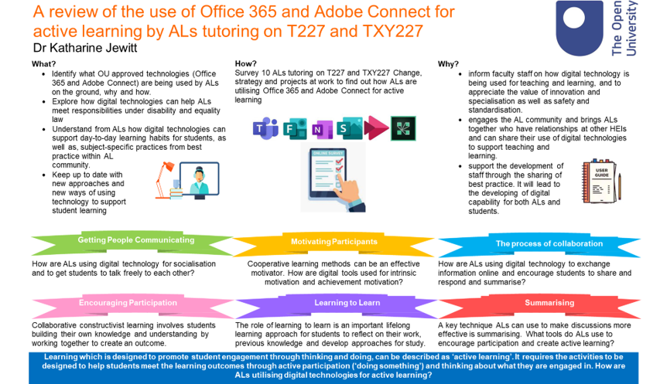

Slide 4
“Learning is not a spectator sport. Students do not learn much just sitting in classes listening to teachers, memorizing pre-packaged assignments, and spitting out answers. They must talk about what they are learning, write reflectively about it, relate it to past experiences, and apply it to their daily lives. They must make what they learn part of themselves”.
Chickering and Gamson (1987, p3)
Active Learning

Slide 5
Bingo Card

Slide 6
Using role play or debate for perspective taking and empathy | Gather feedback using a poll | Use of images eg to aid discussion, thinking about issues from a different perspective | Q&A Session to check understanding / gather feedback
Compared data / findings from research | Share stories to explain a point and add context | Using drawing tools to draw out participants’ thinking & develop understanding | Using breakout rooms for problem solving or other activities and discussion
Using chat / creating a space for sharing in informal discussion and social interaction (fostering community) | Used a quiz or game to summarise learning | Participating in collaborative activities eg a collaborative writing / literature review / debating /analysing an issue | Poster / slide presentations
Bingo Card

Slide 7
Other examples from the research
Using OneNote to develop specific learning and study habits, including keeping an activity log and a diary for reflection.
Using FutureYou OneNote templates with students for reflection
Creating summaries in MS word
Simulations – eg MS Powerpoint to create online circuits, calculations step-by-step and plotting graphs
Flipped classroom approach - students engaging with content through the OU library prior to a live tutorial. Then, during the tutorial, students engage with their peers and tutor to discuss and inquire into the concepts and explore what they have learned and how it can be applied using breakout rooms for discussion and the white board in Adobe Connect to share ideas.

Slide 8
Pockets of innovative use of Office 365 and Adobe Connect by ALs, but in the minority.

Slide 9
60% of ALs saw the tutor group forum and the module material as the mechanism for active learning.
60% surveyed saw tutorials as broadcast only,
to be delivered and not interactive.
They did not consider Adobe Connect or Office365 tools
to be suitable tools.

Slide 10
60% of ALs reported that they did not feel they had the skills in Adobe Connect, to deliver tutorials in a way that allowed for active learning.

Slide 11
30% of AL participants were not aware of the available functionality in Adobe Connect

Slide 12
50% surveyed used technology to support students with additional needs

Slide 13
30% of ALs reported using Adobe Connect to support student reflection during tutorials.

Slide 14
80% said they did not use Adobe / Office 365 for collaborative learning

Slide 15
ALs were asked if they used Adobe / Office365 to support students in:
Active learning
Reflection
Summarising
Supporting additional needs
Cooperative learning methods
Socialisation
Exchange information
Collaborative learning
Subject specific practices
There is work to be done to support ALs in developing their skills and knowledge in using Adobe Connect and Office 365.

Slide 16
7 workshops with takeaway resources
(280+ ALs attended)
Using Adobe Connect and Office 365 for active learning
100% of ALs attending an event, reported that their practice would change as a result
Impact on:
Student Experience
Teaching

Slide 17
Impact on:
Student Experience
Teaching
Funding for 1000 participants to gain Microsoft accreditation –open to ALs and all staff.

Slide 18
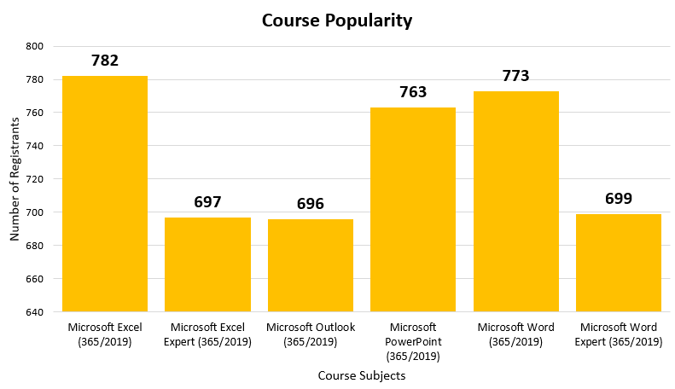
Course popularity
Slide Title 2

Slide 19
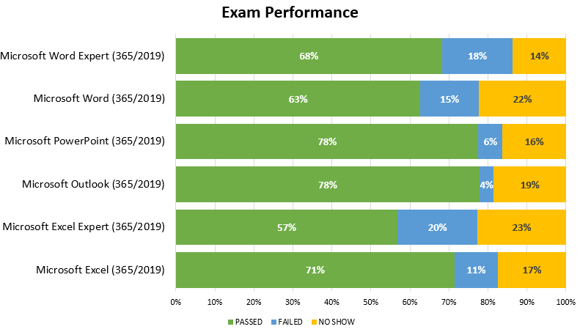
October 2021 – January 2022
285 people had sat an examination
with 191 certifications awarded.

Slide 20
“I am sending you a short note to say thanks for successfully gaining access to the Microsoft Office Specialist programme. I applied to the programme, I learned, I practiced, and I learned some more! I’m pretty sure that being a 58-year-old (recently former) technophobe didn’t help my plight, and my motivation was impeded because of the Christmas closedown period. That said, I did learn massively. Overall, the experience was of great value to my progression and understanding of Office 365 and I gained badges in Microsoft Word and Outlook.”
ALs provided positive feedback on the initiative, for example, one AL said:

Slide 21
Microsoft reported that The Open University performed above average across all institutions in this promotion.
Feedback from Microsoft:

Slide 22
Recommendations
Staff Tutors to be supported in being aware of resources to use in new AL inductions and CDSAs.
ALs are made aware of the Office365 application suite, application features and potential uses, provided with training and ideas on how the applications can be utilised in AL work – ongoing through training and dissemination events. There is regular Adobe Connect training , but less focus on Office365.
Training in Adobe Connect and Office365 built into Career Development Staff Appraisals (CDSAs) for ALs.
Time allocated to all ALs to complete Adobe Connect training and how to make tutorials active and engaging and not ‘talk and chalk’.
The online rooms newsletter to be distributed to all ALs via CAMEL.
A series of short, snappy how-to guides in a variety of formats to provide exemplars of ALs utilising Adobe Connect and Office 365 for active learning, building upon the PALS being creative series.
Support new ALs in developing their use of Office365 and Adobe Connect and build awareness of the resources available, for example, Online Learning Systems Guide, Online rooms forum and support, the PALS forum and guides.

Slide 23
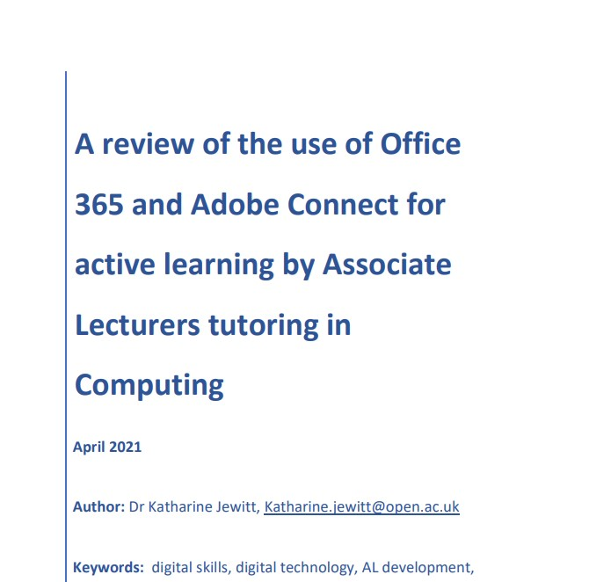
Read the full report at:
A review of the use of Office 365 and Adobe Connect for active learning by ALs tutoring on T227 and TXY227 | eSTEeM (open.ac.uk)

Slide 24

Slide Title 8
Questions

