Slide 1

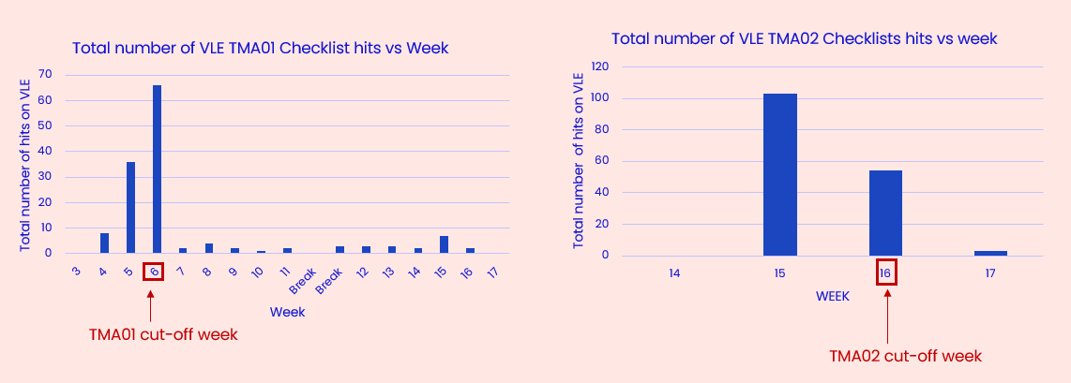

TMA Checklists: Snog marry, avoid?
Kate Fox and Heather Fraser
Rationale
TMA checklists have been proposed as a possible way of reducing student anxiety around assessment, as well as improving TMA submission rates and scores. Within the School of Life, Health and Chemical Sciences (LHCS) the use of TMA checklists is patchy, and there is no cohesive strategy relating to checklist content or location. Anecdotal evidence from ALs on one new Level 2 module, S296 Cell Biology, suggests students find checklists helpful and may be of particular benefit to neurodiverse and/or anxious students.
Aims
This study aims to generate data on whether we should have a fleeting encounter (snog) with TMA checklists, commit ourselves to implementing them across the Faculty (marry) or run fast in the opposite direction (avoid).
We will generate both quantitative and qualitative data to assess potential impact on TMA submission rates, timeliness and score as well as retention on modules.
We plan to survey students on three modules that currently offer TMA checklists, (S296 23J, SDK10023J and 23B and SK190 23J), to enquire about student use of checklists, their perceived value, and any potential barriers to their use. Initial interest in checklists for S296 has been positive (Figure 1)
We also plan to introduce 24J TMA checklists into several modules that have been running for more than three years that currently do not offer TMA checklists (SK299 and S317). This will allow us to compare TMA submission rates and attainment scores pre- and post-checklist implementation. Students on these modules will be surveyed at the end of each module and invited to focus groups or interviews. We plan to ask students to self-report any neurodiversity or anxiety-related mental health issues to assess whether TMA checklists are of particular benefit to these student groups.
Figure 1: Number of clicks on the VLE for S296 TMA01 and TMA02 checklists

