Slide 1

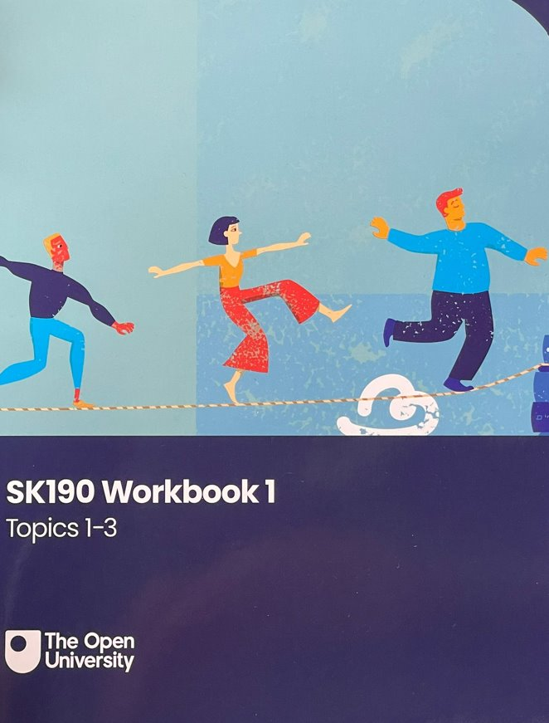

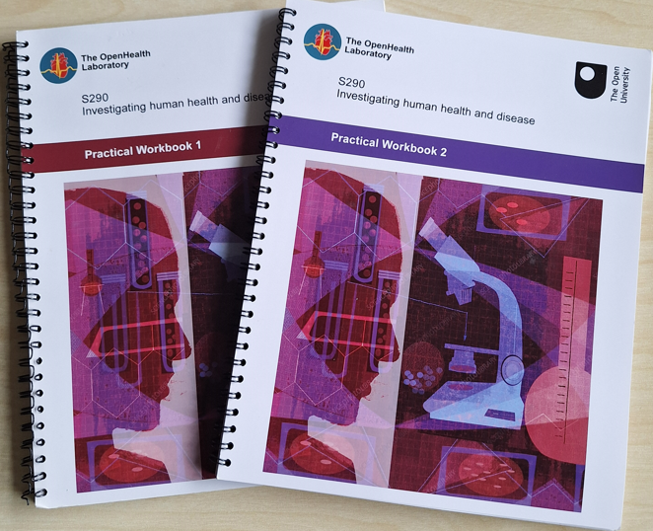

Exploring student perception of laboratory workbooks: authentic learning or missed opportunity?
Karen New, Lorraine Waters & Sarah Daniell
Project to determine how students perceive and use workbooks on their modules, whether they are an important adjunct to their learning and how they could be improved and potentially implemented on other STEM modules
Using questionnaires and focus groups for students using workbooks and round table discussion for staff involved in production of workbooks, we will assess:
The preferred format of workbooks
What students find most useful about workbooks
The best design of workbooks
To inform implementation of workbooks more widely in STEM
Why Workbooks?
Evidence that workbooks enhance student learning in all stages of compulsory education
Authentic learning and builds discipline literacy
Good laboratory practice is a key requirement for many accreditation bodies
Limited research on the use of workbooks in undergraduate, and particularly distance learning environments
Workbook formats
SK190
Printed; non-interactive version on the VLE; Word and/or PDF on the VLE
Multi-use: step towards the 'more formal' use as a laboratory record; a personalised primer for basic concepts
S290
Printed; PDF
Permanent record of investigations
Basis of experimental reports
Instructions for on-screen experiments
S296
Word version (electronic lab book); pdf
Instructions for online investigations and use of digital microscopes
Recordkeeping

