Slide 1


Intro Slide Title 1
TOWARDS BEST PRACTICE IN DESIGNING SUSTAINABLE ONLINE PEER
MENTORING AT SCALE – WHAT’S IN IT FOR THE MENTORS?
Dr Julie Robson and Dr Chris Hutton
Senior Lecturers in Earth & Environmental Science

Slide 2

Overview
Introduction
  Background
  Student Buddy Scheme
  Research Questions
Methods
Results
  Questionnaire 1
  Questionnaire 2
  Focus Groups
Conclusions

Slide 3
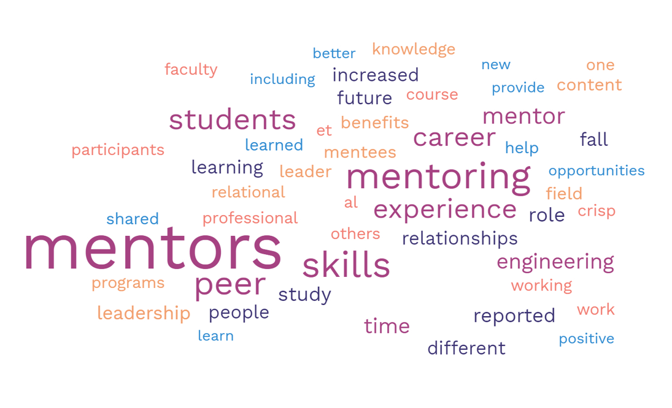
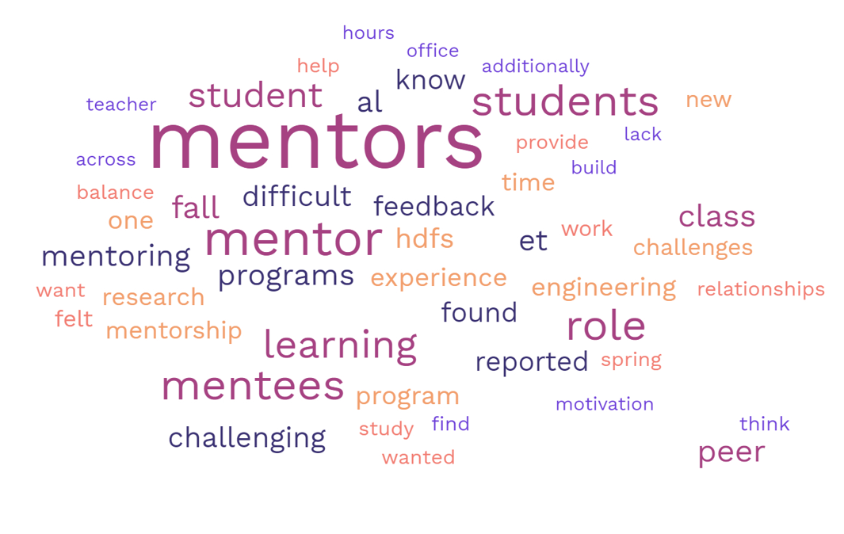
Introduction
Peer mentoring in Higher Education and Distance Learning
Benefits
The literature identified both benefits and challenges to student peer mentors
Challenges
What did our students think?
Notes:
The literature suggests that there were far more benefits to beign a peer mentor than challenges faced by students in the role. Key Benefits primarily unsurprisingly communication and professional skills. Leadership and interpersonal skills. More surprising was the deepening of knowledge of the modules. Key challenges focused on learning the role as it was new to most peer mentors, fitting the role around classes and keeping time boundaries on it. Providing feedback and dealing with difficult students was challenging as a peer.

Slide 4
Introduction
The Student Buddy Programme
 | Number of peer mentors | Number of registered students
Year 1 (1 module) 60 credits | 10 | 1795
Year 2 (2 modules) 60 credits | 9 | 1062
Year 3 (2 modules) 60 credits | 5 | 915
Year 3 (capstone project module) 30 credits | 12 | 1046
Total | 36 | 4818
Pilot in 2017
Since grown to cover nearly all modules in School
Peer mentors (“buddies”) selected from module’s recent “graduates”
Training provided
Buddies operate on rota via a forum : non-academic support
Associate Lecturer (AL) assigned to support buddies.

Slide 5
Introduction
Research Questions
Are online, distance, peer mentoring schemes involving volunteer students sustainable?
What are the benefits and challenges of being a mentor?
3. Can mentoring contribute to students’ employability skills?

Slide 6
Questionnaire 1
(before)
Questionnaire 2
(after)
Focus Groups
Methods

Slide 7
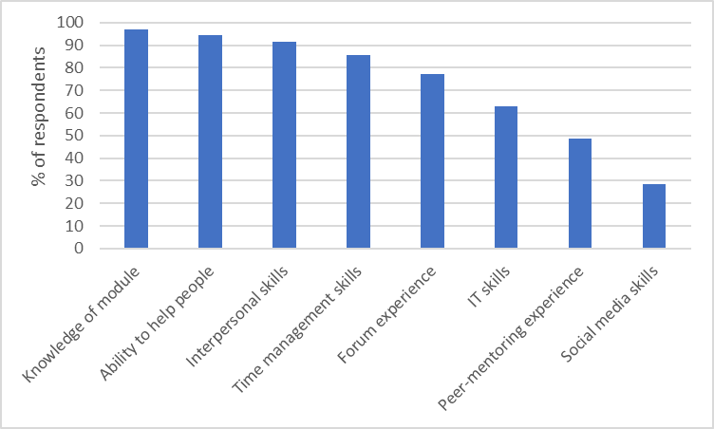
Results
Questionnaire 1 (before starting)
n = 35 (79%)
Motivations | 1. Provide help 2. Personal development 3. Flexible role
Concerns | 1. No concerns 2. Ability to help effectively 3. Time commitment
Thoughts | 1. Eager and excited 2. Confident 3. Supported

Slide 8
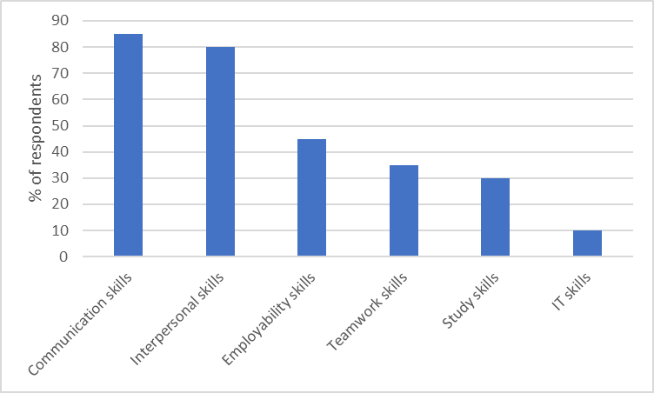
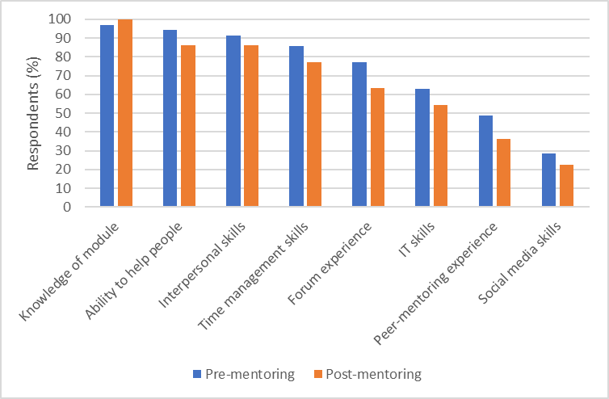
Results
Questionnaire 2 (after mentoring)
n = 22 (47%)

Slide 9
Results
Focus groups
Advice to someone thinking of volunteering | • Draw on own knowledge and experience • Need to be confident, flexible and patient • It is not time consuming • Rewarding to help others
How the practical aspects worked. | • Training was helpful • Include more training on dealing with difficult situations • Access to forums was mostly good • Support available if needed • No need for similar responses to same question • Good to work together in a team • Care needed to avoid academic input
Main rewards and challenges | • Networking / professional development • Helping others is rewarding • Improved learning having studied module before • Reassures of own worth: more confident • Better communication skills • Time management was challenging

Slide 10
Conclusions
The experiences of our students seem to mirror the benefits and challenges of peer mentoring for mentors as recorded in the literature
Benefits and challenges are role related rather than being dependent on mode of delivery or scale
Benefits of being a mentor do outweigh the challenges as mentors return year after year on different modules
The mentoring experiences changes some skills that students thought would be important – interpersonal skills being more important than having an ability to help people
Communication skills and time management are the most important skills for the role
Being a peer mentor is rewarding and provides increased self-confidence
With good training and support the peer mentoring programme is sustainable

Slide 11
Acknowledgements
eSTEeM – The OU Centre for STEM Pedagogy – for funding and support
Dr Barbara Jones – for assistance with data analysis
Student buddy participants (too many to mention individually)

Slide 12
Key References
Carvalho, A. R. and Santos, C. (2022) Developing peer mentors’ collaborative and metacognitive skill technology-enhanced peer learning program. Computers and Education Open, 3. Retrieved from: https://www.sciencedirect.com/science/article/pii/S2666557321000410?via%3Dihub
Marshall, M. Dobbs-Oates, J. Kunberger, T. & Greene J (2021) The peer mentor experience: benefits and challenges in undergraduate Programs. Mentoring & Tutoring: Partnership in Learning, 29(1), 89-109. : 10.1080/13611267.2021.1899587
Pollard, R. and Kumar, S. (2021) Mentoring Graduate Students Online: Strategies and Challenges. International Review of Research in Open and Distributed Learning, 22(2). Available from: https://web-p-ebscohost-com.libezproxy.open.ac.uk/ehost/pdfviewer/pdfviewer?vid=0&sid=5347069f-3787-4cb1-8148-aa9afa876ea7%40redis

Slide 13
Slide Title 30
Thank you – any questions?
Julie.Robson@open.ac.uk
Christopher.Hutton@open.ac.uk

Slide 14
Slide Title 31

