Slide 1

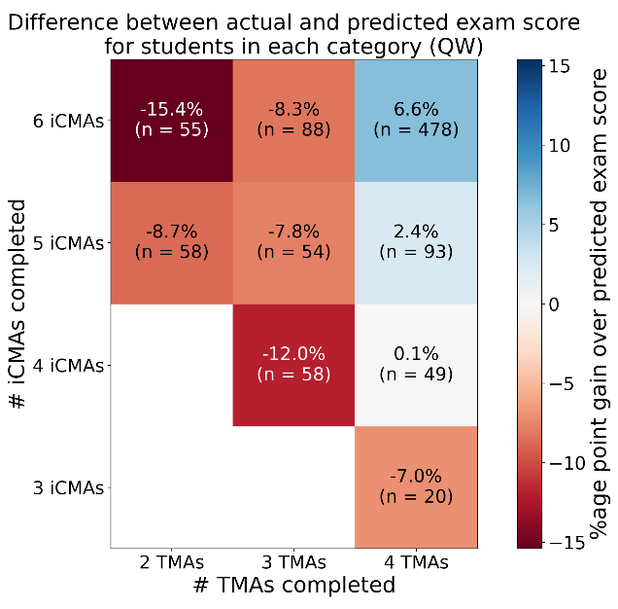

How should formative assessments be assessed?
A study of S217 online quizzes
Jonathan Nylk, Andy Diament
S217 “Physics: from classical to quantum” is a 60 credit Level 2 module
Formative activities are integral for student learning
Students that engage with formative activities are more likely to achieve success in summative assessments (Jordan & Bolton, unpublished)
How does assessment strategy influence student engagement with formative activities?
Current S217 Strategy
Online quizzes indirectly encouraged through reflective question in formative tutor-marked assessments
Formative Thresholded Assessment
Students must achieve a minimum grade to gain a pass (common strategy for many OU modules)
Methods
Measure student engagement
Learning analytics
Quiz/TMA scores
Module outcomes
Determine student motivations
Survey (Spring 23)
Qualitative analysis of free-text responses (NVivo)
Compare other strategies
Literature search
Analysed data from other modules
Expected Outcomes
Inform future S217 assessment strategy
Report to OU Weightings and Thresholds in Assessment committee
Peer-reviewed publication

