Slide 1


90% Student Retention By Design
Jeff Johnson, STEM, Engineering & Innovation, Design Group
8th eSTEeM Annual Conference: STEM Scholarship – From Inquiry to Implementation 8th May 2019

Slide 2
Two modules that illustrate RBD
The design process for OU courses
The Psychology of Assessment
Bringing ALs into the team

Slide 3
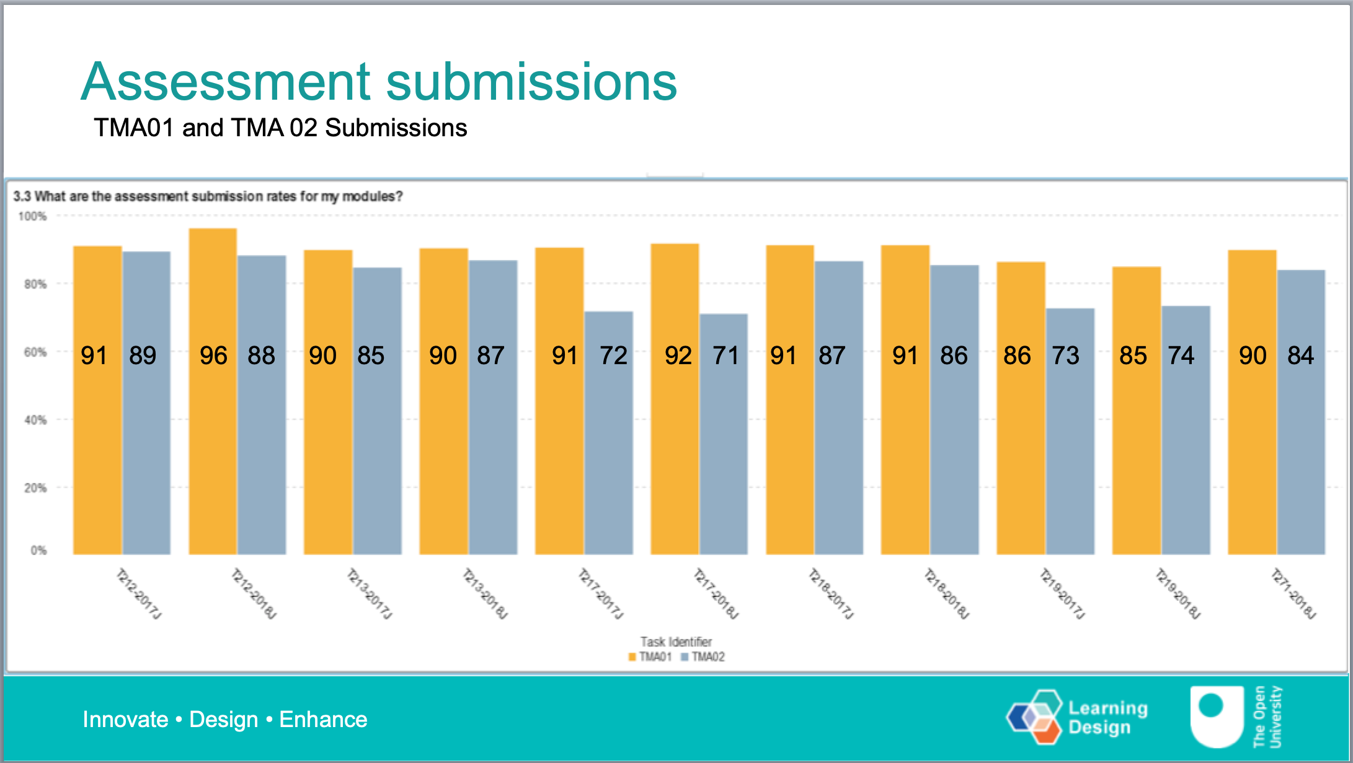

2017J & 2018J
|-------- T212 -------|--------- T213 --------|------ T217-----------|----------T218-----------|----------T219-------|--T217--|
T212 and T218 were both designed for retention

Slide 4
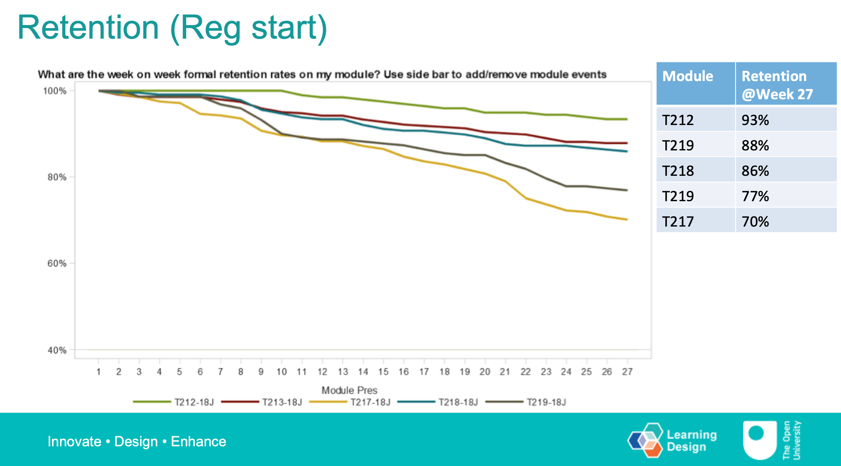
2017J & 2018J
T212 and T218 were both designed for retention

Slide 5
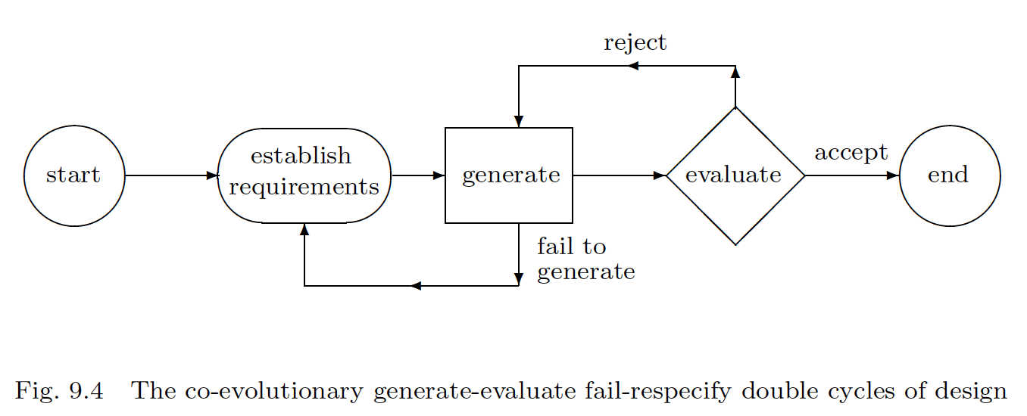
The design process
Co-evolution between design problem & solution
Specification includes 90% student retention
This impacts on the design !

Slide 6

The design process
Design: take the right parts;
put them together the right way;
to get things with desirable emergent properties.

Slide 7

Or not !
Design: take the right parts;
put them together the right way;
to get things with desirable emergent properties.

Slide 8
OU modules
What are the parts ?
materials – books, printed sups,, …
assessment – TMAs, EMAs, iCMAs, Exams, …
OU support services
Tutoring – AL support
What is the right way to put them together?
production – D1-D2-Handover iterative design ☺
production – fixed for 4/8 years (poor design!) ☹
presentation – support the users 😐
identify problems (analytics !) for maintenance ☺

Slide 9
OU modules
What are the parts ?
materials – books, printed sups, videos, interactives, …
assessment – TMAs, EMAs, iCMAs, Exams, …
OU support services
Tutoring – AL support
etc
What is the right way to put them together?
production – D1-D2-Handover iterative design ☺
production – fixed for 4/8 years (poor design!) ☹
presentation – support the users 😐
identify problems (analytics !) for maintenance ☺

Slide 10
OU modules
What are the parts ?
materials – books, printed sups, videos, interactives, …
assessment – TMAs, EMAs, iCMAs, Exams, …
OU support services
Tutoring – AL support
etc
What is the right way to put them together?
production – D1-D2-Handover iterative design ☺
production – fixed for 4/8 years (poor design!) ☹
presentation – support the users 😐
identify problems (analytics !) for maintenance ☺

Slide 11
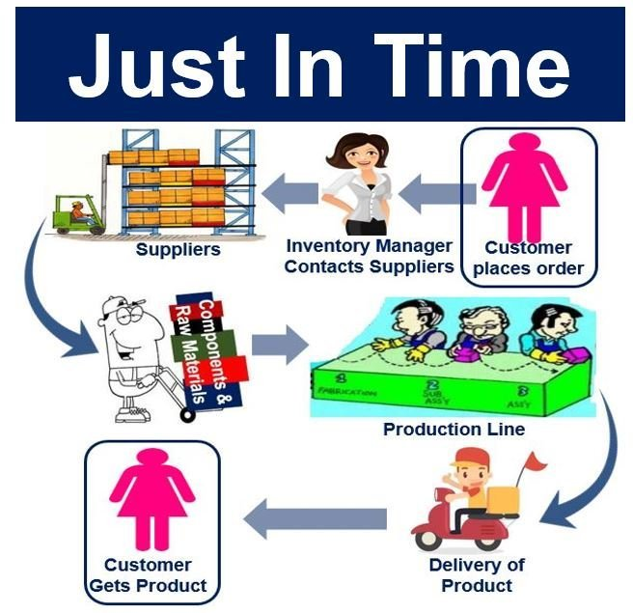
Product Design
Can the OU learn from modern design practice ?

Slide 12

Product Design – OU Big Bang production model
Well done design team …
see you in four years

Slide 13
Product Design – OU Big Bang production model
Well done design team …
see you in four years
No evolution – no resource for continuous improvement
Product Design has the sequence
prototype α-protype, β-prototype, release, maintain
https://requestreduce.org/categories/car-drawing-clipart.html

Slide 14
Lean manufacture – OU Warehouse model
Great! Make 4 years production now and put in the warehouse

Slide 15
Lean manufacture – OU Warehouse model
Great! Make 4 years production now and put in the warehouse
The OU uses a 50-year old print-warehouse model

Slide 16
Lean manufacture – OU Warehouse model
Great! Make 4 years production now and put in the warehouse
The OU uses a 50-year old print-warehouse model
Apparent savings offset by (unnecessarily) poor product
student dissatisfaction & compromises retention

Slide 17
Lean manufacture – OU Warehouse model
Great! Make 4 years production now and put in the warehouse
The OU uses a 50-year old print-warehouse model
Apparent savings offset by (unnecessarily) poor product
student dissatisfaction & compromises retention
Why not print on demand, c.f. Amazon stocks for days

Slide 18
Assessment – the pyschology of the TMA hypothesis
How to go from this … to this ?

Slide 19
Assessment – the pyschology of the TMA hypothesis
JJ – OMG! My TMA is due in on Monday. I’ve done nothing
JJ - Friday night – OK, I’ll start. What’s the first question.
“Assuming *&!-*&£$% give 17 reasons why ….”
JJ – OMG – what the H does this mean. I’ll look at the video
Hopeless – I need the book. OMG I can’t read all that

Slide 20
Assessment – the pyschology of the TMA
JJ – OMG! My TMA is due in on Monday. I’ve done nothing
JJ - Friday night – OK, I’ll start. What’s the first question.
“Assuming *&!-*&£$% give 17 reasons why ….”
JJ – OMG – what the H does this mean. I’ll look at the video
Hopeless – I need the book. OMG I can’t read all that
JJ – I’ve found the solution !

Slide 21

Assessment – the pyschology of the TMA
JJ – OMG! My TMA is due in on Monday. I’ve done nothing
JJ - Friday night – OK, I’ll start. What’s the first question.
“Assuming *&!-*&£$% give 17 reasons why ….”
JJ – OMG – what the H does this mean. I’ll look at the video
Hopeless – I need the book. OMG I can’t read all that
JJ – I’ve found the solution !

Slide 22
Assessment – the pyschology of the TMA - 1
JJ – OMG! My TMA is due in on Monday. I’ve done nothing
JJ - Friday night – OK, I’ll start. What’s the first question.
“Assuming *&!-*&£$% give 17 reasons why ….”
JJ – OMG – what the H does this mean. I’ll look at the video
Hopeless – I need the book. OMG I can’t read all that
JJ – I’ve found the solution ! ...

Slide 23
Assessment – the pyschology of the TMA - 1
JJ – OMG! My TMA is due in on Monday. I’ve done nothing
JJ – Saturday Morning ... This is not going very well
JJ – Saturday Lunchtime – I’ve only answered 2 questions
JJ – Saturday evening – Mrs J wants to go to the movies
I’ll finish tomorrow …

Slide 24

Assessment – the pyschology of the TMA - 1
JJ – OMG! My TMA is due in on Monday. I’ve done nothing
JJ – Sunday Morning ... This is not going very well
JJ – Sunday 11:00 a.m. Oh dear – this is terrible
JJ – Sunday Lunchtime – to H with it – I need a break!

Slide 25
Assessment – the pyschology of the TMA - 1
JJ – OMG! My TMA is due in on Monday. I’ve done nothing
JJ – Sunday Morning ... This is not going very well
JJ – Sunday 11:00 a.m. Oh dear – this is terrible
JJ – Sunday Lunchtime – to H with it – I need a break!
Jj – Sunday afternoon ZZZzzz

Slide 26
Assessment – the pyschology of the TMA - 2
JJ – OMG! My TMA is due in on Monday. I’ve done nothing
JJ - Friday night – OK, I’ll start. What’s the first question.
“What is an xyz?”
JJ – I’ll look that up in the book pdf – Brilliant! Found it
JJ Saturday lunchtime – great Part I finished (at least 30%)
I only need another 10 out of 60 to pass – I’ll stick with it

Slide 27
Assessment – the pyschology of the TMA - 2
JJ – OMG! My TMA is due in on Monday. I’ve done nothing
Sunday morning. I’m getting into Part II
Sunday lunchtime – no pub, I’ll stick with it
Sunday evening – it’s submitted

Slide 28
Assessment – the pyschology of the TMA - 2
JJ – OMG! My TMA is due in on Monday. I’ve done nothing
Sunday morning. I’m getting into Part II
Sunday lunchtime – no pub, I’ll stick with it
Sunday evening – it’s submitted
Reward !

Slide 29

Designing the presentation team
Central Academics
Curriculum Manager
the AL team
LTS
Etc.

Slide 30
Designing the presentation team
Central Academics
Curriculum Manager
the AL team
LTS
Etc.

Slide 31
Conclusion
Modules can achieve better retention by design !
Especially:
➔TMA & EMA Design is crucial to retention
➔Design the presentation team for retention
8th eSTEeM Annual Conference: STEM Scholarship – From Inquiry to Implementation 8th May 2019

