Slide 1


Improving accessibility, inclusion, and engagement in synchronous online learning events.
Project

Slide 2
Contents
Background to the project
The MACE framework
Purpose of the eSTEeM project
What it involved
Initial findings from the eSTEeM project
Future steps

Slide 3
Background to the project
An OU wide collaborative project to develop the MACE (Model for Accessible Collaborative Engagement) framework

Slide 4
Background to the project
Research at the OU
Collaborative project with staff and students
Staff – ALs, staff tutors, SST, academics, research students
Students – All faculties and levels, significant proportion of students with disabilities
Original focus on sensory impairment but extended
Surveys, interviews, workshops, focus group
Iterative development of a model representing the key factors impacting access and engagement to collaborative learning events
Barriers and how to handle them

Slide 5
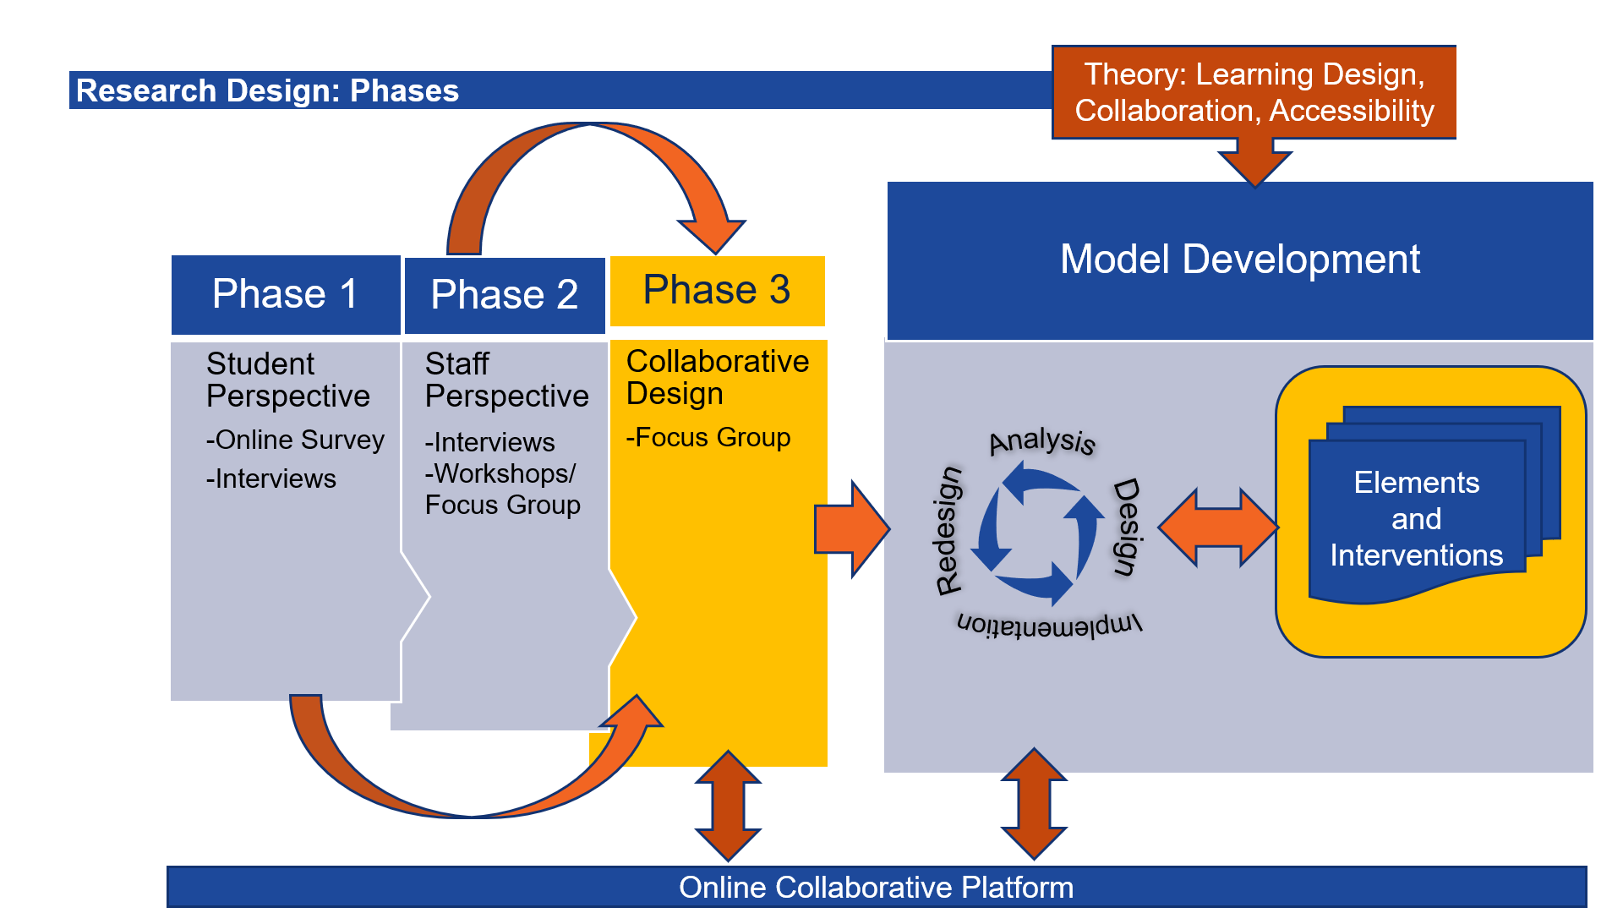
Research overview

Slide 6
MACE
The framework:
Model for Accessible Collaborative Engagement

Slide 7
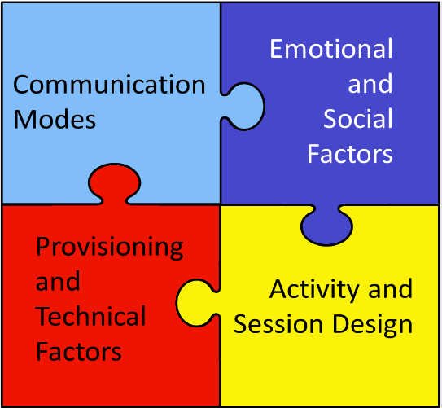
MACE Model
http://jobuxton.online/

Slide 8
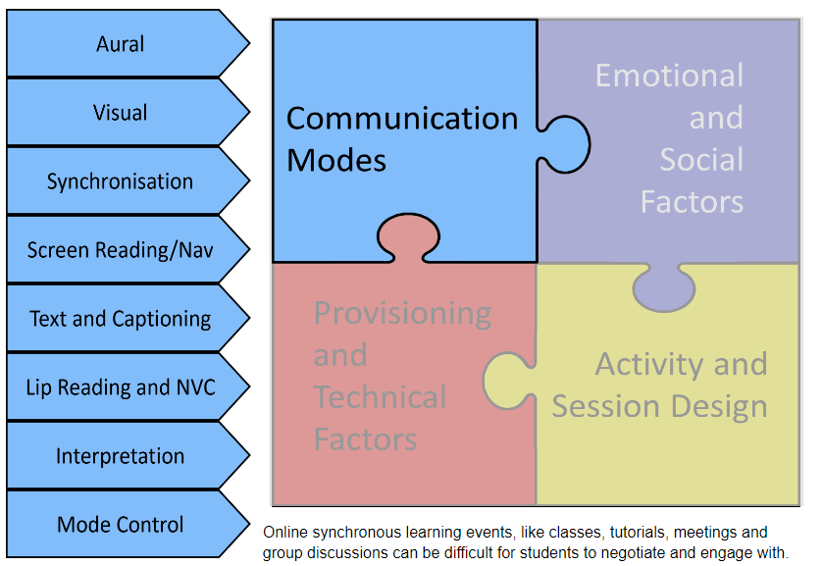
Communication Modes

Slide 9
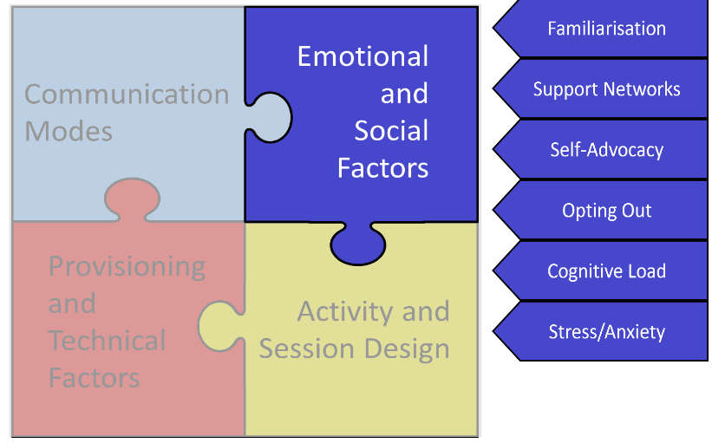
Emotional and Social Factors

Slide 10
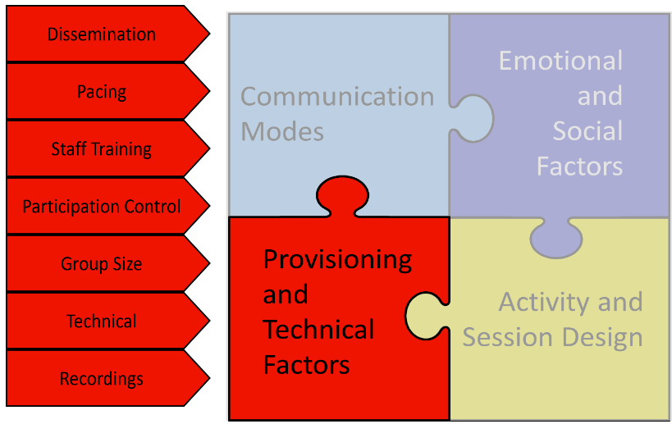
Provisioning and Technical Factors

Slide 11
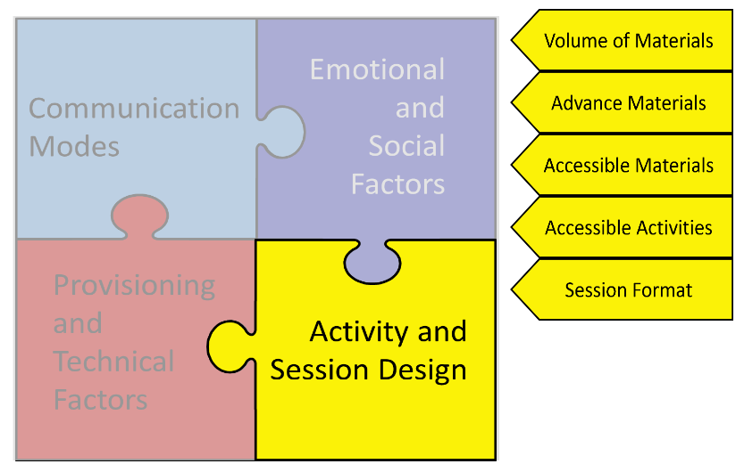
Activity and Session Design

Slide 12
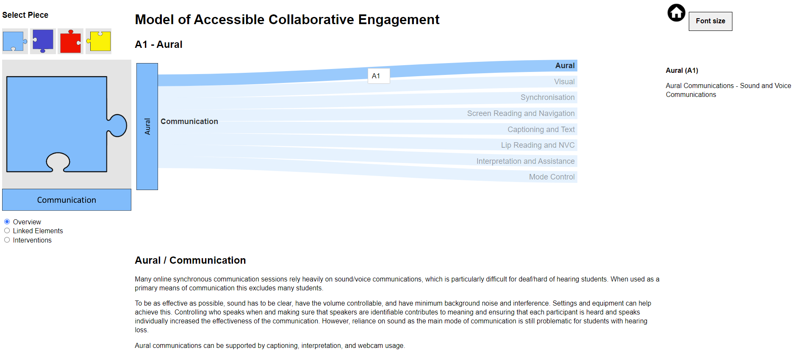
Model (Screen Share)

Slide 13
eSTEeM Project
Implementing the MACE Framework

Slide 14
Purpose of the Esteem Project
Evaluate MACE in practice
Feedback on the feasibility and effectiveness
Help refine and adapt the model
Contribute to the development of the model
Provide a useful reference tool for ALs to help make tutorials inclusive, accessible and effective
Support the ALs rather than cause additional work

Slide 15
What ALs did
Actively work with students to implement the findings
Used the MACE framework as a practice tool
Keep a reflective diary
Participate in a post-module interviews

Slide 16
In Advance
ALs in the study were asked to:
Proactive contact with students to encourage tutorial attendance
D flagged students – contact and ask them what they need specifically to attend tutorials, and any concerns they may have
Encourage them to explore Adobe Connect in advance (drop-in session?)
Explain what will happen in tutorials
Check materials for accessibility
Distribute materials in advance
Check activities for accessibility

Slide 17
Optional
And we suggested they might want to...
Familiarise themselves with a screen reader. NVDA is a free open source screen reader available at https://www.nvaccess.org/download/
Check out the Accessibility Guidance in the AL resource bank(Tutor Home/People and Places) https://openuniv.sharepoint.com/sites/intranet-tutor-help-centre/Pages/al-resource-bank.aspx

Slide 18
During tutorials
Make sure students are familiar with the environment and the tools/different modes of communication
Check their equipment – high quality sound and vision
Allow thinking and communication delay time (e.g. third-party assistance, screen reader, captioning)
Control participation – one speaker at a time, all able to contribute in whatever mode they feel most comfortable
Use Web Cams if they can
Pacing – have regular checks and controls
Encourage but don’t force participation
Clear structure to the session, and explanations in advance of what it will involve and how it will be conducted

Slide 19
After tutorials
Publish recording and make sure students are aware

Slide 20
eSTEeM project initial findings

Slide 21
Communication Modes - eSTEeM Project Reflections

Slide 22
Emotional and Social Factors - eSTEeM Project Reflections

Slide 23
Provisioning and Technical Factors - eSTEeM Project Reflections

Slide 24
Activity and Session Design - - eSTEeM Project Reflections

Slide 25
Key lessons Learned
Foster a culture where we keep accessibility in mind throughout: planning, execution, post-session
Support networks and tutor/student relationships
Provide training: producing accessible materials, activities and hosting accessible session
Take ownness off the student: make it the default
Dissemination: pass on good practice, student feedback, protocols and practices
Reduce anxiety and stress

Slide 26
Questions? Feedback? Ideas?

Slide 27
Thank you

Slide 28
Open University

