Slide 1

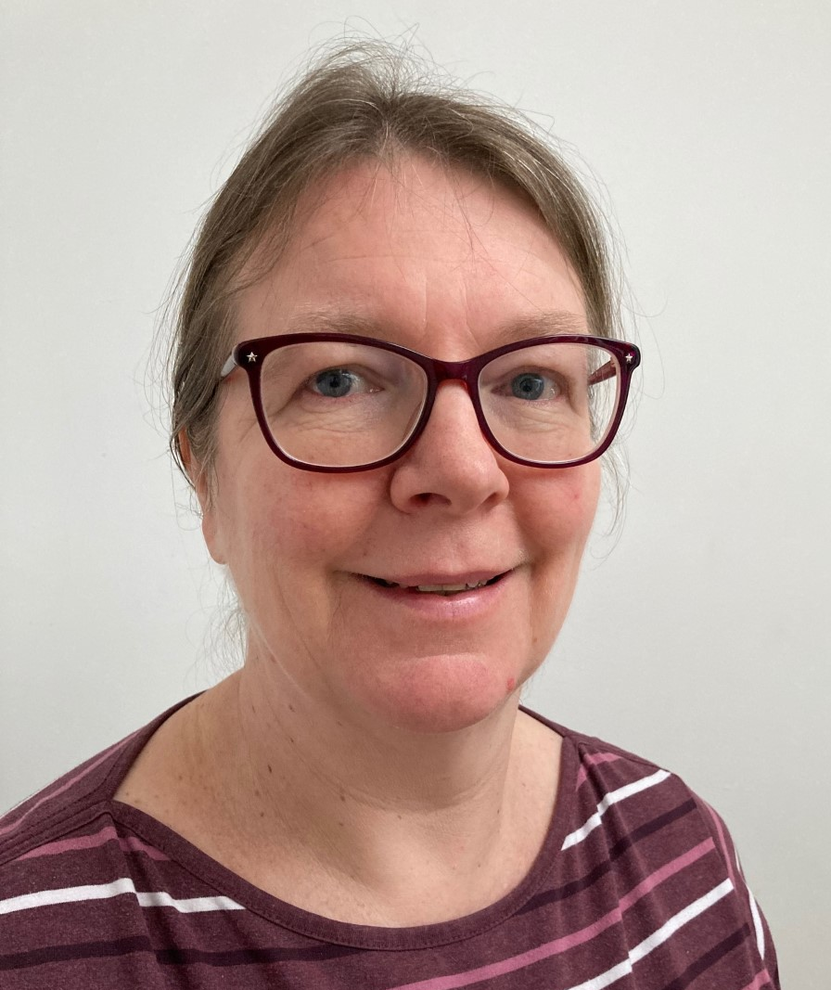
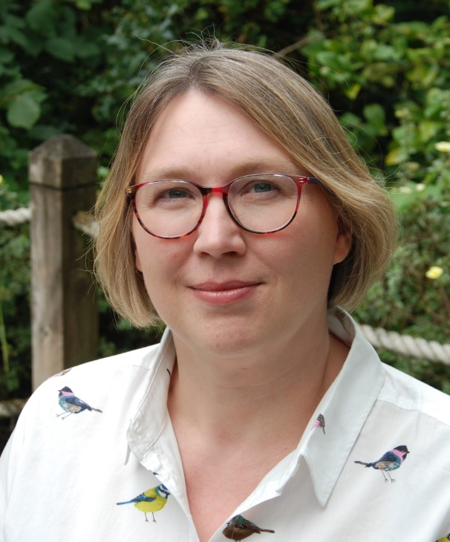
Can an asynchronous student conference in Open Studio develop students’ higher-order academic skills?
JENNY DUCKWORTH & CATHERINE HALLIWELL

Slide 2
THE PROJECT
One of the first AL-led eSTEeM projects
S350 – ‘Evaluating Contemporary Science’
Students from different disciplines e.g. Chemistry, Health Science, Environmental Science
Approximately 250 students in 18J & 19J
Asynchronous 2 week student conference in OpenStudio

Slide 3
S350 STUDENT CONFERENCE
Choice of 5 topics: antibiotic resistance, diesel vehicles, nuclear legacy, moons and asteroids, rare earth elements
Comparison of two recent scientific papers
Students upload poster, elevator pitch and key image
Peer feedback given
Major component of TMA03, work developed further for EMA

Slide 4
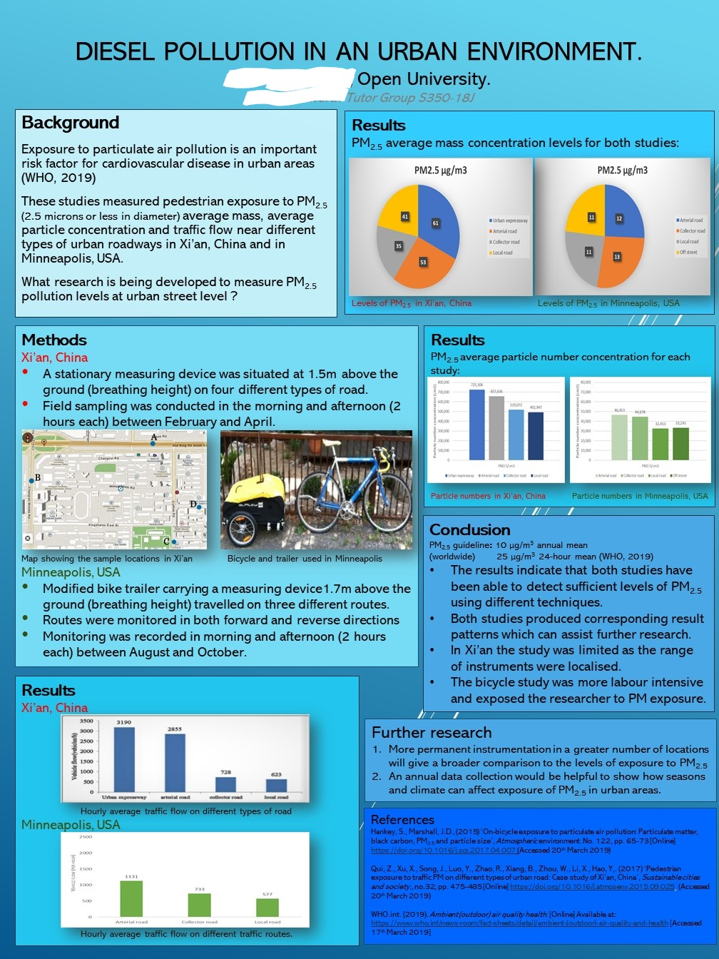
Example poster from the S350 18J Conference

Slide 5
RESEARCH QUESTIONS
Can an asynchronous online conference help develop science students’ understanding, application, and critical evaluation skills?
What ‘quick fixes’ can we put in place to help promote development of these skills through the conference?

Slide 6
METHODS (I)
100 randomly selected posters from 18J
Checklist of questions including content, ‘quality’ and feedback received
Assessed against criteria for:
- Understanding (language; use/amendment of figures)
- Application (results, conclusions, contextualisation; future research)
- Evaluation (quality of each study; comparison of study quality)
Criteria used scale from 1 (not attempted/no evidence) to 5 (excellent)
AL focus group discussions before 19J conference - suggestions

Slide 7
COMMON FEATURES OF THE ‘BEST’ POSTERS
‘Sensible’ choice of studies that did not differ too much (e.g. same organism with different experimental variables)
Focus on comparison of the two studies
Did their own presentation of results
Clear consideration of study limitations
Proposed ‘sensible’ and specific future research

Slide 8
METHODS (II)
‘Top tips’ document produced and shared with students before 19J conference
Tutorial on poster preparation for 19J given greater focus on higher-order skills
Assessment against criteria repeated on another 100 randomly selected posters from 19J conference
18J and 19J scores compared for overarching criteria (understanding, interpretation, evaluation)
19J student focus group discussions (facilitated by OU students)

Slide 9
Poster topics
18J
19J

Slide 10
Comparison of criteria scores between 18J & 19J
Scores for all three overarching criteria (Understanding, Application, Evaluation) increased between 18J and 19J
Increase statistically significant (p <0.05) for Application and Evaluation
Could the ‘quick fixes’ have made a difference (despite the Covid-19 pandemic)?

Slide 11
Poster feedback
Was effective evaluation of scientific content shown?
18J
19J

Slide 12
THEMES FROM STUDENT FOCUS GROUP DISCUSSIONS
Constraints
Time pressure
Assessment
Academic challenges
Researching and preparing poster
Selecting posters and giving feedback
Skills and experience
Appreciation of value of feedback
Skills development
Experience of ‘real’ science
Personal development
Interest and enjoyment
Building confidence
Social learning

Slide 13
CONCLUSIONS
An asynchronous conference can develop students’ higher-order skills
Improvement in criteria scores between 18J and 19J (despite the pandemic)
Greater emphasis on scientific content in feedback for 19J posters
Students recognised value of the conference for skills development (including higher-order skills)
They also enjoyed the conference and the insight it gave into ‘real’ science
Online conferences have come to the fore since 2020
An asynchronous format is simple to implement and still enables aspects of social learning

Slide 14
PROJECT OUTPUTS
Oral presentations at eSTEeM and Horizons in STEM conferences 2020
Poster presentation at Advance HE STEM conference 2021
Peer reviewed Journal article:
Duckworth, J. and Halliwell, C. "Evaluation of higher-order skills development in an asynchronous online poster session for final year science undergraduates". The International Review of Research in Open and Distributed Learning, 23(3). Available at https://www.irrodl.org/index.php/irrodl/article/view/6238/5718 (Accessed 20 Sept 2022).
eSTEeM final report: https://www.open.ac.uk/scholarship-and-innovation/esteem/projects/themes/supporting-students/can-asynchronous-student-conference-open-studio-develop-students

Slide 15
REFLECTIONS
AL-led eSTEeM project
Support and training
Highly recommended for ALs looking to develop their scholarship
Case study for SFHEA application

Slide 16
ACKNOWLEDGEMENTS
eSTEeM team, particularly Trevor Collins and Diane Ford
Our mentor, Karen Kear
Simon Collinson and the S350 module team
AL focus group participants
Cath Brown and Charlotte Hancox
Student focus group participants

Slide 17
Any questions?

