Slide 1


Putting a face to a name: students’ use of profiles in VLE forums
Helen Jefferis, Frances Chetwynd, Karen Kear and John Woodthorpe
MCT

Slide 2
User profiles in social networking
A profile is an area where the user can share information about themselves.
Profiles play a central role in social networking environments.
Members of online communities can use profiles to learn about each other.
Notes:
…add photographs etc.
…such as LinkedIn and Facebook

Slide 3
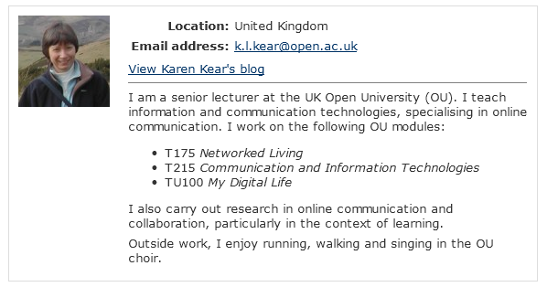
Profiles in the OU VLE

Slide 4
Aims of the project
This project aims to discover:
  how students use the profile facility in VLE forums
  whether user profiles contribute to online identity and community
  how to support students in developing their online presence

Slide 5
Project context and data gathering
Data gathered at two stages in the module
  before and after TU100 module materials on social networking
Data gathered so far
  observations of students’ profiles
  online survey
Notes:
This presentation will concentrate on the survey

Slide 6
The initial online survey
Mix of closed and open questions
Included questions on students adding information and photos to their profile
24 respondents out of 29 – 83% response
Notes:
Next – details of the survey

Slide 7
Have you uploaded a photo or image to your OU forums profile? (If so this image appears beside all messages from you)

Slide 8
What kind of photo or image did you upload?
93.3% (14/15) just one replied:
One commented:
And one also stated:
A photo of me, on my own
A photo of me and my pet dog, making sure the photo did not actually show my face
i 'digitised' my face - my course is entitled 'My Digital Life' so i though it was appropriate

Slide 9
What prompted you to upload a photo/image?
Common responses were that it was more personal, added “identity” to their profile , or helped to “put a face to a name”
Or that it was conventional or the norm
I think it makes it more personal
I just normally do when I'm on a forum. It seemed the convention
Images are very prominent on VLE forums and one did say
Seeing the anonymous image on forum posts against my profile didn't look right
Notes:
… when you can see someones face over the internet, and makes it easier to talk to them, instead of them being this 'anonymous' stranger behind a computer. I like to be approachable.”

Slide 10
What information is in an OU profile?
Profile information of two types:
Basic information added by University
Additional information added by student
Different levels of visibility available:
Hide all information from ‘everyone’
Limit who can see their email
Reveal all University and personal information
Notes:
The basic information added by the University consists of: email address; location; link to OU blog; The student can choose to some text data, a picture and things like Skype ID
Choices about what to reveal include: email address or not; etc.

Slide 11
Have you entered information into your OU forums profile?
Notes:
half of respondents had some of their own information into their profile. Some confusion here since there was some confusion as to what the OU put in and what they choose to put in themselves.

Slide 12

Confusion about the profile
Why did you add information?
Confusion about what others can see
It was part of the application form
…it was requested in my profile. I was merely filling it in.
‘…All that should be visible is my name and location though I am not certain that it isn't showing my email address as well…’
Notes:
Discussion of confusion apparent between OU added info and own info. Also confusion with our question. Lastly students not certain about what is visible and whether their own choice work.

Slide 13
Why did students add information?
Some social responses
some more pragmatic
Community spirit - share some carefully chosen info with other students for friendlyness
..Just seemed appropriate.
I felt it was sociable to tell people who were interested, who I am and what I do
Suggested as part of the course work
To allow a small insight into my personality
Notes:
Others in the same vein were: I wanted to let people know what sort of person I was by listing some basic information about myself; again, not sure, just seemed appropriate

Slide 14
Why did students not add information?
Some privacy/security fears responses
Some pragmatic
Security reasons
Too busy
I simply don’t see any need
Privacy concerns mainly…
I have no wish to share private information on these forums
Notes:
Blue person also added: even though I’m aware of limited access to my profile, may also be linked to my introverted nature
Also the reasons for not uploading an image were the same.

Slide 15
Conclusions
Nearly 70% added a photo to their profile
Nearly 50% added some text information
There were social reasons for adding material
There were privacy concerns
Usability issues of the profile
Future work
  Addition of ‘B’ tutor group
  Elluminate focus group

