Slide 1
Enrichment workshops to encourage awareness of employability skills
Janet Haresnape PFHEA
School of Life, Health and Chemical Sciences, STEM Faculty, Open University
Horizons in STEM Conference
Swansea University, June 28th-29th 2023

Slide 2
Enrichment workshops for biology students – a pilot in summer 2022
Why did we decide to run these?
A survey of OU biology students based on practical skills progression and employability (Haresnape, 2022) revealed that many students don’t realise:
  the employability benefits of engaging with practical investigations
  they are gaining crucial skills by engaging in practical work
To fill the gap over the summer months – keep keen students engaged
To help students feel a sense of community
Additional tutorials (outside the core tuition provision) had been run on several modules in 2021
  These had focussed on ‘what it is like to work as a field/lab biologist’
  It was clear these would be of wider interest beyond just one module

Slide 3
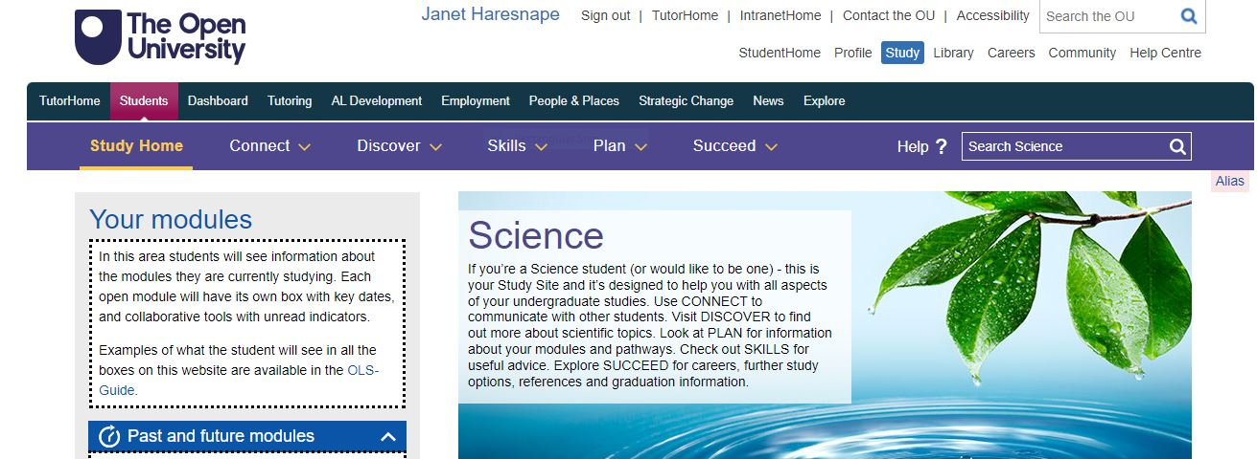
Enrichment workshops – a pilot in summer 2022
Therefore ran a series of workshops
for students in June and July 2022.
Eleven workshops, in an online room on on the Science Study site
Run by biology tutors
One tutor coordinated the programme (10 day’s work)
  Contacted facilitators to arrange times
  Put together the programme
  Advertised the programme on module forums
  Introduced the facilitator at each session, and welcomed the students
  Posted a link to a feedback questionnaire at the end of each session
  Collated the feedback at the end of the summer
The workshops focussed on a variety of biology-related jobs, giving first hand knowledge of what the job was like and the particular skills required (e.g. field-based jobs, lab-based jobs, working in bioinformatics)

Slide 4
Enrichment workshops – titles, summer 2022
Title
HIV: the state of the global epidemic, and current approaches to HIV care in UK
Foodborne Pathogens
Science Communication and Questioning Skills
Sexual health
Collaboration in Science
Penguins, parasites and poo: how to survive life as a field biologist
The Microbiology of Fermented Foods
Working in a scientific spin-out company
A career in bioinformatics
Finding and reading scientific literature: how a grizzly bear turned me into a biologist
Nosey ears: troubleshooting, and applying laboratory skills in medical entomology

Slide 5
Enrichment workshops – students invited
Invitations to the workshops were sent out after the June 2022 exams had finished.
Students invited by email, plus posts on module forums:
  initially just Level 5 (equivalent to 3rd Year UG) biology students (1446 students)
  extended to all Level 4 and 5 (equivalent to 2nd and 3rd Year UG) biology and health students (2750 students).
10-15 students attended each workshop.
149 different students either attended or accessed recording of at least one workshop.

Slide 6
Enrichment workshops – feedback from 2022
Valuable insight into the skills required for fieldwork, and the challenges too.
Real experience brought it to life for me.
Relates degree work to outside world
Opened my eyes to opportunities out there to do field work
I had never heard of bioinformatics - really great to hear about this as possible career path
Learnt how biological techniques are used to research real-world problems.
Keeps the student/study momentum going over the break. I am impressed overall with the Biology department approach.
Notes:
Roseanne’s session on communication was excellent this morning. Lots of enthusiastic participation throughout - one of the students cheekily suggested at the end that some tutors would benefit from watching the session.

Slide 7
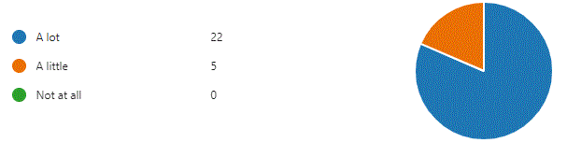
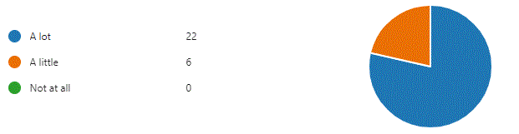
Enrichment workshops – feedback
Did this session help you to understand the skills required for a particular field of work?
Is this programme helping you to feel part of an OU community of biology students?

Slide 8
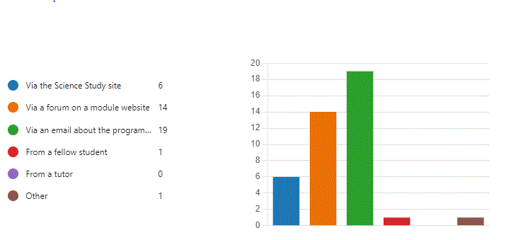
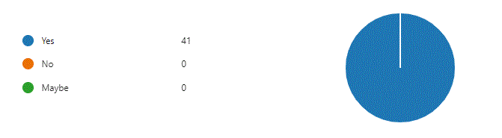
Enrichment workshops – feedback
How did you hear about the programme?
Would you recommend participating in this programme to other students?

Slide 9
Enrichment workshops
– 2023 programme
Successful pilot
Expanded for 2023
More workshops
– started in May, paused for exam fortnight, resumed in late June, continuing through to September.
Several workshops per week.
Expanded to include skills for chemistry and health sciences
Invited more students – all those on modules in School of Life, Health and Chemical Sciences
Advertised more widely and earlier in the year
Ask tutors to mention the programme to their students before June exams
Including a wider range of workshop topics and styles

Slide 10
Enrichment workshops – 2023 programme
Title
Cancer research at the OU – research overview
What’s it like to be a PhD student? – panel event with current and recent PhD students
Embark on a scientific research expedition with the OU Library
‘Let me tell you a story…..’ - Best practices in science communication
Basic Shoe Leather Epidemiology – working in the field and being a detective in public health
Rising from the ashes: problems with practical investigations
Nanotechnology: Can the power of ‘the small’ shape a sustainable future?
Monitoring wolf populations in Slovakia
One Health: Spotlight in the connections between human and animal health

Slide 11
Enrichment workshops – feedback from 2023 – What did you find particularly useful?
Really interesting to find out about people's research …….. gain a wider understanding of biology and the different contexts not necessarily covered in the modules. (cancer research)
Seeing how science is put into practise and how it’s communicated (cancer research)
Inspired me to feel excited about public health again (epidemiology)
Great interacting with a presenter who has worked in the field and is knowledgeable (epidemiology)
The chance to hear about someone’s work (epidemiology)
How people talk about fake news (epidemiology)
Learnt about a completely new subject and how it can be applied to my studied area (nanotechnology)
Notes:
Roseanne’s session on communication was excellent this morning. Lots of enthusiastic participation throughout - one of the students cheekily suggested at the end that some tutors would benefit from watching the session.

Slide 12
Enrichment workshops – feedback from 2023:
Is this programme helping you to understand skills required in particular fields of work?
Provided another perspective from someone who's had their feet on the ground!
Useful to hear from people working in industries we might want to work in in future
It's easy to get immersed in the coursework and lose sight of the career aspect. This brings that back.
It was really informative about specific skills
Experimental skills and relevance to employment skills
Mentioned Interview skills
Good emphasis on understanding the science behind problems
Notes:
Roseanne’s session on communication was excellent this morning. Lots of enthusiastic participation throughout - one of the students cheekily suggested at the end that some tutors would benefit from watching the session.

Slide 13
Enrichment workshops – feedback from 2023 – Is this programme helping you feel part of an OU community?
These sessions outside of course content ………. to get that extra connection.
It definitely helped. I hope there's more of these
Seeing Jon’s face as he spoke made it feel more interactive.
I like seeing people I’ve met before
It’s good to hear from students outside your own modules
Great to have access to this type of session – and get to interact with likeminded students and tutors in an informal way.
Shared experience, inclusivity, team work, recognition and motivation.
You can only feel so much of a sense of belonging when its remote.

Slide 14
Evidence of providing enrichment
Very informative, informal and a great way to find out more
Very useful for those like me who struggle to understand everything.
This is so enriching. It was amazing.
Does what it says on the tin - enriches your studies, helped to put information and knowledge into a wide range of contexts
Covering a wide range of subjects …………. science works best when collaborative between different disciplines
Useful and a nice subject-relevant break from direct study and exam prep!

Slide 15
Thank you
Any questions?
Contact details : janet.haresnape@open.ac.uk
Horizons in STEM Conference
Swansea University, June 28th-29th 2023

