Slide 1


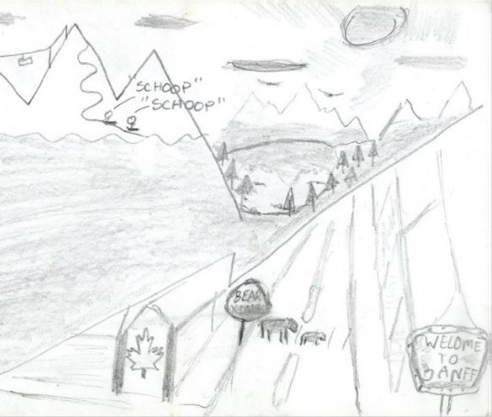
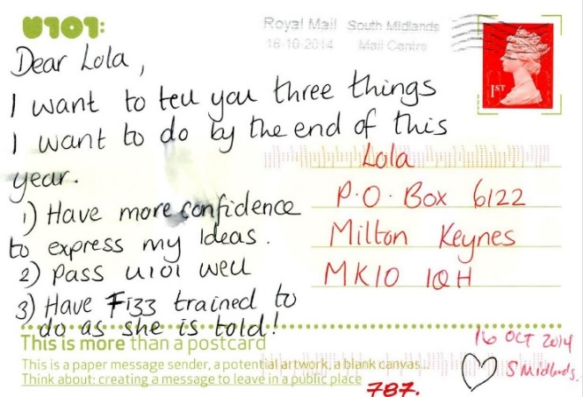
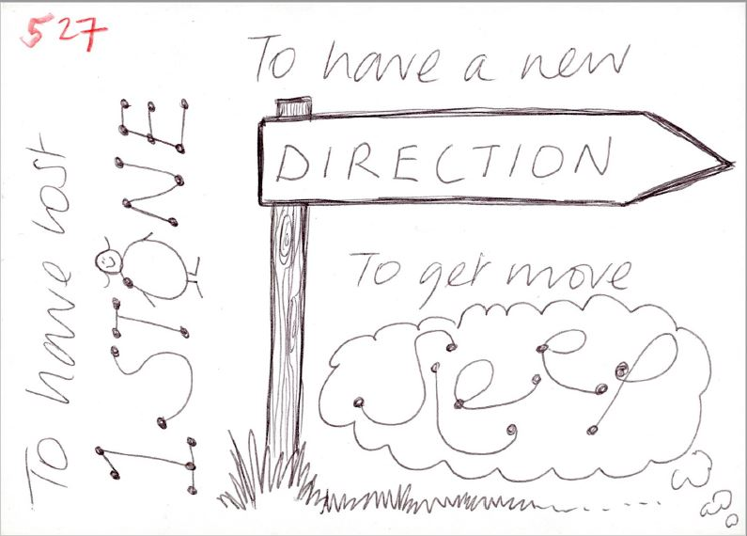

Postcard Confessions:
Deepening Understanding of Students via their Hopes and Dreams
Georgy Holden, James Warren, Derek Jones, Nicole Lotz, Emma Dewberry, Christian Nold
We think that we know our students, but do we fully understand their hopes and the reality of their daily lives? The U101 design Welcome Pack includes postcards inviting students to tell 'Lola’ their hopes and dreams for the coming year. U101 asks for three things the students want to achieve or three things the students want to learn.
We plan to:
Hoped for outcomes:
❶
Digitise, code and analyse approximately 2400 postcards to reveal trends over time,
and for the entire cohort
Inform the new Design degree
❷
Carry out visual pattern analysis and draw out insights from thematic text to build up a series of design student personas for use elsewhere
Improve understanding of student goals to tailor teaching and tuition
❸
… Finalise design personas and author booklet to act as a Guide to Design Students, to be made available in print and PDF
Contribute to development of learning design
What do you want to achieve this year?
What do you want to learn this year?

