Slide 1
Data Management for Scholarship Projects
Thursday 17th November 2022
Isabel Chadwick
library-research-support@open.ac.uk

Slide 2
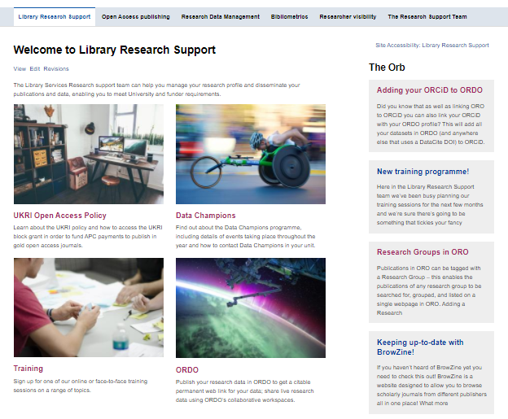
http://www.open.ac.uk/library-research-support/
Notes:
Before I start I’m going to flag up our website where you can find loads of information about Data Management Plans and everything else we support, and how to contact us.

Slide 3

WHAT WE’LL COVER
What is Research Data Management?
What is a Data Management Plan and why write one?
What to include
Questions?
Notes:
Overview of the workshop
There is quite a lot of content to get through. There will be time for questions at the end but if you have a question along the way please pop it in the chat and I will try to address it.

Slide 4

What is Research Data Management? (RDM)
“Research data management concerns the organisation of data, from its entry to the research cycle through to the dissemination and archiving of valuable results. It aims to ensure reliable verification of results, and permits new and innovative research built on existing information."
Digital Curation Centre (2011)
Making the Case for Research Data Management
http://www.dcc.ac.uk/sites/default/files/documents/publications/Making%20the%20case.pdf

Slide 5

What do we mean by research data?
...the evidence that underpins all research conclusions (except those which are purely theoretical) and includes data that have been collected, observed, generated, created or obtained from other sources, for subsequent analysis and synthesis to produce original research results.

Slide 6
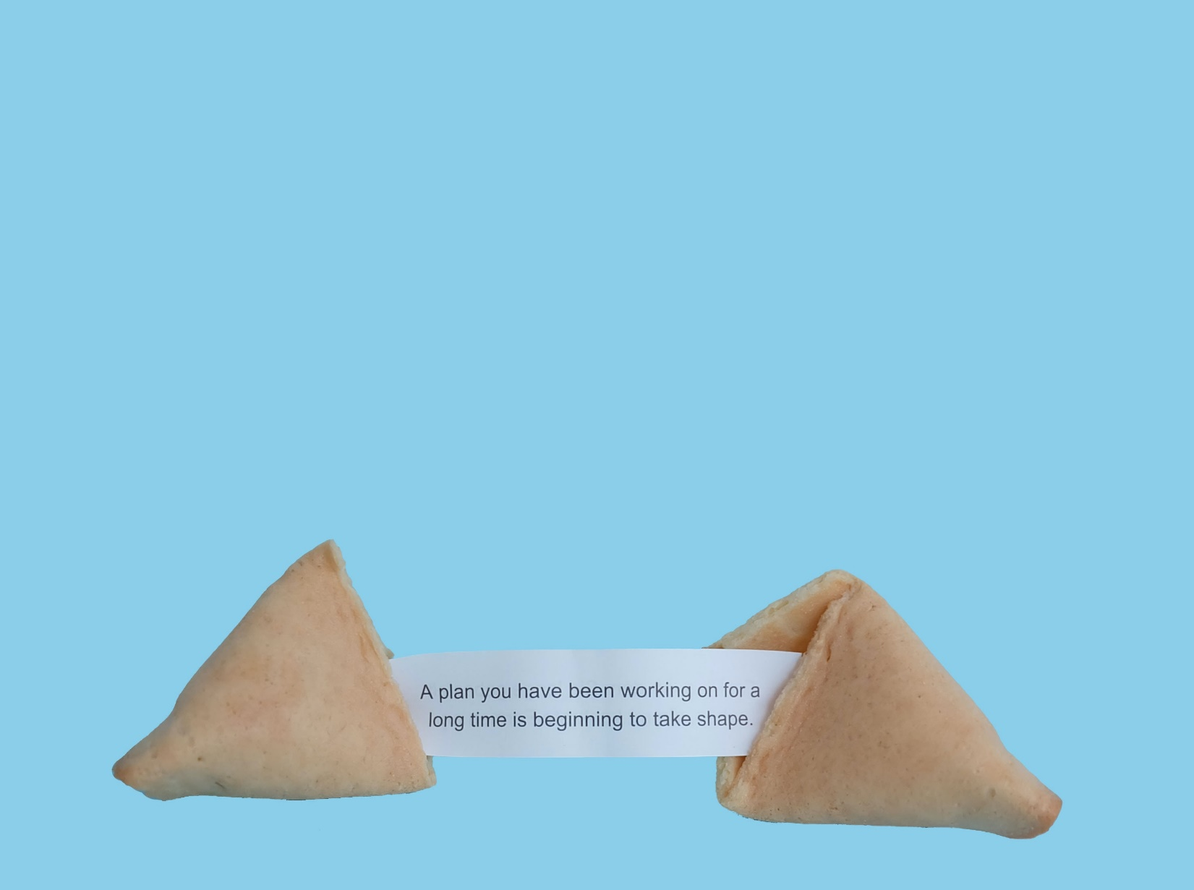
The Data Management Plan
What are they?
A project document that describes:
the data that a project will collect
how data will be stored, transferred, backed up during the project
how data will be archived at the end of the project
how access will be granted to data where appropriate
Notes:
What is a Data Management Plan?
Funding bodies increasingly require grant-holders to develop and implement Data Management and Sharing Plans (DMPs). But even if you’re not asked to do one, it can be a useful way of addressing all the data management issues you will encounter during your research.
Plans typically state what data will be created and how, and outline the plans for storage, back-up, sharing and preservation, noting what is appropriate given the nature of the data and any restrictions that may need to be applied.

Slide 7

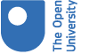
The Data Management Plan
Why write one?
Make informed decisions to anticipate and avoid problems
Develop procedures early on for consistency
Avoid duplication, data loss and security breaches
Tell your funder that you know what you are doing (and get funding!)
Save time and effort – make your life easier!
Notes:
Your DMP isn't just for your funder. It should be a useful document for you.
Don't feel that you have to adhere to everything you put into it before you start your research, it's not a static document and should evolve along with your project.
Data Management is becoming increasingly valued as a key research skill.

Slide 8

The Data Management Plan
When do I need to do one?
As soon as possible
When submitting funding bids
But if you’re not applying for funding, do one too
Update it during your work

Slide 9
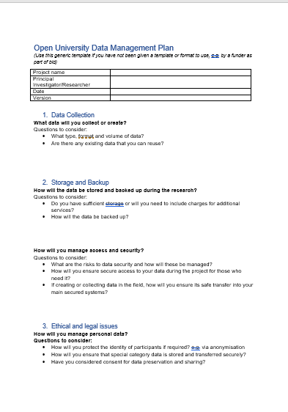
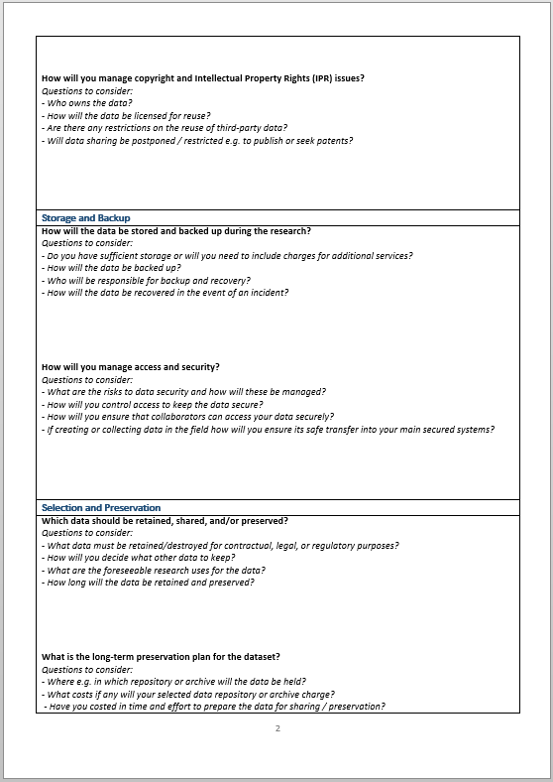
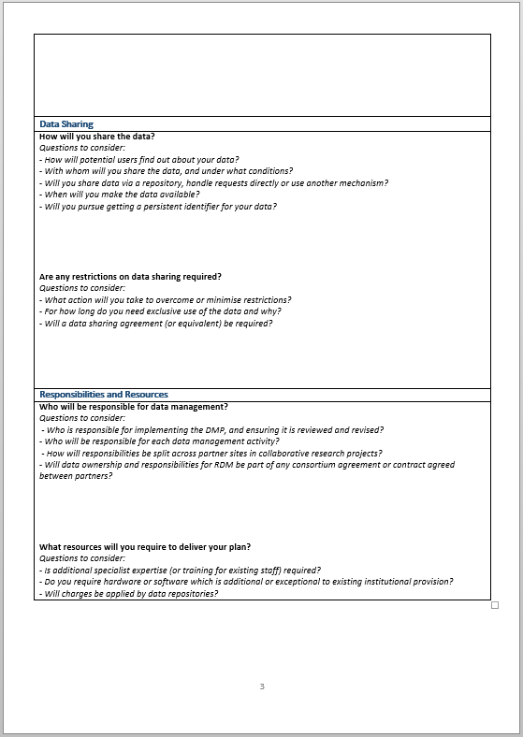
The Data Management Plan
Template
Click here to download
Notes:
Our standard template that you can use. You can download it from the link here.
We’ll now look at each section and the kind of information you should put there.

Slide 10
The Data Management Plan
Data Collection
What type, format and volume of data?
Are there any existing data that you can reuse?
Notes:
Be thorough in your description – include details of quality assurance, if you’re working in a big team how will you ensure that data collection is consistent?
Mention file formats
Can you estimate how much data you’re going to collect? If it’s audiovisual for example this may have cost implications on the grant.

Slide 11
The Data Management Plan
Data Collection
What type, format and volume of data?
Are there any existing data that you can reuse?
Storage and Backup
How will the data be stored and backed up during the research?
How will you manage access and security?
Notes:
Questions to consider:
Do you have sufficient storage or will you need to include charges for additional services?
How will the data be backed up?
Questions to consider:
What are the risks to data security and how will these be managed?
How will you ensure secure access to your data during the project for those who need it?
If creating or collecting data in the field, how will you ensure its safe transfer into your main secured systems?
Again, be thorough. The OU recommends storing on OU servers and systems – like network file storage or tools like OneDrive or Sharepoint, which are regularly backed up, but you may want to back up to an external hard drive to be extra secure (though be cautious with storing personal/sensitive data on external drives).
In terms of access and security this becomes more complicated if you are working with collaborators outside the institution, particularly if those collaborators are overseas. You need to consider whether there are any legal issues regarding data transfer overseas – look at the data protection legislation and of course contact the University’s DP team for advice.
Think carefully about who needs access to what, it may be that not everyone on your team needs to access everything. For example, transferring only anonymized data is less risky than transferring personally identifiable data.

Slide 12
The Data Management Plan
Data Collection
What type, format and volume of data?
Are there any existing data that you can reuse?
Storage and Backup
How will the data be stored and backed up during the research?
How will you manage access and security?
Ethics and Legal Compliance
How will you manage personal data?
How will you manage copyright and Intellectual Property Rights (IPR) issues?
Notes:
Questions to consider:
How will you protect the identity of participants if required? e.g. via anonymisation
How will you ensure that special category data is stored and transferred securely?
Have you considered consent for data preservation and sharing?
Questions to consider:
Who owns the data?
How will the data be licensed for reuse?
If you are using third-party data, are there any restrictions on your usage?
Will data sharing be postponed / restricted e.g. to publish or seek patents?
We ran another webinar on working with personal and sensitive data on 15th November and another on legal and ethical issues in sharing data on 29th November which looks at this in more detail.
You need to include details of how you will obtain consent to collect, use and share data, and whether you will be anonymizing your data, if so how? Will you be using any community standards or employing an external company – if the latter what confidentiality agreements are in place?
Briefly, IP for research data collected or produced by OU employees lies with the institution, although if you are collaborating with other institutions or with commercial partners IP will be shared and in these cases it’s wise to draw up an agreement. If you are using secondary data you need to make sure you understand any IP or copyright issues related to using and reproducing this. IP team can help you with these aspects if needed. Library team cab advise on copyright.

Slide 13
The Data Management Plan
Selection and Preservation
Which data should be retained, shared, and/or preserved?
What is the long-term preservation plan for the dataset?
Notes:
Thinking here about plans for your data once you have completed your research. You don’t need to keep everything (although in some cases you might want to).
For example, if your audio recordings have been transcribed and anonymized then do you need to keep the recordings?
Likewise, you may only want to put a subset of your data into a repository, this is particularly relevant if you have a lot of data which would take a long time to prepare and upload.
Most funders (*and the OU) require you to preserve your data for a minimum of 10 years post project. How will you do this?
Documentation and metadata make it easier to understand what’s what. – it’s how your data is described to make it understandable to you and others.
It’s a good idea to assign this information from the very beginning, or you may end up in the situation where you can’t understand your own data, let alone anyone else! This documentation might be integral to the file – like headings and file properties or it might sit alongside your data, like README files, data lists and lab notebooks.
You need to think about what a 3rd party would need to understand your data – contextual information, explanation of fields and codes, methods adopted to collect data.

Slide 14
The Data Management Plan
Selection and Preservation
Which data should be retained, shared, and/or preserved?
What is the long-term preservation plan for the dataset?
Data Sharing
How will you share the data?
Are any restrictions on data sharing required?
Notes:
There is an expectation and sometimes requirement that research data is shared – supporting publications and at the end of a project - and the best way to do this is to use a dedicated research data repository. When choosing a data archive or repository the order of preference should be:
Funder archive (for example ESRC funded researchers should submit their data to the UK Data Archive)
Discipline specific archive
Institutional archive
Online data sharing service (like Figshare/Zenodo)
This will help ensure discoverability.
You might want to assign access restrictions to parts of your dataset – are there files which should only be accessible to other trusted researchers who agree to conditions of use? Is the dataset too large to share online? Do you want to embargo the data for a period, say 12 months, so that you can do further work before sharing it?

Slide 15
The Data Management Plan
Selection and Preservation
Which data should be retained, shared, and/or preserved?
What is the long-term preservation plan for the dataset?
Data Sharing
How will you share the data?
Are any restrictions on data sharing required?
Responsibilities and Resources
Who will be responsible for data management?
What resources will you require to deliver your plan?
Notes:
Be thorough. Tasks here might include:
designing and overseeing the research
collecting, processing and analysing data
generating metadata and documentation
designing databases, preparing data for archiving and sharing.
This is likely to require more detail if you’re working with a large team rather than working on your own.
And you may need to think about people outside of your direct research team e.g.
external contractors involved in data collection, data entry, transcribing, processing or analysis
support staff managing and administering research and research funding, providing ethical review and assessing Intellectual Property rights
institutional IT services staff providing data storage, security and backup services
external data centres or web archives that facilitate data sharing

Slide 16
Data collection

Slide 17
Data collection
The basics
What data will I have?
How many files?
How big will they be?
What format(s) will I use?
How will it be collected?
How will it be organised?
Notes:
1 min
Think about names and formats before clicking save
Where do you need this file; is it used by another program?
Do the name and location make sense?
Consideration at the beginning makes it easier to find files and related documents later.

Slide 18
Data collection
Good example
Public opinion data will be collected via telephone surveys, from about 500 adults. As is recommended in this subject discipline, the interviewers will use computer-assisted telephone interviewing software (CATI). The responses will be entered into the CATI system as the interviewee answers the questions that the interviewer reads from the instrument, to ensure consistent quality and reduce the chance of error.
The data collected are the responses from the interviews. These responses will be cleaned, processed and analyzed using SPSS statistical software package. The cleaned data will include data for all valid responses only and will consist of a single SPSS file. The file will consist of quantitative data only and will be about 1GB in size.
Notes:
Here is an example of the data collection section of a DMP regarding the collection of longitudinal opinion data.
They include info on the data type (public opinion data collated into a single SPSS file), volume (500 surveys), size of files (1GB file). They also include info on collection methods (CATI software), including quality assurance processes.

Slide 19
Storage and backup

Slide 20
Storage and backup
Data storage and security
Stuff happens!

Slide 21
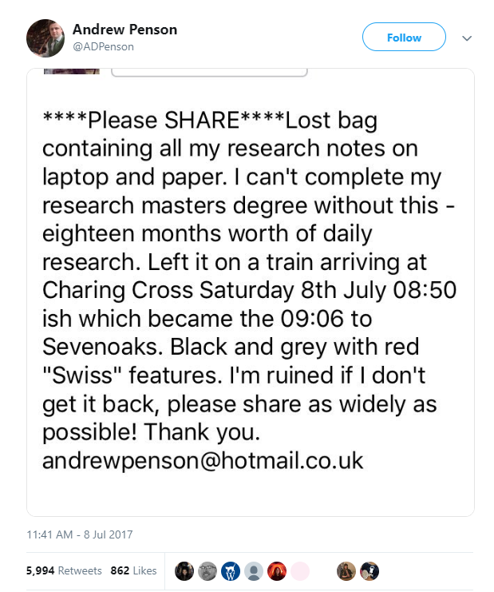
Storage and backup
Data storage and security
What would happen if you lost your data?
Imagine if you left your bag on a train, containing your laptop (with all your digital research notes on) and your paper-based notes too – this situation happened to Andrew Penson
https://twitter.com/ADPenson/status/883637257323896832
Notes:
He kept his paper and digital copies of his research notes all together in his bag – making it impossible to finish his Masters degree

Slide 22

Storage and backup
Data storage and security
What would you do if you lost all your data?
Notes:
Imagine if you lost all of the data you’d been working on for the past few years?
This almost happened to the Toy Story 2 production team.
Moral of the story – regularly back up your data! (and aren’t mums amazing?!)

Slide 23
Storage and backup
Data storage and security
Data size, complexity
Where will you be working, collecting and accessing your data?
Are you working with anyone?
Notes:
So, this drives home the point of how important it is to back up your data!
When choosing your storage and backup options, you need to consider:
Data size, complexity (limited storage?)
Where will you be working, collecting and accessing your data? (will you have internet access? Limited bandwidth?)
Are you working with anyone? (who else needs access, can they access the storage location if they are external to OU? If they are abroad, what will you need to do to ensure GDPR compliance?)

Slide 24


Storage and backup
Data storage and security
Team working?
Use Teams
Working alone?
Use OneDrive
Notes:
3 mins (50)
These are the recommendations from the information security team. They advise against the use of Sharepoint as they have seen instances where people have set up the access permissions incorrectly. Both of these systems have been approved for storing personal and special category data, and enable you to share your files with others if necessary.
In terms of cloud services, these are not recommended for use by the OU, but we know that they offer some benefits…
Benefits:
• Very convenient
• Accessible anywhere
• Good protection if working in the field
• Background file syncing
• Mirrors files
• Mobile apps available
But,
• These are not necessarily secure
• Potential GDPR issues
• Limited control over where data is stored
• Not necessarily permanent
• Intellectual property right concerns?
• Limited storage?
One Drive allows you to share materials rather like Dropbox, but is more secure, and stores are within EU locations, so is complies with UK Data Protection laws concerning the storage of personal data.

Slide 25
Storage and backup
Good example
When in the field, data will be stored on the PI’s laptop and backed up to an external USB hard drive on a nightly basis. Both will have password protection. Backups will be performed on a nightly basis after the data are transcribed from the physical datasheets. Upon return to the university, all digital data will be transferred to the network shared drive, which makes nightly backups to multiple locations. Additionally, weekly snapshots of the survey data analysis file will be made and stored on the network drive. Files will be organised in a hierarchical structure, e.g. within ‘Data’ folder are ‘Survey’ and ‘Photos’ subfolders.
Notes:
Relating to a DMP around observational data (survey data and analysis) collated during field work where there was to be no internet access.
Weekly snapshots of data analysis files allow them to revert to most recent version should there be a loss/corruption of data in the interim. Though, SharePoint and OneDrive already have sophisticated version control which allow you to do this, so could have been a better option.
Note how they also give details of how they are organising their files. This could be as specific as detailing the convention used for file naming, in addition to file names/structures.

Slide 26
Ethical and legal issues

Slide 27
Ethics and legal
Personal and sensitive data
Working with personal data?
Ethical: See Human Research ethics guidance and the ‘HREC Project Registration and Risk Checklist’
Link to website http://www.open.ac.uk/research/ethics/human-research
Legal: See ‘OU Data protection procedures’ and start with the DPIA screening questions
Link to intranet (requires log-in) http://intranet6.open.ac.uk/governance/data-protection/
Notes:
Data Protection Impact Assessment screening questions will establish if your activity is high risk – if it is, you will need to complete the DPIA form itself. All personal information the OU collects and uses must also be added to the University’s Information Asset Register (IAR)​. Please add entries for any new personal data you are collecting, or update entries where you are changing how you are using or handling personal data. – see the linked guidance on OU Data protection procedures for full instructions.

Slide 28

Your responsibilities when working with personal data:
Complete Data Protection screening questions
You are processing special category data
You are NOT processing special category data
Fill in the Information Asset Register
AND
complete a Data Protection Impact Assessment (DPIA) form
Fill in the Information Asset Register
Data Protection and Research
Notes:
If you are handling special category you will be required to complete a Data Protection Impact Assessment form – you can access this through the DP intranet site.
Everyone collecting personal data should fill in the screening questions first (even if you don’t believe that you are handling special category data), as this will help you to decide if you need to fill out the DPIA form or if you just need to register it on the Information Asset Register.
Within the Information Asset Register you will be expected to record which lawful basis you are using to collect and process personal data. In most cases for scholarship this will be public task.
You will need to contact your IGLO (Information Governance Liaison Officer) to get your information added to the Information Asset Register – the link at the bottom of this slide gives full details about these processes and a link to the full list of IGLO contacts.
The link at the bottom of the page here will give you further details about your responsibilities for DP when conducting research.

Slide 29
Ethics and legal
Personal and sensitive data
When working with research participants....
Inform your participants what will happen with the data during and after the project
Ensure you have obtained their consent for all processes
Consider who needs access to the data
Can data be anonymised or pseudonymised?
Pre-planning and agreeing with participants during the consent process, on what may and may not be recorded or transcribed, can be more effective than anonymisation
For more information, see the UK Data Service guidance:
https://www.ukdataservice.ac.uk/manage-data/legal-ethical/consent-data-sharing/gaining-consent
Notes:
2 mins
While the lawful basis for collecting personal data for scholarship or research will usually be lawful basis, you are also expected to gain ethical consent to gather and process personal data from your participants.
Now, in the past researchers gained consent from participants primarily so that they could collect data.
However, there is now an expectation that researchers will share and preserve their data alongside their papers.
It is therefore important that participants fully understand:
how you will store, publish and share their data (even where it has been anonymized)
how you will ensure that their data remains confidential and anonymous (where applicable) throughout the duration of the project and after
If things change, you may be able to go back to your participants and change the details of the agreement.
Anonymisation can be time-consuming, so agreeing what can and can’t be recorded or transcribed may well save you time and effort. For example, if they don’t want you to use names, then conduct the interview without using names.
It is your duty to protect participants and comply with data protection

Slide 30
Ethics and legal
Copyright and licences
Copyright applies to:
Original literary, dramatic, musical and artistic works
Sound recordings, films, broadcasts
The typographical arrangement of publications
NOT facts
Note: data collected via recorded/transcribed interviews – researcher holds copyright of recordings and transcripts, but each speaker is author of his/her own words.
Notes:
You may also need to think about copyright and licenses., both for any data you are using (3rd party data) or for your own data if you plan to share it.
It’s worth taking a minute here to describe what copyright is
Copyright is one of the main types of intellectual property. It allows the copyright owner to protect against others copying or reproducing their work.
Intellectual property gives a person ownership over the things they create, the same way as something physical can be owned. The main legislation dealing with copyright in the United Kingdom is the Copyright, Designs and Patents Act, 1988.
In the UK, there is no need to register copyright. Copyright arises automatically when a work that qualifies for protection is created. The work must be original, meaning it needs to originate with the author, who will have used some judgement or skill in its creation. Copyright provides redress against others copying a work, not borrowing an idea or creating something similar.
Depending on what your data is it may or may not attract copyright. We can see here the types of work that copyright applies to.
Most research outputs such as spreadsheets, publications, reports and computer programs fall under literary work and are therefore protected by copyright. Facts, however, as it says on the slide, cannot be copyrighted.

Slide 31
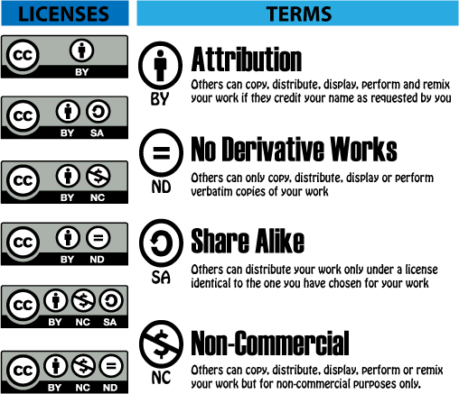
Ethics and legal
Copyright and licences
How do you want your data to be re-used?
Other options should be considered for databases and software.
Notes:
So, owning copyright of your data allows you to share it – and when you upload data to a repository for sharing, for example, you’ll be asked whether (or it will be assumed) you are the owner of the data. So take care if you are using someone else’s data. Do you have the right to share it? Is it easier to direct others to it?
Assigning a licence will make it really clear to anyone who wants to re-use the data what the conditions are. Some common licences in this area are Creative Commons licences, which allow you to assign the right for your work to be used in different ways (Go through the CC terms). Make sure you put detail about which license you plan to use to share your data in your plan (though this will usually fall under the ‘data sharing’ section of your plan. Further info on these will be available in our upcoming sessions.

Slide 32
Ethics and legal
Good example 1
The University ethical approval procedure was followed and informed consent required from all participants, including consent for public sharing of anonymised data. The original non-anonymised audio files will be securely destroyed by Open University IT Services at the earliest possible opportunity.
Notes:
Note the specific reference to consent for data sharing. They don’t mention any IP issues here as they are not re-using any existing data.

Slide 33
Selection and preservation

Slide 34
Selection and preservation
Data storage and security
What data should be retained, preserved and shared?
What data must be retained/destroyed for contractual, legal, or regulatory purposes?
How will you decide what other data to keep?
What are the foreseeable future uses for the data? (may be research, teaching, policy)
How long will the data be retained and preserved?
See our guidelines for selecting data for preservation and sharing (pdf)
Notes:
What to keep? It doesn’t have to be everything.
What data must be retained/destroyed for contractual, legal, or regulatory purposes?
Does it have commercial value – IP you are looking to exploit?
Will the data support a publication(s) – increasingly the publisher will require data underpinning publications to be retained and shared.
Who is your funder – what are their requirements? The OU requires a minimum retention period of 10 years for research data.
Does your ethics approval allow you to retain any sensitive information – if not you may need to anonymise prior to preserving and sharing and delete any identifying information.
Do your consent forms allow you to retain and share all the data gathered? Check what permissions you sought.
You will need to consider where to preserve your dataset. We will cover this when we discuss data sharing in the next section, since data repositories are used for sharing and preservation.

Slide 35
Selection and preservation
Metadata and documentation
Metadata is additional information that is required to make sense of your files – it’s data about data.
What information is needed to understand your data?
Project level
1. For what purpose was data created
2. What does the dataset contain
3. How was data collected
4. Who collected the data and when
5. How was the data processed
6. What possible manipulations were done to the data
7. What were the quality assurance procedures
8. How can data be accessed
Supporting documentation
Working papers
Questionnaires or interview guides
Final project reports and publications
Catalogue metadata
READ ME file
CESSDA ERIC: https://www.cessda.eu/Research-Infrastructure/Training/Expert-Tour-Guide-on-Data-Management
Notes:
Most people do it to a certain extent without thinking
You might organize your collection by artist, title, even colour! This is made much easier in a digital environment
What information is needed for the data to be to be read and interpreted in the future?
Describe the types of documentation that will accompany the data to help secondary users to understand and reuse it. This should at least include basic details that will help people to find the data, including who created or contributed to the data, its title, date of creation and under what conditions it can be accessed. Documentation may also include details on the methodology used, analytical and procedural information, definitions of variables, vocabularies, units of measurement, any assumptions made, and the format and file type of the data
.
Anything that will help others understand your data is useful.

Slide 36
Selection and preservation
Metadata and documentation
Metadata is additional information that is required to make sense of your files – it’s data about data.
What information is needed to understand your data?
Object level
Embedded documentation
code, field and label descriptions
descriptive headers or summaries
recording information in the Document Properties function of a file (Microsoft)
CESSDA ERIC: https://www.cessda.eu/Research-Infrastructure/Training/Expert-Tour-Guide-on-Data-Management
Notes:
Embedded documentation is integral to the file

Slide 37
Selection and preservation
Good example
To minimise space requirements for preservation, only selected key datasets will be preserved on ORDO, the institutional data repository which assures long-term data preservation and DOIs for each item. We would involve the University’s Research Support Team early in the project, to ensure that data is preserved in appropriate formats and timeframes, and that the required space is available.
Documentation will be recorded for each dataset including all relevant information relevant information such as conditions and input values. The final results will be accompanied with detailed methodology documentation to ensure reproducibility. Documentation will be stored alongside the data files during and after the project. Metadata will be added as required by the repository.
Notes:
Example selection and preservation strategy from a project with a very large dataset.

Slide 38
Data sharing

Slide 39
Data sharing
A quick overview
It may be desirable to share the data which you have collected during your scholarship project alongside your papers/reports.
Supporting papers or end of project​
In a trusted repository​
With metadata​
As open as possible​
Available for 10 years​
Discoverable, accessible, citeable​
With a licence
Data access statement in publications

Slide 40
Data sharing
A quick overview
Benefits: transparency, re-use, impact
Required by many funders and publishers
Lots of tools and guidance to help researchers
We run training throughout the year:
  See details of upcoming sessions on our website
Notes:
Publicly funded data should be publicly available.
Greater reach and impact of your work – more visible
Accessible to researchers in countries/at institutions that can't afford subs e.g. global south
Our webpages offer more tools and guidance to help

Slide 41
Data sharing
Good example
  The data may be of interest to other researchers in this field across the world, especially in comparative studies in different countries/cultures. It may also be of value in informing company policy development.
  We aim to share all preserved data openly with the public via the ORDO repository under a Creative Commons CC-BY 4.0 license. However, if any concerns are raised during the project about the level of anonymisation that is possible, the transcripts may be made available only on demand, requiring researchers to request access and sign terms of use, to guarantee preservation of anonymity in future publications.

Slide 42
Responsibilities and resources

Slide 43
Responsibilities and resources
Who will be responsible for data management?
Who is responsible for implementing the DMP, and ensuring it is reviewed and revised?
Who will be responsible for each data management activity?
How will responsibilities be split across partner sites in collaborative research projects?
What resources will you require to deliver your plan?
Is additional specialist expertise (or training for existing staff) required?
Do you require hardware or software which is additional or exceptional to existing institutional provision?
Will charges be applied by data repositories?

Slide 44
Responsibilities and resources
The PI will direct the data management process overall, with the UK research assistant responsible for ensuring metadata production, day-to-day cross-checks, back-up and other quality control activities are maintained. The lead country researchers will be responsible for routine supervision of the dataset development.
Data extraction, processing and inputting for the dataset will be undertaken by the in-country junior researchers. The UK Institution, lead country and junior researchers will share responsibilities for collecting and transcribing focus group and interview data, with the UK research assistant supporting as necessary. The PI will be finally responsible for dealing with quality and sharing and archiving of data.

Slide 45
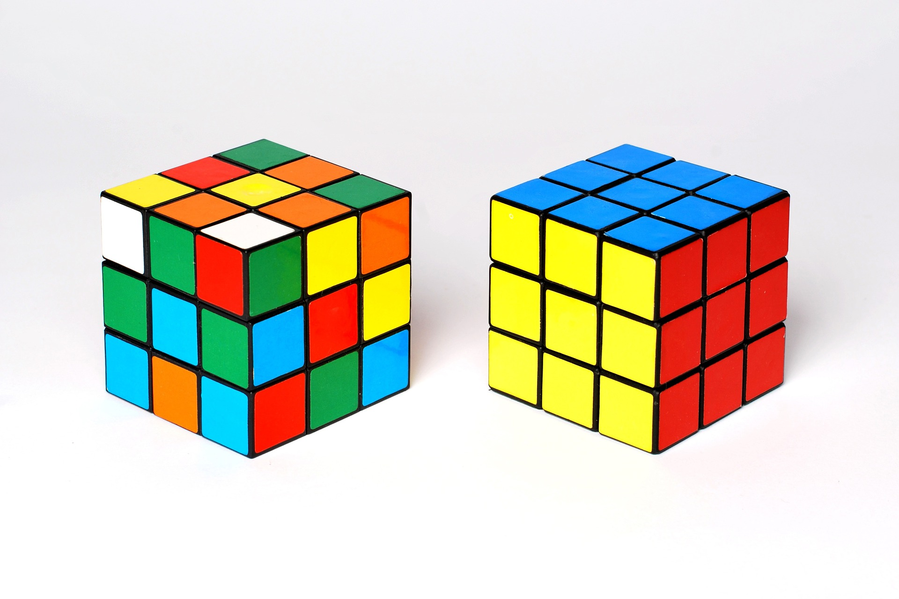
PLANNING FOR DATA MANAGEMENT
The Data Management Plan
So, there’s a lot to think about…

Slide 46
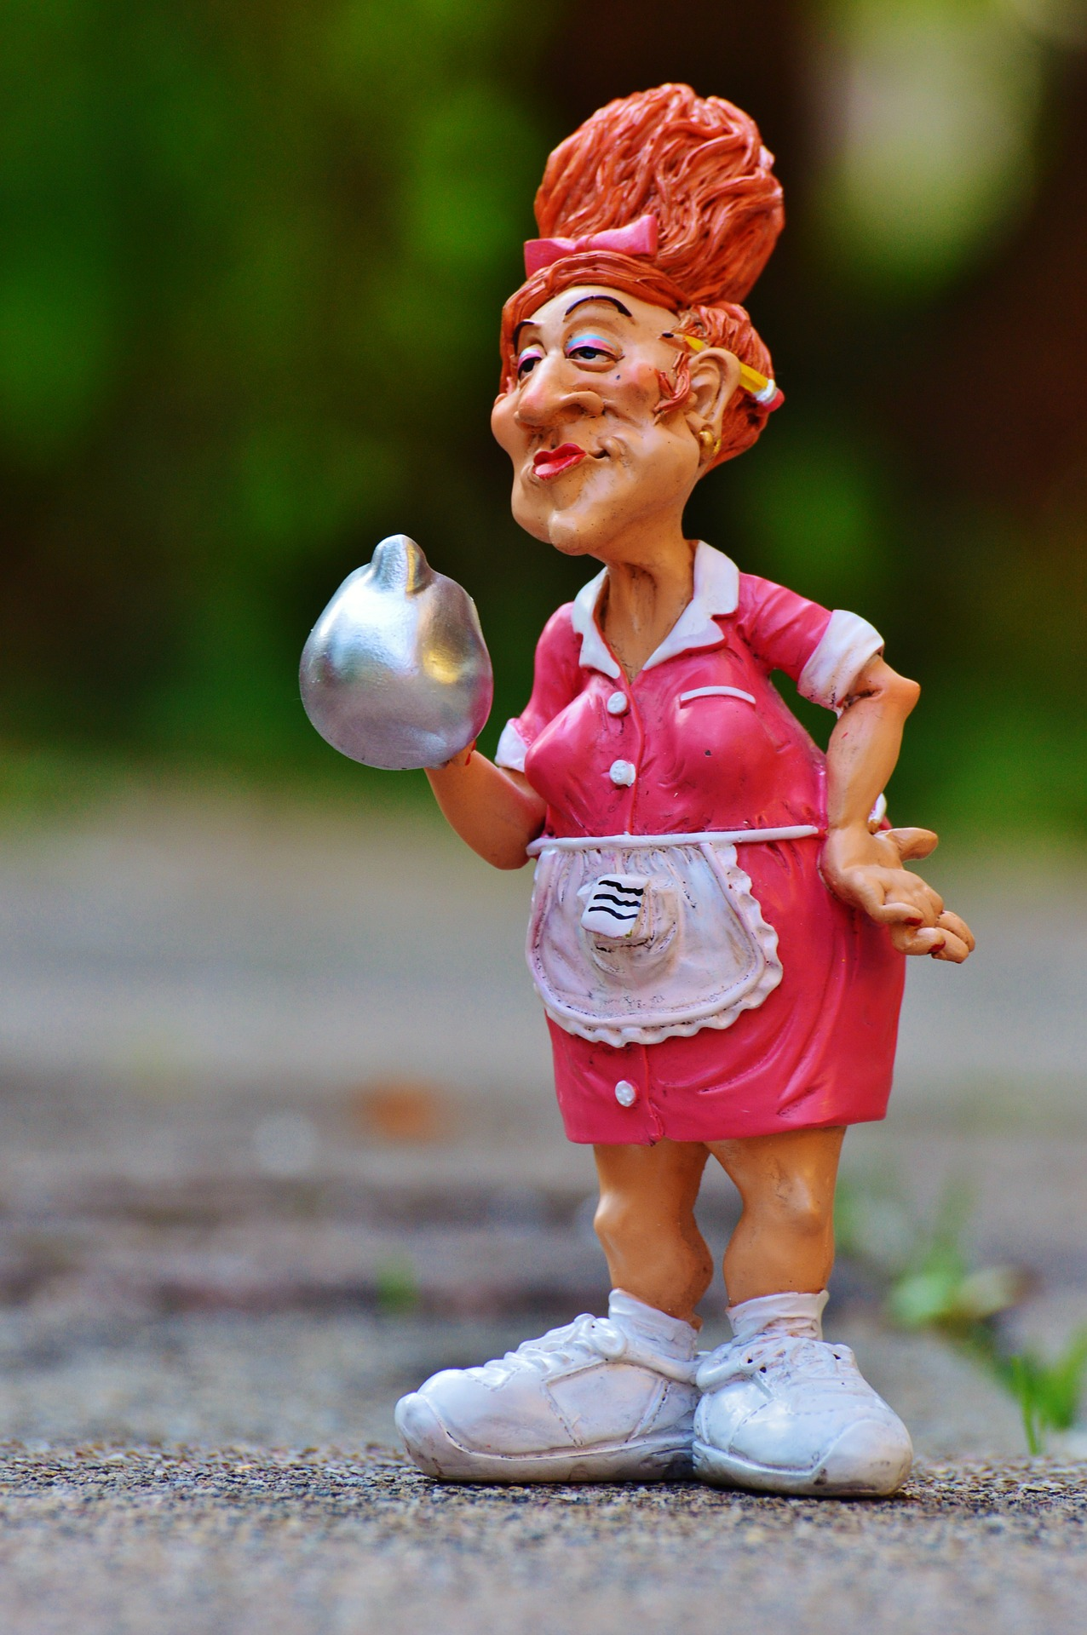
PLANNING FOR DATA MANAGEMENT
How we can help
Data Management Plan checking
Support with setting up new projects
Advice on preparation of data for sharing
Data Repository (ORDO)
Online guidance
Enquiries
Notes:
How we can help

Slide 47
3 TAKE HOME POINTS
Start early to help you work better and protect your precious data
Write a Data Management Plan and use it!
Don’t be shy. Ask for help ☺
Notes:
Our 3 take home points

Slide 48
WRITING SUCCESSFUL DMPs
Links
The OU Library Research Support website: http://www.open.ac.uk/library-research-support/research-data-management
DMP Online: https://dmponline.dcc.ac.uk/
Digital Curation Centre: http://www.dcc.ac.uk/resources/data-management-plans
UK Data Service: https://www.ukdataservice.ac.uk/manage-data/plan/planning
CESSDA ERIC training: https://www.cessda.eu/Research-Infrastructure/Training/Expert-Tour-Guide-on-Data-Management
OU Human Research Ethics Committee: http://www.open.ac.uk/research/ethics/
OU Data Protection: http://intranet6.open.ac.uk/governance/data-protection/advice-and-resources (if clicking on the link doesn’t work, copy and paste the address)
OU Information Security: http://intranet6.open.ac.uk/it/main/information-security (if clicking on the link doesn’t work, copy and paste the address)
Notes:
DCC (Example plans – organised by funder)
UK Data Service – good source of guidance on Data Management, particularly in Social Sciences
CESSDA ERIC – online training course in all aspects of RDM, really good resource

Slide 49
QUESTIONS?

Slide 50
IMAGE CREDITS
Fortune cookie photo by Elena Koycheva on Unsplash
Question mark photo by Towfiqu barbhuiya on Unsplash
Clock photo by Laura Chouette on Unsplash
Yellow pencils photo by Joanna Kosinska on Unsplash

