Slide 1

Evaluation of D-flag students accessibility and use of online tutorials and forums in L2 modules
Sarah Daniell & Lorraine Waters
Notes:
Hello and welcome to our ignite presentation: “Evaluation of D-flag students accessibility and use of online tutorials and forums in L2 modules”. This is an outline of the eSTEeM project that myself and Sarah have recently applied for. I’ll be presenting the first half of the talk before handing over to Sarah who’ll present the second half.

Slide 2
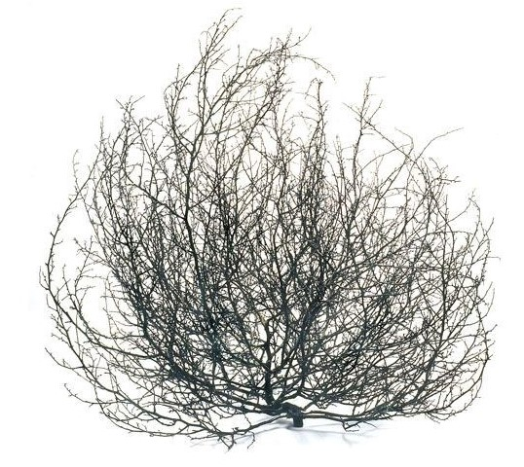
So what are we really interested in?
We can all agree -
Very few students come to level 2 tutorials (mainly tutor group tutorials) unless they have to!
Very few students properly engage in forums.
This is exacerbated for D-flag students
Notes:
Anecdotally it seems that many level 2 students in LHCS don’t attend online synchronous tutorials or engage fully with forums. And it seems that this is even more so for students with D flags. In this study we are aiming to look at data relating to this as well as understanding why this might be the case.

Slide 3

Why do we want students to come along or join in?
Students miss out on valuable tuition
Important to have a cohesive experience
Building up a relationship with their peers
Peer-peer learning beneficial to learning outcomes
Relationship with tutor
Part of a team
Notes:
If students don’t attend tutorials or engage with forums, they will miss valuable tuition as well as peer to peer learning. Additionally, this could impact on the chance to build a relationship with their peers, their tutor, become part of a team and have a far more cohesive experience during their studies.

Slide 4
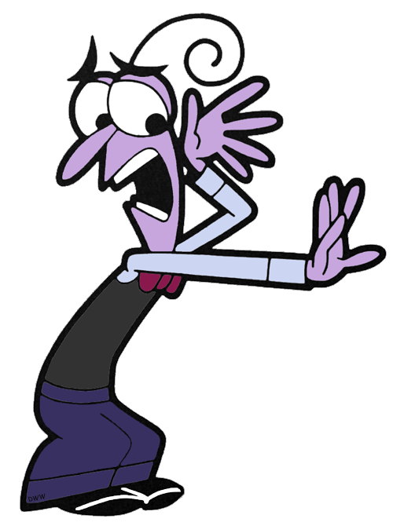
What might put students off?
Habit of non-attendance
Poor motivation
Fear of online environment
Technical issues
Lack of confidence
Don’t enjoy experience or see benefits
Preference for passive learning?
Notes:
So, what might put students off engaging? There are probably many reasons such as fear of the online environment, technical issues, lack of confidence and a sense that the benefits of attending don’t outweigh the issues. Of course, it may also be the type of learning expected; for tutors this tends to be active but students would prefer passive learning.

Slide 5




Where might students be going instead?
Tutorial recordings
FaceBook
WhatsApp groups
Twitter
Other social media forums??
Notes:
Alongside this we’ve also seen an increase in use of social media sites such as WhatsApp and Facebook, which is fine in principle but of course this isn’t moderated by tutors or module teams so there’s no guarantee that the information they receive there is accurate or that they’re sufficiently supported.

Slide 6

Why are we concerned about D-flag students?
Equality of access to online resources
Greater inhibition towards using online resources
Reluctance to feedback issues to tutor
Disenfranchised with online learning
Notes:
But why are we particularly concerned about D-flag students in this case? We need to ensure that there is a realistic equality of access to online resources so that these students aren’t becoming disenfranchised with online learning. There may also be a sense that issues can’t be fed back to their tutors, due to the perceived hierarchical academic barrier.

Slide 7
What effect might this have?
Perceived expectation to interact
Feel distanced from their peers
Impact on retention
May have a substantial impact on learning and module results.
Notes:
If this happens you could end up with a sub-group who feel excluded or isolated. In turn this might impact retention as well as student learning and module results. I’ll now hand you over to Sarah who will be describing how we intend to study this and our expected outcomes.

Slide 8

What would we like to do?
Target students studying S294 and SK299
What are their perceptions of synchronous and asynchronous resources and tuition?
What inhibits participation?
Focus on D-flag students, their perceptions and what we can do to build confidence.
Notes:
So what we’d like to do is target level 2 students, and find out how they feel about what we offer in terms of tutorials and forums.
What inhibits their participation, in particular D-flag students so we can think about practical ways of building confidence and participation.

Slide 9

What is our starting point?
Build on ongoing scholarship projects
Talk to colleagues
Learn from what’s been done before
Notes:
Our starting point is to find out what has already been going on. From what we’ve been reading so far there are ongoing scholarship projects which tie in really well with what we’d like to do, so we’re very keen to talk with colleagues with similar interests and learn from others experience.

Slide 10
Others have investigated
Student/tutor preferences & expectations
Student awareness of learning opportunities
Anxiety related inhibition
Academic and hierarchical barriers
Lots more!
Notes:
As far as we’re aware, others have looked at student and tutor preferences and expectations, Student awareness of learning opportunities, anxiety related inhibition and academic and hierarchical barriers.
We’re very aware that there is a lot of other projects too.

Slide 11

Then we will…..
Utilise historical data for online tutorial attendance and forum use
Compose and send out questionnaires by email to willing SK299 and S294 students
Notes:
First on the list is to look at historical data and try to see if there is any correlation with D-flag students with mental health issues and tutorial attendance and forum use.
We’re then planning to compose and send out questionnaires to our willing students! Fingers crossed we’ll get some responses!

Slide 12

And we will…..
Carry out telephone interviews with D-flag students
Anonymise results, collate and interpret data
Hopefully have some interesting results to discuss!
Notes:
The plan is then to look at some D-flag students who responded initially and carry out telephone interviews to probe a little deeper.
Then we’ll be able to start on the fun bit of collating and interpreting data so hopefully we’ll have some results to share in the future.

Slide 13

What are we hoping to achieve?
An understanding of how we can improve accessibility
A better understanding of what we’re getting right and wrong
Students feeling comfortable attending tutorials and using module based forums.
Notes:
Ultimately what we’d like to do is improve accessibility and gain a better understanding of what we’re getting right and things we could potentially improve on.
We’re very aware that one size doesn’t fit all, but hopefully there is lots of potential for us to understand, learn and improve our practice.

Slide 14
When would be like to do this?
Ideally over the course of the 20J presentation.
Distributing questionnaires January 2021
Interviewing Spring 2021.
Collating and organising our data Summer 2021.
Notes:
Ideally, we’re hoping to work primarily over the course of the 20J presentation. Our feeling is to send out questionnaires in January, when there are fewer distractions, hopefully interviewing February/March time so we can start working on the data over the summer.

Slide 15

Thank you!
Many thanks indeed for taking the time to listen!
Please do share your good ideas and experience with us and feel free to ask any questions!
Notes:
Thanks so much for listening to our whistle-stop tour of our project! We’re really excited to be making a start and would really love to have a chat with anyone who has worked in a similar area. Any questions?

