Slide 1
A qualification world?

Slide 2
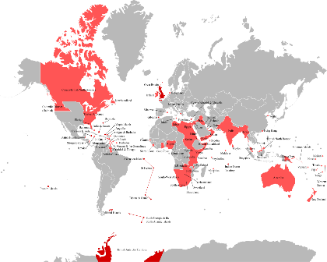
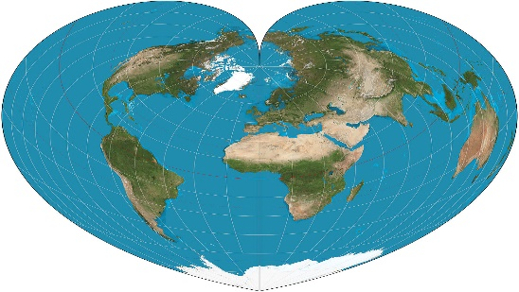
Old world …New world… same building blocks just viewed and displayed differently
Module world… Qual world…..same building blocks just viewed and displayed differently
This Photo by Unknown Author is licensed under CC BY-SA
So maybe we should consider other views of our OU world

Slide 3

It is not unknown for students to vote with their feet and lead the way
So maybe we should talk more with students
This Photo by Unknown Author is licensed under CC BY-SA-NC

Slide 4
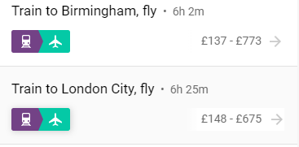
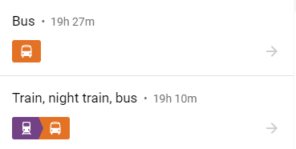
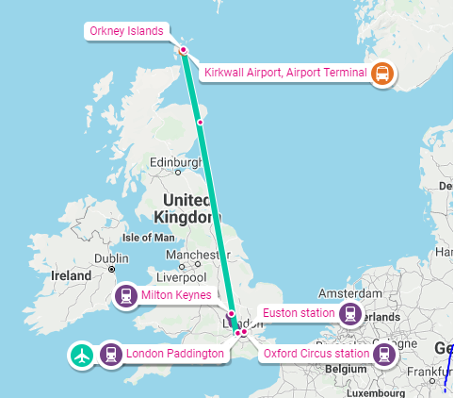
More than ONE way from Milton Keynes to Orkney
So maybe we need to consider more ways for students to undertake their study journeys

Slide 5
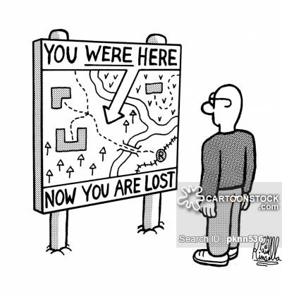
Well I wouldn’t start from here
This Photo by Unknown Author is licensed under CC BY-NC-ND

Slide 6
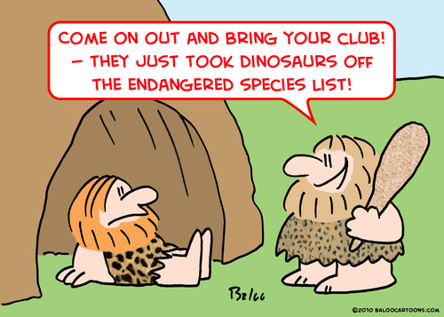
Gap analysis
Where we are
Where we want to be
What are the relative importance to fix the gaps
What is the cost of fixing the gaps
This Photo by Unknown Author is licensed under CC BY

Slide 7


Strand 1- Pressure points identified in qualification world
Strand 2 –Tailoring of materials to reflect qualification world
Strand 3 – tailoring tutorial support to reflect qualification world

Slide 8
Strand 1:Identifying pressure points – ask students and look what they are doing
Students
Saying
Doing
In module questionnaire
Individual interviews
Forums etc
SEAM
Practice quizs- at time and at revision time
Tutorials views and live
Exam questions

Slide 9























































Strand 2: Change the view of the module materials to support not dominate qualification route
M140
R38
Q31
Q36
Q67
Q15
M248
QD
Qual
module

Slide 10
Strand 2: Change the view of the module materials to support not dominate qualification route
M140
R38
Q31
Q36
Q67
Q15
M248
QD
Qual
module

Slide 11
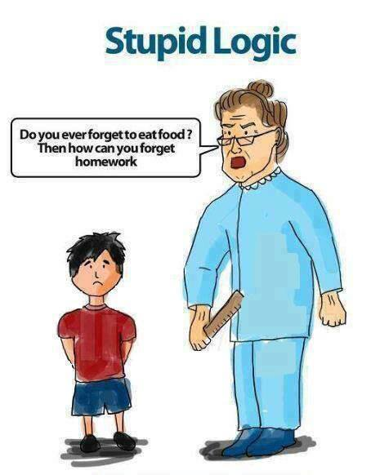
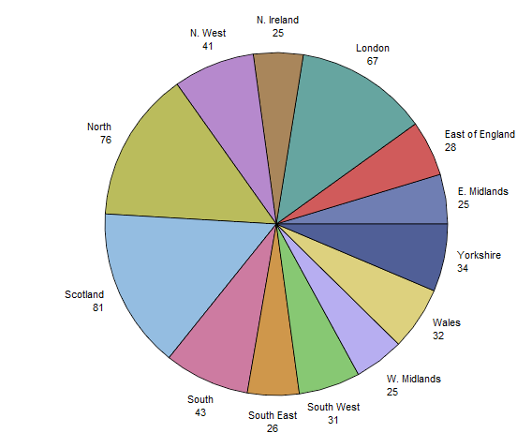
Strand 3: Allocate students by qualification not region
This Photo by Unknown Author is licensed under CC BY-NC-ND
We appoint tutors by regions but regions no longer exist
We allocate students by regions but students don’t attend f-2-f

Slide 12

Strand 3: Allocate students by qualification not region
Why would physical proximity grow a sense of academic group identity/ community of learning when physical meetings do not occur
Why would there be a greater sense of identity if members shared a longer term goal?
This Photo by Unknown Author is licensed under CC BY

Slide 13
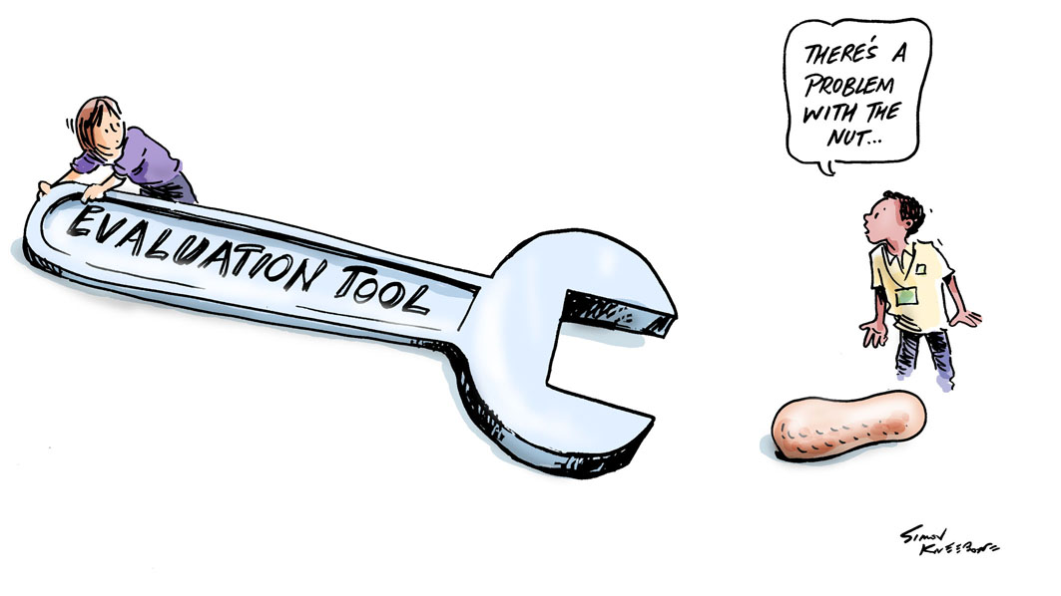
How to evaluate
This Photo by Unknown Author is licensed under CC BY-SA-NC

Slide 14

Student views in module questionnaire
In depth interviews
BUT
here’s that difference between saying doing
Retention
Completion

Slide 15
Thank you
Thoughts/views/questions after all the presentations
Or to
Carol.calvert@open.ac.uk

