Slide 1

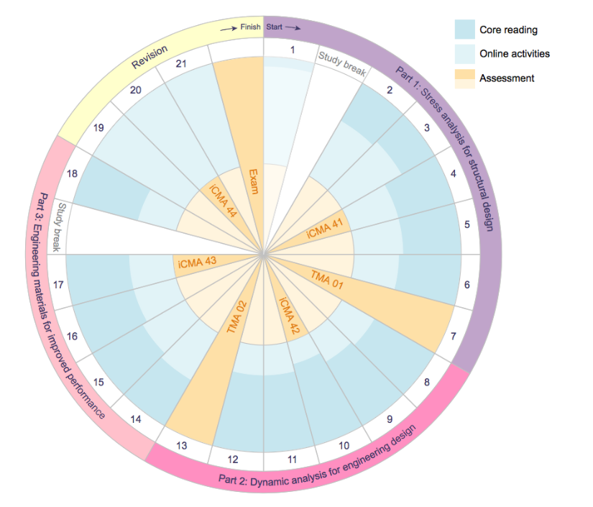
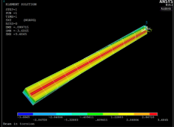
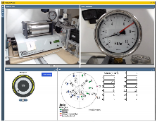
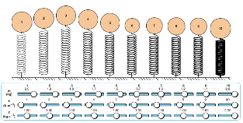

Investigating students perception of some of the key learning activities in T272
Foroogh Hosseinzadeh, Anne-Marie Gallen, Helen Lockett, Rafael Hidalgo
Background:
T272 is the first module in the undergraduate qualification that introduced the industry standard Finite Element Analysis (FEA) Software, ANSYS and an OpenEngineering Laboratory (OEL) experiment in which students run the experiment on their own. In addition, the mathematical content in the module is a pedagogical major step up for students compared to the maths content in earlier modules.
What we are intending to do:
To identify students perception on some of the key activities in T272 and whether students make the connection with the taught theory when doing the activities.
Interview
How will we do it:
Integrate Real Time Student Feedback (RTSF) at specific points during T272 presentation
Interview a group of students who completed the RTSF
Collate the outputs of the RTSF and interviews and analyse the data
What we hope to achieve
Identify students’ perceptions around these key activities that have potential impacts on their learning experience
Recognize why students respond differently to the designed activities and look to improve learning more widely.
Identify whether students make the link between the taught theory and the designed activities.
The outcome of the in-depth analysis of the data will be used to define recommendations for potential changes to the module material and inform future module design.
Key activities
ANSYS
OEL
RTSF
tools to support maths
RTSF

