Slide 1


What are the learning objectives of online laboratories?
Helen Lockett (helen.lockett@open.ac.uk),
Director of the OpenSTEM Labs
Team members: Kay Bromley, Kevin Gowans, Duncan McNicholl, Claire Richardson and James Smith

Slide 2
Overview
eSTEeM project aim and objectives
Purpose of laboratory work in STEM education
Online Laboratory definitions
Brief introduction to the OpenSTEM Labs
Classification scheme for online laboratories and their learning objectives
Project findings
Summary

Slide 3
eSTEeM Project aim and objectives
Aim:
To explore the breadth of activities, skills and educational outcomes developed in OpenSTEM Labs experiments
Objectives:
  Understand how remote and virtual laboratories are classified in the literature
  Develop a classification scheme for OpenSTEM Labs experiments and their learning objectives
  Create a database of OpenSTEM Labs experiments to help us understand the range of experiments available and their learning objectives
  Develop a design tool to aid development of new OpenSTEM Labs experiments

Slide 4
What is the purpose of laboratory work in STEM education?
Gatsby Charitable Foundation defines the purposes of practical science education as:
to teach the principles of scientific inquiry;
to improve understanding of theory through practical experience;
to teach specific practical skills, such as measurement and observation, that may be useful in future study or employment;
to motivate and engage students;
to develop higher level skills and attributes such as communication, teamwork and perseverance
https://www.gatsby.org.uk/uploads/education/reports/pdf/good-practical-science-report.pdf

Slide 5
Online laboratories definitions
Online Laboratory
Virtual Laboratory
Remote Laboratory
“interactive experiments provided over the internet” (Zutin et al., 2010)
“Imitations of real experiments...” (Adapted from Ma and Nickerson 2006)
“real physical laboratories accessed through a network...” (Rivera and Petrie, 2016)

Slide 6
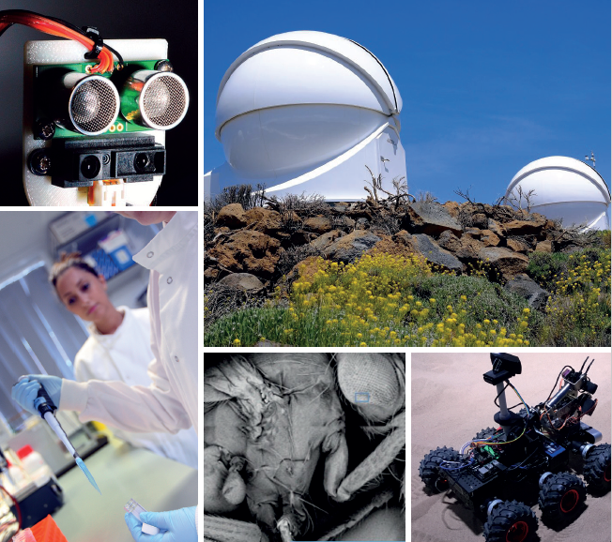
OpenSTEM Labs
The OpenSTEM Labs are the STEM Faculty’s online laboratories and deliver authentic practical experiences to our distance learning students
The OpenSTEM Labs deliver both remote and virtual experiments and have more than 100 experiments with more than 10,000 users/year

Slide 7
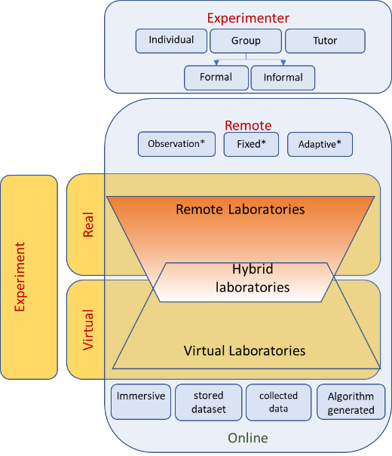
Classification scheme for online laboratory types - 1
Developed from Zutin et al. (2010)

Slide 8
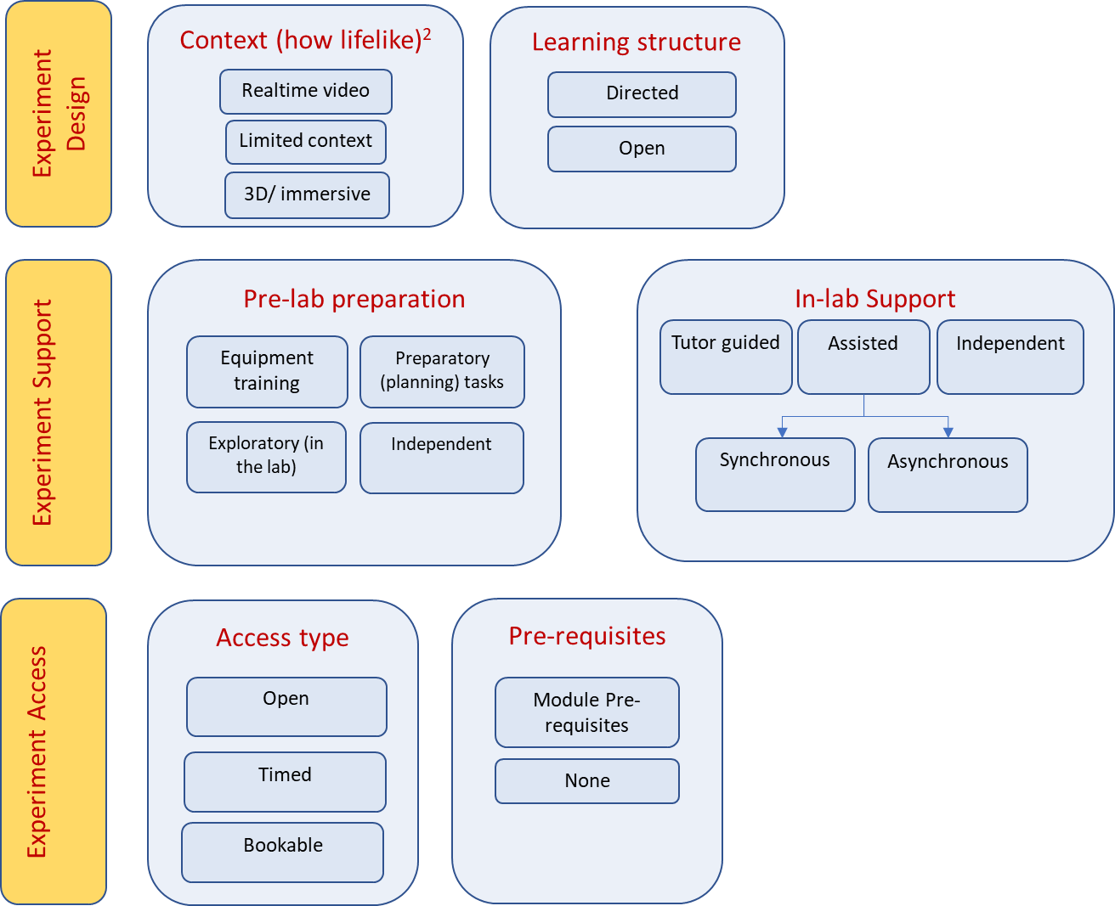
Classification scheme for online laboratory types - 2

Slide 9
Classification scheme for online laboratory learning objectives
Develop subject knowledge and understanding
Apply appropriate instrumentation to make measurements
Use theoretical models to predict behaviour
Devise an experimental approach
Collect data
Analyse and interpret data
Identify unsuccessful outcomes and learn from failure
Demonstrate creativity in problem solving
Demonstrate competence in operating apparatus
Identify and deal with health and safety issues
Communicate effectively about laboratory work
Work effectively in teams
Behave with high ethical standards
Use human senses to gather information
Design, build, or assemble a product
(Developed from Feisel and Rosa (2005) and Brinson (2015)

Slide 10
Classification scheme for online laboratory learning objectives
Develop subject knowledge and understanding
Apply appropriate instrumentation to make measurements
Use theoretical models to predict behaviour
Devise an experimental approach
Collect data
Analyse and interpret data
Identify unsuccessful outcomes and learn from failure
Demonstrate creativity in problem solving
Demonstrate competence in operating apparatus
Identify and deal with health and safety issues
Communicate effectively about laboratory work
Work effectively in teams
Behave with high ethical standards
Use human senses to gather information
Design, build, or assemble a product
(Developed from Feisel and Rosa (2005) and Brinson (2015)

Slide 11
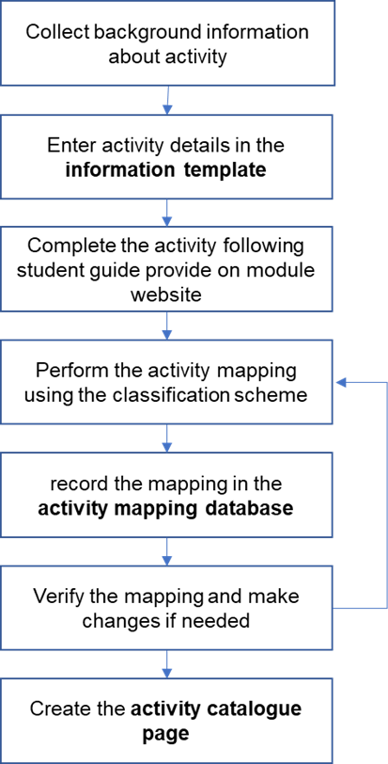
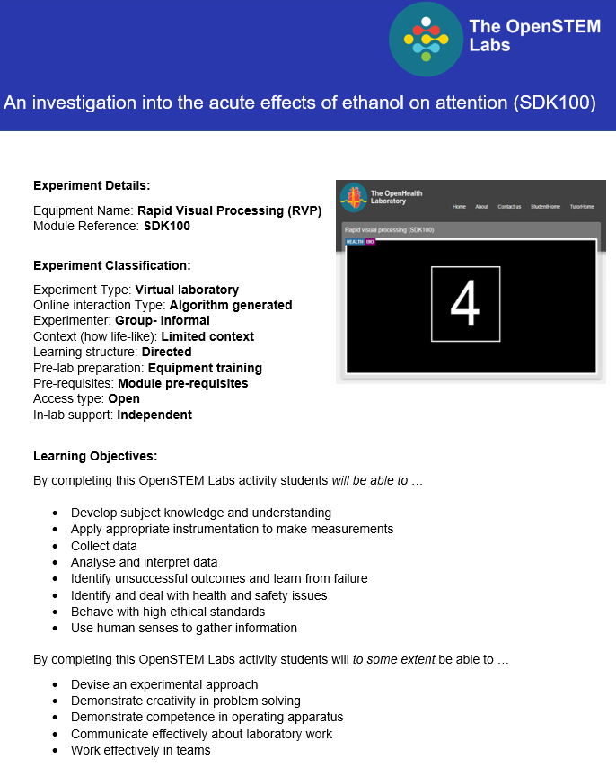
Activity mapping process

Slide 12
OpenSTEM Labs experiments mapped in the project
Twenty three experiments were mapped in the project
All the experiments in three core OpenSTEM Labs modules:
  SDK100 – Science and health: an evidence-based approach
  SXPS288 – Remote experiments in physics and space
  T212 – Electronics: sensing, logic and actuation
Experiments from other biology and engineering modules: SXHL288, SK299, T271, T272, S112

Slide 13
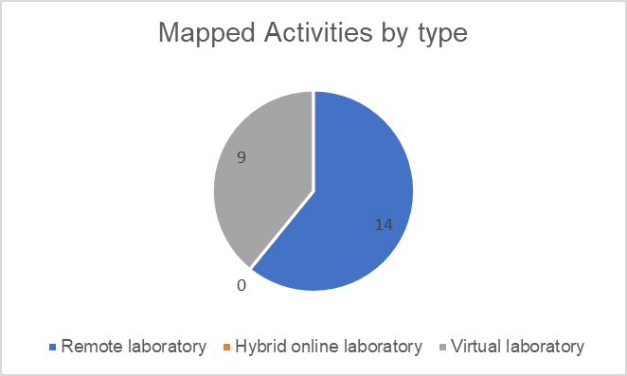
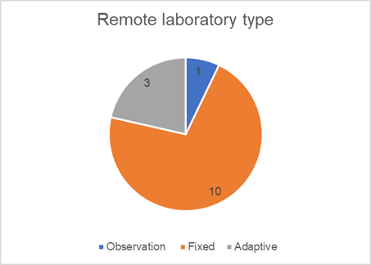
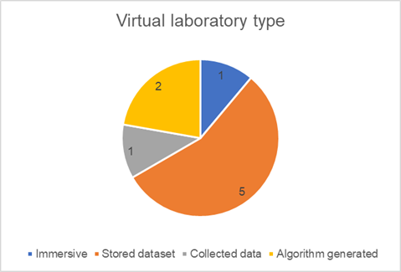
Initial findings – activity types
Discipline | Total number of activities | Number of Remote activities | Number of Virtual activities
Health/ Biology | 7 | 0 | 7
Engineering/ Electronics | 10 | 10 | 0
Earth sciences | 1 | 0 | 1
Astronomy/ Physics | 5 | 4 | 1
Total | 23 | 14 | 9

Slide 14
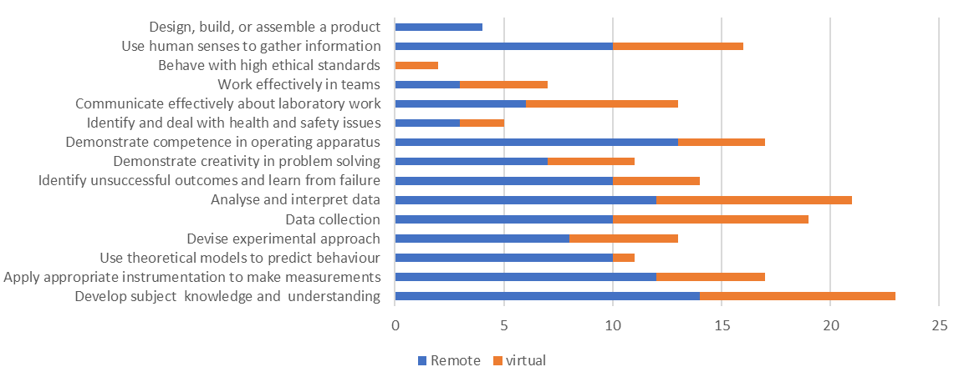
Initial findings – learning objectives

Slide 15
Summary
This project has helped us to understand the bread of learning objectives and interaction types in OpenSTEM Labs experiments
Analysing existing experiments using can help us to identify gaps in learning objectives
The activity catalogue and database will help disseminate information about existing experiments and encourage reuse
The classification schemes can be used as a checklist by module teams designing new online experiments to ensure that a range of learning objectives and interactions are considered
Please get in touch if you would like to know more!

Slide 16
Useful Links
eSTEeM report and associated documents:
https://www.open.ac.uk/scholarship-and-innovation/esteem/projects/themes/technologies-stem-learning/investigation-the-breadth-learning-outcomes-and-skills
THE Article about designing online experiments:
https://www.timeshighereducation.com/campus/when-use-online-laboratories-stem-teaching-and-why

Slide 17
References
Feisel, L. D. and Rosa, A. J. (2005) ‘The Role of the Laboratory in Undergraduate Engineering Education’, Journal of Engineering Education, 94(1), pp. 121–130.
Brinson, J.R. (2015) Learning outcome achievement in non-traditional (virtual and remote) versus traditional (hands-on) laboratories: A review of the empirical research. Computers and Education, (87), pp. 218–237.
Nickerson, J.V., Corter, J.E., Esche, S.K. and Chassapis, C., 2007. A model for evaluating the effectiveness of remote engineering laboratories and simulations in education. Computers & Education, 49(3), pp. 708-725.
Zutin D.G., Auer M.E., Maier C., and Niederstatter M., “Lab2go – A repository to locate educational online laboratories,” in Proc. of IEEE EDUCON 2010 Conference: The Future of Global Learning Engineering Education, Madrid, Spain, 14-16 April 2010, IEEE, pp. 1741-1746.

