Slide 1

Cluster tutorials - what do the students think?
An investigation of level 1 (TM111) students' views and experiences of online tutorials.
Helen Jefferis, Chris Gardner & Frances Chetwynd
Notes:
To provide recommendations to the Faculty and School on:
-the optimum tuition strategy needed to enhance Level 1 student engagement in their studies
-the staff development needed to enhance the digital experience of our students when attending tutorials.

Slide 2
Background
TM111 – Introduction to computing and information technology 1
6 month ‘short fat’ module, 2 presentations per year, 2 TMAs and an emTMA
J presentation 3104 students
D presentation 3288 Students
For many students this is their first experience of the OU

Slide 3
Key points of the project
Our main aim was to find out students’ experiences of tutorials, from booking through to attending
Pilot group of TM111 20D students from 2 regions
Larger study on TM111 20J
Students surveyed at the beginning and again at the end of the module
The survey included free text answers to every question
Of the students that responded in 20J 74% (115) were new to OU study

Slide 4
How do you find out what tutorials are being offered?
The majority of new and continuing students used ‘a list on an OU web page’
From the free text comments a theme of confusion
“Now I know where to find a list I can sign up to them. In my previous course I didn't even know tutorials were a thing.”
There were some suggestions e.g. a new student
“A dedicated email for upcoming relevant tutorials would be a good idea”
Notes:
Mostly going to concentrate on the end of module survey but worth noting that confusion over finding and booking tutorials was a theme found in the free text comments on the start of module survey
Email reminder – we will come back to this

Slide 5
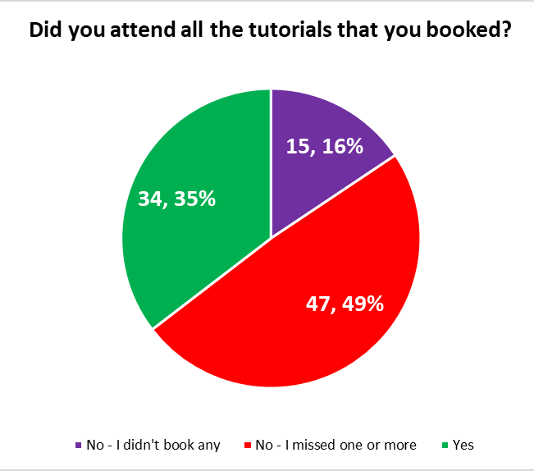
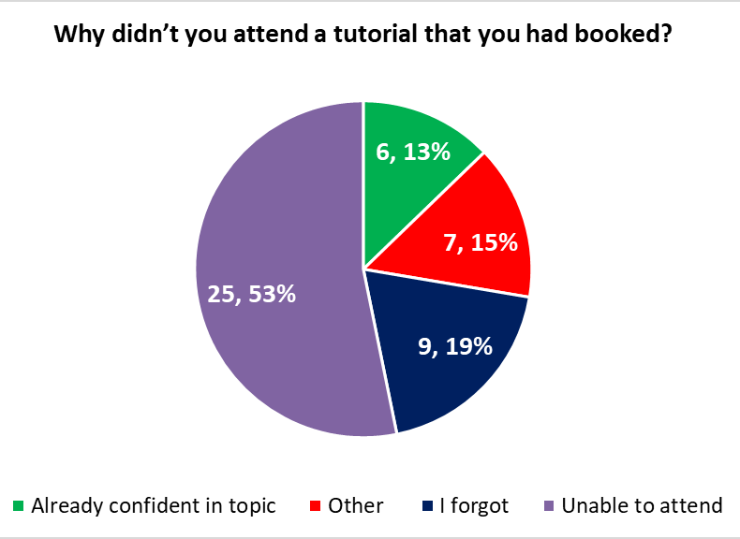
Booking tutorials and not attending
16% (15) didn’t attend any
“Most of the time I was at work when they were taking place.”
49% (47) missed one or more tutorials they had booked
53% unable to attend
19% forgot
15% other, included forgot
13% already confident
Notes:
Reasons for not booking any included
(click) work commitments,
Click – 49% missed one or more
Click – reasons for not attending
Unable to attend - It is however clear that asking students to book a long time ahead does not make much sense as whether they are unable to attend due to something coming up or because they are ‘already confident in the topic’ they could not predict this at the time of booking. This means that for one reason or another nearly 50% of the respondents admitted not attending a tutorial that they had booked.

Slide 6
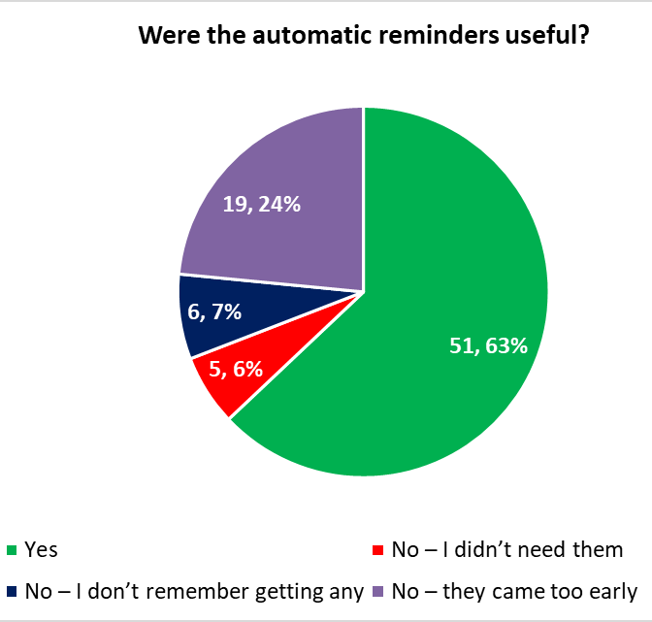
Automatic reminders & attending tutorials
63% (51) said they were useful (however 4 of these forgot to turn up!)
24% (19) thought they came too early
7% (6) didn’t remember getting any reminders
42% (40) students were unaware they could attend tutorials they hadn’t booked; only 11% (11) students did attend tutorials without booking.
Notes:
For the students that do remember to attend the reminders seem to be useful, however 4 people who said they were useful still said that they forgot to turn up to the tutorial, so they don’t seem to have been that useful!
What is in the reminder? Could tutorials be released eg for each block
Add in poll

Slide 7
Question Time
For the following poll please text your single letter response into the chat (we will collate).
Do you encourage the use of reminders:
A – ST/SEM: I ask tutors in my clusters to send reminders
B – ST/SEM: I leave it up to the tutors to decide
C – Tutor: I send reminders to booked and tutor- group students
D – Tutor: I send reminders to booked students
E – Tutor: I send reminders to tutor-group students

Slide 8
Question Time
For the following poll please text your single letter response into the chat (we will collate).
Do you think asking students to book is:
A – useful for the tutor to prepare the tutorial
B – unnecessary bureaucracy
C – useful for students to help them focus on attending
D – a waste of time
E – useful for providing data to the University

Slide 9
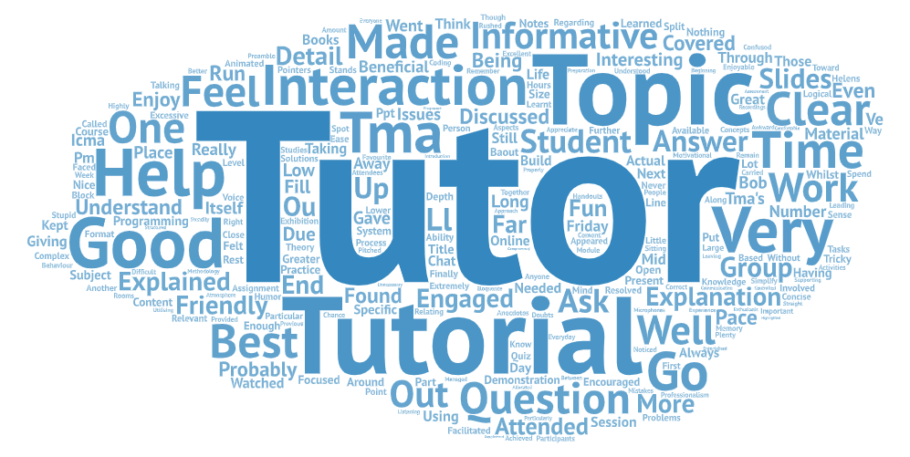
What was the best tutorial and why?
33% (20 students) mentioned a good tutor
Content – 13% (8) appreciated the chance to ask about TMAs, but equally ‘topics’ in general
Ability to ask specific questions (and listen to questions asked by other students)
Group size – linked to interactive tutorials
“Interactivity and lower size of the group.”
“there were a large amount of students on the tutorial, […] It was highly interactive and gave everyone a chance to get involved.“
“.. I think tutorials try to cover too much and end up feeling like a rushed lecture. [..] I would like [..] tutorials that are shorter (half an hour or so) but much more tightly focussed on a particular subject. “
Notes:
Good Tutor - tutor attributes eg humour, professionalism and friendliness (being friendly was mentioned by 5 students). 5 students also mentioned that the tutor provided good explanations.
Interactive - 9 students mentioned that they enjoyed interactive tutorials, although for some this meant larger size and for some smaller
Student comments +interesting idea of shorter tutorials

Slide 10
Did you attend any tutorials that you didn’t think were a good use of your study time?
53% (27 students) said ‘No they were all good’
37% (19 students) did have some complaints e.g.
they didn’t add to the module materials (10%, 5)
“..the tutorials just felt like slide shows of stuff that was already explained in the books..”
the timing was wrong (6%, 3)
“..it was about a section that was not even studied at the time so I felt very lost listening to topics that I hadn't even started”
But also “I think I was much further ahead in the course.”
Technical issues (6%, 3)
Other students – not muting, off topic, irrelevant questions
Notes:
How good are our tutorials (according to the students)

Slide 11
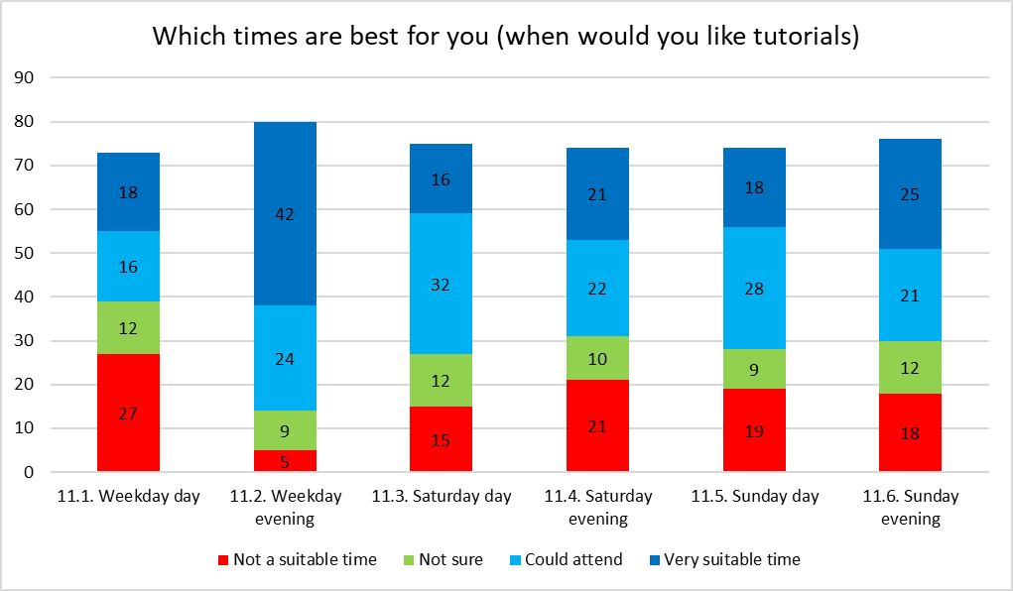
Tutorial timing
Notes:
This hasn’t much changed since the start of module survey, all times are good for some students…
Weekday evenings are the most popular but all times are suitable for someone

Slide 12
Summary / thoughts
Overall students that attend tutorials seem to think they are good so:
How do we explain the benefits of tutorials better?
How do we get them to attend?
Can we advertise them (promote) better?
How do we organise them? (should we offer more and keep them shorter?)
Will this all change when (if?) we reintroduce f2f?
Questions?

