Slide 1

Intro Slide Title 1
A tutor-room of one’s own
Dr Hayley Ryder and Dr Tacey O’Neil

Slide 2
Slide Title 10
Once upon a time, long, long ago, GTP arrives
Module team meeting
Tutors can specialise and just tutor what they want to
All students can go to all sessions
We can have:
  The usual session in the evenings
  Extra day schools at the weekends
  Refresher sessions on previous books
  Essentials sessions for time-poor students
  Extension sessions
  Special interest sessions
  And so on and so on

Slide 3
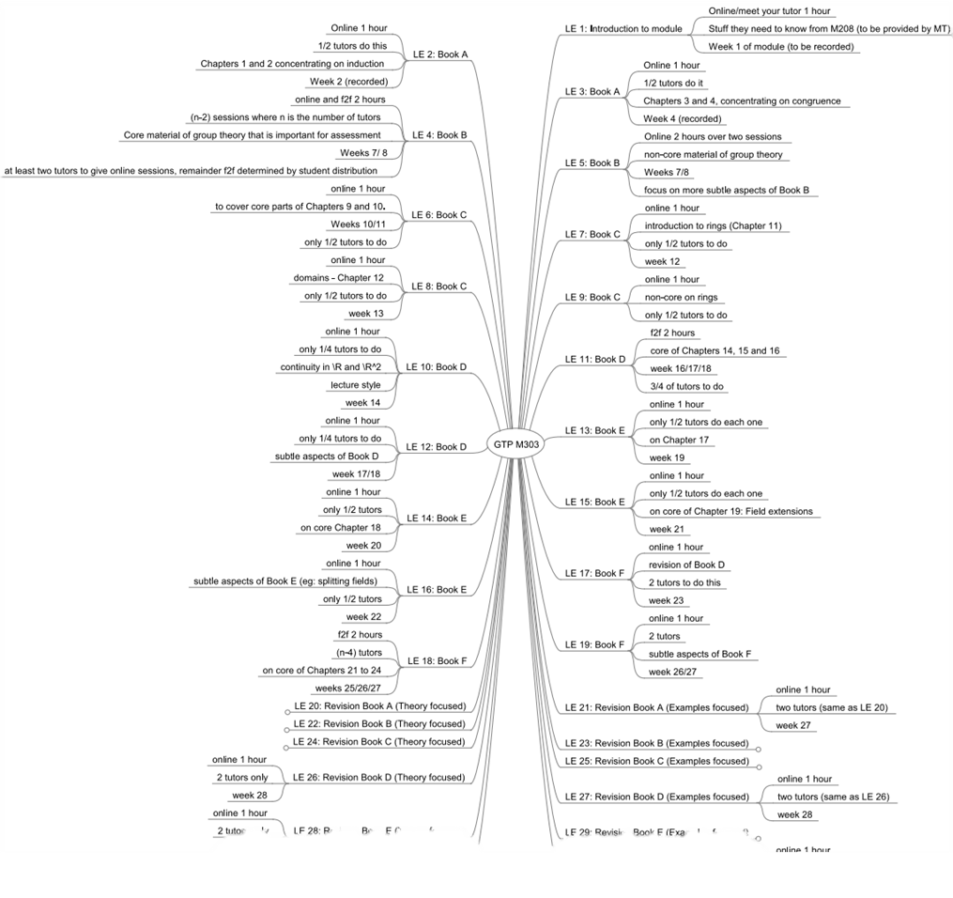
Slide Title 10
GTP arrives
One timetable to rule them all

Slide 4
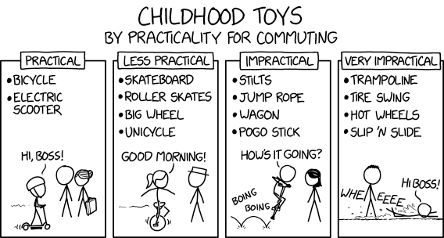
Slide Title 10
Is it practical?
No.
https://xkcd.com/2603/

Slide 5

Slide Title 10
How is it likely to go down with our tutors
https://en.wikipedia.org/wiki/The_Scream

Slide 6

Slide Title 10
This is all happening against a background of GTP
https://www.npr.org/2010/02/09/123500164/dantes-inferno-makes-a-hell-of-a-video-game?t=1548937874156

Slide 7
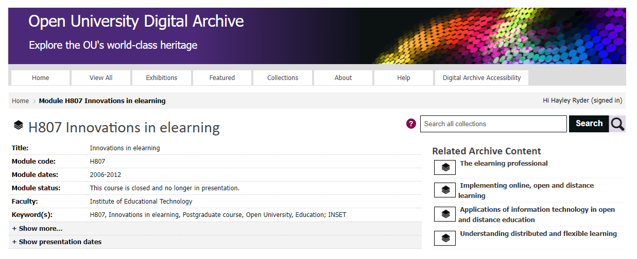
Slide Title 10
Wait a minute…

Slide 8
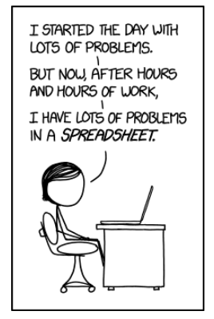
Slide Title 10
Meanwhile – pragmatically - how can we make this work?
https://imgs.xkcd.com/comics/making_progress.png

Slide 9

Slide Title 10
Our plan
Each tutor will have their own personal teaching room for M303
All students can access all rooms
The module team can use the website to direct students to the correct room
We’ll have a special tutorials forum so that the tutorial tutor and students can communicate about the tutorial content
Tutors can post their slides to this forum

Slide 10
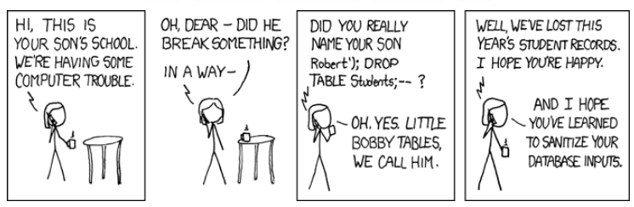
Slide Title 10
What followed was many meetings…
… in which the LEM featured heavily
https://imgs.xkcd.com/comics/exploits_of_a_mom.pn

Slide 11
Slide Title 10
The result was happy tutors and students and a fantastic timetable
https://www.npr.org/2010/02/09/123500164/dantes-inferno-makes-a-hell-of-a-video-game?t=1548937874156

Slide 12
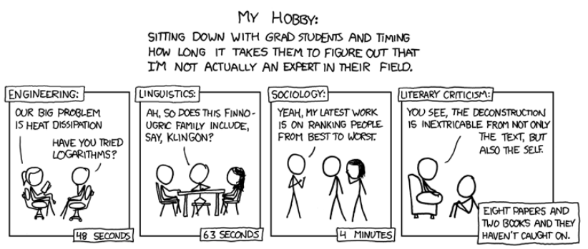
Back to the scholarship project
https://imgs.xkcd.com/comics/impostor.png

Slide 13
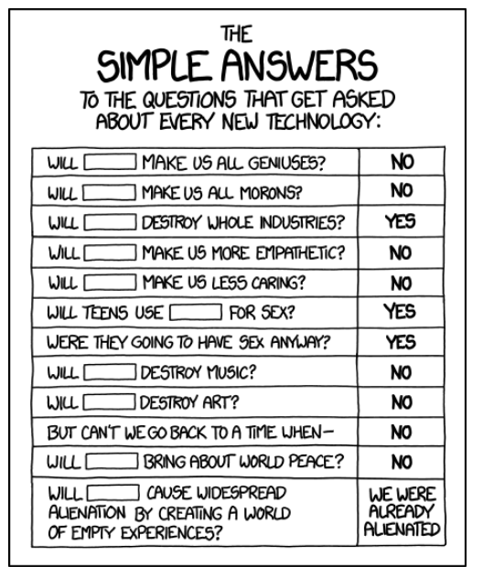
Slide Title 11
What innovations are we talking about?
https://imgs.xkcd.com/comics/simple_answers.png

Slide 14
Slide Title 11
Language
We are considering the following two concepts as the two innovations that we are comparing.
GTP delivered using personal teaching rooms
GTP delivered using shared teaching rooms
GTP-own
GTP-shared

Slide 15
Slide Title 11
Theoretical framework
Rogers’ theory of the diffusion of innovation [R, 2010]
Relative advantage - “is it better?”
Compatibility – “does it fit with existing values?”
Complexity – “can I visualise it working?”
Observability – “can I see it being used?”
Trialability – “can I practise?”
Davis’s Technology acceptance model (TAM) [D, 1989]
Perceived usefulness - “will it make me more effective?”
Ease of use - “will it make life easier?”
Both Rogers’ model and the TAM have been used in educational contexts [G-M, 2019; D, 1999] and the two have been combined in educational contexts [L-H-H, 2011].
Perceived usefulness and relative advantage are often equated concepts [A-N-T, 1992; M-B, 1991] so we have considered them analogous

Slide 16
Slide Title 11
Link with well-being
Prescribed blueprint as to how individuals will be organised to engage with it.
“a set of social and symbolic circumstances in which people…are more or less obliged to carry on their daily affairs” [P, 1988]
New technology or innovation

Slide 17
Intro Slide Title 3
Method and results

Slide 18
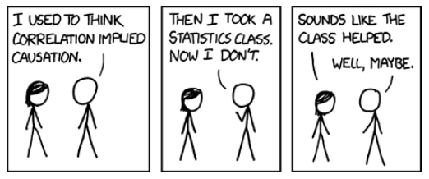
Slide Title 12
Questions
Did tutors have a better or worse experience with the M303 GTP-own tutorial set-up when compared to other modules with a GTP-shared model?
How did attendance by students at tutorials for M303 compare with other equivalent modules?
https://imgs.xkcd.com/comics/correlation.png

Slide 19
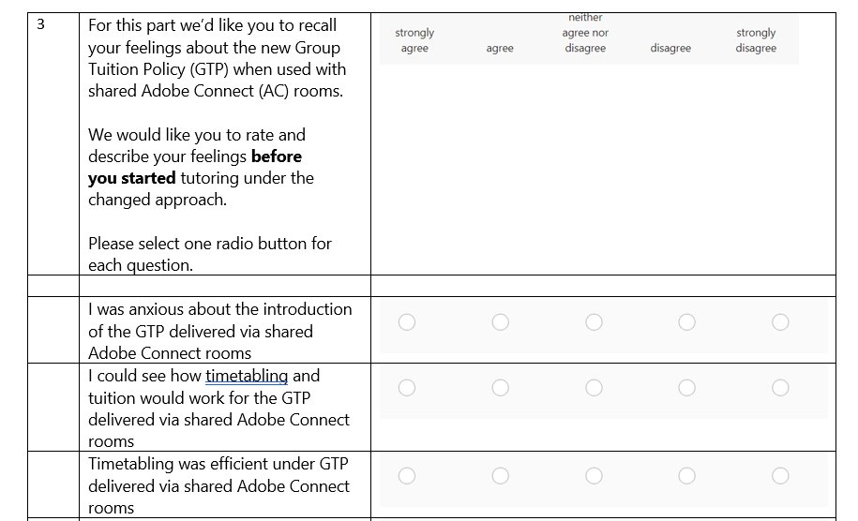
Slide Title 12
What we did
Tracked student attendance at tutorials
Asked tutors to complete a (modified) Technology Acceptance Model Questionnaire in which they could give free text responses to some questions enabling a qualitative analysis in addition to the quantitative TAM questions.
We also had a free text box and did a thematic analysis of the comments
Sample TAM questions

Slide 20
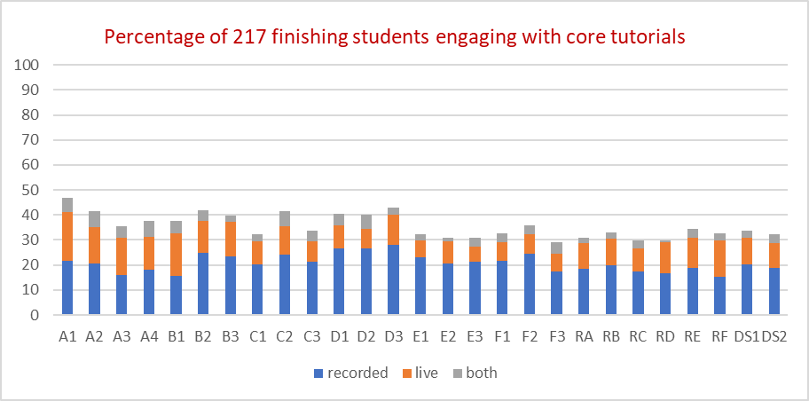
Slide Title 12
Student attendance (in 18J)
On M303, 77% of students opened at least one recording, with an average of 17.2 viewings per student.
On MT365, 54% of students opened at least one recording, with an average of up to 9 viewings per student.
On M248, 37% of students opened at least one recording.
[C-T-R-H-R-P, 2020]

Slide 21

Slide Title 12
TAM questionnaire results
Was it stressful?
GTP-shared
I found delivering tutorials via shared Adobe Connect rooms stressful
GTP-own
I found delivering tutorials via shared Adobe Connect rooms stressful

Slide 22

Slide Title 12
Could tutors experiment?
GTP-shared
I was able to practise anything in advance that I wanted to
GTP-own
I was able to practise anything in advance that I wanted to

Slide 23


Slide Title 12
Was it better for students?
GTP-shared
…made tuition better for students compared to the pre-GTP setup.
GTP-own
…makes tuition better for students compared to how things were before the introduction of GTP

Slide 24

Slide Title 12
Did it make my job more satisfying?
GTP-shared
…made my job more satisfying
GTP-own
…made my job more satisfying

Slide 25
Slide Title 12
Tutor free-text themes
GTP-shared (before implementation)
system-focused
less rich
Tutors talked about the rules, training, and procedures seeming to be primarily driven by the needs of the software system and not by pedagogy, consideration of the student experience or of tutor well-being. They also felt that a less rich tutorial experience was an inevitable outcome.
GTP-shared (after implementation) additional theme
workarounds/avoidance.
GTP-own
richness of tutorials
valuing of tutors
control and flexibility.

Slide 26
Intro Slide Title 3
Analysis and conclusion

Slide 27
Slide Title 11
Relative advantage and Perceived usefulness
In theory GTP in both shared rooms or personal rooms allowed the following:
More types of tutorial
Specialization for tutors if wanted by tutors
In practice the constraints and complexity associated with timetabling meant that this didn’t work as well as planned in shared room set-ups.
“The AC trainers had to keep reminding themselves that we were likely to be using shared rooms, and clearly didn't think it was a good idea.”
“[in shared rooms] I feared that students would end up with a less rich provision of teaching and learning activities.”

Slide 28
Slide Title 11
Relative advantage and Perceived usefulness
Personal teaching rooms eliminated these constraints and significantly reduced the complexity.
“[On M303 I am] working in cooperation with my fellow ALs (and the Module Team) to offer a rich package of sessions for each cohort.”
“[with personal rooms on M303] Attendances are far better than before”

Slide 29
Slide Title 11
“[with shared rooms] I thought that the needs of a system, rather than the needs of pedagogy, were driving the system.”
Compatibility
The desire for a personal space is acknowledged [P-K-D, 2001]
Bruckerhoff [B, 1988], after a 7-month field study of an American high school, described the classroom as a “highly valued territory”, and we hoped that by giving our tutors an online version of this personal space, we would reduce some of the negative feelings associated with the move to the GTP.
“I very much value having my own room.”
“Under the M303 online tutorial setup, I feel part of a team”

Slide 30
Slide Title 11
“I like to set up dynamic interactive tutorial activities, using draw tools on an uploaded PowerPoint, and polls, in advance of the tutorial. I was concerned that this would be difficult, with several tutors trying to access the room, and that other tutors might inadvertently delete or change my materials.”
Complexity
Visualizing GTP working well in shared rooms seemed hard.
GTP with personal rooms mapped on to the familiar secondary school set-up.
“[With my own room] “I need not worry about messing up someone else's stuff.”
“[On M303] the students seem happy, and they don't seem to have any trouble finding the right room.”

Slide 31
Slide Title 11
Observability
Once the M303 tutorials’ programme started, each tutor could see both that students were using the recordings and the positive posts from students in the tutorials forum
Trialability
Tutors could practice using set-ups in the room that they would be teaching in, without risk of being disturbed by another tutor.
“[Using a visible room, I could] plan how the tutorial would go, without getting mixed up with other tutors' stuff. I was able to prepare better material, and I felt confident and not stressed. Sharing was the opposite.”

Slide 32
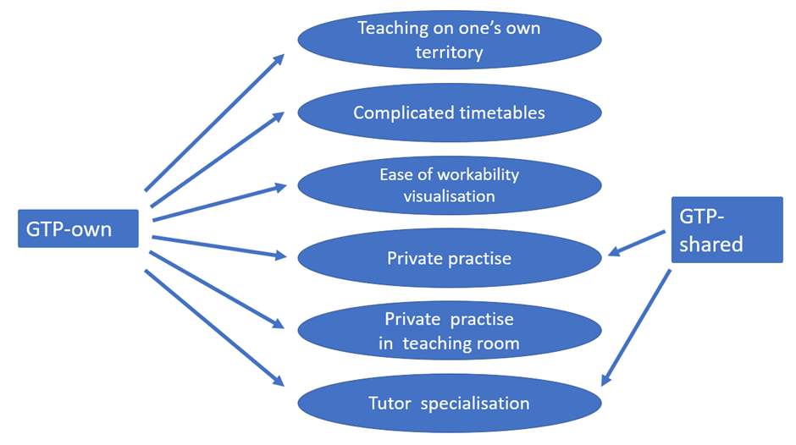
Slide Title 11
Affordances of GTP-own and GTP-shared

Slide 33
Slide Title 11
Conclusion
GTP can work well, from both the tutors’ viewpoints and the students’ viewpoints, if tutors are given their own personal teaching rooms.
More information on personal teaching (visible) rooms
Full eSTEeM report
https://www.scholarship-exchange.open.ac.uk/articles/report/Does_the_provision_of_an_own_working_space_for_tutors_enhance_the_learning_experience_for_students_when_implementing_an_extensive_module_level_tutorial_timetable_eSTEeM_Final_Report/25957915
Visible rooms good practice and implementation
https://openuniv.sharepoint.com/:w:/r/sites/units/lds/scholarship-exchange/_layouts/15/Doc.aspx?sourcedoc=%7B9E84DF42-CCFF-45F9-9E3E-63A2F33255BC%7D&file=Visible%20rooms%20good%20practice%20and%20implementation.docx&action=default&mobileredirect=true&DefaultItemOpen=1
Visible Rooms in Adobe Connect: Report of a Trial on MS327 and M303 https://openuniv.sharepoint.com/sites/units/lds/scholarship-exchange/documents/Forms/Metadata.aspx?id=%2Fsites%2Funits%2Flds%2Fscholarship%2Dexchange%2Fdocuments%2FVisibleRoomsFinalReport%2Epdf&parent=%2Fsites%2Funits%2Flds%2Fscholarship%2Dexchange%2Fdocuments

Slide 34
Slide Title 11
References
[A-N-T, 1992] Adams, D.A., Nelson, R.R. and Todd, P.A., 1992. Perceived usefulness, ease of use, and usage of information technology: A replication. MIS quarterly, pp.227-247.
[B, 1988] Bruckerhoff, C.E., 1988. Defense of Territory: A Report of High School Teachers at Work.
[C-T-R-H-R-P, 2020] Calvert C, Thomas C, Ryder H, Holmes H, Rogers K, Pawley S,. Increasing online tutorial attendance and the number of viewings of tutorial recordings
[D, 1989] Davis, F.D., 1989. Perceived usefulness, perceived ease of use, and user acceptance of information technology. MIS quarterly, pp.319-340.
[D, 1999] Dooley, K.E., 1999. Towards a holistic model for the diffusion of educational technologies: An integrative review of educational innovation studies. Journal of Educational Technology & Society, 2(4), pp.35-45.
[G-M, 2019] Granić, A. and Marangunić, N., 2019. Technology acceptance model in educational context: A systematic literature review. British Journal of Educational Technology, 50(5), pp.2572-2593.
[L-H-H, 2011] Lee, Y.-H., Hsieh, Y.-C. and Hsu, C.-N. (2011) ‘Adding Innovation Diffusion Theory to the Technology Acceptance Model: Supporting Employees’ Intentions to use E-Learning Systems’, Educational technology & society, 14(4), pp. 124–137.
[M-B, 1991] Moore, G.C. and Benbasat, I., 1991. Development of an instrument to measure the perceptions of adopting an information technology innovation. Information systems research, 2(3), pp.192-222.
[R, 2010] Rogers, E.M., 2010. Diffusion of innovations. Simon and Schuster.

Slide 35
Slide Title 30
Thank you

Slide 36
Slide Title 31

