Slide 1

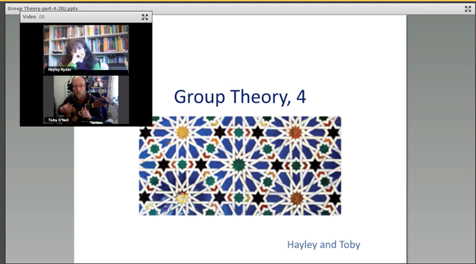

Evaluating student wellbeing after informal online sessions and computer-generated examples in a level 3 pure maths module.
Hayley Ryder, Toby O’Neil
Context
We currently record over 20 hours of informal sessions for each presentation of a 60 credit level 3 module. These are very popular with students but resource intensive to produce and not particularly accessible.
Our plans
Use in-module questionnaires and semi-structured interviews to understand what the students are getting out of the sessions.
To elicit the key features that make the sessions work.
To design several possible templates and trial these.
To add a worked example and self-test feature to the sessions.
Our hope
Learn how to produce similar, more accessible, online sessions that are still useful, feel current and personal but that are less intensive to produce.
Our goals
To understand what can be reused and what needs redoing each year.
To understand how the sessions add value and what value they are adding.
Investigate possibilities for automatic closed-captioning of online sessions and generally increase accessibility.

