Slide 1
Impact of introducing new practical and dataset project options to the science undergraduate capstone project module (S390)
Hannah Gauci
Julie Robson, Janette Wallace, Jon Golding
Lorraine Waters, Jenny Duckworth, Vicky Taylor, Miranda Dyson, Vikki Haley, Clare Lawson.

Slide 2
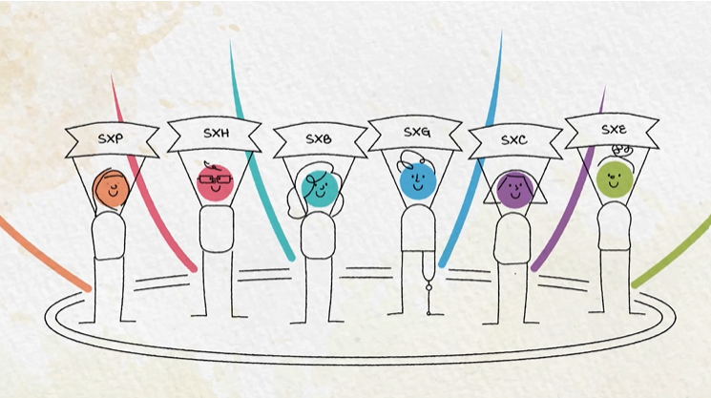
Background
S390 Science project module
Umbrella module with 6 science discipline specific strands
Historically, up to 2021, literature review + primary research (SXE390)
Module due a re-write for 2023, but:
2020
Biology RSB accreditation
COVID-19 pandemic impact on field work
Data analysis projects
Secondary datasets

Slide 3
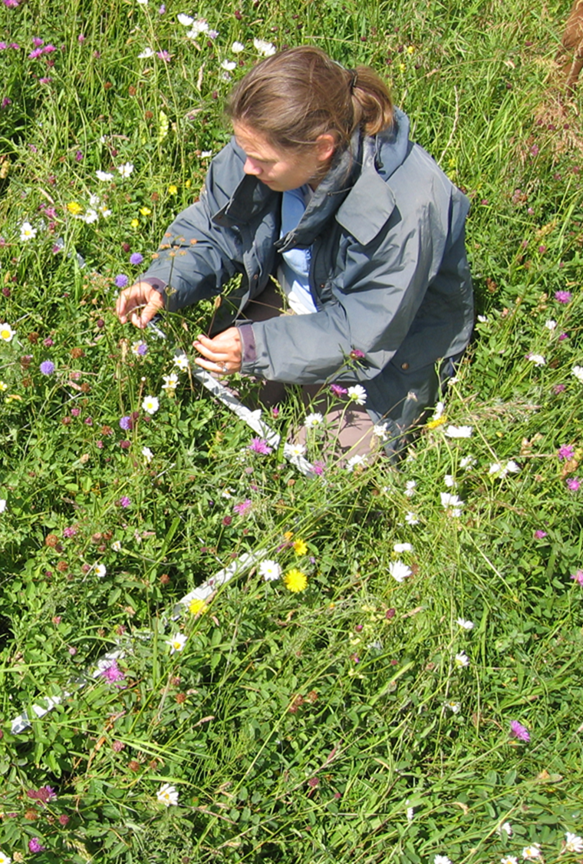

Background
Early revisions for SXE390 (Environmental Sciences) and SXL390 (Biology and Health Sciences) in 21B:
SXE390 additional secondary data project options
SXL390 split into two routes:
  Biology (B) with new practical project options and secondary data options
  Health Sciences (H) literature review projects

Slide 4
Project types 21B and 22B
 | SXE390 | SXL390 (B) | SXL390 (H)
Literature review | X | X | ✓
Field-based | ✓ | ✓ | X
(secondary) Data-based | ✓ | ✓ | X
Home Experiment | ✓ | ✓ | X
Lab-based | ✓ | ✓ | X
Note:
Two sub types:
Mentored data-sets (secondary data) SXL390 (B)
Field & data combined (field) SXE390 and SXL390(B)

Slide 5
Project Aim
Opportunity to:
evaluate impact of changes and gather information to inform module re-write.
Consider any impact on accessibility, particularly for disabled students.
Contribute to sector discussions on diversification of project types.
Aim:
Evaluate the impact of introducing new practical and data options to SXE390 and SXL390 on student achievement and experience, and on the AL role.

Slide 6


Methods: data collection
Student project types
Module results
Student demographics
n=918 (21B, 22B, SXL390, SXE390 combined)
Student questionnaire end of 21B and 22B combined n=117 (16% response rate)
AL questionnaire end of 21B (n=23)
Student focus groups end of 21B (n=7) and 22B (n=6)
AL Focus group end of 21B (n=6)
Data collated in MS EXCEL, JISC survey tools used to summarise questionnaire data, StatsCloud PRO used for statistical analysis.

Slide 7
Student demographics
 | Whole cohort (n 918) | Survey respondents (n 117)
Strand | SXE390 34%, SXL390 66% | SXE390 30%, SXL390 70%
Sex | Female 68%, Male 32% | Female 77%, Male 23%
Declared disability | 26% | 15%
Working full time | 45% | 46%
Ethnicity | Asian 6%, Black 3%, Mixed 2%, White 87%, Other/unknown 2%. | Asian 4%, Black 2%, Mixed 2%, White 86%, Other/unknown 7%.

Slide 8
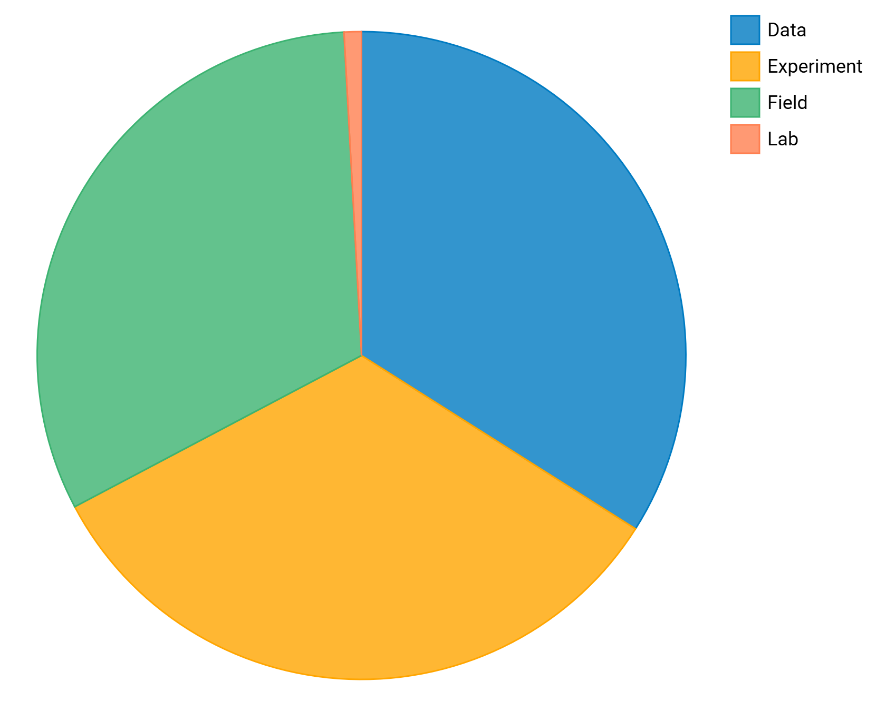
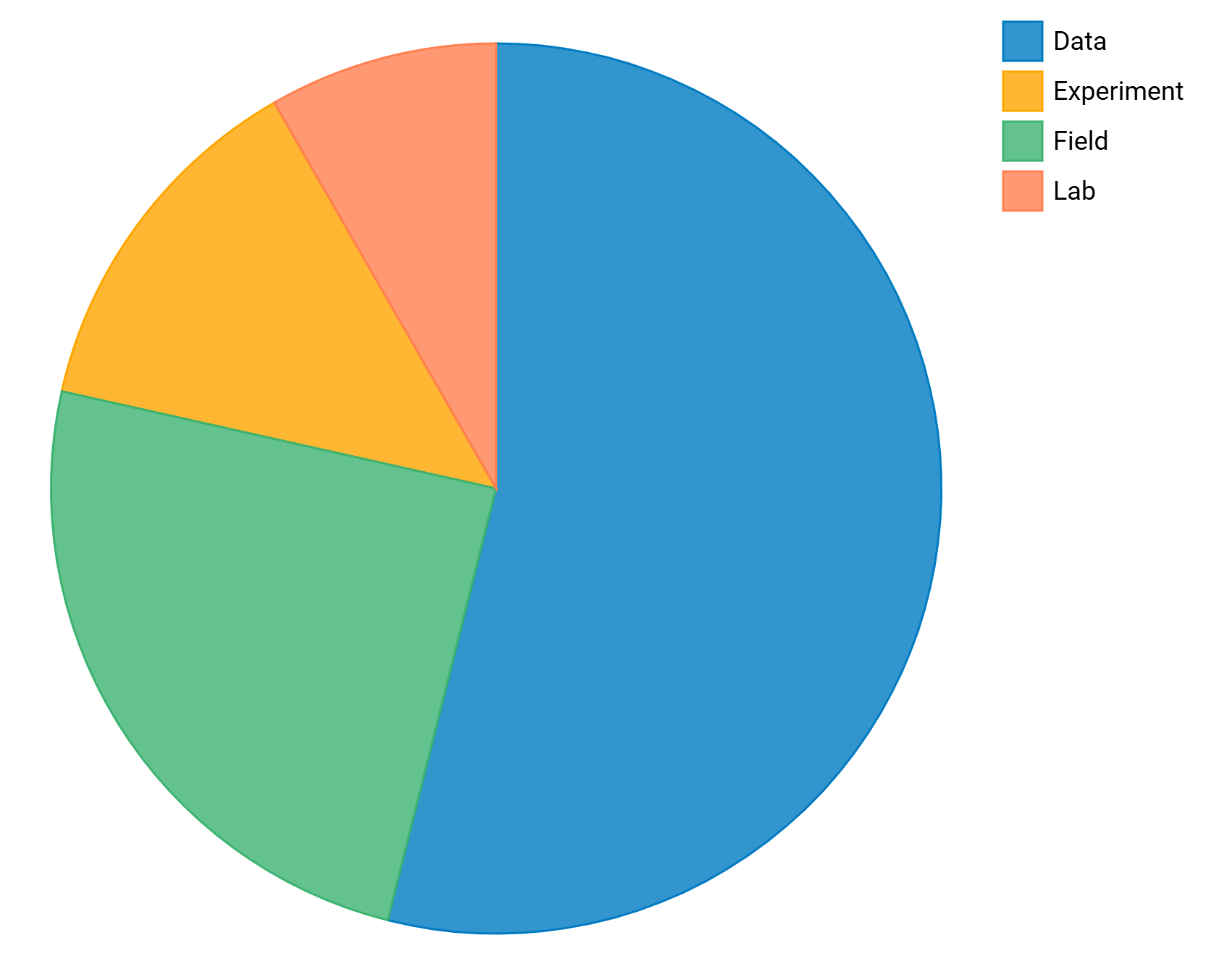
Results: Choice of project type on each strand (21B +22B combined)
SXE390
SXL390(B)
SXL390 (H) all completed literature reviews

Slide 9
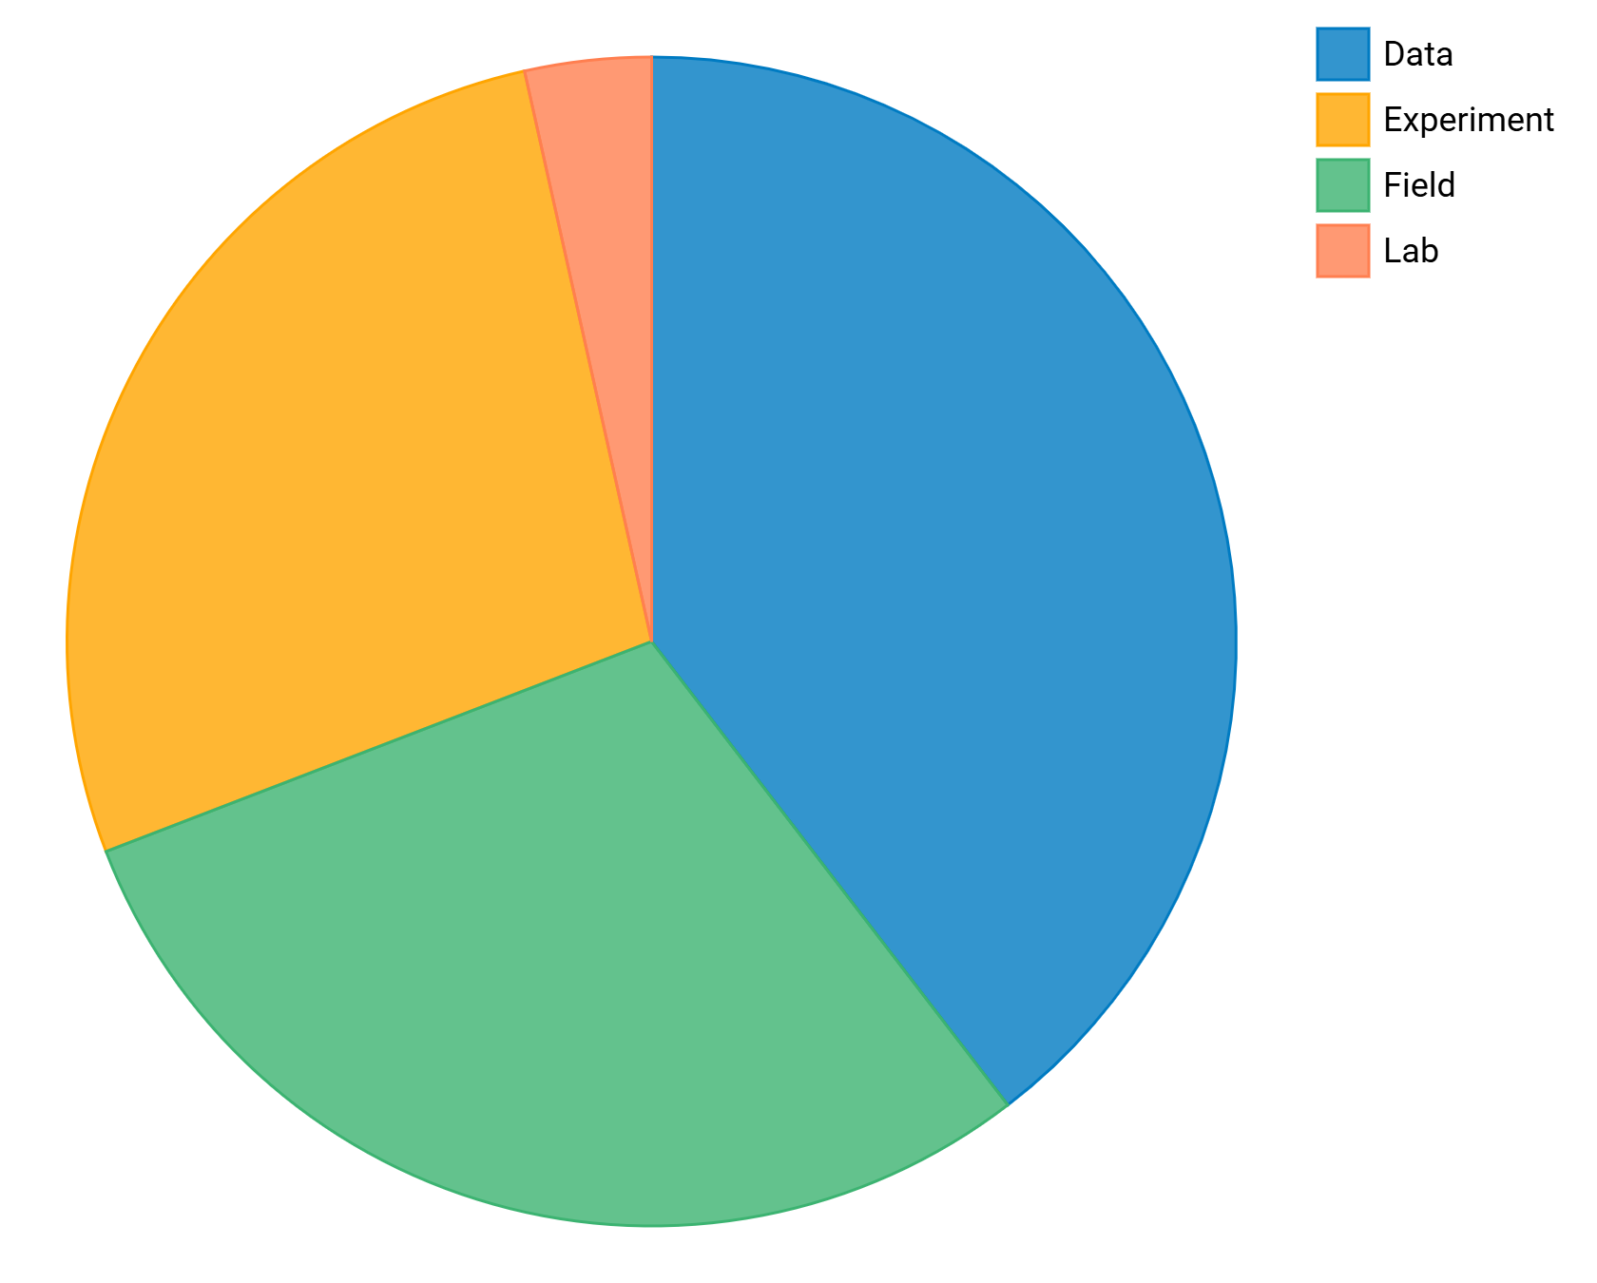
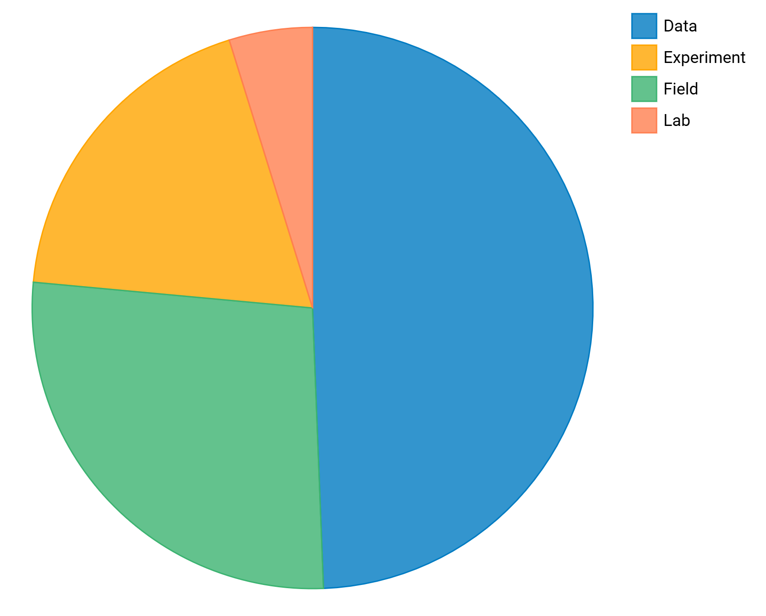
Results: choice of project type
No declared disability
Declared disability
Disabled students more likely to choose a data-based project?
No significant association between project type and disability status Χ² = 6.54, p =0.163.
No associations between project type and ethnicity or sex, or employability status.
Data combined across 21B and 22B, and both SXE390 and SXL390 (B)

Slide 10
Results: student survey respondent project types.

Slide 11
Results: Factors influencing choice of project type/topic
Pandemic effects?
7
8
2
5
4
6
3
1

Slide 12
Results: student completion and pass rates.
Similar overall module completion and pass rates in 21B and 22B as in previous years.
No evidence that increasing project options improved pass rate for disabled students.
No significant association between project type and module result (1-6)
Χ² = 13.82, p = 0.839.
No significant association between project type and module result (1-6) for disabled students Χ² = 8.83, p = 0.985.
Overall, students did equally well regardless of project type

Slide 13
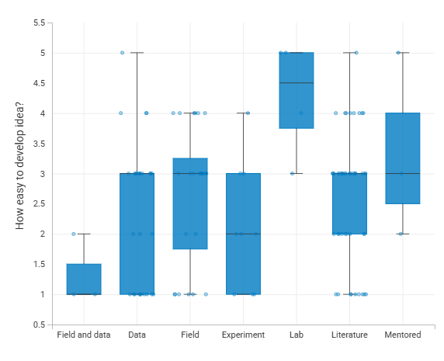
Results: student experience developing an idea
Forming an idea relatively difficult for most students.
Kruskal-Wallis test indicated a significant difference between project types H=13.87 p=0.031.
Dunns post hoc indicated lab easier than all other project types except mentored.
Difficulties with developing idea echoed in focus groups.
ALs indicated preparedness most important factor.
Likert scale 1 = very difficult, 5 = very easy

Slide 14
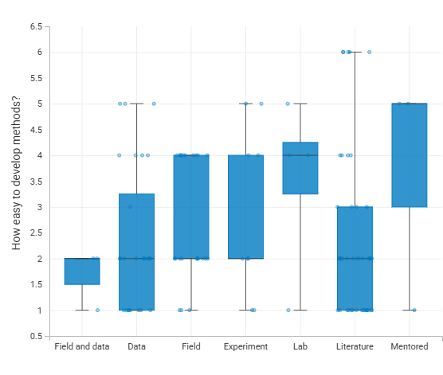
Results: student experience developing methodology
No significant difference between project types in ease of developing project methodology H=6.38, p=0.382.

Slide 15
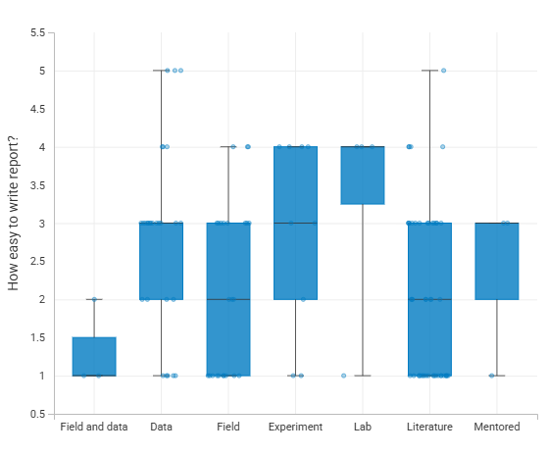
Results: student experience writing the project report
There was a significant difference in the ease of writing the report between project types H = 13.23, p =0.039
Dunns post hoc p <0.05
Field/data (1) and data (3)
Field/data (1) and experiment (3)
Field/data (1) and lab (4)
Data (3) and literature (2)

Slide 16
Results: student workload
No significant association between project type and the average number of hours students spent on their project work
Χ² = 14.04, p = 0.994
But students and ALs commented on the heavy workload at the start of the module and students completing practical and data-based projects had the addition of ethical and risk assessments (not required for literature-based projects).

Slide 17

AL experience
Generally liked the variety of project types.
On SXL390 change to practical projects needed module team support and development time.
Found secondary data-based project more challenging to support than primary research projects.
Amount of support students required tended to relate to strength of student rather than type of project.
Many students struggled to get started.
ALs felt that pandemic had more impact on their
workload than project type.

Slide 18
Summary
No impact of project type on student outcomes.
Some impact on student experience but a lot of variation.
ALs coped well with the change but support and development important.
Students have a range reasons for their project choice and need support in choosing the best option.
Trend for disabled students to choose data-based projects. Suggests introducing new options might improve accessibility.
Consistency across the module possible even when project options differ.

Slide 19
Recommendations
For S390 module re-write:
Improve support at module start to help students form their ideas (animation).✓
Provide specific skills resources for different project types. ✓
Update and improve data analysis resources. ✓
Review tuition strategy to ensure consistency of support work on this more for mid-life review
Provide ALs with development especially around data analysis ✓
Faculty/sector-wide recommendations
When diversifying project types explore accessible project options.
Tailor resources and support for different project types.

Slide 20


Acknowledgements
Barbara Jones
Jonathan Evans

