Slide 1

Associate lecturer induction: requirements, challenges and recommendations
Hannah Gauci & Janette Wallace
Hannah.Gauci@open.ac.uk Janette.Wallace@open.ac.uk

Slide 2
Background
After closure of regional centres induction became ad hoc and variable
Generic (AL Essentials & tutoring on-line course) and support from mentor & staff tutor.
Literature indicates benefits of a multifaceted approach to lecturer induction (e.g. Barlow & Antoniou 2007).
Series of eSTEeM projects:
  Phase 1: 2017 new module SK299 Human Biology module-based induction
  Phase 2: 2018 LHCS school-based induction
  Phase 3: 2019 STEM faculty-based induction
Notes:
After closure of regional centres induction became ad hoc and variable
Als could access a generic induction comprising (AL Essentials & tutoring on-line course) and support from mentor & staff tutor.
Some Als reported feeling unprepared.
In terms of the Literature a multifaceted induction tends to be recommended that includes orientation to the university, faculty and teaching.
We became interested in AL induction when we became line managers of brand new ALs on a brand new module SK299 Human Biology and wanted to address the gap in provision of induction for these ALs.
We developed a module-based induction programme for those tutors comprising of a series of online workshops, and a forum in addition to the generic induction resources. Evaluated this, and the following year repeated a similar induction programme for all new Als in the school with, the results from the 2017 study feeding in to this one. Finally, we shared the good practice from the first two phases to develop a STEM based induction programme, which we again evaluated and it is the results from that phase of the study that we are presenting today.

Slide 3

Results from phases 1 and 2 indicated:
A critical mass of ALs required to enable:
  effective delivery of interactive workshops
  development of supportive community for new ALs
ALs value the opportunity to meet up face to face
Induction events need to take place in the first few months
New ALs in LHCS have varied previous experience
New ALs in LHCS least confident about moderating forums, supporting (disabled) students online, and delivering online tutorials
New ALs are overwhelmed with information
Notes:
A critical mass of ALs required to enable:
effective delivery of interactive workshops
development of supportive community for new ALs
ALs value the opportunity to meet up face to face
Induction events need to take place in the first few months (ALs don’t attend events later in the year if spread out over a longer period)
New ALs in LHCS have varied previous experience
New ALs in LHCS least confident about moderating forums, supporting (disabled) students online, and delivering online tutorials
New ALs are overwhelmed with information and volume of induction materials they are expected to engage with.

Slide 4

Development of a faculty-based induction
Faculty-based induction allows for critical mass of new ALs
STEM faculty-based induction developed by working group.
Supported by website: forum, online room, calendar of events, links to generic induction.
All 46 ALs new to the STEM faculty in 2019 invited
Notes:
Unless you are recruiting toa new module, the number of new ALs at a school level tends to be variable so a faculty-based induction allows for the critical mass of ALs required for a successful programme of induction and this was our focus for phase 3.
I (Janette!) led a working group of Staff Tutors to develop a new STEM faculty-based induction programme.
This was supported by a website containing forum, online room, calendar of events and links to generic induction.
All 46 new ALs in the faculty were invited.

Slide 5
STEM faculty induction programme (19J)
Online: top tips for starting (October) attended by 25 ALs
Face to face event with overnight stay (early November) attended by 57% (26) ALs
  Networking
    Meeting with school, tour of facilities
    Dinner
  Workshops
    Correspondence tuition (in schools)
    Supporting students and working with SST
    Tutorials – ideas and techniques (in schools)
In addition to OU generic induction (AL Essentials & Tutoring online courses)
Notes:
The faculty-based induction comprised an online getting started workshop followed by a face to face event:
Face to face event with overnight stay (early November) attended by 57% (26)
Networking
Meeting with school, tour of facilities
Dinner
Workshops
Correspondence tuition (in schools)
Supporting students and working with SST
Tutorials – ideas and techniques (in schools)
ALs were also encouraged to access AL Essentials, and attend tutoring online courses to learn how to use AC and moderate forums.

Slide 6
Phase 3 aims
previous experience
confidence in AL tutoring tasks before and after a period of induction.
usefulness and value of induction programme
components for STEM AL induction
recommendations for future STEM induction programmes.
recommendations for faculty-based AL induction that would be applicable across the OU.
aspects of HE practitioner induction that are relevant to the wider HE sector.
Notes:
In Phase three we repeated the type of evaluation done for phases 1 and 2 to to:
gather information about previous experience of new to the OU STEM ALs.
assess confidence in AL tutoring tasks before and after a period of induction/first presentation.
assess the usefulness and value of aspects of the induction programme by gathering feedback from both ALs and their managers.
make identify key components for STEM AL induction.
make recommendations for faculty-based AL induction that would be applicable across the OU.
and identify aspects of HE practitioner induction that are relevant to the wider HE sector.

Slide 7

Methods
Survey 1: sent to all ALs new to STEM in 19J (n=46) October 2019 (BOS online surveys).
  Previous experience.
  confidence in key tutoring tasks.
Survey 2: sent to same ALs (n=46) end 19J June 2020 (BOS online surveys).
  Confidence in key tutoring tasks.
  Experience of induction process.
Online focus group of ALs June 2020 (n=4).
Survey of mentors (via email) n=2 June 2020.
Online Workshop discussion in (+ forum discussion) of STEM Staff Tutors May 2020.
Notes:
Survey 1 about a month after starting role to identify AL’s previous experience and confidence in key tutoring tasks
Survey 2 sent to same ALs end of June to again ask about confidence in key tutoring tasks (after induction and one presentation) and their experience of the induction process. Worth noting that not all respondents were the same in surveys 1 and 2
Gained further qualitative feedback from ALs in a focus group held in June
We also surveyed mentors, and held a workshop for AL line managers but we are only reporting results from the AL surveys and focus group here.

Slide 8









Results: Survey 1 (n=19, 41%)
Previous experience
All had prior teaching experience
100%
Been an OU Student 42%
Delivered online tutorials
37%
Other 58%
School 32%
Marked assessment online 42%
Been AL >1 year ago 26%
HE
74%
FE
42%
Moderated online forums 47%
Currently employed by OU 21%
Notes:
Results from survey 1 relating to new ALs previous experience presented here.
All ALs had prior teaching experience – most had HE teaching experience, some had school and or experience of FE, and some had other experience such as private tutoring.
Around a third had delivered online tutorials previously and a few more had experience of marking assessments online and moderating forums.
42% had previously been an OU student
5 had been an AL with more than a years break
4 had other roles at the OU e.g. central academic

Slide 9
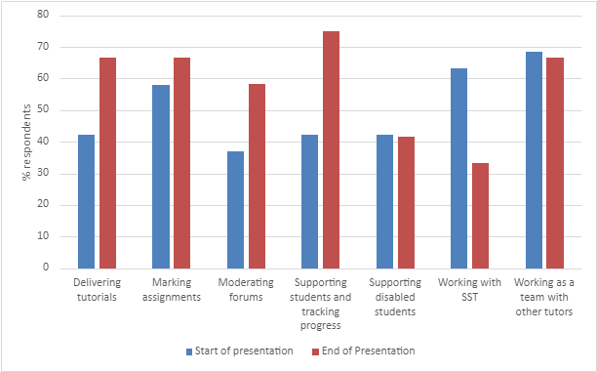
Results: Confidence in key online tutoring tasks
ALs asked to rate confidence using a Likert scale
Similar to LHCS ALs, at presentation start new STEM ALs were least confident in delivering tutorials, moderating forums and supporting students
Proportion of ALs who were very confident/confident at the end of the presentation increased for most tasks.
Proportion of ALs who were very confident/confident in supporting disabled students and working with the SST had stayed the same or decreased.
Proportion (%) respondents who indicated they were either very confident or confident in performing key online tuition tasks at the start (survey 1 n=19) and end (survey 2 n=12) of the ALs’ first presentation.
Notes:
ALs asked to rate confidence in tutoring tasks at the beginning and end of the first presentation of tutoring using a Likert scale.
The graph shows the proportion of respondents who indicated they were either very confident or confident in performing key tuition tasks at the start and end of AL’s first presentation
Note there were different respondents and also self selecting group, not necessarily representative of all ALs.
Similar to phases 1 and 2 at the start ALs were least confident in delivering tutorials, moderating forums and supporting students. Qualitative feedback indicated confidence at the start was influenced by lack of knowledge of systems and platforms (e.g. AC), and uncertainty in what was expected of them.
Proportion of ALs that were very confident or confident increased by the end of the presentation for most tasks except those related to supporting students.

Slide 10
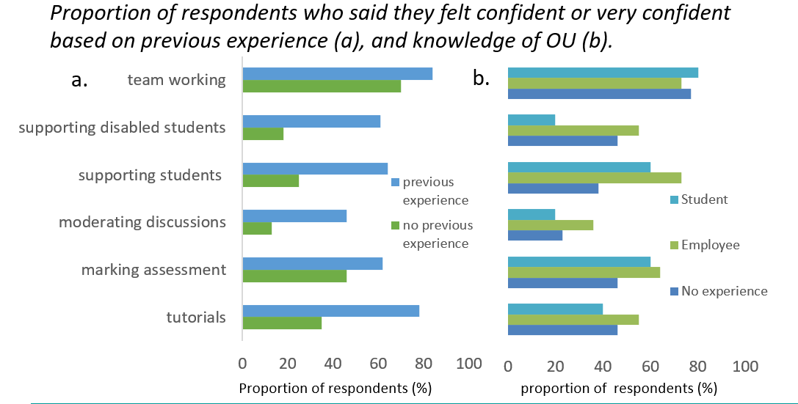
Results: Does new ALs’ previous experience affect confidence in key online tuition tasks at start of their first presentation?
Data from survey 1 18J and 19J combined (n=29)
a) Higher proportion of ALs rated themselves as very confident or confident in key tuition tasks if they had had previous experience of the task
b) Being an OU employee or student had variable effects on confidence.
Notes:
We also looked at whether AL’s previous experience affected their confidence in tuition tasks – this is actually data from Phases 2 and 3 combined.
The graphs show the proportion of respondents who said they felt confident or very confident based on previous experience (a) and knowledge of the OU (b). The number of ALs in each category of experience/inexperienced varied with some categories having much fewer ALs responses than others so we need to be a bit cautious about this comparison but it’s a useful indication that we could explore a bit further.
Looking at graph a - unsurprisingly, a higher proportion of ALs rated themselves as very confident or confident in all key tuition tasks if they had had previous experience of the task
Looking at graph b Having previous experience of the OU had variable effects.
Being a student seemed to result in slightly less confidence for most task (perhaps more aware of student expectations perhaps?), whereas being an OU employee seems to result in more confidence.

Slide 11
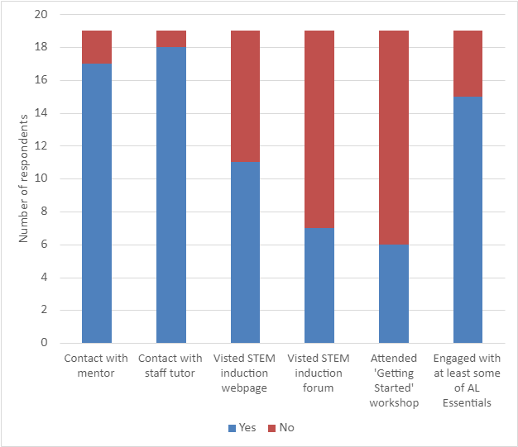
ALs’ experience of getting started ~ first month.
Survey 1 n = 19 Have you engaged with…. ?
13 (69%) felt confident about where to find appropriate support and guidance
Qualitative feedback
Volume of information
Difficult to locate information
Not enough time
Overwhelmed
Survey 2 results (n=12) indicated that 6 (50%)of respondents attended the online getting started workshop and 5 found it useful or very useful.
Notes:
This graph shows which students had and had not engaged with various aspects of AL induction by the time of survey 1. Had engaged in blue and hadn’t engaged in red.
Encouragingly most had engaged with their mentor and staff tutor.
Engagement with the induction website was less good, and only 6/19 surveyed attended the getting started online session, although around 50% of all ALs did actually attend. and the later Survey 2 suggested that those that attend find it useful.
Most ALs felt confident about where to find support and guidance, but worryingly 6 of the ALs surveyed did not.
Qualitative feedback indicated that ALs struggled with the volume of information, finding the information, lack of time and feeling overwhelmed.
Overwhelmed because not visited the induction page? Or spending too much time on AL essentials because that is flagged in the info they receive on appointment

Slide 12
Face to face event 5 (40%) survey respondents (n=12) attended and all indicated all sessions useful or very useful.
Good to put names to faces
Really helped me to work out priorities
Great to meet other tutors and feel part of a supportive team
Faculty session:
Intro and networking
Who’s who?
Role of AL
Useful to see how module fits into qualification
Interesting to see how school integrates research and teaching
Info on research not useful
Tour of school/labs
Dinner and networking
Excellent way to informally meet other ALs and STs
Examples of marked work and group discussions engaging
Correspondence tuition (similar subject groups)
Great to get a clearer idea of marking
Faculty session: Supporting students & working with SST
Some of the session was not engaging & spent listening to info
Good to hear questions generated as everyone shared their experiences
For me one of the best sessions
Tutorials ideas and techniques (similar subject groups
Notes:
This slide relates to the evaluation of the face to face
5 of the ALs that responded to survey 2 attended the face to face event and all found the workshops useful or very useful.
Summarise comments relating to each session.

Slide 13

Feedback from focus group (n=4)
Lots to do including mandatory training
Some ALs appointed very close to presentation start
Not clear what to do when (despite guidance given on webpage) would like a checklist
AL Essentials very large and links out to other resources
Some inconsistency between workshops delivered at school level
Mentors were invaluable
Face to face event valued – opportunities to network, build community
Induction was great just not enough time
Notes:
Comments in focus group consistent with survey.
Lots to do including mandatory training
Some ALs appointed very close to presentation start
Not clear what to do when (despite guidance given on webpage) would like a checklist
AL Essentials very large and links out to other resources
Some inconsistency between workshops delivered at school level
Mentors were invaluable
Face to face event valued – opportunities to network, build community
Induction was great just not enough time

Slide 14
Summary phase 3
Response rates low
Results similar to those in phases 1 and 2
Novice ALs have varied backgrounds
Confidence in core tuition tasks increased for most tasks except working with the SST and supporting disabled students.
Running induction workshops at faculty level ensures critical mass of ALs
Those who attended the STEM faculty induction workshops found them useful
Face to face to meet other ALs and faculty staff valued
A lot for new ALs to do
Combination of OU-wide and faculty-based induction allows for a multifaceted induction that includes orientation to the University, faculty, school and tutoring role.
Notes:
Response rate to survey was small
Results similar to those in phases 1 and 2
Novice ALs have varied backgrounds
Confidence in core tuition tasks increased for most tasks except working with the SST and supporting disabled students.
Running induction workshops at faculty level ensures critical mass of ALs for interactive workshops and development of community
Those who attended the STEM faculty induction workshops found them useful
Face to face and meeting other ALs and faculty staff valued
A lot for new ALs to do
Combination of OU-wide and faculty-based induction allows for a multifaceted induction that includes orientation to the University, faculty, school and tutoring role.

Slide 15
Recommendations for STEM AL induction programme
The faculty programme overall was a success and should be repeated. (20J and 21J all online)
Ensure adequate coverage of student support.
Ensure workshops are interactive.
Include informal elements for networking.
Track AL attendance and develop strategy for supporting those were did not participate.
Clear signposting to STEM AL induction required.
Workload needed for updating faculty induction resources and website.
Notes:
The faculty programme overall was a success and should be repeated. (20J and 21J all online)
Ensure adequate coverage of student support.
Ensure workshops are interactive.
Include informal elements for networking.
Track AL attendance and develop strategy for supporting those were did not participate.
Clear signposting to STEM AL induction required.
Workload needed for updating faculty induction resources and website.

Slide 16

Recommendations for OU wide induction
Review/replacement of AL essentials
Clear communications to new ALs around requirements for induction and mandatory training
Adequate time should be allocated to induction activities
Staff tutor should be responsible for supporting new ALs with their induction process.
Mentors are valued by new ALs. Time allocations and training for mentors should be reviewed.
Notes:
Review/replacement of AL essentials (OU-wide AL induction website has been developed with links to faculty sites).
Clear communications to new ALs around requirements for induction and mandatory training including timescales and expectations (check list).
Adequate time should be allocated to induction activities – preferably before module start.
Staff tutor should be responsible for supporting new ALs with their induction process.
Mentors are valued by new ALs. Time allocations and training for mentors should be reviewed

Slide 17
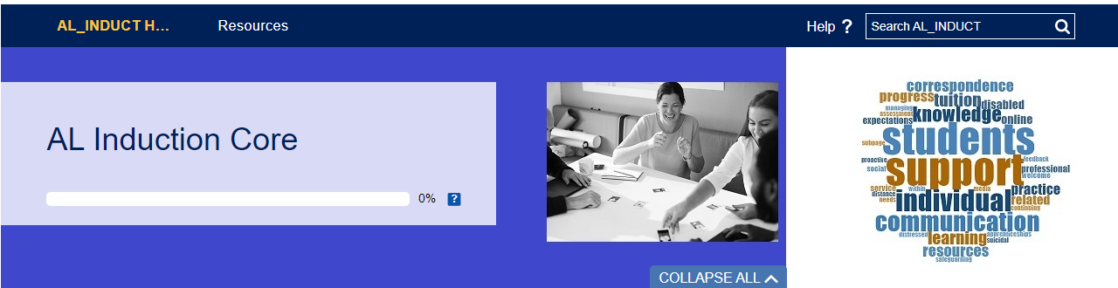
Impact:
Development of STEM induction programme and webpage
Good practice shared with other faculties who are developing own programs
Instigated AL induction task and finish group resulting in development of new OU-wide AL induction resource.
Findings are transferable to wider HE sector particularly due to increased homeworking and online teaching.
Notes:
Development of STEM induction programme and webpage
Good practice shared with other faculties who are developing own programs
Instigated AL induction task and finish group resulting in development of new OU-wide AL induction resource.
Findings are transferable to wider HE sector particularly due to increased homeworking and online teaching

Slide 18
THANK YOU
Thanks to eSTEeM
Reference: Barlow, J. and Antoniou, M. (2007) Room for improvement: the experiences of new lecturers in higher education. Innovations in Education and Teaching International
Vol. 44, No. 1, pp. 67–77

