Slide 1


Getting to know eSTEeM
Mark Jones and Sue Pawley
Thursday, 27 Oct 2022
Via MS Teams
While waiting to start, please introduce yourself at
https://padlet.com/esteem/Getting_to_know_eSTEeM
Notes:
Mark 1-5

Slide 2
Our purpose is to promote and empower practitioner-led, evidence-informed scholarship in open and distance STEM education.

Slide 3
Scholarship of Teaching and Learning
Scholarship of Teaching and Learning (SoTL) is a:
  systematic and ethically reasoned investigation of aspects of teaching and student learning by applying disciplinary knowledge, resulting in reflections and outcomes that are publicly shared for peer-review and for others to build upon.
  (Minocha, 2021)
eSTEeM facilitates such investigation through practitioner-led projects

Slide 4
From scholarly teaching to scholarship
Teaching
Scholarly Teaching
Scholarship of Teaching and Learning
Research
Evidence-informed teaching
Evidence-informed teaching made public and open to critique
Discipline based educational research

Slide 5
Example SoTL project titles
Assessing The ‘Open Field Lab’: Evaluating Interactive Fieldcasts for Enhancing Access to Fieldwork
Decolonising Computing: A Resource for Educators
Early start MU123
SiSE only tutor groups and the effect on SiSE students and their tutors
These are eSTEeM projects led by practitioners

Slide 6
Benefits of SoTL
Question:
Who benefits from the Scholarship of Teaching and Learning?
(answer in chat)
Notes:
Sue: 6-10

Slide 7
Benefits of SoTL
Students
Staff
Scholarship of Teaching and Learning
The OU and other institutions

Slide 8
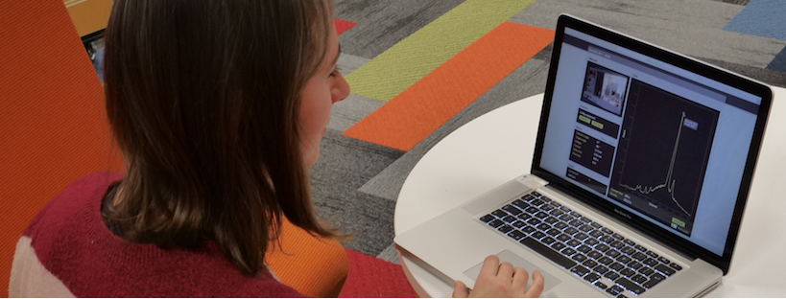
How does SoTL help students?
Motivation for improvement
Allows changes in teaching or student support to be evaluated
Provides insights into the student experience that can inform further changes
Improves student experience

Slide 9
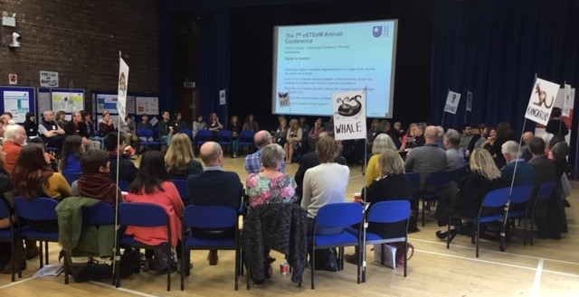
Staff engagement in SoTL
Testing ‘what works’
Develops understanding of complex issues
Benefits from collaboration and partnership working
Basis of an academic community around teaching and learning
Enhances professional identity, professional recognition and forms evidence that can be used for promotion cases

Slide 10
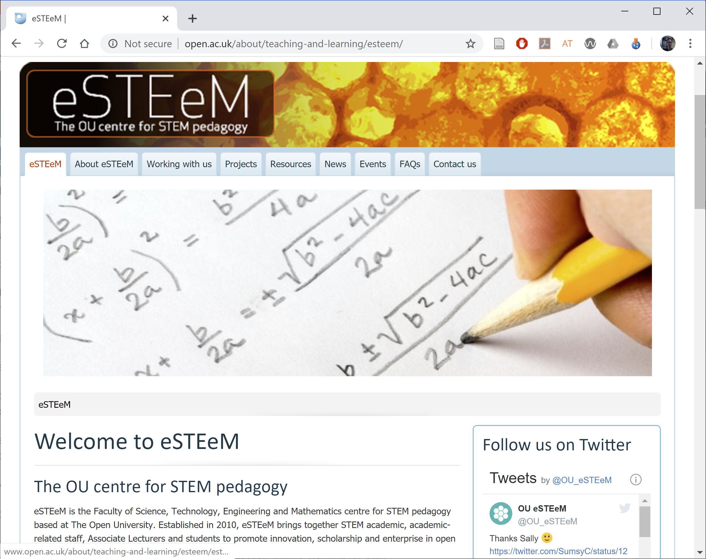
Impact of SoTL on the institution
Informs decisions about approaches in teaching and student support (Module Teams, Boards of Study, Faculty, University).
Supports a culture of responsiveness and innovation that is open to scrutiny. (Quality Enhancement)
Develops staff skills and builds an extended academic community.
Has external impact.

Slide 11
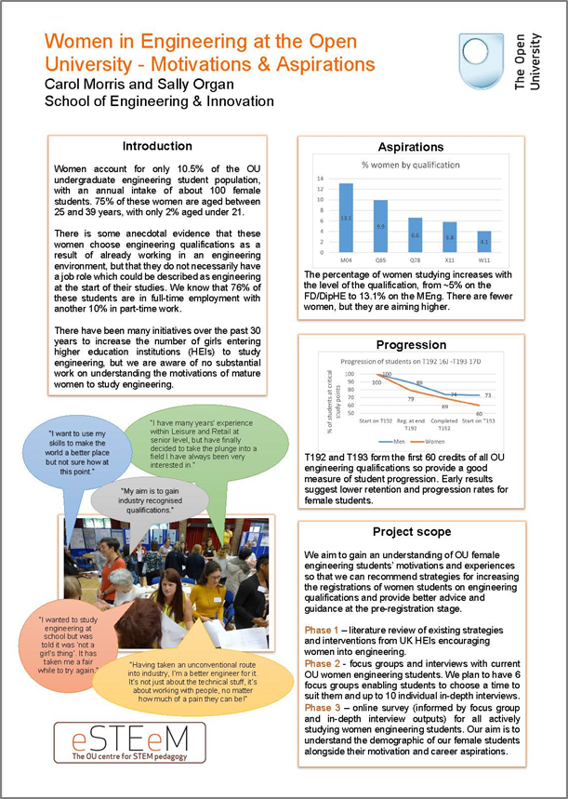
About eSTEeM
The OU centre for STEM pedagogy (Dec 2010)
Scholarship to enhance learning and teaching practice and strategy
Over 200 projects supported since 2011
Over 60 currently in progress
Individuals, groups and cross-disciplinary
project teams
Professional development and support for project team – Applaud (HEA Fellowship)
External influence in HE STEM environment
Notes:
Mark: 11-17

Slide 12
eSTEeM people
Management Team
  Director: Mark Jones
  Deputy Director: Sue Pawley
  Senior Manager: Diane Ford
  Support Assistant: Rachel Redford
  Project Officer: Jonathan Evans
School Scholarship Leads
  C&C: Shailey Minocha
  EEES: Fiona Aiken
  E&I: Daphne Chang
  KMi: Trevor Collins
  LHCS: Duncan Banks
  M&S: Sue Pawley/Martina Gibbons
  SPS: Jonathan Nylk/Jimena Gorfinkiel

Slide 13
From ideas to projects
Project proposal endorsed by Scholarship Lead and workload approved by line manager
Proposal submitted by advertised deadline
eSTEeM Coordination Group meeting to evaluate proposals – accept, revise or decline
Project proposers informed of decision
Where necessary, plans revised. Final sign-off by eSTEeM Directors
Project idea and draft proposal – discuss with School Scholarship Lead
Notes:
Too wordy

Slide 14
From ideas to projects
Project proposal endorsed by Scholarship Lead and workload approved by line manager
Proposal submitted by advertised deadline
eSTEeM Coordination Group meeting to evaluate proposals – accept, revise or decline
Project proposers informed of decision
Where necessary, plans revised. Final sign-off by eSTEeM Directors
Project idea and draft proposal – discuss with School Scholarship Lead
Notes:
Too wordy

Slide 15
Progress and completion
Induction workshop: project begins
Ongoing staff development events
Short reports approx twice a year
Dissemination - eSTEeM Annual Conference, internal and external events
Final Report, outputs and publications uploaded to eSTEeM website/ Scholarship Exchange/ ORO
Ethics review, SRPP/SSPP approval, Data Protection compliance
Mentoring and ongoing project management and support

Slide 16
Progress and completion
Induction workshop: project begins
Ongoing staff development events
Short reports approx twice a year
Dissemination - eSTEeM Annual Conference, internal and external events
Final Report, outputs and publications uploaded to eSTEeM website/ Scholarship Exchange/ ORO
Ethics review, SRPP/SSPP approval, Data Protection compliance
Mentoring and ongoing project management and support

Slide 17
Project framework – key information
eSTEeM puts out project calls twice a year (January and July)
eSTEeM projects normally complete within 18 months.
Each team member expected to commit at least 10 working days
Central and regional staff time must be signed-off by Head of School
AL colleagues time must be approved by lead line manager. ALs must be able to fulfil role within 1.3FTE.
eSTEeM may provide support for conference attendance and expenses to attend eSTEeM community events

Slide 18
Project framework – key information
Endorsement from your School Scholarship Lead and approval from your HoS (central and regional staff) or Lead Line Manager (Associate Lecturers).
All eSTEeM funded project teams are required to submit interim short reports and a final project report within two months of completion
We particularly encourage projects that involve students as collaborators/co-investigators on the project (and not just as participants in a study)
Scholarship skills development and project mentoring will be provided by eSTEeM

Slide 19
Your view
How have you benefitted, or how do you anticipate benefiting, from scholarship projects and working with eSTEeM?

Slide 20
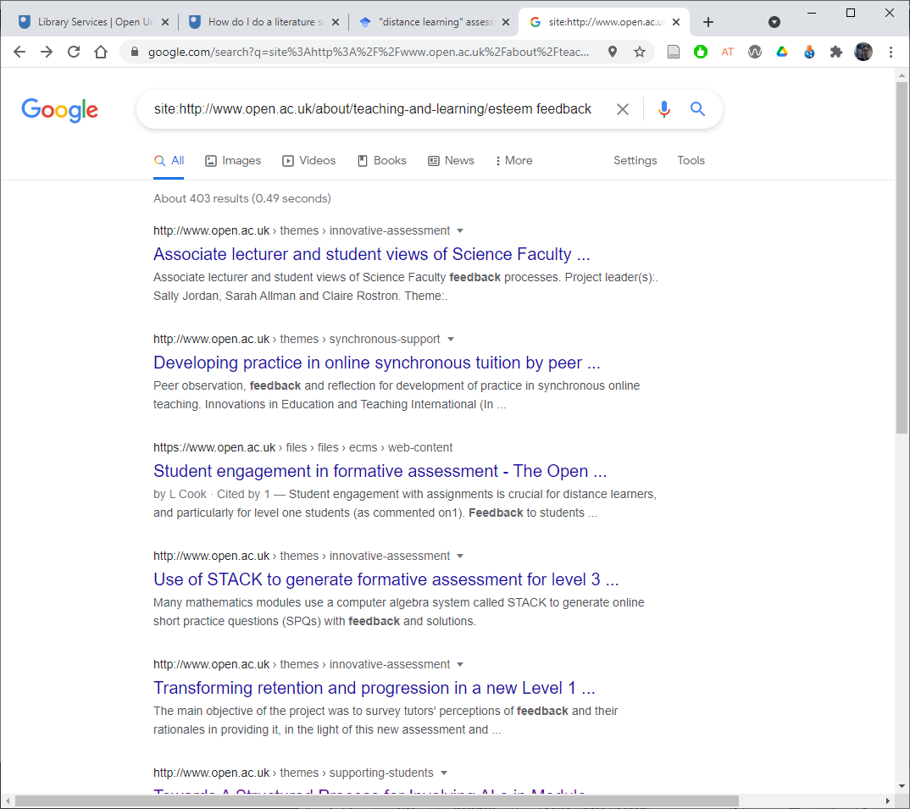
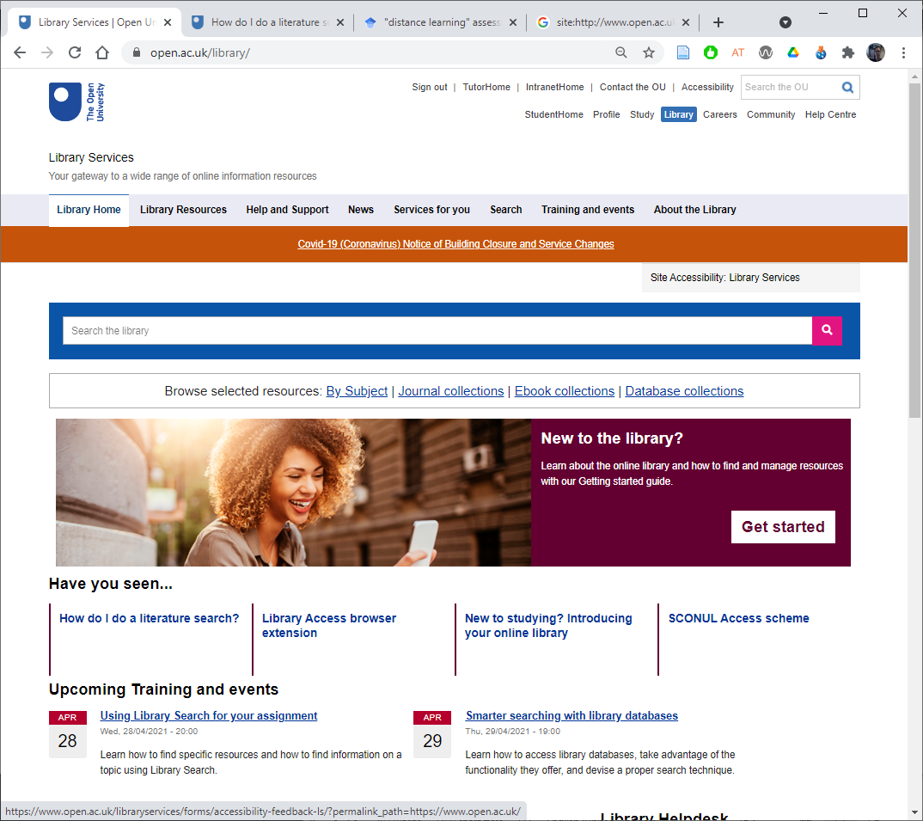
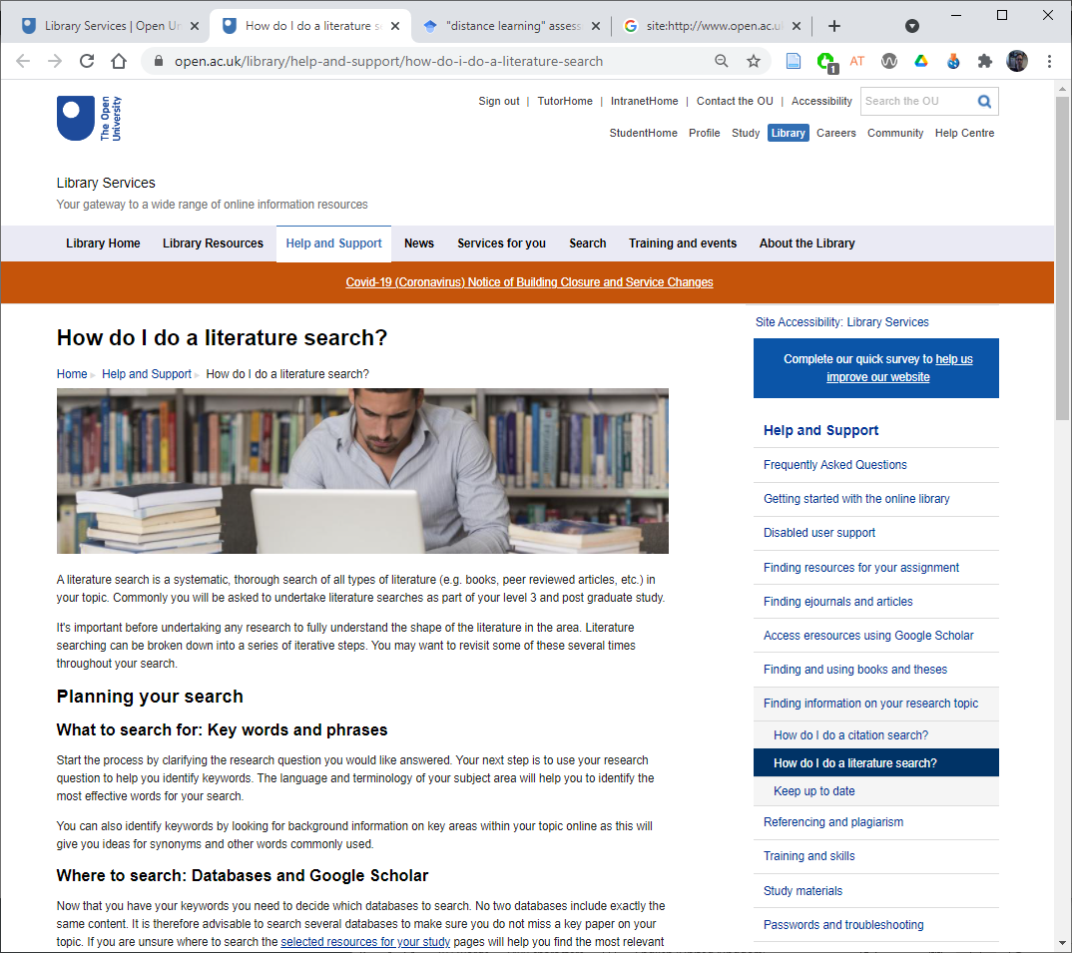
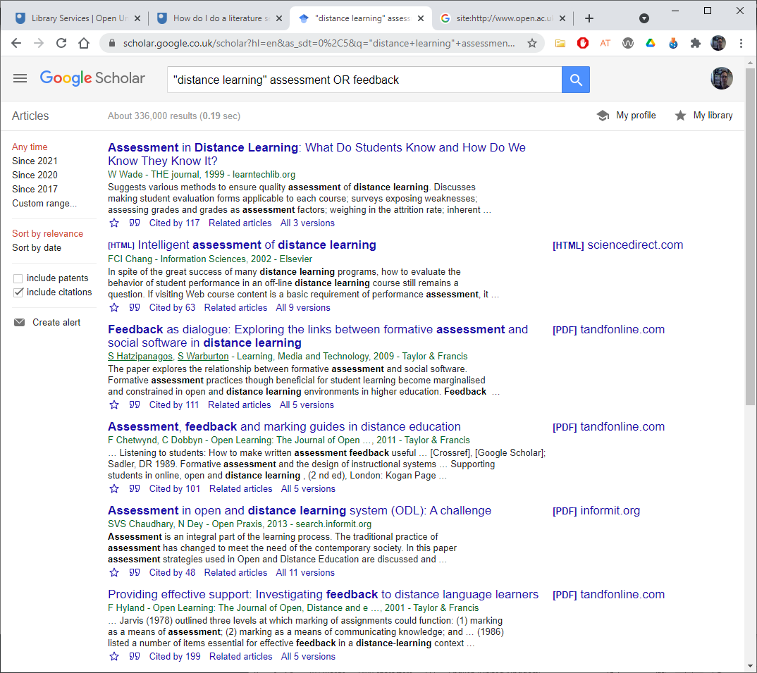
Things to consider in a proposal
What are you planning to investigate and improve?
Is the project consistent with the aims of eSTEeM?
Which theme(s) does it address?
Have you considered the literature?
Are you aware of related projects?
Explain how your project builds on the prior work?
Notes:
Sue: 18-19

Slide 21
Things to consider in a proposal
Would your project benefit from student involvement at any stage (other than as participant in your research)?
Would your project benefit from the involvement of other staff at any stage?
Do you have any specific development needs to enable you to undertake this project?
Will the project produce significant deliverables/outputs within a reasonable timeframe and what might these be?
Is there an evaluation and dissemination plan, including dissemination to students?

Slide 22

eSTEeM Community Support
Professional development sessions
Badged Open Course: SoTL in STEM
Seminar series – monthly
Annual eSTEeM conference
NVivo users self-help group (email esteem@open.ac.uk)
eSTEeM | The OU centre for STEM pedagogy (open.ac.uk)
Notes:
Mark: 20 - end

Slide 23
Other support for scholarship
SHARE – OU, cross faculty forum for scholarship for Region/Nation academic staff.
Schools have their own scholarship plans – keep an eye out for initiatives within your own school.
Pan-university scholarship calls – support for projects that cross faculty boundaries.
The Scholarship Exchange is a repository of OU scholarship reports
https://openuniv.sharepoint.com/sites/units/lds/scholarship-exchange/Pages/Search-Exchange.aspx

Slide 24
Any other support?
Are there other ways of supporting you to conduct scholarship of teaching and learning that you’d like to see?

Slide 25
Any questions?
Any questions arising from today’s session (or email esteem@open.ac.uk)

Slide 26
Summary
Scholarship of Teaching and Learning has multiple benefits.
  For students, SoTL drives improvement to learning experiences.
  For staff, SoTL provides a way to engage with teaching and learning that is open to scrutiny and wider academic debate.
  For the institution, SoTL generates a culture of evidenced quality enhancement.
eSTEeM provides a supported mechanism to enable staff to run SoTL projects.
We hope you’ll be inspired to start on your scholarship journey with us!

Slide 27
eSTEeM people
Management Team
  Director: Mark Jones
  Deputy Director: Sue Pawley
  Senior Manager: Diane Ford
  Support Assistant: Rachel Redford
  Project Officer: Jonathan Evans
School Scholarship Leads
  C&C: Shailey Minocha
  EEES: Fiona Aiken
  E&I: Daphne Chang
  KMi: Trevor Collins
  LHCS: Duncan Banks
  M&S: Sue Pawley/Martina Gibbons
  SPS: Jonathan Nylk/Jimena Gorfinkiel

Slide 28
Thank you!
esteem@open.ac.uk

