Slide 1
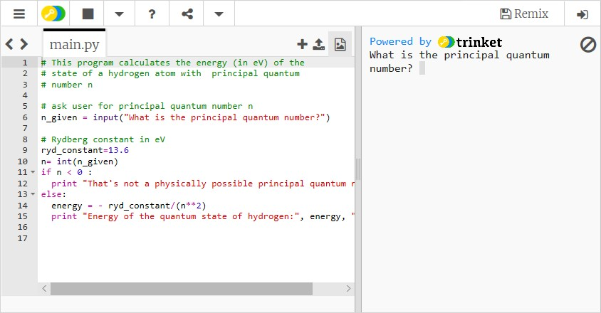
What are the barriers to participation and success in the Python element of SM123?
Gemma Warriner and Andy Diament, SPS
Background SM123 Physics and Space, is a Level 1 module, fully online and designed to be taken after S111. It is hoped that students studying on SM123 will go forward to study SPS modules at Levels 2 and 3. Retention on SM123 is therefore important to Physics & Astronomy qualifications as a whole. Computer programming in Python is one of 4 components of SM123 (with Physics, Experimental & Practical work, and Mathematics). It is an area they will need to develop in level 2 and 3 modules, in order to prepare them to be practicing physicists and space scientists. The Python tuition takes place over four weeks spaced out over the year. Students are encouraged to do programming tasks via “Trinkets” embedded in the SM123 website. An example is given below. Retention on SM123 is lower than on other level 1 STEM modules. It is apparent from forums and SEaM comments that many students are daunted by Python and some do not make good progress in learning. This may include students that score well in other aspects of the module. Feedback from students does not always make it clear what aspects of programming they are struggling with. | Proposed Project There are two research questions that this project seeks to address: What are the barriers that prevent students participating in Python initially? What are the barriers that prevent subsequent success? We would like to understand what prevents some students new to programming from engaging with the materials at all and other students to give up part way through the module. Methodology Students will be asked to complete a questionnaire focussed on how they engage and any barriers to the engagement. We would like to establish the following. The prior level of programming experience Which aspects of programming are causing issues. For example, it may be constructing algorithms or learning to debug code. Learning to think in a logical way may be from study that students have done previously Which existing resources students find most helpful In addition, learning analytics will provide information on student engagement in previous cohorts. Outcomes The project will provide STEM with a better understanding of the barriers that prevent students engaging successfully with Python. This should identify which resources are most useful to students and if additional support needs to be put in place. This research will benefit other STEM modules that deliver Python and could inform broader issues of supporting novice programmers. SM123 students will be able to progress to level 2 and 3 and feel confident tackling Python at a higher level.

