Slide 1

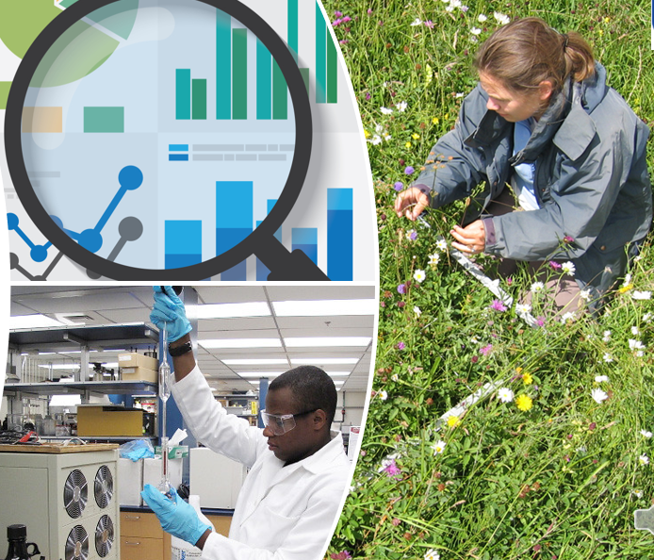

Impact of introducing new practical and dataset project options to the science undergraduate capstone project module (S390).
Hannah Gauci (LHCS), Julie Robson (EEES), Jon Golding (LHCS), Janette Wallace (LHCS)
Vicky Taylor (LHCS), Miranda Dyson (EEES), Clare Lawson (EEES), Lorraine Waters (LHCS), Vikki Hayley-Mirnar (LHCS)
What's the issue?
Requirements for accreditation & impact of COVID resulted in introduction of new practical and dataset project options on SXL390 and SXE390
Achievement gaps for black students and those with declared physical or mental health conditions
Need to identify strengths and weaknesses of current operating model to inform module re-write
Aim: To evaluate the introduction of new practical and data set project options on student achievement, retention and experience, and on the Associate Lecturer Role.
Methods:
Literature review
Evaluate 21B and 22B, SXL390, SXE390
Compare literature, practical (lab, &field) and dataset projects
Module performance data (retention, achievement, satisfaction).
Student Experience: Survey and focus group, evaluation of research logs.
Associate Lecturer Experience: Survey and focus group
Outcomes:
Recommendations for re-write of S390
Handbook for others in OU/wider HE sector
Conference presentations and journal article

