Slide 1
Creating a discipline-based accessibility working group
Anne-Marie Gallen, Trevor Collins & Chetz Colwell: IncSTEM

Slide 2
Creating a discipline-based accessibility working group
Background to the project
Setting a context
The narrative around the Maths and Statistics Accessibility Group
So what…?
Where next...
Notes:
The OU language is mainly social model and refers to

Slide 3




IncSTEM
HEFCE Catalyst Fund (Now: Office for Students)
Addressing barriers to student success
1st March 2017 to 31st August 2019
Notes:
Trevor will do the introduction to catalyst fund etc to set context

Slide 4
Background to the discipline-based accessibility working group
Reasons for setting up the group:
- Move from regional support to School/SST
- Inaccessible module materials
- Accessibility guide update needed
Formation of accessibility group:
- Participants
- Goals
- Practices
Discipline-based accessibility working group in action
Notes:
The focus on the accessibility guide meant the team had a goal to strive for in turn allowing them to pull together appropriate membership and set attainable goals
This is the WHY

Slide 5
Membership
Group consists of different types of stakeholders
Academic
Academic-related
Academic services
Student support team
Disability resources team
Securing Greater Accessibility (SeGA) team
School of Mathematics and Statistics
Notes:
So this is the WHO and highlights the diversity of support and membership. Skills and perspectives they had to bring were also key

Slide 6
Timeline
Dates | Decisions
May 2017 | Identification of need: Changes to support, inaccessibility of delivery mechanism, specific goal Identification of key stakeholders (13 members across discipline and service areas)
Aug 2017 | Negotiates terms of practice
Nov 2017 | Identification of goal, further development of roles, growth of membership
May 2018 | Further developments and broadening of goals, requirements and reporting

Slide 7
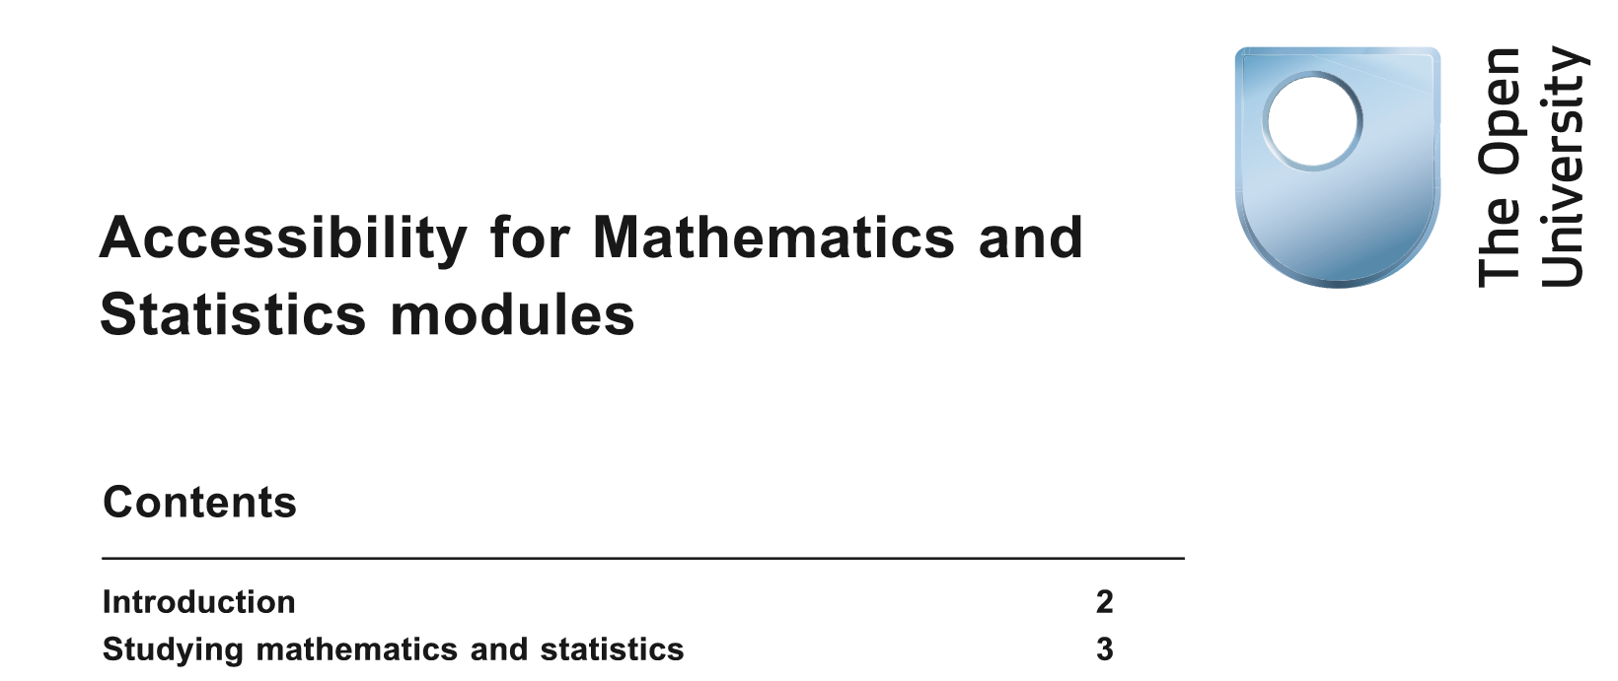
Discipline-based working groups in action:
New Accessibility Guide was completed in November 2017
Accessibility guide for module teams is ongoing
Individual student cases raised and tackled with sharing of outcomes and approaches
Forward-looking approach that anticipates issues
High level engagement with use of symbolic language in accessible formats
Notes:
Elaine to come in at this stage
Mention that the deficit medical model was not necessarily seen as negative but in this context it was not seen in this way. Want them to be taken seriously…

Slide 8
So what …
Why is the formation and working of this one group important?
How can the lessons learned by this one discipline-based accessibility working group help others?
Notes:
Using IncSTEM to disseminate the outcomes of ASSIST project

Slide 9
IncSTEM
Discipline-based working groups have a role to play in developing a more inclusive educational future
Project is looking at other examples and approaches internally (WELS) and externally (DiG UK; Mental health Dept Earth Science and Engineering, Imperial College)
Drawing together of ideas, practices and methodologies
Define timelines, policies and goals
Creation of a ‘How to set-up a discipline-based working group’ pack

Slide 10
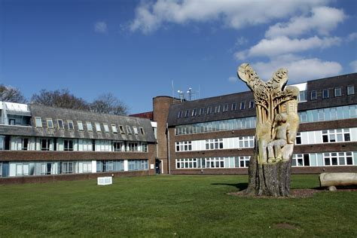
Anne-Marie Gallen, Trevor Collins., Chetz Colwell
Thank you

