Slide 1

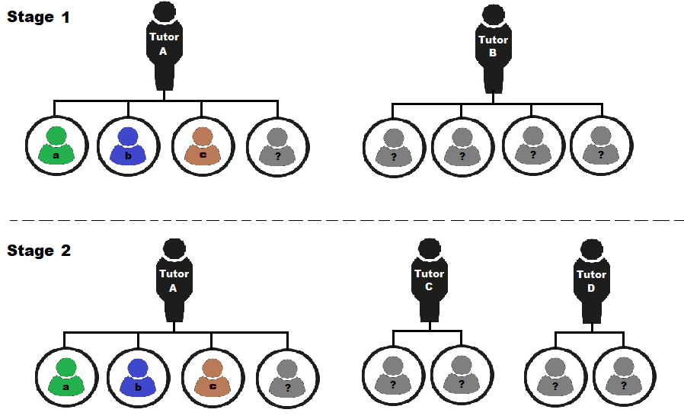

Do students benefit from having continuity in their module tutors between level 1 and level 2 on Q71, Health Sciences?
Fiona Moorman, Sarah Daniell, Katie Acutt
The project aims to provide bespoke TSA for ~ 100 24J SDK100 & SK190 students (Health Sciences) to increase tutor continuity.
At 25J TSA, students will be allocated (wherever possible) the same tutor /another tutor who also teaches on multiple Q71 modules.
We will evaluate:
student and tutor experience
student outcomes.
Expected outcomes:
closing academic awarding gaps
continuity and retention
enhancing student engagement
community and belonging.
Notes:
What you are intending to do
How you are going to do it
What you are expecting to find/achieve/develop at the end of it.
We will evaluate:
student and tutor experience via a short survey at the end of each presentation.
student outcomes on each module studied via withdrawal rates, VLE engagement, TMA scores and pass rates.

