Slide 1


Can we reduce anxiety of students sitting online exams? Sharing best practice between SPS and LHCS.
Fiona Moorman, Gemma Warriner and Becca Whitehead
This Photo by Unknown Author is licensed under CC BY-SA-NC
Notes:
Fi from here to 5

Slide 2




Project
Reason
What did we do?
Data gathering
A scholarship project that aimed to investigate the reasons for online exam anxiety
Reduce online exam anxiety if possible
Some students who sat OU online exams were very anxious about the move from face-to-face
Ran online exam support sessions
Prepared students for the experience
Large scale JISC questionnaire
JISC based interviews
Focus group
Student feedback from exam support sessions
Outcomes
Identified strong themes in reasons for student anxiety about online exams
Reduced anxiety about online exams for some students

Slide 3
Exam preparation sessions
Number of Attendees
104 attended in March with 625 views. 187 attended in May with 380 views
These were provided to Science students to de-mystify the remote exams processes, to facilitate students to take ownership of problem solving, and to attempt to increase their self-efficacy concerning their upcoming remote exam.
We noted that there were very anxious students at the first sessions
What we covered
Exam format, iCME system, creating & uploading pdf/word files, revision, exam day planning, advanced troubleshooting, plagiarism
What students asked about
Discretionary exam postponement special circumstances, access to websites, plagiarism, timing of the exam and the timer
Notes:
self-efficacy - ‘a person’s belief in their ability to succeed in a particular situation’

Slide 4
Survey
When
June 14th until July 10th (JISC survey)
How many took part
Sent to >2500 students. 349 responded – 138 from SPS and 211 from LHCS. >100 students indicated would take part in future research
Style of questions
Mix of qualitative and quantitative
What did we ask about
Their preparation, were the sessions helpful, how did they cope, could they complete the exam, any other issues

Slide 5
Survey: What did you wish you had known?
Theme | Number of responses
How little time I’d have / how fast it would go | 37
That an open book exam would be harder/ take longer | 4
That I’d have IT issues | 33
That the support/ preparation would not have been adequate | 11
That I would be confused about other aspects of the exam/ processes | 21
That it would be ok / positive | 21
Miscellaneous (timer / distractions / OU admin / anxiety) | 13
We were interested in sources of anxiety that were particular to sitting an online exam.
Students have always found exams stressful, but we have picked out two themes related to sitting an exam at home:
Lack of time and distractions
IT issues
These affected even very well-prepared students
Notes:
As can be seen IT issues and time management are the largest factor here. It is pleasing that 21 students wish they had realised that the exam would be alright, hopefully this will feed into their next remote exam experience.

Slide 6

Time

Slide 7

Sources of anxiety – Lack of time
I answered as much as I could but typing an exam was very difficult especially with equations etc and then having to add in scanned drawings etc was time consuming so wasn't able to complete the exam fully.
Exam set as open book, but insufficient time to consult books
I didn't feel completely sure about the timing. We were told 3 hours for the exam and 1.5 hours for scanning/uploading but I was worried.....that I would be penalised for submitting after the 3 hours.
I think when these exams are being planned someone should be timed doing it on a computer
Even though I’d revised for the exam I still struggled to finish within the time allowed without getting penalised.
We asked students how easy it was to complete their exam in the time available:
33% said it was very difficult
14.1% said it was difficult
Of the students asked 11.2% were unable to complete the exam
33% of students
Notes:
A little over 10% of the 340 students who responded to the question ‘Were you able to complete your remote exam’, indicated that they were unable to complete their exam (38; 11.2%).

Slide 8

Sources of anxiety – Lack of time
It being open book was more of a hinder than a help - too tempting to refer to books which caused time to run out.’
‘Exam set as open book, but insufficient time to consult books’
‘I am not a novice where exams are concerned and have never failed to finish before. The time constraints meant there was no time for thought or planning and everything was rushed’
‘I submitted the exam but wasn't able to complete all questions due to the time taken to resolve technical issues and the slow speed of my laptop due to extreme heat.’
‘I am unable to type quickly and this is a real disadvantage in this situation.’
‘Time allowed - using a computer is actually slower than an exam in a room to complete.’‘
The word cloud for free the free text answers indicates how often "time" was used
Notes:
A little over 10% of the 340 students who responded to the question ‘Were you able to complete your remote exam’, indicated that they were unable to complete their exam (38; 11.2%).

Slide 9

Questionnaire and focus group
“Finally, I found the exam questions required a lot more time than that allocated. Disappointingly, I run out of time while I was working on a question for which I knew the answer”
“You don’t actually know the notes that well and that’s – it starts absorbing time, and once you get into the notes you start reading the notes again and that’s not what you are meant to be doing”
“I actually found it more stressful having access to my books and the internet than in a conventional exam setting! It was too much of a temptation to look up something you didn’t know”

Slide 10
IT related problems

Slide 11

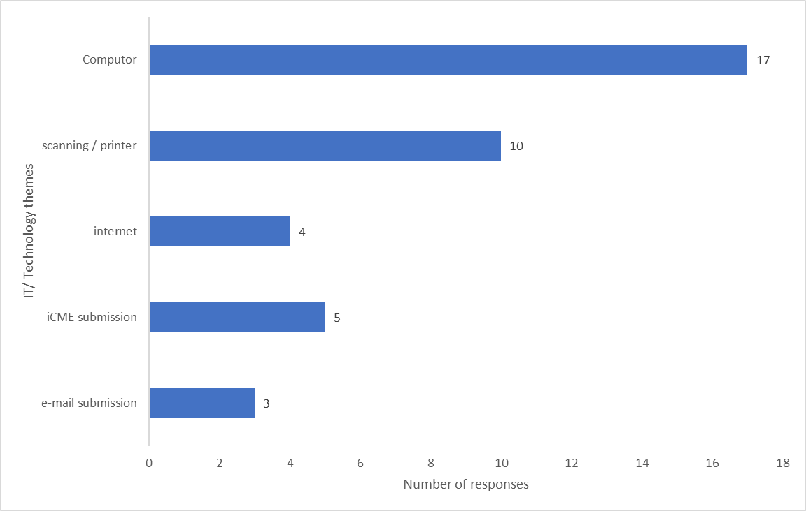
Sources of anxiety; technical issues
The top two causes of technical issues are the student’s own equipment
Their computer and scanner/printer
Notes:
Computer issues were the biggest issues followed by the scanning /printer.

Slide 12
Survey : technical issues experienced
‘…Slow internet speed.’ ‘Internet went down for 5 minutes it just caused anxiety but it all went back to normal soon‘.
‘The tab froze on my computer. The clock was still counting down but I could not move to the next question using next button on question status box.’
‘‘I managed to get the computer working by closing the laptop for a few minutes (around 3 or 4) but I lost some time doing this.’
‘My keyboard stopped working so I couldn't type anything!‘
‘I inadvertently pressed the submit button before uploading my answers on the system.’
Notes:
When asked whether their IT/ technical issues had been resolved, 33 students said yes, but 14 students (29.8%) said that they had not been resolved.
These results indicate that not all students are seeking the correct help for technical issues, the SST are not able to help with IT. Contacting the helpdesk is a better idea and it was good to see that students were filling in the special circumstances form.

Slide 13

Interviews and focus group
“In respect to the scanning, you end up with about 20 pages to scan in and even with the best equipment in the world things go wrong and suddenly it scans 16 pages and then it stops and you have to start again …I found that quite difficult because I’d give myself lots of time to scan it in, and I was literally down to the last minute or two before the cut-off to get it in”
“I'm fortunate to have a dedicated desk space plus dual screens. I think if people were having to work from a laptop screen it would have been a challenge.”
“The IT equipment was fine - although I had a worrying moment at one point when my internet connection went down”
Theme 1 – Physical Setting
Theme 2 – Time/Anxiety
Theme 3 – Preparation for exams

Slide 14

Questionnaire and focus group
“I’d spent years working towards doing these exams, and everything that comes with that, and I felt reassured that I would be at home in a known and cosy environment, and I had everything set up, I thought, but I could not have prepared myself as the sheer panic when …the digital timer that you have on the screen was ticking down”
“It really did panic for me and it definitely did affect my performance on the day, so in future I would have to prepare for that element of it.”

Slide 15


Conclusions
Recommendations
And Impact

Slide 16
Conclusions and Recommendations
Preparation
Time
Inequality
Preparing students for their exam via the online sessions did reduce the anxiety of many
This work should be continued and extended
Some students will continue to find exams very stressful
Emphasise to students that searching for internet-based resources is not needed.
Recommend module teams consider how much they expect students to consult module materials when writing exams
Need for clarity around timings and the timer itself
Inequality of students’ own equipment will be a factor in remote exams
Home setting will not be equal for all students
Continued anxiety around using OU exam systems and technical support on the day is vital
A scholarship project that aimed to investigate the reasons for online exam anxiety
Reduce online exam anxiety if possible

Slide 17

Impact
The exam preparation sessions directly contributed to a better examination experience for the cohort who sat their exams in June 22, as measured by fewer reports of issues on forums and fewer phone calls to the student support teams.
The need to practise producing a document was emphasised and students were encouraged to decide whether to type or handwrite based upon their own skills, and the type of questions that they would face. Practise on using the exam systems was advertised more widely to students.
Findings from our survey were disaggregated by module and shared with Module teams who used these findings to inform setting exam papers and planning student support measures. highlighting the issue of lack of time fed into discussion about the number of questions to have and to factor in time spent looking at module materials.
We contributed to discussions resulting in changes to AQC guidance given to students on the Help Centre concerning the term “open book.”

Slide 18
Using our work looking forward

Slide 19
What will assessment look like going forward?
With the advent of freely available AI our project has these insights:
Need to develop student self-efficacy to respond to ongoing changes in assessment.
The information applying to both the use of GenAI and Proctoring must be clear and comprehensive to minimise uncertainty / anxiety.
Students in sessions were anxious about inadvertently plagiarising. Search engines and grammar checkers use AI, so there is a possibility of anxiety related to the unintentional use of AI. “Can I use google?”
Two of our key conclusions was there was anxiety associated with the use of IT and timing, both of which are relevant to the use of proctoring. “What happens if my internet times out?”
Some students reported an unwillingness to go back to face-to-face exams
Notes:
We found that lack of clarity in instructions led to anxiety in some students.

