Slide 1

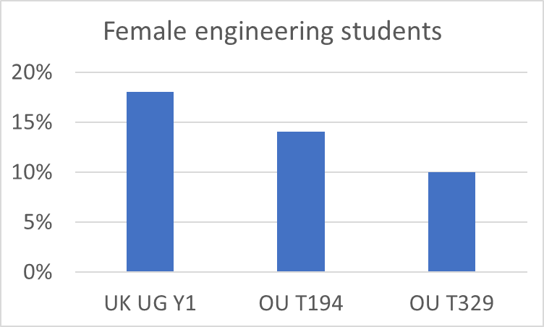

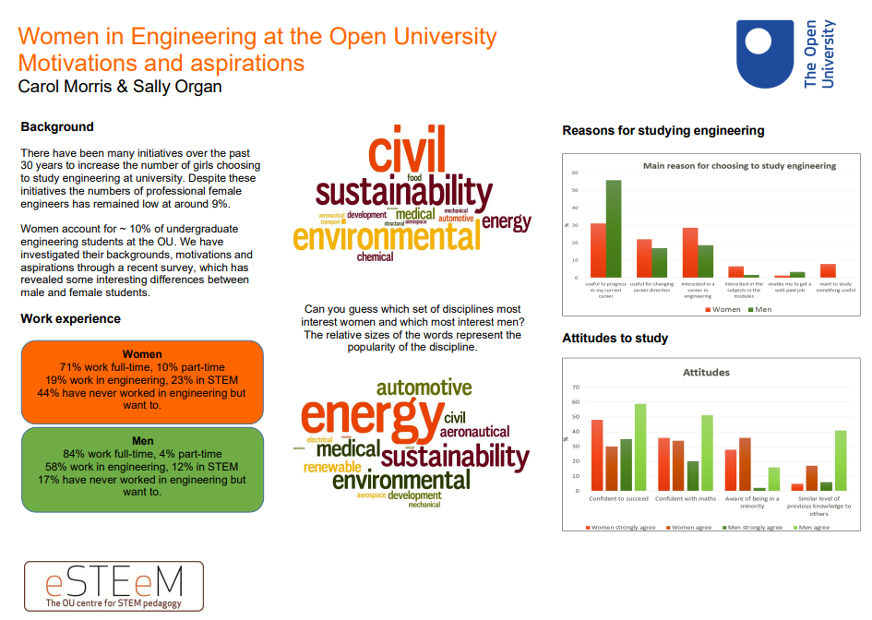
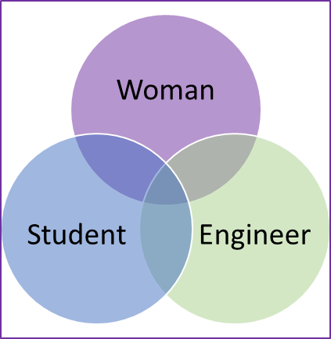

Making space for female engineering students: an evaluation of the effectiveness of a face-to-face Student Conference
Fiona Gleed, Claudia Eckert
Workforce
Engineering equality
Women are under-represented in the UK Engineering profession
OU is below average, for undergraduates and for workforce
At 10% of students, with tutor groups of 20:
1 in 8 groups have no female students, reducing visibility to peers and Tutors
1 in 4 groups have one female student, reducing intervisibility
Women in Engineering conferences at OU
Started 2016, paused 2020, online 2021, face-to-face 2023
Carol Morris and Sally Organ now retired
- need to rebuild and update knowledge base
Objectives
Evaluate the 2023 face-to-face conference
Explore barriers and challenges, to belonging and progressing
Make recommendations for future activities

