Slide 1


Open WIDE
an inclusive approach to extracurricular events in engineering
eSTEeM Seminar Series: Scholarship Showcase
July 2026
Presenter(s): Dr Fiona Gleed, Prof Claudia Eckert
Notes:
Hello, my name is Fiona Gleed and I want to tell you a bit about work in the school of Engineering and Innovation to support female engineering students. The reflection draws on two projects funded by eSTEeM, the STEM Scholarship Centre. The first of these was completed by Carol Morris and Sally Organ, and Professor Claudia Eckert and I have revisited their work in our project, Making Space for Women in Engineering.

Slide 2
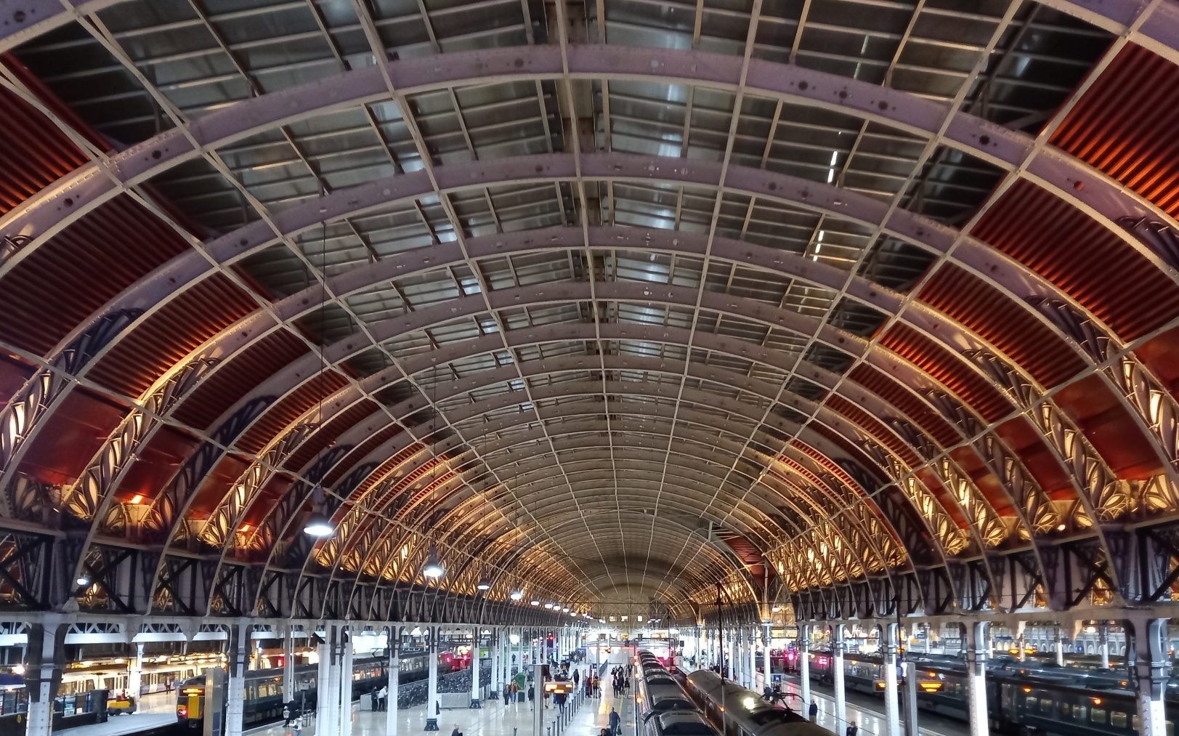
Making space for women in Engineering
Dr Fiona Gleed, Prof Claudia Eckert
What is Engineering?
Where are the women?
The role of the OU
10 years of progress
What next?
Notes:
I'm going to start by looking at what is engineering?
then ask where are the women?
consider the role of the OU.
Reflect on 10 years of progress and
consider what's next.

Slide 3
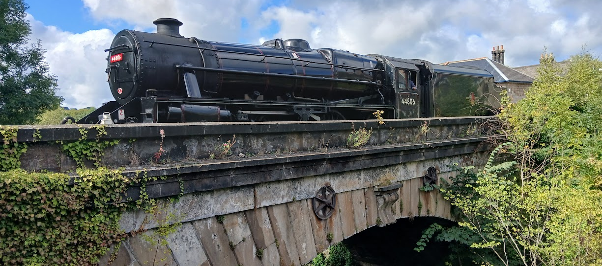
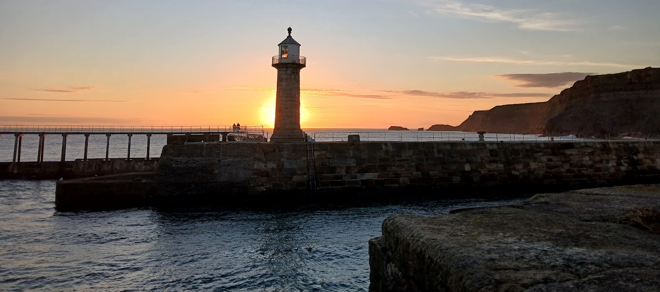
What is Engineering?
Not just engines
Ingenuity
Notes:
So, what is engineering? Well, we often associate engineering with the word engine, but engineering is not just about engines – although steam engines, internal combustion engines and jet engines are all great examples of engineering.
However, the root of the word engineering is ingenuity, and hence engineering covers so much more than engines, from the lighthouses that guard our coasts to the software for this hybrid seminar.

Slide 4
Engineering as a Profession
UK timeline
Organisations
Education
Evolution of specialisms
Slow start – a century or more behind Europe
1818 Institution of Civil Engineers
1847 Institution of Mechanical Engineers
1871 Society of Telegraph Engineers (now IET)
1908 Concrete Institute (now IStructE)
1919 Women’s Engineering Society
1957 British Computer Society
1964 Joint Council of Engineering Institutions (now Engineering Council)
1976 Royal Academy of Engineering
1812 School of Military Engineering, Chatham
1824 Mechanics Institutes, London & Liverpool
1840 School of Engineering, University of Glasgow
1853 Engineering degree, UCL
A recent profession
Notes:
As a profession in the UK, engineering made a slow start and has had a lengthy evolution. The first professional engineering institution was established in 1818; the Institution of Civil Engineers. Civil Engineering originally, was a contrast with military engineering and included many emerging disciplines. The Institution of Mechanical Engineers branched off in 1847 and both Institutions continue under those names today. Other prominent institutions today include The Institution of Engineering and Technology (IET), originally founded in 1871 as the Society of Telegraph Engineers and the Institution of Structural Engineers, founded in 1908 as the Concrete Institute.
During World War One, many women took on Engineering roles as men were called up to fight. However, as men returned to their civilian roles, women were pressured to leave the workforce and the Women's Engineering Society was formed to support and promote women in engineering.
Specialist institutions continued to emerge, including British Computer Society in 1957, but it wasn't only in 1964 that what is now known as the Engineering Council was formed as the Joint Council of Engineering Institutions; And as late as 1976 that the Royal Academy of Engineering was formed.
Hence, these overarching bodies are much younger than the institutions that they now coordinate and champion.
In terms of education, the UK also got off to a slow start, a century or more behind Europe. In 1812, the School of Military Engineering was formed at Chatham and in 1824, Mechanics Institutes were set up in London and Liverpool. But it was 1840 before the first School of Engineering started, at the University of Glasgow, and the first formal engineering degrees were offered in about 1853, at University College, London.
Engineering is therefore a relatively recent profession in the UK

Slide 5
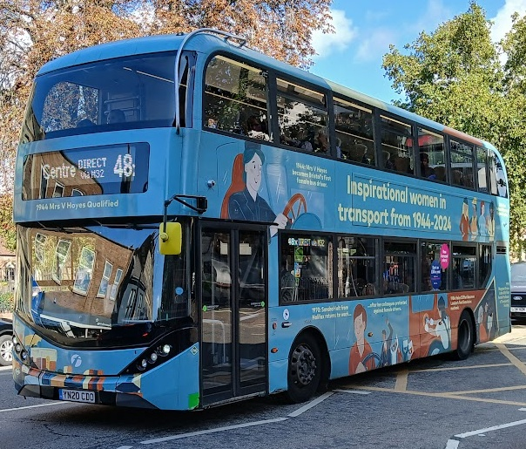
Where are the women?
And who counts as an engineer?
Inspirational women
First female …
1899 Hertha Ayton - elected to IEE (now IET)
1906 Alice Perry – engineering graduate
1930 Amy Johnson – solo flight to Australia
1944 Mrs V Hoyes – Bristol bus driver
1965 Barbara Castle – Minister of Transport
1991 Helen Sharman – Briton in space
2007 Sarah Buck – IStructE President
2014 Ann Dowling – RAEng President
2015 Naomi Climer – IET President
Few, familiar names – particularly in leadership roles
Notes:
I've illustrated this slide with a picture of a Bristol bus celebrating inspirational women in transport from 1944 to 2024. World War Two again saw many women moving into jobs to free up men for active service. However, because the profession was so new and registration was so fragmented, many people were working in engineering roles without necessarily being recognised as engineers.
Inspiration can therefore be drawn from transport pioneers such as Bristol Bus Driver Mrs V Hoyes and Minister of Transport Barbara Castle, as well as Hertha Ayton, the first woman elected to membership of a Professional Engineering Institution, and Alice Perry, the first woman in Ireland to graduate from an Engineering degree.
However, it is only as we get into the 21st century that we start getting women leading Professional Engineering Institutions - Sarah Buck the IStructE president in its centenary year, Ann Dowling as RAEng president in 2014 and Naomi Climer as the first IET president in 2015.
There are few familiar names - perhaps Helen Sharman, the first Briton in Space, and Amy Johnson for her solo flight to Australia – but few are generally well known outside Engineering, and I was not even able to confirm a first name for Mrs V Hoyes!

Slide 6
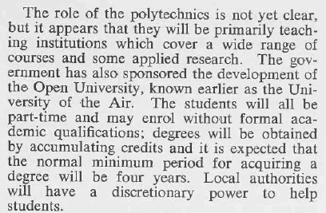
The Woman Engineer - Winter 1969
Open University created opportunities for married women
Notes:
When the Open University was established, it was seen as a significant game changer for women in engineering, in particular the opportunity for married women to study engineering was exceptional at the time. You may recognise the name Daphne Jackson - she became the first female professor of physics in the UK a couple of years later.

Slide 7
Keeping count
Fuzzy fractions
UK Female Engineering Graduates
UK Initiatives
Data from various sources
For women and for higher education
1919 Women’s Engineering Society founded
1963 Robbins Report – Higher Education
1969 Year of Women in Engineering
1980 Finniston Report – Engineering our Future
1984 Women in Science and Engineering
1992 Education Reform Act
2014 National Women in Engineering Day
Growing participation,
but reaching a low plateau
Notes:
Looking at development of engineering education from 1969, the Year of Women In Engineering, the data is rather fuzzy. The estimates here draw on data in the 1980 Finniston Report, a 1998 parliamentary debate on scientific careers reflecting on the 1984 Women Into Science Engineering initiative, and recent data from Engineering Professors’ Council.
Definitions of Universities and Engineering degrees have changed, and calculations rely on rounded values but there does seem to be a steady increase in the proportion of female engineering graduates, from about 4% in the late 70s rising to 14% by 1998, before slowing again to reach about 16% just before the COVID pandemic. Participation by women was growing, but seemed to be reaching a plateau - prompting. National Women in Engineering Day, instigated by Dawn Bonfield in 2014, amongst renewed attention to diversity in Engineering Education. NWED has now expanded to INWED and is celebrated on 23 June each year, the anniversary of WES’ formation

Slide 8
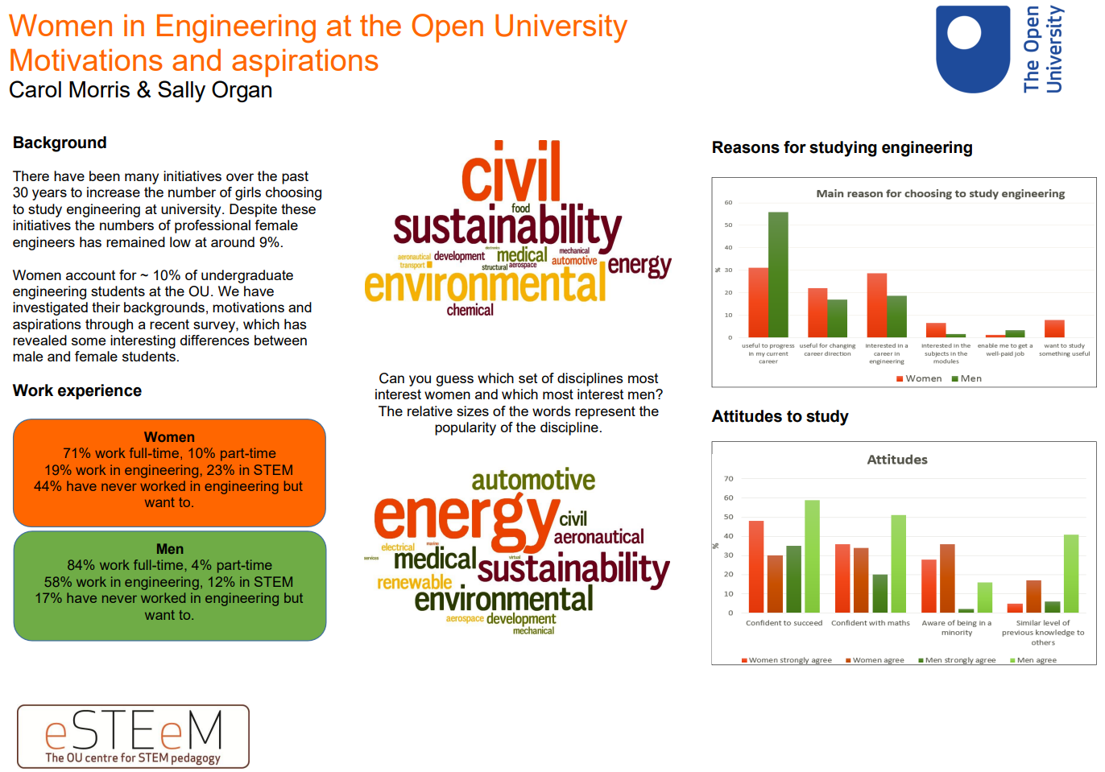
Women in Engineering at the Open University
Previous research 2015-2020
Supporting women in engineering
Degrees of diversity
eSTEeM project (2017-2019)
  Carol Morris and Sally Organ
  Engineering qualifications at the OU – what motivates women to study?
Women on Engineering OU qualifications were:
  ~10% of the cohort
  less likely to be working in engineering
  more likely to have a degree
  already aware they are minoritised
Female students less likely to already be working in an engineering role
Notes:
Here at the Open University, Carol Morris and Sally Organ considered the motivations and aspirations of women in engineering. They found that 10% of the Undergraduate engineering cohort were female and that female students were less likely to be already working in engineering but more likely to already have a degree in another subject than their male contemporaries.
Female engineering students were also already aware that they were minoritized in the industry, and in their studies.

Slide 9
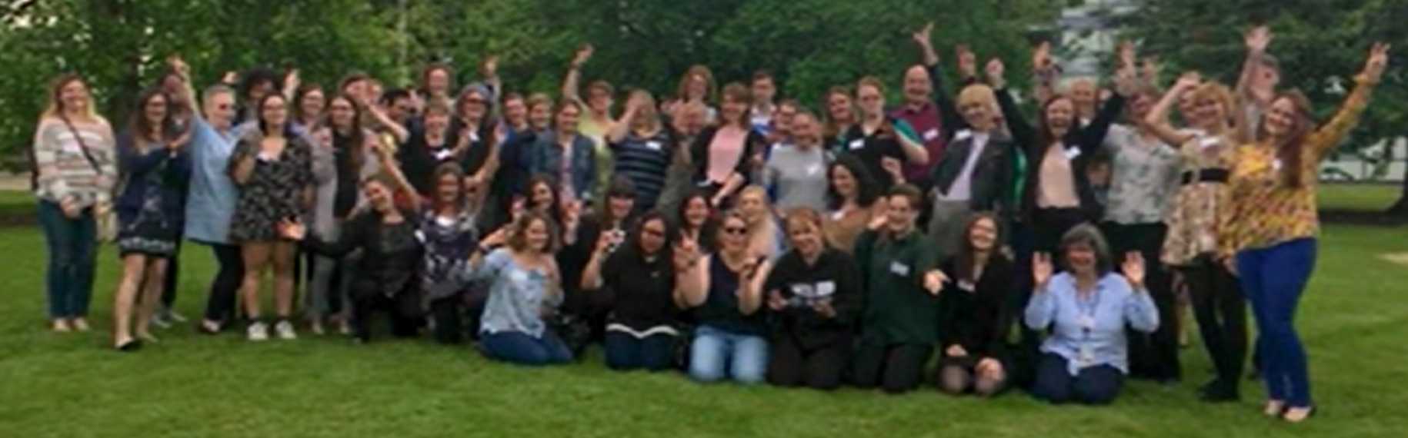
Recommendations
Concerted effort, within curriculum and beyond
The OU journey to 2020
Interventions and recommendations
Designing in diversity
Community building to reduce isolation
  Annual student conference
  Dedicated webpages on VLE and internet
RAEng Visiting Professor Jan Peters
  ‘Transforming Engineering Culture’
Curriculum renewal
Women’s Engineering Society
  Education Partner
  Student network
  Gender decoder for recruitment
Year | Conference | Venue
2016 | Making connections – Celebrating Women in Engineering | Milton Keynes
2017 | Creating supportive environments | Milton Keynes
2018 | Levelling the playing field | Milton Keynes
2019 | Transforming the future – engineering for all | Birmingham
Notes:
A number of recommendations were made, designing gender diversity into our engineering curriculum and initiating a series of conferences, which ran from 2016 to 2018 on campus in Milton Keynes, and then in 2019 at Aston University, in Birmingham. Dedicated web pages were set up on the VLE and the Internet. The Royal Academy of Engineering funded a visiting professor, Jan Peters, and she worked with the School on transforming engineering culture.
The engineering curriculum was under review and a concerted effort was made to embed diverse role models and broaden case-studies, for a wider range of future engineers and engineering careers. The Open University is also now an Education Partner of the Women’s Engineering Society, with benefits including support for WES OUSS, our Open University Student Society and access to a gender decoder to diversify language used in recruitment advertising.

Slide 10
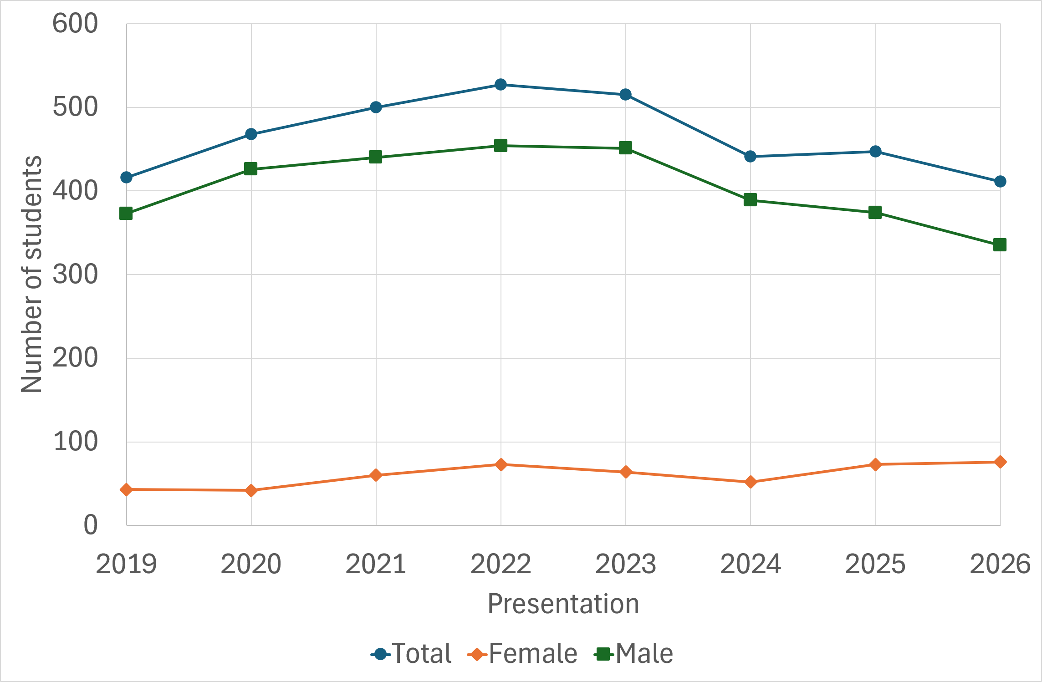
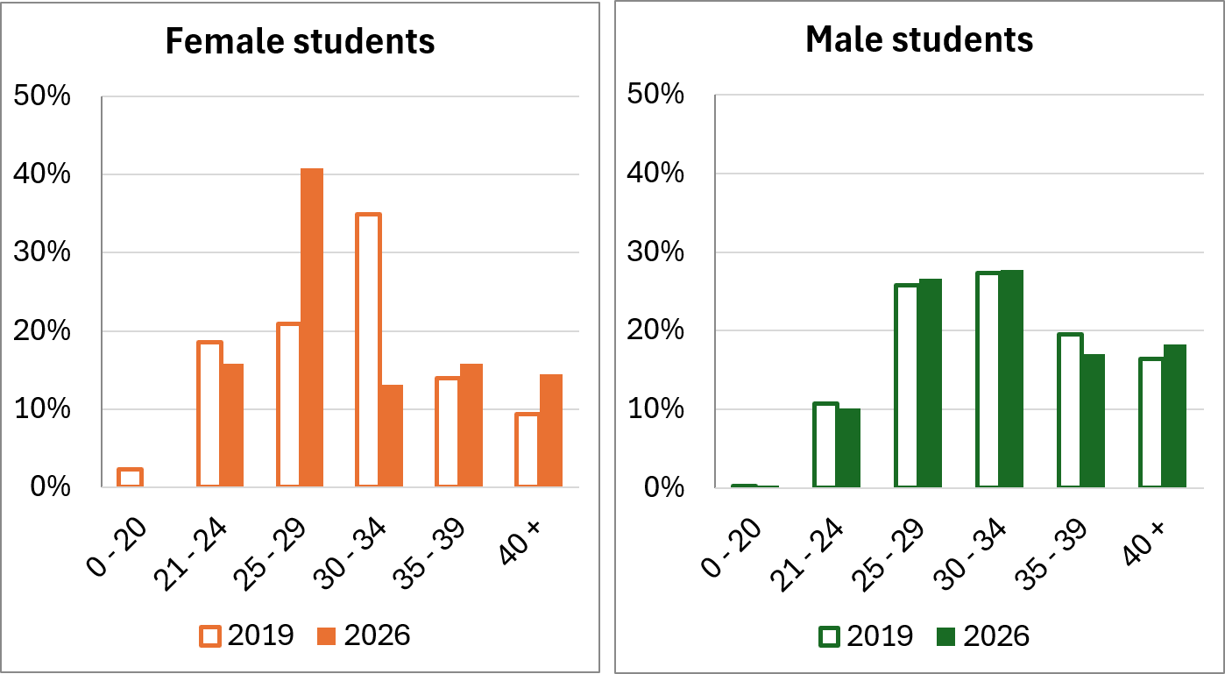
2020 and beyond
Data from a Level 2 Core Engineering module
Gender balance
Proportion by age
Female students increasing
10% female in 2019; 18% female in 2026
Median and mode still 30 – 34 for male students, Median and mode now 25 – 29 for female students
Participation is increasing, particularly in younger age groups
Notes:
The COVID pandemic in 2020 prompted big changes in HE and in Engineering so in our eSTEeM project, Making Space for Women, we revisited the previous study to understand how cohorts and experiences had changed. The data here is from T272, a Level 2 core engineering module, taken primarily by engineering students and required for all Undergraduate engineering qualifications.
When the module started in April 2019, the cohort was 10% female students and that has grown to 16% female students on the 2025D presentation, and 18% this year.
The age distribution has also shifted for female students, with the median and mode dropping to 25-29, whilst these remain at 30 to 34 for male students. Hence, whilst the overall proportion is now at 18%, the proportion has reached 26% for students under 30.
Our initial plan would also have considered ethnicity. However, it was evident as soon as we started on the student survey request that the level of diversity was too low for any analysis to be meaningful, and considering intersectional demographics would make students individually identifiable.

Slide 11
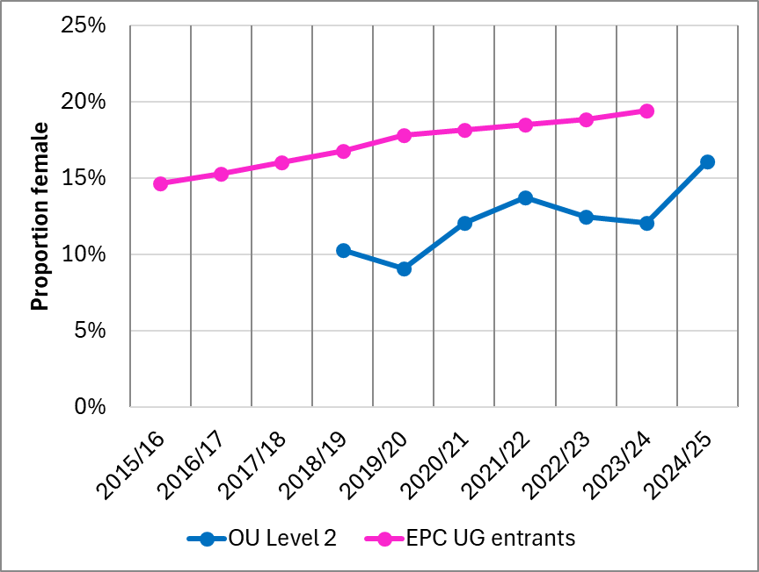
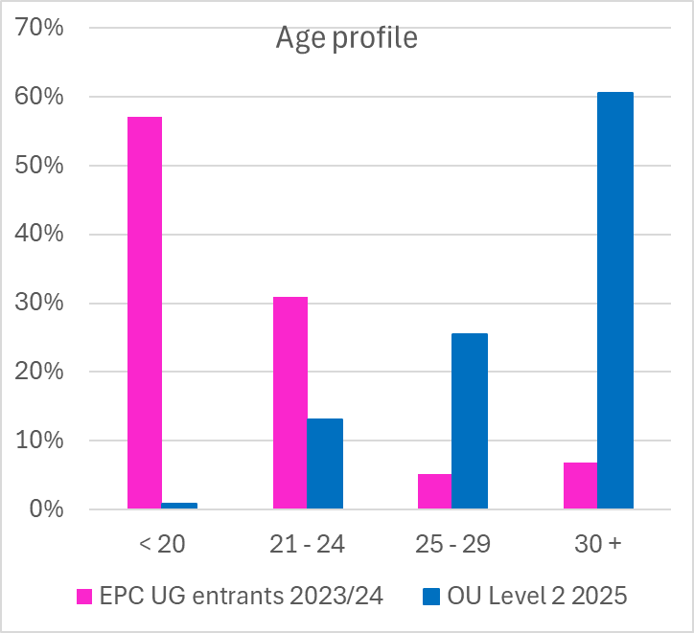
Comparison of OU Level 2 core module to UK HE
Data from Engineering Professors Council (EPC)
Gender balance
Proportion by age
Proportion increasing but still below average …
However, OU students are significantly older
Still well below courses elsewhere
Notes:
Comparing that with UK wide data collated by the Engineering Professor's Council, we see a steady increase in UCAS applications from about 15% of enrolments in 2015/16 up to 20% of enrolments in 2024/25. Comparing our students on the Level 2 core engineering module, we had increased from 10% in 2019 to 16% in 2025, a decade or so behind. However, there are striking differences between our cohort and those elsewhere – whilst the vast majority of entrants to Undergraduate engineering degrees are under 20, the majority of our Engineering students are over 30. And we are exceptional in primarily education engineering students via part-time routes.

Slide 12
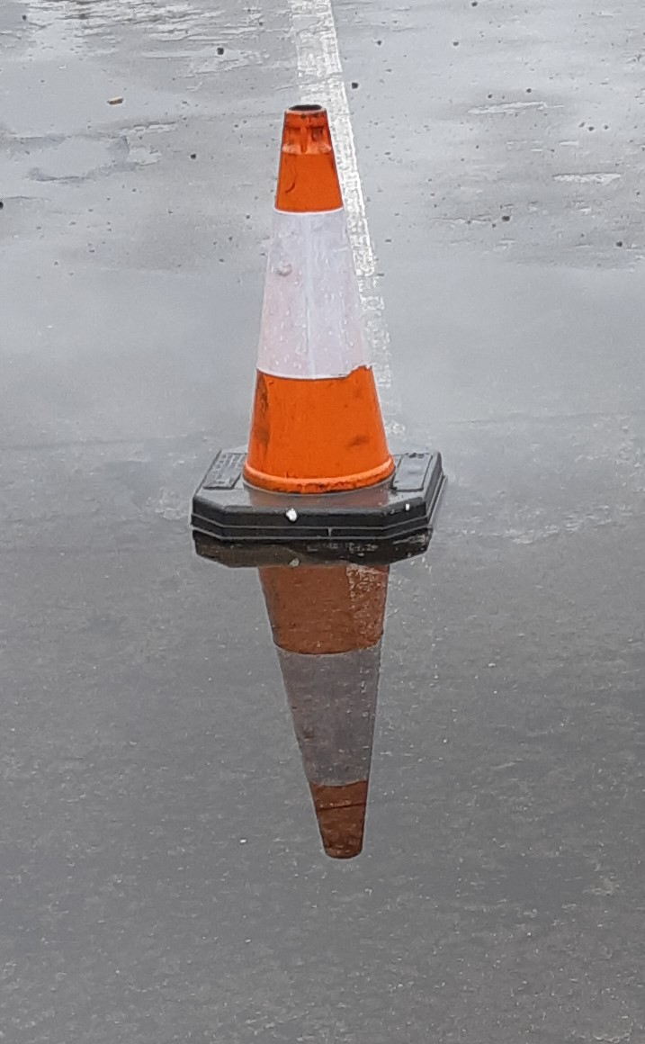

What next?
Engineers 2030 - future skills for UK Engineering profession
More engineers
With different knowledge, skills and behaviours
Increasing and replacing
Reflective, interdisciplinary practitioners
  Climate action
  Career progression
  Specialists and generalists
  Sustainability
  Systems thinking
  Creativity
Women in Engineering can provide:
more engineers
wider range of skills
resilient recruitment pool
as well as
improving equity , diversity & inclusion!
Notes:
So what next?
Engineers 2030, a large project initiated by the Royal Academy of Engineers, looked at future skills for the UK engineering profession. They concluded that more engineers are needed to increase the engineering workforce and to replace engineers approaching retirement.
Those engineers are needed are to meet the increasing demand for climate action, to support career progression and to provide a range of both specialists and generalists able to tackle complex challenges.
Engineers in the 2030s, will need different knowledge, skills and behaviours to those who have come before: they need to be reflective, interdisciplinary practitioners, well versed in sustainability, systems thinking and creativity.
Recruiting and retaining more women in engineering are critical to meeting this challenge, providing more engineers, with a wider range of skills and offering a more resilient recruitment pool than recruiting overseas - as well as the benefits of improving equity diversity and inclusion.

Slide 13
Landscape for learning
What has changed?
Improvements
Challenges
At OU and beyond
Emerging or continuing
Curriculum development
Associate Lecturers as permanent staff
Visible diversity
Online events
  Greater choice
  Affordability
  Accessibility
Budgets restricted
In-person contact rare
Qualifications secondary to modules
Extra-curricular events
  Overwhelm
  Engagement
  Inter-visibility
Resistance to inclusion
Increasing visibility:
OU as an Engineering educator
Engineering within OU
Across OU Engineering staff and students
Notes:
But there have been many other changes since 2020 at the Open University and beyond. Our curriculum has developed, with associate lecturers as permanent staff better able to support progression and engagement with the professional engineering institutions. We have more visible diversity amongst teaching staff. And the move to online events has allowed us to offer greater choice with greater affordability and improved accessibility. These changes were welcomed by the students we surveyed and interviewed.
However, challenges were also identified. Some module content seemed dated, with budgets limiting the frequency of updates, many students had never met a member of OU staff and interactions with other students were by chance, at work or through family. Students had enjoyed their modules but did not have a well-developed programme identity. Extra-curricular events are difficult to engage with due to an overwhelming array of channels and messages and offer only limited opportunities for interaction or inter-visibility within the audience.
Whilst we had set out to understand the needs of female engineering students, we found that many students would benefit from activities that provided greater visibility of OU as an Engineering educator, of Engineering within OU, and inter-visibility of OU engineering staff, students and graduates.

Slide 14
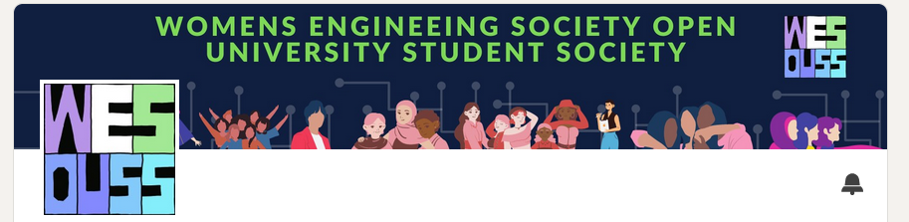
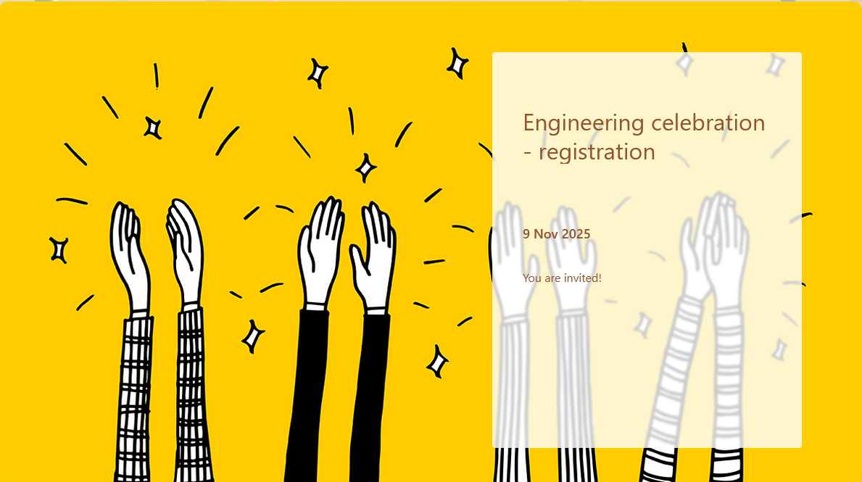
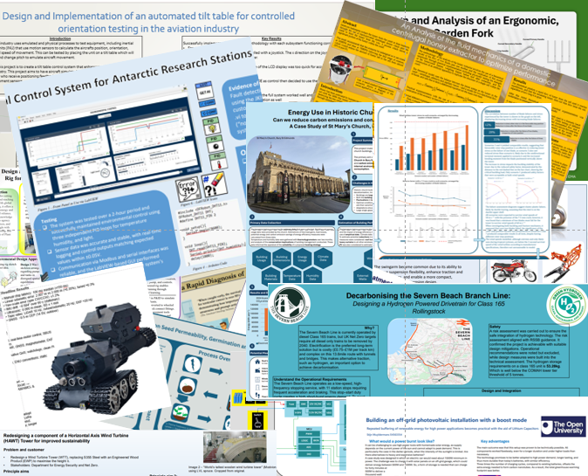
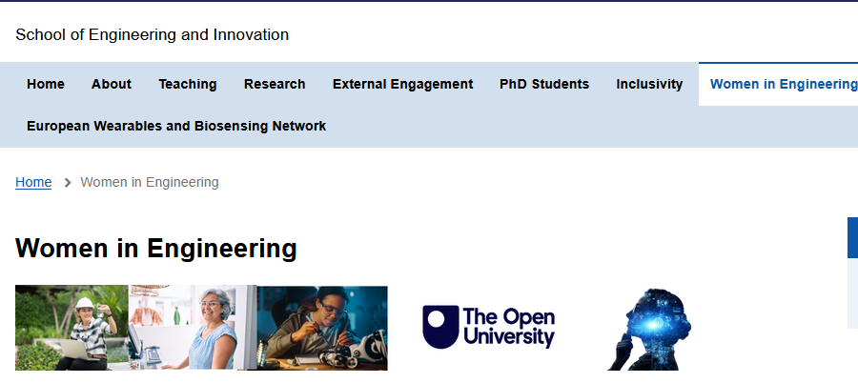
External engagement has potential
to publicise qualifications,
enhance learning
develop the alumni network
Building community
Design for diversity, open to all
Extra-curricular
Women’s Engineering Society (WES)
Engineers Without Borders (EWB)
Professional Engineering Institutions (PEI)
Association for Black Engineers (AFBE)
Events
INWED (June)
Engineering Celebration (November)
Promoting events by others
Careers
Faculty
WES/EWB/PEI/AFBE
Notes:
We are therefore using our women in engineering activities to build community for all engineering students. We will continue to design events of particular relevance to female engineering students but open to all, including external speakers and guests. Hence, we are promoting extra-curricular opportunities offered not just by the Women's Engineering Society but also by Engineers Without Borders and professional engineering institutions. We hope a new OU Robotics Society can learn from the founders and committee of WES OUSS.
We will continue to run events, including celebrations of International Women in Engineering Day each June and National Engineering Day in November, but favouring short, online seminars that are affordable and efficient – both for the organisers and the attendees. In November 2025 that has included an online poster show for our Engineering projects, with dates under discussion for 3 online events in 2026. We can also use our Women in Engineering Forum to promote particularly relevant events by others, both internally from the careers and employability service and the STEM faculty, and externally by WES, EWB and PEI.
A focus on external engagement benefits students by raising the profile of their qualifications, as well as enhancing their learning and developing the alumni network.
The approach also allows us to support a wider range of minoritised students by meshing with other initiatives, for example signposting Black In STEM internally and Association for Black Engineers externally, and ensuring events remain inclusive of trans women.

Slide 15

Next steps
Making space for community
Scholarship
  eSTEeM – OBSTACLES in-person day schools for T452
  OSC – soft skills for professional practice
Delivery
  leveraging the LEM
  extra-curricular events
Production
  design for in-person practical work
Collegiate
  Building Belonging Together 2026
  inclusion of ALs
  showing up
3249: Neutrino Project - explain xkcd
Notes:
Since completing the eSTEeM project, our work on community has carried on. On the scholarship front, I am involved in a new project looking at overcoming barriers in the capstone project, through in-person day schools. We are both working on a cross-faculty project on soft skills in professional practice. Interaction is an essential requirement to develop and demonstrate many of these, such as communication and teamwork.
As a Staff Tutor, I am also applying some of the lessons learnt for populating and publicising the learning event schedule, for example consistently offering daytime and evening options for attendance and publicising schedules on forums. We also continue to organise extra-curricular events and share details of events – but budget and workload constraints make this increasingly difficult. In production, I am also involved in writing for what we hoped would be a return of in-person practical work, as a short residential on campus. That was rejected at scrutiny, but we will still write to keep the return possible and to maximise the interaction online.
Beyond STEM, I have also been a contributor to the Building Belonging project, which has produced a toolkit; As with production, I had high hopes but the concept of building community by providing individuals with a toolkit misses the mark. We need a more radical approach – considering how we can build in-person contact back into the OU experience – not for every module, in every region, but sufficient to ensure that every students and every Tutor has opportunities to meet with peers every year. The funding may not stretch to a neutrino project, but the grants and support we receive through eSTEeM, are a foundation and a beacon for building community within and beyond OU STEM ☺

