Slide 1


Front Cover Title 1
Can we reduce anxiety of students sitting online exams?
Fiona Moorman, Gemma Warriner and Becca Whitehead
This Photo by Unknown Author is licensed under CC BY-SA-NC
Notes:
Fi from start

Slide 2




Project
Reason
What did we do?
Data gathering
A scholarship project that aimed to capture the reasons for online exam anxiety
Reduce online exam anxiety if possible
Some students who sat OU online exams were very anxious about the move from face-to-face
Ran large scale online exam support sessions
Prepared students for the experience
Pre-results large scale JISC survey (349 respondents)
Later JISC based interviews and focus group
Student feedback from exam support sessions
Outcomes
Identified themes associated with student anxiety about online exams
Reduced anxiety about online exams for some students

Slide 3
Survey: What did you wish you had known?
Theme | Number of responses
How little time I’d have / how fast it would go | 37
That an open book exam would be harder/ take longer | 4
That I’d have IT issues | 33
That the support/ preparation would not have been adequate | 11
That I would be confused about other aspects of the exam/ processes | 21
That it would be ok / positive | 21
Miscellaneous (timer / distractions / OU admin / anxiety) | 13
We were interested in sources of anxiety that were particular to sitting an online exam.
Students have always found exams stressful, but we have picked out two themes related to sitting an exam at home:
Lack of time and distractions
IT issues
These affected even very well-prepared students
Notes:
As can be seen IT issues and time management are the largest factor here. It is pleasing that 21 students wish they had realised that the exam would be alright, hopefully this will feed into their next remote exam experience.

Slide 4

Potential sources of anxiety: time concerns
Notes:
Gemma from here

Slide 5
Sources of anxiety – Lack of time
I answered as much as I could but typing an exam was very difficult especially with equations etc and then having to add in scanned drawings etc was time consuming so wasn't able to complete the exam fully.
It being open book was more of a hinder than a help - too tempting to refer to books which caused time to run out.
Even though I’d revised for the exam I still struggled to finish within the time allowed without getting penalised.
We asked students in the survey how easy it was to complete their exam in the time available:
33% said it was very difficult
14.1% said it was difficult
Of the students asked 11.2% were unable to complete the exam
Free text comments from survey and focus group
(survey data from 349 students; Eighteen students took part in Jisc-based interview and 6 students took part in a focus group 8 months after their exams)
Notes:
A little over 10% of the 340 students who responded to the question ‘Were you able to complete your remote exam’, indicated that they were unable to complete their exam (38; 11.2%).

Slide 6
Potential sources of anxiety: technical issues
Notes:
Becca to end

Slide 7

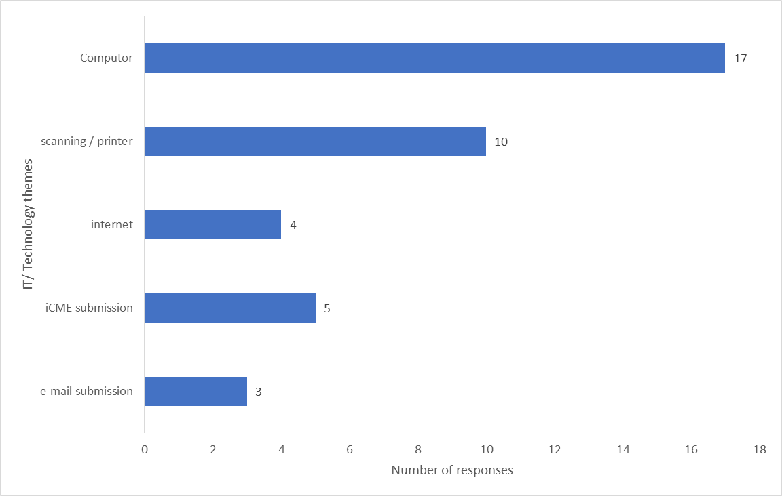
Sources of anxiety: technical issues
The top two causes of technical issues are the student’s own equipment
Their computer and scanner/printer
Free text comments organised into themes (survey)
Notes:
Computer issues were the biggest issues followed by the scanning /printer.

Slide 8
Sources of anxiety: technical issues
‘…Slow internet speed.’ ‘Internet went down for 5 minutes it just caused anxiety but it all went back to normal soon‘.
‘The tab froze on my computer. The clock was still counting down but I could not move to the next question using next button on question status box.’
‘My keyboard stopped working so I couldn't type anything!‘
‘I inadvertently pressed the submit button before uploading my answers on the system.’
There was evidence from the survey responses that the quality of the IT equipment could influence the exam experience and potentially the level of anxiety.
However not all students reported these experiences
Free text comments (survey)
Notes:
When asked whether their IT/ technical issues had been resolved, 33 students said yes, but 14 students (29.8%) said that they had not been resolved.
These results indicate that not all students are seeking the correct help for technical issues, the SST are not able to help with IT. Contacting the helpdesk is a better idea and it was good to see that students were filling in the special circumstances form.

Slide 9

Online Jisc-based interview and focus group reflections
“I’d spent years working towards doing these exams, and everything that comes with that, and I felt reassured that I would be at home in a known and cosy environment, and I had everything set up, I thought, but I could not have prepared myself as the sheer panic when …the digital timer that you have on the screen was ticking down”
“It really did panic for me and it definitely did affect my performance on the day, so in future I would have to prepare for that element of it.”
Eighteen students took part in Jisc-based interview and 6 students took part in a focus group 8 months after their exams.

Slide 10
Conclusions and Recommendations
Preparation
Time
Inequality
Preparing students for their exam via the online sessions did reduce the anxiety of many
This work should be extended
Some students will continue to find exams very stressful
Emphasise to students that searching for internet-based resources is not needed.
When setting exams, module teams should consider the extent to which students consult sources
Need for clarity around timings and the timer itself
Inequality of students’ own equipment will be a factor in remote exams
Home setting will not be equal for all students
Continued anxiety around using OU exam systems and technical support on the day is vital
A scholarship project that aimed to investigate the reasons for online exam anxiety
Reduce online exam anxiety if possible
Notes:
The exam preparation sessions directly contributed to a better examination experience for the cohort who sat their exams in June 22, as measured by fewer reports of anxiety-issues on forums and fewer phone calls to the student support teams.
The need to practise producing a document was emphasised and students were encouraged to decide whether to type or handwrite based upon their own skills, and the type of questions that they would face. Practise on using the exam systems was advertised more widely to students.
Findings from our survey were disaggregated by module and shared with Module teams who used these findings to inform setting exam papers and planning student support measures. highlighting the issue of lack of time fed into discussion about the number of questions to have and to factor in time spent looking at module materials.
We contributed to discussions resulting in changes to university-wide guidance given to students on the student-facing ‘Help Centre’ concerning the term “open book.”

Slide 11

Thinking about assessment changes in the future
Some students will feel that they have gained - others will feel that they have lost
A massive student concern: “What happens if my internet fails?” but some students reported an unwillingness to go back to face-to-face exams
Inequality of students’ IT equipment and home setting will be a factor in remote assessment
Clarity in instructions and support will be essential
Need to continue to develop student self-efficacy to reduce anxiety in response to any key change in assessment.
Any change in assessment may have unintended consequences
Notes:
Students may be concerned about inadvertent plagiarism

