Slide 1

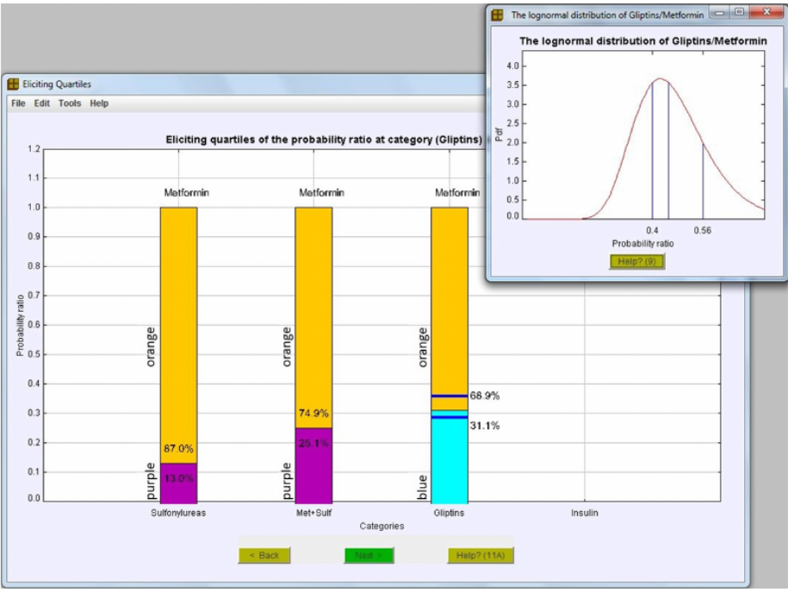

Using knowledge from Associate Lecturers in a Bayesian model to predict the probability of students’ results
Fadlalla Elfadaly, Carol Calvert and Rachel Hilliam
Project Aims
We believe that incorporating the ALs’ opinion and expertise together with the data can be highly beneficial in building predictive statistical models to predict probabilities of students’ grades.
* The proposed project aims at building a Bayesian multinomial logistic model.
* The experts’ knowledge (ALs in this case) will be elicited and quantified into the model.
* It is proposed that a grade for a student could be predicted from the model.
Objectives
We aim for a two-year project where the statistical methods and available user-friendly tools are used:
* In the first year we build the models, elicit the ALs’ opinion and predict the probabilities of different outcomes.
* This will provide a full prediction system that can be used for future presentations.
* In the second year of the project we aim to test and evaluate our proposed system.
Outputs
Based on the predicted probabilities of each pass grade:
* Student support can be efficiently tailored to individual students.
* Hence, this improve students’ satisfaction and/or retention.
* For example, students with potential risk of failure can be identified to get more support.
A screenshot from the elicitation software to be used

