Slide 1
Can a new OU Study App enhance the learning experience of students on S350, an online only module?
Catherine Halliwell, Jenny Duckworth, Rachel McMullan & Simon Collinson

Slide 2

Presentation outline
Aims
Methods
Findings
Suggestions
Conclusions

Slide 3

Aims
The average person in the UK spends more than a day a week online, according to an Offcom 2018 report on the impact of the “decade of the smartphone”.
Traditional OU study

Slide 4
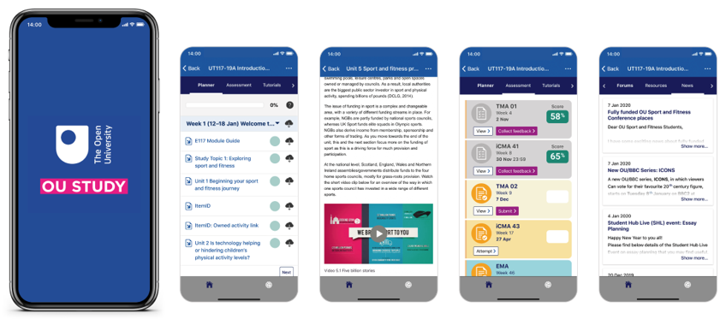
Aims
How can OU students best engage with the OU Study App to optimise their study?
What aspects of the App are critical to supporting the student learning journey and should be developed next/further?’
OU Study App Project Site (2019). Available at https://learn3.open.ac.uk/course/view.php?id=301070

Slide 5
Methods

Slide 6
Methods
8 student volunteers took part in the study
Student volunteers completed study diaries recording their use of the OU Study App during their daily routines over a three week period.
Student partners gave early feedback on our aims and methods.
‘I think the questions in the practical diary look good, and the fact that they are mostly tick boxes should mean it's easy and quick to fill in. You mentioned it was an online version, which sounds great, so even better if no downloading and sending back is required. ’

Slide 7
Findings

Slide 8
Findings
Based on 21 days of diary entries
How long did you use the OU Study App?
Where did you use the OU Study App?

Slide 9
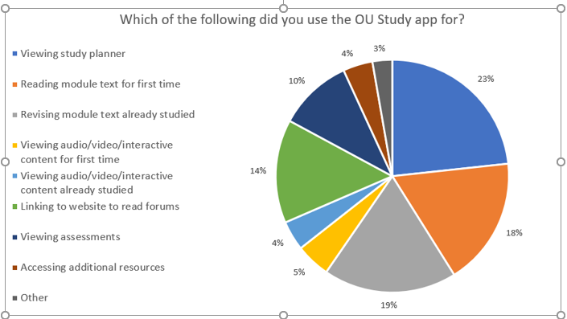
Findings
What are students using OU Study App for?
‘I was able to re-read content I had read previously to remind myself of key concepts as well as keep reading them to gain understanding.’

Slide 10


Findings
Learning Enhancement: deeper understanding of concepts
‘I was able to re-read content I had read previously to remind myself of key concepts as well as keep reading them to gain understanding.’
‘yes definitely, I can check often on study material’
‘Yes, it does feel different - it enables me to increase my available study time a bit. As I'm working close to my maximum capacity, this is particularly helpful! I don't think it helps my understanding specifically but it does help me to study a little more.’
‘Not this week, as I was mainly looking at the assessment brief for TMA02, so I could look at this in the morning and plan my answer throughout my working day in my head’
‘I think it would be hard to read papers on my phone, and to do in depth assignment writing and editing.’
‘Using the app on my phone is a bit cumbersome as reading longer texts would be tiring. So, no.’
?

Slide 11

Findings
Learning Enhancement: time management and effectiveness
‘I found it helped massively with my time management, as if I am unsure of something…, I can quickly look at the required content wherever I may be without access to a PC.’
‘I was able to utilise the otherwise wasted time on my commute.’
‘I fitted in more studying than usual by making better use of small study opportunities. I do think it's useful for this.’
‘Not this week. I was busy with other things and when studying I was mostly writing an assignment and watching tutorials, neither of which used the app….’
‘Not so much this week as I was doing a TMA so I used it less than normal.’

Slide 12
Findings
Learning Enhancement: learning experience
‘I find this app extremely helpful as I am able to study wherever, whenever which in return helps me massively with my time management. ‘
‘Still really enjoying using the app!’
‘I feel this app is extremely helpful... As it is on my phone, I often have my phone to hand ..therefore I am able to access module materials/ assessments easily.’
‘Overall, I would recommend this app and hopefully I will be able to gain access to my other modules! ‘
‘the menus are a bit user unfriendly.’
‘The thing that stops me is that it’s small to read on my phone and don’t want to use my phone battery so I’d rather study on my laptop. But it helps me do bits of studying here and there’

Slide 13
Suggestions
What students would like to see developed

Slide 14
Suggestions
I wonder if future versions could have the ability to highlight text? I use the Mendeley app which enables me to highlight text which then synchronises via the website
From students:
Cut and paste would be helpful. Dark mode would be wonderful. Make a version for Fire tablets (Amazon's Android OS)
to highlight text, in order to come back to the app to take notes when I'm on the computer, and/or to be able to copy and paste from within the app
Please make it so we can select and copy portions of text.
to access the forums

Slide 15
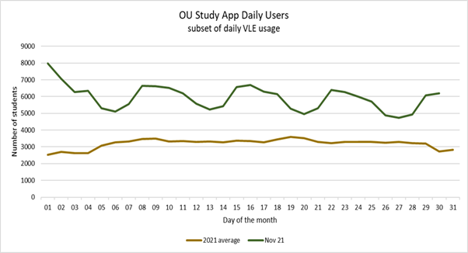
Relevance
Since end of this project:
All module websites live in 2021 are available in the app
~ 6,000 unique users per day (50,000 daily users of VLE)
~ 25,000 unique users per month (140,000 for VLE)
So are a significant subset of main VLE users – all evidence points to most use as a complementary tool to study rather than replacement.
In line with general digital study habits, VLE usage more popular early in the week (tutorials are more often scheduled Mon-Wed pm, perhaps a trigger for these study habits).

Slide 16
Conclusions

Slide 17
Conclusions
From students:
An enabler for students to improve their learning experience:
‘I'm chronically ill and mostly in bed, so it doesn't affect whereabouts I study, but it does make it easier to do little bits of studying here and there.‘
Feelings of improved time-management and control
More useful at certain times in module study than in others
Increased interest in scholarship
From research team:
Positive feedback on Study App and their relationship with the module
Direct relevance to skills development
Can be used to support study
Need for further development identified

Slide 18

THANK YOU
OU Study App Team
Steve Rycroft
Dolly Majithia
eSTEeM

