Slide 1

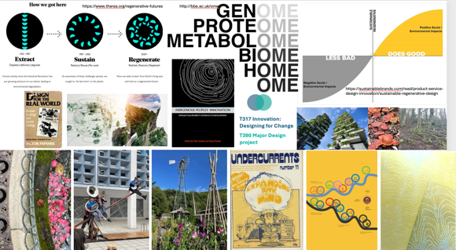
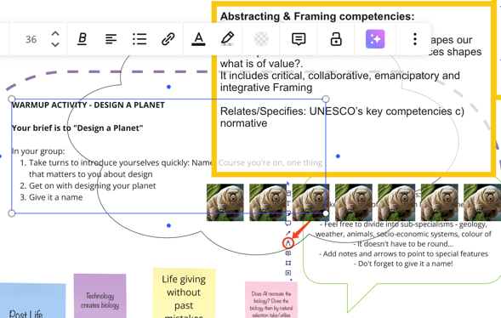
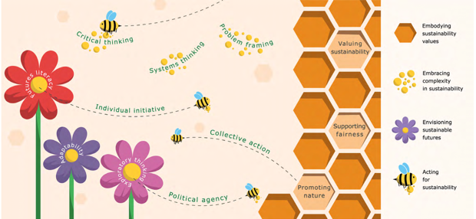
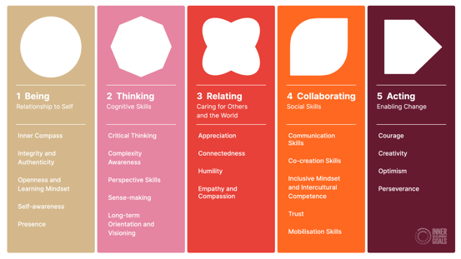

Exploring life competences and green skills for 21st century designers
Emma Dewberry, Vera Hale
R63 STAGE 3 MOOD BOARD
STUDENT’S DESIGNATHON – MIRO ACTIVITIES
This project aligns with the OU 2022-2027 Strategy that highlights Sustainability as a key theme. It explicitly responds to eSTEeM’s focus on embedding sustainability in curriculum design.
The project focuses on supporting Stage 3 curriculum development of the BDes (R63) qualification, reviewing frameworks for sustainability competences and exploring what ‘green skills’ for the 21st century should look like. Drawing on literature and practice we examine sustainable pedagogy, life-wide capabilities and different reflective practices. We will undertake expert and employer interviews, as well as seeking student input from the Responsible Futures Survey and OU design-led events (Designathon, Sustainathon).
The project aims to develop a framework for integrating green skills into OU design education, contributing to wider debates on higher education’s role and impact in delivering ecological transformation for the creative economies and beyond.
VISUALISATION OF EUROPEAN GREEN COMPETENCES
UN’S INNER DEVELOPMENT GOALS FRAMEWORK

