Slide 1

Inclusive Curriculum in STEM
Where are we now, and where to next?
Diane Butler, Andrew Potter and Peter Wood
eSTEeM STEMinar series
18th March 2025

Slide 2



Page Title 2
Inclusive Curriculum
Background
The Inclusive Curriculum Tool (ICT) was developed by colleagues across the University as part of a suite of measures to address awarding gaps as part of the University’s Access and Participation Plan (APP).
Training, guidance and resources available on the Inclusive Curriculum intranet page
In March 2022, VCE Academic mandated that:
  All new modules must use the ICT
  All existing modules must use the ICT before the end of AY 28/29

Slide 3
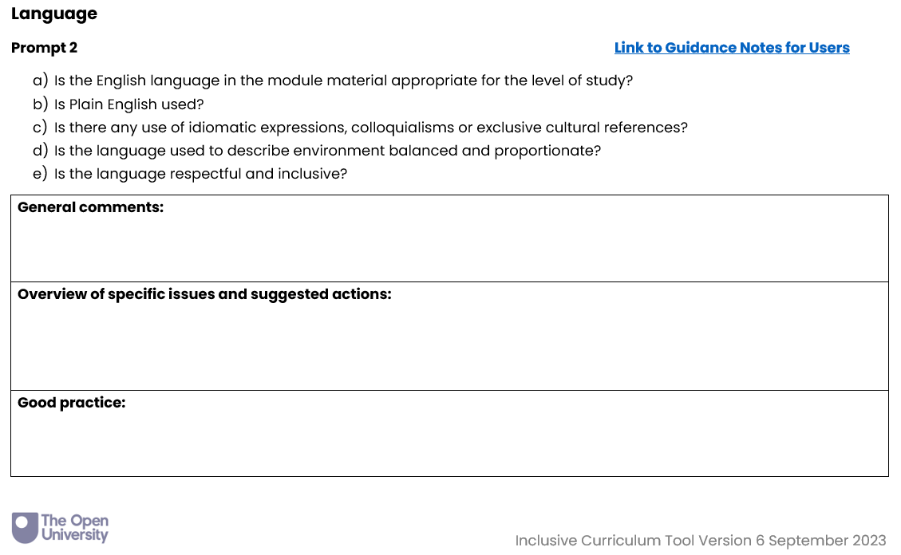
Page Title 3
STEM Inclusive Curriculum Project
Phases 1—4: from May 2021 to present
Audits of ~65 STEM modules – looking at distance learning materials, both online and print
Associate Lecturer reviewers
Intensive expert-led EDI training

Slide 4
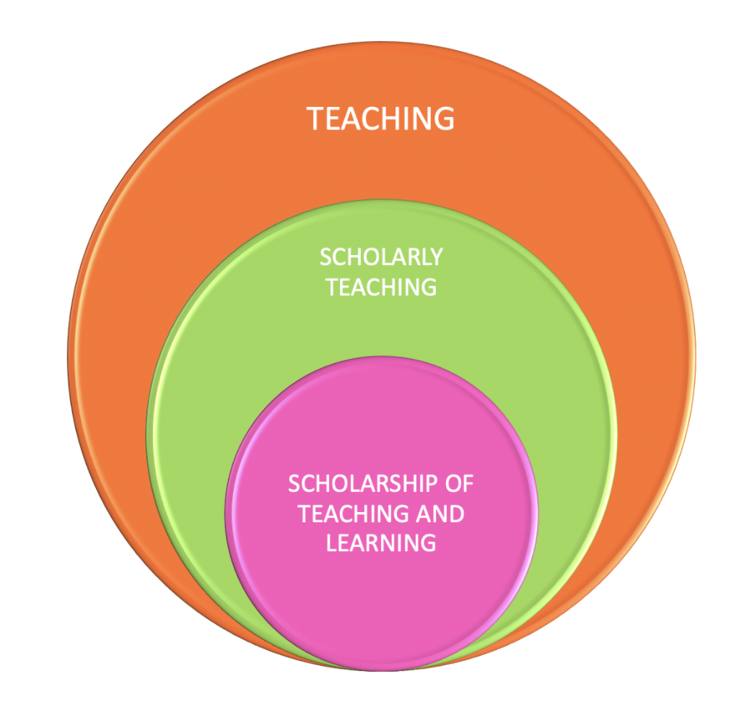
Page Title 2
Scholarship of Teaching & Learning
Bringing a scholarly lens to the day job
We decided early in the project that the work would benefit from a scholarly evaluation, with generous support from eSTEeM.
Qualitative data collection
Practitioner reflective journals
Recorded project meetings
Semi-structured interviews
Thematic analysis
Results on what kind of issues were identified in reviews
Meta-analysis on the experience of being a reviewer

Slide 5
Page Title 6
Themes
Reducing harm
Greater representation
Critical perspectives
What came up?
Language
Avoiding colloquialism and cultural assumption
Use of diverse pronouns
Inviting student reflection on language
History
Avoiding problematic figures / issues
Including non-Western perspectives
Confronting challenging figures / issues
Images
Removing stereotypical images
Representation of diverse people & culture
Story behind the image – power relations
Case Studies & Data Sets
Avoiding ‘disaster narratives’
Inclusion of global examples
Posing contextual questions/challenges

Slide 6
Page Title 3
So I think it's helped me to help my students imagining, imagine that they might read and go through and they see something that is sort of really UK based and they don't feel like they fit in.
Reflections on inclusivity
Results from our Associate Lecturers
AL reviewers reported a transformative effect on their own teaching practice
An institutional justification for breaking down perceived hierarchies
A stepwise model for describing an individual practitioner’s approach to inclusivity
I think using the tool puts you in a different way of thinking. That opens you up emotionally to look at those kind of hierarchies and power dynamics within society as a whole.
It's informed my practice. It's made me think about my practice and I would say I'm all the better for it.

Slide 7
Page Title 5
A stepwise journey to inclusion?
Where does the Inclusive Curriculum Tool provide support on this journey?
Critical reflections on our approach
Step 4
Challenge
Explicitly challenge injustices past and present in our disciplines
Step 3
Engage
Provide opportunities for all students to have their lived experiences valued
Step 2
Diversify
Provide opportunities for all students to see themselves reflected in the materials
Step 1
Reduce harm
Make sure we don’t cause any offense or harm to our students from minoritized groups

Slide 8

Page Title 3
What’s next?
What do we think is crucial?
Students-as-partners approach
Excellent professional development
Diversifying the staff base
Recognition for staff working in EDI
Critical approach to institutional change
Greater awareness of institutional power dynamics
Recognition of the importance of qualitative data and narrative voice
Image, L to R: Nicole Lotz, Ida Rodrigues and Cindy Darbandi.
Example of Students as Partners in Inclusive Design Curriculum Co-Creation at the OU.

Slide 9
Thank you!
Diane.Butler@open.ac.uk
Andrew.Potter@open.ac.uk

