Slide 1




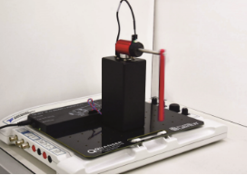


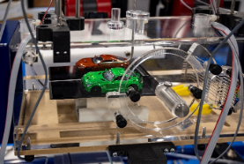
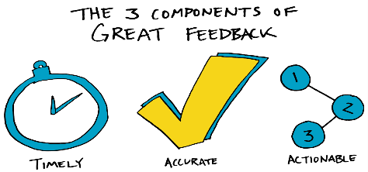


OELAssist - Enhancing the Open Engineering Lab (OEL)
Student Experience
Dhouha Kbaier and Andrew Mason
What we intend to do
Revolutionise OEL student experience
Reduce awarding gaps, increase retention, and promote progression
Create OELAssist support system for real-time assistance
What we expect to achieve
Enhanced student experience
Data-driven insights
Effective feedback mechanism
Generative AI model
Curriculum integration for long-term impact
How we are going to do it
Two integral stages:
Stage 1: Identification and diagnosis
Collect and analyse data on student interactions
Derive sequential rules for successful experiment completion
Stage 2: Intervention and remediation
Real-time issue detection
Timely feedback and remedial advice
Generative AI for flexible support
Notes:
This Photo by Unknown Author is licensed under CC BY-SA-NC
This Photo by Unknown Author is licensed under CC BY-ND
This Photo by Unknown Author is licensed under CC BY
This Photo by Unknown Author is licensed under CC BY
This Photo by Unknown Author is licensed under CC BY

