Slide 1
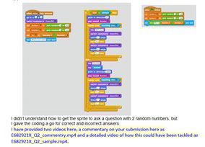
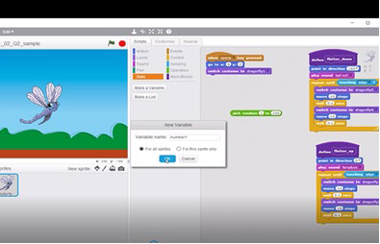
Developing programming problem-solving skills using individualised screencasts
Sarah Mattingly, Christine Gardner, Richard Walker
Michael Bowkis, Shena Deuchars, Nigel Gibson, Dave McIntyre, Peter Thomas

Slide 2

Background
TM111 - 30 credits
D and J presentations 4600 students p.a.
Issue
Problem-solving in programming involves:
analysing, designing, implementing, testing…
tricky programming concepts (iteration, selection…)
complexity
problems for novice programmers!
Inspiration
Problem-solving screencasts in TM111 online teaching: videos
of programmer thinking aloud their approach to solving a
problem – making mistakes, backtracking, testing, finding
errors, correcting code …

Slide 3
Project outline
Tutors provide screencast instead of written feedback on individual TMA answers, giving audio-visual insight into how an experienced programmer solves a problem, following the student's own initial thought processes.
Aims
Are problem-solving skills enhanced?
What screencast content is most beneficial?
How time-consuming for tutors?
Activities
Stage 1 - Free-rein screencasting exploration Five experienced, funded TM111 tutors created individual screencast TMA feedback, deciding on which solutions to focus; the content and structure of screencasts; and the technologies.
Stage 2 - Guided screencasting
Two volunteer tutors created individual screencast TMA feedback, following guidelines developed from Stage 1.
Notes:
Stage1 - 55 screencasts were created for 31 students.
Stage 2 - Four screencasts were created for four students.

Slide 4
Student feedback
"… adressed to me, easy to understand and I found it vey useful"
… easier to follow the visual feedback within OU Build than just being presented with screen captures and written explanation
"I didn't understand how to get the sprite to ask a question with 2 random numbers. But I have the coding a go for correct and incorrect answers."
"I have produced two videos here, a commentary on your submission."
Two Stage 2 screencasts were selected to be used as examples for tutors in future presentations:
Sample 1
Sample 2
Notes:
Two Stage 2 screencasts were selected to be used as examples for tutors in future presentations (https://youtu.be/QX5tDYC0Iaw and https://youtu.be/M_ehmI_bKug).
Two Stage 2 screencasts were selected to be used as examples for tutors in future presentations (https://youtu.be/QX5tDYC0Iaw and https://youtu.be/M_ehmI_bKug).
Two Stage 2 screencasts were selected to be used as examples for tutors in future presentations (https://youtu.be/QX5tDYC0Iaw and https://youtu.be/M_ehmI_bKug).

Slide 5
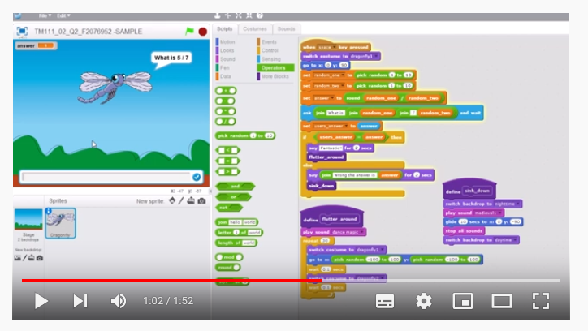
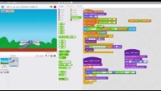
Example screencast
Notes:
https://youtu.be/M_ehmI_bKug
Run some of this?

Slide 6
Findings
Pedagogic and technical guidance
Successful screencasts:
focus on developing transferrable programming concepts and skills
exploit the visual aspects of code creation
focus on student solutions that are substantially right and can made fully correct with a small amount of tutor guidance
are planned, but only roughly
are shared via a simple delivery mechanism such as YouTube
are imperfect. Students benefit from seeing tutors make and recover from mistakes

Slide 7
Areas of impact
Student engagement
Audio-visual feedback is more interesting and easier to understand.
Time watching screencasts is well-spent.
Potential to enhance students’ problem-solving techniques.
Increased confidence in tackling programming tasks.
Tutor feedback
Screencasting feedback has advantages where written feedback would be lengthy and laborious.
Looking ahead
Approach the teaching of OUBuild more visually.
More materials in screencasting format?

Slide 8
Developing programming problem-solving skills using individualised screencasts
sarah.mattingly@open.ac.uk , chris.gardner@open.ac.uk, richard.walker@open.ac.uk
Project outline and final report is available at: https://www.open.ac.uk/about/teaching-and-learning/esteem/projects/themes/technologies-stem-learning/developing-programming-problem-solving-skills-using
Thank you
Questions?

