Slide 1
‘Decolonising the ‘STEM’ curriculum’.
Dr Jenny Douglas, October 2020

Slide 2
History and context of decolonizing the curriculum
Defining decolonizing the curriculum
The BAME Attainment Gap/ BAME Awarding Gap
National Picture – What are universities doing?
Scientific Racism or Biological Racism
Environmental Issues
OU Inclusive Curriculum Tool
Conclusion

Slide 3
Decolonising the Curriculum
History and context

Slide 4
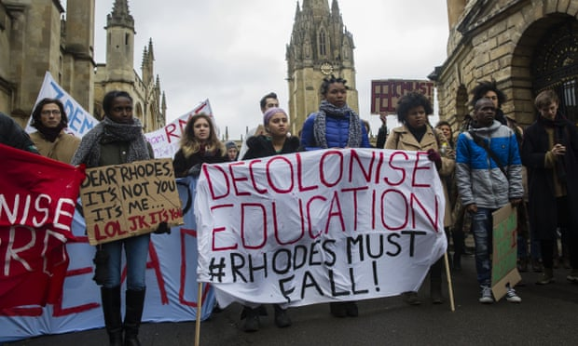
Student Movements to Decolonise the Curriculum

Slide 5
History and context
Rhodes Must Fall Movement, University of Cape Town, South Africa began on 9th March 2015 – students demanded that the Cecil Rhodes statue prominently and centrally on display at the University be removed for what it symbolized and the history it represented in a place of education. Led to a wider movement to ‘decolonise’ education across South Africa, Statue removed on 9th April 2015.
Rhodes Must Fall Oxford Campaign. University of Oxford students demand the removal of the statue at Rhodes at Oriel college, where it still stands. University statement: ‘the debate had underlined that the continuing presence of these historical artefacts is an important reminder of the complexity of history and of the legacies of colonialism still felt today…..we can help draw attention to this history, do justice to the complexity of the debate, and be true to our educational mission.’
Why isn’t my professor Black? March 2014 UCL live panel discussion
NUS Why is my curriculum white? Film 2015
Why is my professor still not Black? 2016 On the second anniversary of March 2014 meeting
This movement has slowly spread through the UK
May 2019 : NUS/ Universities UK: Black , Asian and Minority Ethnic Student Attainment at UK Universities: #Closing the Gap.

Slide 6
Definition from Keele University’s Decolonizing the Curriculum Manifesto
‘
‘decolonizing the curriculum means creating spaces and resources for a dialogue among all members of the university on how to imagine and envision all cultures and knowledge systems in the curriculum, and with respect to what is being taught and how it frames the world’
Keele University, “Keele Manifesto for Decolonising the Curriculum”

Slide 7
SOAS: What is meant by Decolonising SOAS
‘Whilst “decolonisation” is a concept that can be understood in different ways: in our usage, it connects contemporary racialised disadvantages with wider historical processes of colonialism, seeks to expose and transform them through forms of collective reflection and action. ‘Decolonising SOAS’ therefore refers to thought and action within the university to redress forms of disadvantage associated with racism and colonialism.’
A background assumption for us is that global histories of Western domination have had the effect of limiting what counts as authoritative knowledge, whose knowledge is recognised, what universities teach and how they teach it.
Decolonising SOAS, Learning and Teaching Toolkit, May 2018 pg 3.

Slide 8
Open University ‘Innovating Pedagogy 2019’
A curriculum provides a way of identifying the knowledge we value. It structures the ways in which we are taught to think and talk about the world. As education has become increasingly global, communities have challenged the widespread assumption that the most valuable knowledge and the most valuable ways of teaching and learning come from a single European tradition. Decolonizing learning prompts us to consider everything we study from new perspectives. It draws attention to how often the only world view presented to learners is male, white, and European. This isn’t simply about removing some content from the curriculum and replacing it with new content – it’s about considering multiple perspectives and making space to think carefully about what we value. Decolonizing learning helps us to recognize, understand, and challenge the ways in which our world is shaped by colonialism. It also prompts us to examine our professional practices. It is an approach that includes indigenous knowledge and ways of learning, enabling students to explore themselves and their values and to define success on their own terms.
Open University (2019) ‘Innovating Pedagogy 2019. Exploring new forms of teaching, learning and assessment, to guide educators and policy makers’. Report, January 2019, page 3

Slide 9
Kingston University Inclusive Curriculum Framework
Create an accessible curriculum
Enable students to see themselves and their backgrounds reflected in the curriculum
Equip students with the skills to positively work in a global and diverse world

Slide 10
The BAME Attainment Gap or the BAME Awarding GAP
Why do we need to decolonise the curriculum?

Slide 11
The BAME Attainment Gap
Research on Black Attainment Gap since at least 2007
The Equality Challenge Unit’s (ECU) (2017) sets the attainment gap between Black and white under-graduates leaving university with a 1st or 2:1 at 25.3% even if entry tariffs and class are taken into account.
Poor retention rates- Black, Asian and ‘Mixed Other’ have a higher drop-out rate than white or Chinese students.
Urgent issues because it is not only degree outcomes but lack of access to graduate jobs and economically better futures
HEFCE (2017) ‘Tackling Inequality’ – four explanatory factors in the attainment gap:
curricula and learning
relationships
cultural, social and economic capital
psycho-social and identity factors
Higher Education Funding Council for England (HEFCE, 2017). Tackling Inequality

Slide 12
Decolonising the curriculum
Decolonising the curriculum – moving beyond diversification and opening up conversations about ‘race’
Recognising the colonial epistemology – the way in which we come to know, understand and view the world - nature of knowledge - ways of knowing and learning
Developing de-colonial ontologies - world view - how things exist in the social world and assumptions about the form and nature of that social reality.

Slide 13
What Universities are doing in relation to decolonising the curriculum
There is a long list of universities and it is growing :

Slide 14
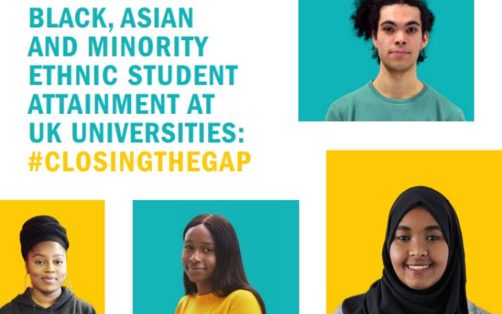

Slide 15
Black, Asian and Minority Ethnic Student Attainment at UK Universities: #Closingthegap
Providing strong leadership: University leaders and senior managers need to demonstrate a commitment to removing the BAME attainment gap and lead by example. UUK and NUS have created a checklist for university leaders to draw upon when considering how to address their institution's attainment gap.
Having conversations about race and changing cultures: Universities and students need to create more opportunities to talk directly about race, racism and the attainment gap and identify what students think is causing it. A change in culture is needed alongside a clear institutional message that issues of race will be dealt with as part of wider, strategic, organisational practice. Not as an 'add on'.
Developing racially diverse and inclusive environments: University leadership teams are not representative of the student body and some curriculums do not reflect minority groups' experiences. A greater focus is needed from universities, working with their students, on ensuring that BAME students have a good sense of belonging at their university, while institutions need an understanding of how a poor sense of belonging might be contributing to low levels of engagement, including with curriculums, and progression to postgraduate study, embedding best practice.
Getting the evidence and analysing the data on the attainment gap: Universities need to take a more scientific approach to tackling the attainment gap – gathering and scrutinising data in a far more comprehensive way than they may currently be doing, to inform discussions between university leaders, academics and students.
Understanding what works: Universities can collectively work to address gaps in the evidence base by using applied research to ensure evidence on 'what works' is high quality, and share evidence of what works and what doesn't. As a first step, UUK is creating a case study library.

Slide 16
Decolonising the ‘STEM’ curriculum

Slide 17
Opposition to ‘decolonising’ science’
Persistent belief that science is objective and neutral

Slide 18
‘Race’

Slide 19
Scientific Racism
Antecedents of scientific racism began in the late 18th century. These notions underpinned the Transatlantic Slave Trade.
Birth of modern science was applied to the study of ‘race’ in the 19th century:
Joseph Arthur Gobineau in France
Robert Knox in Scotland
Samuel George Morton, Josiah Nott and George Glidden in America
Charles Hamilton Smith
James Cowle Prichard
They put forward the notion of biological ‘races’ as discrete and separate entities and argued that each ‘race possessed its own distinctive attributes and characteristics – supporting the notion that ‘races’ could be ranked – with white ‘races’ at the top and African ‘races’ at the bottom.
Racial antipathy was innate, natural.

Slide 20
Genetic definitions of ‘race’
Work of Gregor Mendel from 1870s – a geneticist whose research and writing provided the intellectual basis to challenge scientific racism.
He distinguished between (1) phenotype – how we look, and (2) Genotype – gene profile.
His work demonstrated that all genes were shared by groups that had previously been defined as distinct racial groups.
He determined that there was greater variation within so called ‘races’ than between them.
No basis for the separation of ‘race’.
Completely undermined and dismantled the validity of scientific racism
Scientific racism still continues to dominate the discourse for example ‘race’ based medicine despite the accepted view that ‘race’ is a social construct

Slide 21
The pharmaceutical industry
June 2005 The USA Food and Drug Administration (FDA) approved the first pharmaceutical indicated for a specific ‘race’ – BiDil – combination drug that relaxes blood vessels as an important treatment for heart failure in only African-Americans.
Professor Dorothy Roberts (2011) argued:
‘By claiming that race, a political grouping, is important to the marketing of drugs and that race-based drugs can reduce health disparities, which are caused primarily by social inequality, those who promote racialized medicine have made it a political issue.’
Race- based medicine is based on the assumption that there is a biological basis to ‘race’.
‘Race’ is a social and political construct.

Slide 22
Biological consequences of racism
“While race may not be biological, racism has biological consequences”
Leith Mullings (2005:87)

Slide 23
Maternal Mortality
Black women are 5 times more likely,
than white women, to die from
complications in pregnancy and
childbirth.
Saving Lives, Improving Mothers’ Care, MBRRACE,UK Nov 2018, Nov 2019

Slide 24
Mothers Experiences
Themes emerging from conversations with Black women in community groups across the UK in August 2019 in preparation for a research proposal.
Black mothers said they were not listened to by health professionals.
When Black women expressed their pain they are not heard.
Black women felt that they were not believed by health professionals.
Black women were not treated with care and compassion.
Black women experienced systemic racism.

Slide 25
James Marion Sims
“
“Father of modern gynaecology”
Performed experiments on enslaved black women without anaesthetic
Medical innovation is the modern form of vaginal speculum

Slide 26
James Watson
1962 Awarded Nobel Prize for the discovery of the double helix of DNA with Francis Crick and Maurice Wilkins
The work of Rosalind Franklin was ignored.
2007/2019 Claimed a genetic link between intelligence and race:
‘There’s a difference on the average between Blacks and Whites on IQ tests. I would say the difference is genetic.’
Lost his job and honorary title due to his views on race. (Daniel Akinbosede, 2020)

Slide 27
Environmental Issues
Older housing where there may be exposure to lead in the dust from old lead paint and lead in water from old lead pipes.
Inner-city areas with high levels of pollution
Primary school children who grow up in Birmingham could lose half a year of their lives due to illegal levels of air pollution in the city.
Flint Water crisis USA

Slide 28
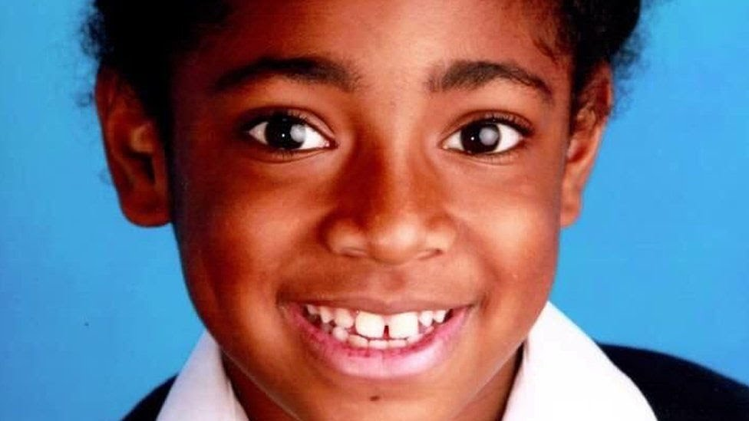
Ella Kissi-Debrah

Slide 29
Ella Kissi-Debrah
Lived 25m from the south Circular Road in south London.
Died in 2013 after having seizures for three years
Nine year old fatal asthma attack may have been linked to air pollution near her home
Inquest in 2014 concluded her death was caused by acute respiratory failure and severe asthma

Slide 30
Ella Kissi-Debrah
2018 report said it was likely unlawful levels of pollution, which were detected at a monitoring station one mile from Ella's home, contributed to her fatal asthma attack.
After tireless campaigning by her mother Rosamund, High Court granted a new inquest into her death in May 2019 which will take place on 30th November 2020.
Ella may become the first person in the UK for whom air pollution is listed as the cause of death.

Slide 31
Other examples
Depo Provera – tested in Jamaica. Given to Black and minority ethnic women and white working class women in the UK in 1970s and 1980s.
Hela gene cells – taken from Henriette Lacks without her consent in 1951.
Tuskagee Study – where black prisoners were infected with syphilis to chart the cause of disease rather than being given drugs to cure it as they were told. Clinical study conducted between 1932 to 1972 by the United States Public Health Service. 1997 Clinton formally apologized to victims of the study.

Slide 32
The inclusive curriculum tool
Access , Participation and Success, PVC -Students

Slide 33
Inclusive Curriculum Tool
The protoype tool is based on reviewing three principles:
All students can access the curriculum:
Checking that all content uses inclusive language, avoids colloquial language and provides a glossary of new and complex terms.
All students see themselves reflected:
Content (including case studies) draws from sources that reflect a wide range of diversity
Students allowed to use their diverse experiences and backgrounds to contribute to the learning and assessment activities
Students are equipped to participate in a global and diverse world:
Ensuring students are exposed to a range of culturally challenging views, opinions and contexts
Ensuring there are structured opportunities for an understanding of and respect for diversity and the contribution diversity makes in an international context

Slide 34
Development of the inclusive curriculum tool
Closing the Black Attainment Gap on Access Project launched in Summer 2018
April 2019 report was written by Julie Young, a consultant under contract to APS
Summer 2019 trials conducted by Kuda Mukundu with four Level 1 modules: E102 ‘Introduction to Child Studies and Psychology’; S111 ‘Questions in Science’; W101 ‘An Introduction to Law’; and DD102 ‘Introducing the Social Sciences’.
March 2020 it was agreed to introduce the tool into all learning design workshops for new modules with the support of Learning Design Services (LDS).

Slide 35
Principles
Not just about adding a few BAME faces/ case studies.
Social Justice Framework
Developing a critical pedagogy
Global perspective
Intersectional lens – Coles,( 2009) three questions: when discussing analytical categories- ethnicity, ‘race’, gender, age, social class, disability, sexuality.
Who is included in this category?
What role does inequality play?
Where are there similarities?
Discuss oppression and how it operates in British society- STEM is not exempt from this.
Enables conversations about ‘race’ and racism

Slide 36
Conclusions and Future Work
Decolonising the curriculum cannot happen outside of decolonising the university.
It’s not just about adding a few global South authors to our reading lists, but male – dominated reading lists teach wrong lessons about who is an intellectual authority.
It’s not about abolishing the canon - must interrogate its assumptions and broaden our intellectual vision to include a wider range of perspectives.
BAME students need to see themselves reflected in the curriculum as legitimate creators of knowledge.
Need to interrogate the fundamental role of slavery and colonialism in all of our curricula – not just social sciences and humanities, but also science, technology, engineering and maths. Science is not objective and neutral.
It is not the role of BAME academics - we all need to work together.

Slide 37
Reviewing the literature
Daniel Akinbosede (2020) Science curricula must be decolonised too, Times Higher Education, 5th June, 2020
Jason Arday and Heidi Safia Mirza (2018) Dismantling Race in Higher Education: Racism, Whiteness and Decolonising the Academy, London: Palgrave Macmillan.
Gurminder K. Bhambra, Dalia Gebrial and Kerem Nisancioglu (2018) Decolonising the University, London: Pluto Press.
Bhopal, Kalwant (2017) The experiences of black and minority ethnic academics. A comparative study of the unequal academy. London: Routledge.
Case,Kim (2017) Intersectional Pedagogy: Complicating Identity and Social Justice. London: Routledge.
Charles, Elizabeth (2019) Decolonizing the Curriculum, Insights,UKSG, 32. http://www.uksg.org/publications#aa
ECU. (2017) Degree attainment gaps. York, England: Advance HE.
Ferguson, R., Coughlan,T.,Egeelandsal, K.,Gaved, M.,Herodotou,C. Hillaire,G.,Jones,D.,Jpwers,I., Kukulska-Hulme,A., McAndrew,P., Misiejuk, K., Ness,I.J., Rientes,B.,Scanlon,E., Sharples, M., Wasson,B., Weller,M. and Whitelock,D. (2019). Innovating Pedaogy 2019: Open University Innovation Report 7. Milton Keynes: The Open University.
Gabriel. Deborah (2019) Enhancing Higher Education Practice Through the 3D Pedagogy Framework to Decolonize, Democratize and Diversify the Curriculum, International Journal of Technology and Inclusive Education, Volume 8, issue 2, December 2018,1459-1466.
Higher Education Funding Council for England (HEFCE) (2017). Tackling inequality. London:HEFCE
NUS (2017) Attainment Gap. London: NUS
Tate, Shirley (2019) The Student of Colour Attainment Gap in Higher Education and the Institutional Culture of Equality, Diversity, and Inclusion. In R. Papa (ed), Handbook on Promoting Social Justice in Education. Switzerland: Springer Nature
.

Slide 38
THANK YOU FOR LISTENING! Dr Jenny Douglas jenny.douglas@open.ac.uk

