Slide 1


Welcome to the eSTEeM Seminar Series 2020-21
Decolonising the science curriculum:
1980s experience of anti-racist science teaching
Dr Les Levidow
Wednesday 27th January 2021

Slide 2
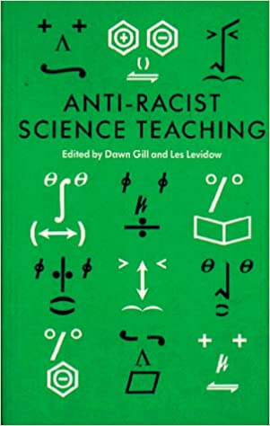
1987 collection

Slide 3
Colonial legacies in science
Racist aspects of science and its teaching: colonial origins
Neo-colonial practices have been obscured by racist explanations of societal problems.
Mid-1980s examples:
Ethiopian famine and Bhopal disaster

Slide 4
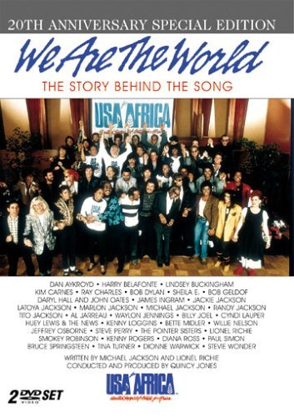
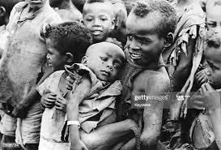
1985 Ethiopian famine needed white saviours:
‘We are the world, you are the Third World’

Slide 5
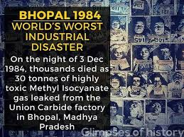
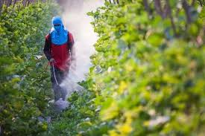
Bhopal disaster: narratives obscured causes in Green Revolution

Slide 6
Racism in science today
British colonialism was accompanied by scientific approaches which sought a natural legitimation for dominating colonized people.
The earlier, blatantly racist forms can help us
to identify today’s more subtle forms and
to understand how racism defines what counts as science today
Science is what gets funded by elite priorities

Slide 7
Decolonise what?
Eventually ‘decolonisation’ meant liberating all European colonies from foreign domination, exploitation, plunder and mass murder.
Now in the 21st century, colonies in the classic sense still exist in some places.
Today colonization has more subtle forms: Since gaining formal independence, new countries have extended a neo-colonial exploitation, treating entire social groups as an internal colony, in ways analogous to their former imperialist masters.
Lower-income, dark-skinned groups are ideologically framed as backwards – as deficient in knowledge, culture, technical capabilities, etc.
Thus they need a rescue by modern expertise, capital-intensive technology, development, modernisation and emergency aid.

Slide 8
Neo-colonial technoscience
Science = technical expertise = technoscience
This mutually constitutes two modes: knowing the world (science), and shaping it through various instruments or techniques.
Science tries to answer questions that could have been asked differently, so could have framed societal problems differently.
Technoscience has provided a crucial weapon for neocolonial domination in a dual sense:
techniques for more efficient discovery, plunder and use of resources, alongside techniques to suppress dissent;
an ideology attributing that process to the natural order of things.

Slide 9
‘Development’ as neocolonial agenda
Neocolonial processes continue today, often in the name of modernising backwards societies/peoples through more efficient techniques for controlling or unlocking resources, so that economies can become more globally competitive.
Dominant narrative: the already developed countries must assist lower-income countries to develop their economies.
Narrative inverts historical reality: Walter Rodney analysed
How Europe Underdeveloped Africa.
Technoscience has informed and legitimised the problem-diagnosis of ‘under-development’ and thus racist agendas.

Slide 10
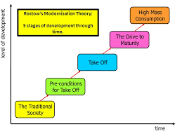
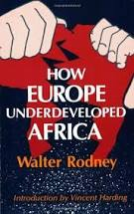
Rostow versus Rodney

Slide 11
Decolonise the science curriculum = ?
Science education today reproduces and obscures racist frameworks of knowledge production.
Privileges students willing/able to fragment reality.
Hence it generates inequalities of class, race and gender
To decolonise the science curriculum means:
identifying and contesting all technoscientific forms of neo-colonial domination;
shifting the educational process away from individualistic-competition, instead towards groups collectively investigating how technoscience frames societal problems, and thus
identifying how some knowledges provide liberatory alternatives that empower subaltern groups and how this could be strengthened.

Slide 12
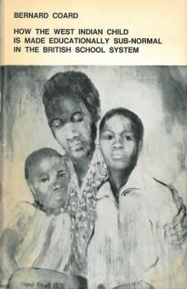
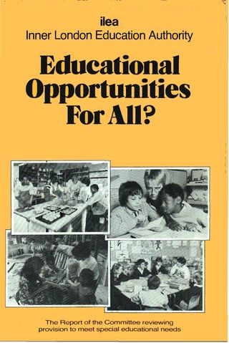
ILEA: 1983 shift to anti-racist education

Slide 13
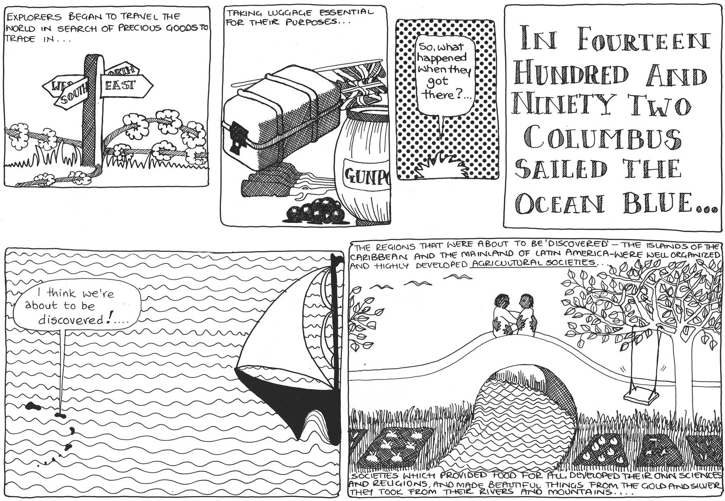
ILEA promoted anti-racist materials from IRR

Slide 14
Anti-racist education was extended to science
Some teachers attributed contemporary inequalities to racist forms of science and to their roots in colonial domination.
These inequalities underlay both the content and process of science education.
Science teachers started changing towards issue-based topics, each bringing together science, technology and social science to address the topic.
All students became intrigued by alternative viewpoints and so more involved.

Slide 15
Our book: Anti-Racist Science Teaching
These efforts were discussed in a conference at Holland Park School.
Presentations there became the basis for the book,
Anti-Racist Science Teaching
These efforts were brought together in a conference hosted by Holland Park School.
ILEA helped to publicise and distribute the book.
Next hear from teachers who developed the new approach.
(See online resources on the final slide)

Slide 16
Thank you for attending
Join us for the ‘Putting talk into action’ online discussion on Thursday 4th February, 19.30-20.30
Contact esteem@open.ac.uk to register

Slide 17
Resources for anti-racist education
Institute of Race Relations (IRR), https://irr.org.uk/resources/materials-on-racism-for-teachers/
1980s source pack, https://sesc.hist.cam.ac.uk/wp-content/uploads/2019/11/Anti-racist-education-workshop-source-pack.pdf
1980s retrospect from today’s anti-racist agendas, https://sesc.hist.cam.ac.uk/2020/07/31/talks-and-resources-for-anti-racist-education-history-theory-practice/
Technoscience
Decolonising the science curriculum, https://www.sheffield.ac.uk/polopoly_fs/1.894561!/file/Decolonise_Handbook.pdf
Cambridge University, HPS Dept, https://www.varsity.co.uk/science/18820
Bringing decolonial science and technology studies to secondary education, https://bera-journals.onlinelibrary.wiley.com/doi/abs/10.1002/curj.97

