Slide 1
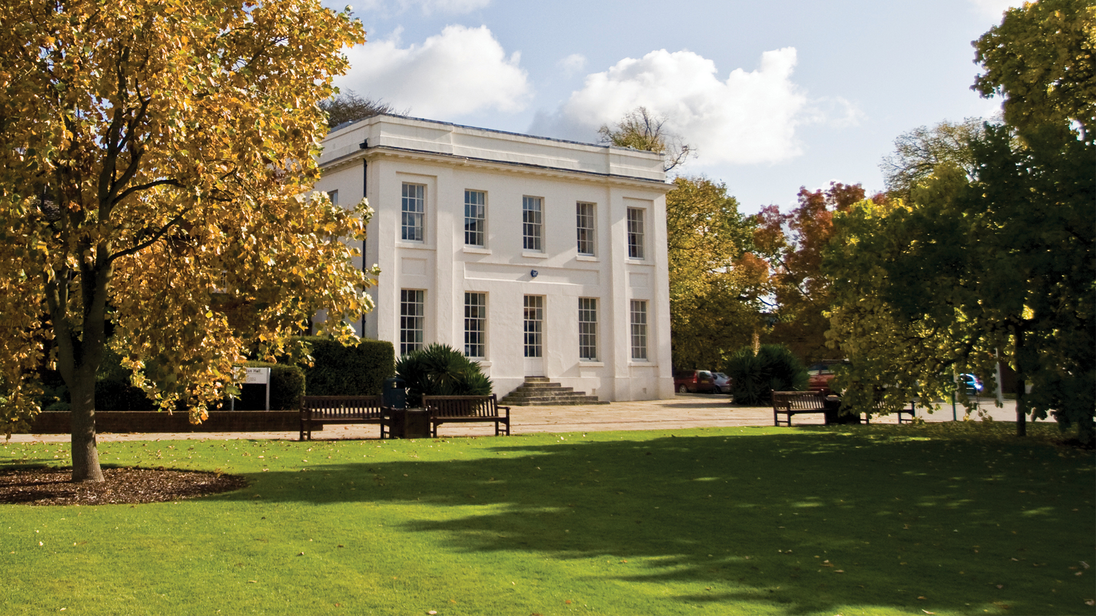
Exploring the extent of Maths Anxiety within the STEM faculty
Susan Pawley, Sally Organ
With thanks to Colin Blundell and John Morgan for arranging and conducting student interviews

Slide 2
Background
Whilst maths anxiety has been recognised by academics for over half a century, little work has been done within the Open University to establish its extent within our population, how it is affected by distance learning and what techniques can be used to mitigate its effects.
“an emotion that blocks a person’s reasoning ability when confronted with a mathematical situation” [Spicer 2004]
"Math anxiety is an inability by an otherwise intelligent person to cope with quantification, and more generally, mathematics. Frequently the outward symptoms of math anxiety are physiological rather than psychological. When confronted with a math problem, the sufferer has sweaty palms, is nauseous, has heart palpitations, and experiences paralysis of thought ... this quick description does not begin to describe the torment ..." (Krantz, 1999)
References: Krantz, S.G. (1999). How To Teach Mathematics. Providence: American Mathematical Society
Spicer, J. (2004). Resources to combat math anxiety. Eisenhower National Clearinghouse Focus 12(12)
Notes:
Maths Anxiety is a very emotive issue, with mental and physical symptoms, it can range from mild discomfort “I’m not very good at maths” “please don’t ask me” to extreme anxiety, where sufferers go to extensive lengths to avoid doing anything to do with numbers and maths and experiencing extreme discomfort and physical signs of anxiety.

Slide 3
Aims, Objectives and Project Plan
This project is intended to be the first of several, which will culminate with a STEM-wide program for supporting students with Maths Anxiety. It will identify the extent of maths anxiety within the community of STEM students and aim to identify some underlying reasons for the issues.
Stage one: Student survey across the level 1 STEM curriculum to establish the extent of maths anxiety within the OU.
Stage two: In-depth semi-structured interviews to further investigate specific issues and explore how these might be addressed and supported.
Outcomes: highlight the extent of maths anxiety for distance learning students at the start of their studies in STEM.
Future projects: create practical methods for addressing maths anxiety with a faculty wide program for supporting students and staff, which will feed into additional projects on mental health issues in general.

Slide 4
Module Surveys
Modules included in survey:
  21J: MU123, MST124, S111, SDK100, T192, TM111, U101, U116
  22B: MU123, MST124, U101, U116, S111, SDK100
  22D: T192, TM111
Surveys used:
  Maths anxiety: The Maths Anxiety Scale (MAS) (Betz)¹ plus two further questions on studying maths at a distance
  Maths resilience: The Mathematical Resilience Scale (MRS) (Kooken et al 2013)²
Response rate:
  For the 21J survey we were able to contact 7275 students (62.4% of current cohort), of those contacted we gained a response rate of 14.5%.
Sources: ¹Betz, Nancy E. (1978). Prevalence, distribution, and correlates of math anxiety in college students. Journal of Counselling Psychology, Vol 25(5), 441-448. doi: 10.1037/0022-0167.25.5.441
² Kooken, J., Welsh, M., McCoach, D., Johnston-Wilder, S., Lee, C. (2013). Measuring Mathematical Resilience: An application of the construct of resilience to the study of mathematics . Paper presented at national conference of the American Educational Research Association, San Francisco, CA.
Notes:
These results will concentrate on 21J results and mostly on maths anxiety. Also explain about semi-structured interviews, sample taken from students that volunteered in survey concentrating on those with high anxiety Say something about likert scale to give maximum score of 50 and minimum score of 10 to analyse anxiety
Our sample characteristic breakdowns (eg gender) were very similar to the cohort characteristics, however our repondees were slightly more female, slightly more white, slightly less disabled and slightly older. But no major discrepancies.

Slide 5
Maths anxiety survey results
Notes:
Sally - L to R roughly maths, science, engineering, computing and IT, design, environment. Numbers in brackets are the number of survey responses.
Clear differences. A chi-squared test gives a result of p = 0.000, showing very strong evidence for an association between module studied and level of maths anxiety

Slide 6
Module Versus Qualifications
From 75 T192 respondents:
59 are studying towards an engineering qualification 7 are studying for a design qualification
4 are studying for other qualifications
6 have no qualification code recorded
Notes:
Sally -In future analysis we intend to look at it by subject specialism (qualification intention) rather than module. This is just one example of how that might affect the results. Likely to be more significant for the maths modules, since service modules for many different qualifications.

Slide 7
Studying maths at a distance

Slide 8
Studying maths at a distance

Slide 9
Student characteristics
Gender Mean anxiety level
  female (546) 30.9
  male (509) 27.0
p = 0.000
Ethnicity Mean anxiety level
  White (966) 29.0
  BAME (69) 29.0
p = 0.962
Disability Mean anxiety level
  disabled (183) 32.7
  no disability (870) 28.3
p = 0.000
(p-values from two-sided t-tests)
Very strong evidence that mean anxiety level in females is higher than in males ​
​
Little evidence that mean anxiety differs between white and BAME students ​
Very strong evidence that mean anxiety level in disabled students is higher than in those who have not declared a disability
Notes:
Sally - For the whole cohort

Slide 10
Student characteristics
Notes:
Sally - For the whole cohort

Slide 11
Maths resilience scale
The maths resilience scale measures students' attitudes toward studying mathematics, using 3 factors:
Value Refers to the extent to which students find studying mathematics important in attaining their current or future goals.
Struggle Refers to a student's belief that they sometimes have to exert a great deal of effort because mathematics can be a challenge to learn, but their difficulty is not interpreted as an indication of personal incompetence.
Growth A growth theory of learning mathematics refers to the belief that people can improve their knowledge of mathematics.
Results from the MRS help to gauge the likelihood of student participation and persistence in mathematics. ​
Notes:
Sally – not looked at this in any detail yet – need to develop a better understanding of its significance

Slide 12
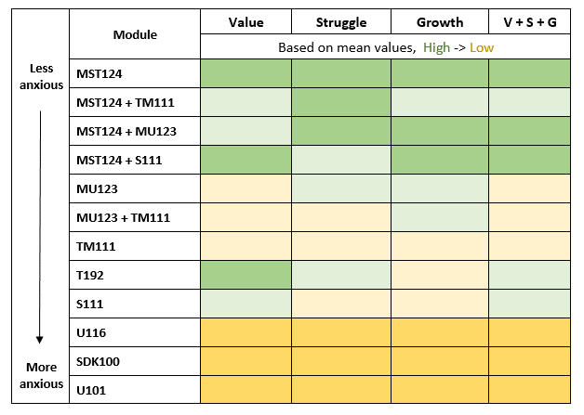
Maths resilience survey results
Notes:
Sally - Most anxious students have lowest resilience for all factors Engineering / science students have relatively high resilience: Score particularly well on value But poorly on growth

Slide 13
Semi-structured interviews
Feedback from interviewer “The interviews are real eye openers for me and have made me think about my own delivery of tutorials and feedback in assignments for lots of different reasons.”
“Yes, yes, I would avoid it at all costs, even now I’m in a job where I have to use maths and I just get someone else to do it.”
“I was refusing to go to school because it just, it was just so terrifying and it never, it never got any better, it was awful. “
“Extremely yes, I mean I would have heart palpitations. I actually developed panic attacks that’s how severe it became”
“Oh terrified, absolutely terrified, you know that somebody was going to tell me that I was stupid”
“the mathematics bit always just left me in a cold sweat. It just didn’t come naturally to me at all, which is just, yes always struggled.”
Notes:
Sue – We’ve conducted a number of semi structured interviews on which we need to do a detailed analysis. Some responses from most anxious students to the question “did you feel anxious in maths classes”

Slide 14
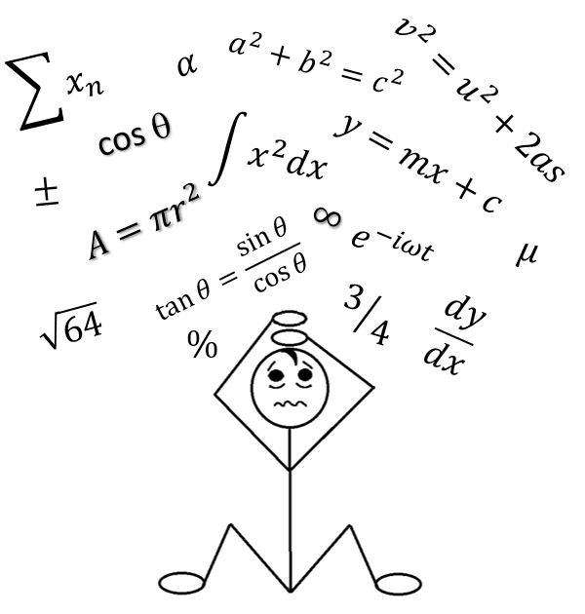
What next?
?
?
One-to-one support for students who have been referred by tutor (similar to English for academic purposes)
Student self-help Website where they can establish their own level of maths anxiety and gain knowledge on ways to manage it
Staff development on how tutors can support students with maths anxiety
?
?
?
?
Tutor experts, trained to give advice and help students/ other tutors (similar to PALS)
Advice for SST staff
?

Slide 15
THANK YOU

