Slide 1
Embracing the voices of the marginalised learners with a declared mental health disability
Nicole Lotz and Muriel Sippel, The Open University
12 May 2022

Slide 2

Background
Consistently low and variable pass rates and large awarding gaps for students with a declared mental health disability across the Design Qualification
Aims
Gain a deeper understanding of the specific issues experienced by Design students with mental health disabilities throughout their study.
Develop recommendations that could inform the learning design of modules in production and positive interventions in presentation to reduce the awarding gap and facilitate progression.
Focus on intersecting factors:
  Discipline (knowledge and skills, coursework, assessment),
  Personal circumstances (work and family, caring commitments, life events),
  Support received during their studies from OU and elsewhere

Slide 3
Approach
Experiential, phenomenological, qualitative, and longitudinal over 4-5 months
4 passionate interviewers, working each with 2 students from one module (levels 1-3)
Aim to build a conversational, trusting relationship, but not as a tutor, more like a friend with a good listening ear!
Student selection: aim for diversity
  Prev. high and low achieving
  Mix of gender and background (e.g. age, ethnicity)
  Low sample size at higher levels challenging

Slide 4
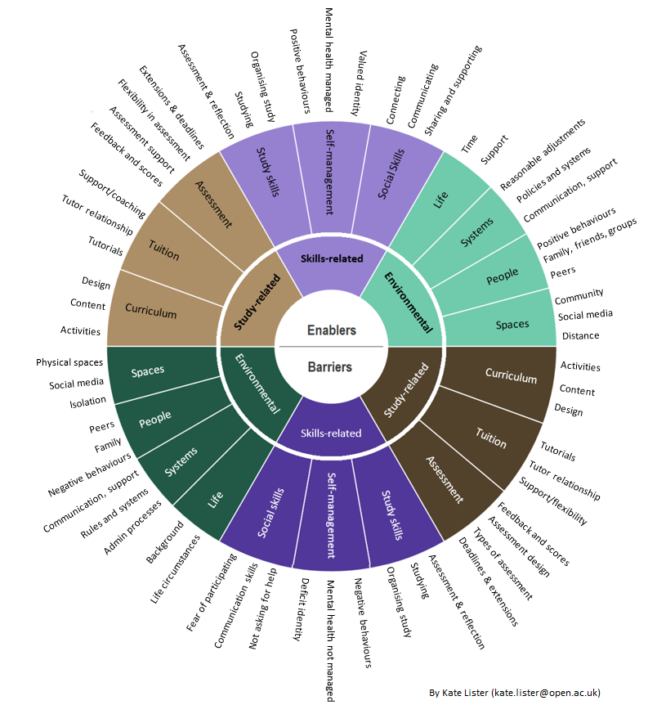
Empirical research
Interviews
Beginning and end
Experience sample
Scheduled prompts to mobile phone 3 times a day
Two in the moment experiences (doing, feeling, thinking) and one reflective end of day recording on barriers enablers
Diary
One message thread a day
Aim at collecting 7 entries over 10 days, describing how they have progressed their assessed project work.
Debriefings

Slide 5
Analysis
Cases
Individual student stories can be used as Personas
Thematic analysis
In vivo if possible, aiming for diversity and overlaps (difference and similarity) in themes across cases – Themes comparison to Lister’s taxonomy ->
Tensions, contradictions and resolutions
Enablers and barriers in the same themes – tensions need to be resolved to move a barrier to being an enabler

Slide 6
Case 1 'Anna'
Level 3 student, female, 30s.
LGBTQ learner, full time carer for partner, voluntary work
Bipolar
Postural tachycardia syndrome (PoTS)
Anxiety

Slide 7
Anna
Background
LGBTQ learner
Long term disabilities
Bipolar - anxious, doesn’t like noise, likes to know where she is, who she is with, struggles with meeting new people.
Postural tachycardia syndrome (PoTS)
Parents separated, lost best friend to cancer, struggled with college timetable.
OU degree gives Anna "an opportunity" which helps with her health, anxiety and role as full time carer for partner.
OU study enablers
With Bipolar, some days are not good for studying, so stop, rest, wait for a better day.
Set up an advocate for times that not able to cope.
Disability mentor supportive with studies, but not a subject specialist.
Have a study space, you know it is your study time, do take a break from it.
Family support welcome as familiar with health needs.
Creative thinking "quietens your mind".
Design modules are more social – as asking for feedback from family
OU study barriers
Overthinking, not getting quick reply to question - more anxious.
Anxious when meeting others in unfamiliar space like forums, Open Design Studio.
Wish to remain anonymous - "my work isn't good enough", as worried not achieving.
Distance learning works well but unable to read body language
Student support services are less helpful with specialist information.
Not always confident to ask for extensions from tutor.
Module resources need a consistent approach with use of terms.

Slide 8
Example tensions and their resolutions

Slide 9
Assessment
Openness of assignment brief
Flexibility on topic and focus
Agency, passion and belonging
Fear of misinterpretation of assignment text
Brief cannot possibly be so simple
Overanalyse written project brief requirements and tutors’ or peers’ feedback
Self-critique / being your worst enemy
A prior good mark cannot possibly be justified
Self-doubt leading to anxiety or depression and inertia
Not knowing when to stop designing in causes anxiety or compulsive behaviour
Resolution
Project exemplar
Simplified wording
Audio TMA instruction and feedback (Using tone of voice to highlight the important bits)
Formative feedback:
Frequent check-ins, one-to-one, one-to-few with tutor
WhatsApp with peers

Slide 10
Practical design work
Peer support
Uncomfortable sharing progress on OpenStudio
Social anxiety
Lurking sometimes helpful
Friends and family
Study buddies, collaborators, friendly critiques.
They offer a safe, secure space
Using technical terms to describe designs disengages them
MH counsellor
Regular meetings developing good habits over the long run
Ineffective to give support in the moment, they do not problem solve projects / subject specific
Resolution
Use lay terms to speak to friends and family(develop communication skills in module)
Use specific skill or knowledge from friends and family, not design-related as such
Create safe online spaces to engage with peers in your discipline
More regular conversations with tutor
Thematic design spaces / clusters / discussion (around MH, disability, marginalisation) to attract students with lived experiences
Design topics using lived experiences

Slide 11
Time management
Self-study
Love of control and independence
Better retention of learning
Few external pace makers
Scheduling
Making your own schedule
Working ahead to pre-empt impact of dip in mental health wellbeing
Overthrown by hidden workload or new or unexpectedly difficult topics / materials / activities
Resolution
Separate theory and reading from social and active learning to allow for better planning and emergency measures
Study planner shows categories: independent, social, active, sub-categorised in essential, optional.
Share assessment deadlines and module schedule with family and friends as external motivator
Give students an allocation of study break days/weeks that can be used flexibly and purposefully

Slide 12
Recommendations that could inform the learning design of modules in production and presentation

Slide 13
Recommendations: Curriculum / Learning Design
Process
  Share cases in Personas to build empathy of marginalised students’ experiences with learning design team
  Prototype learning design ideas from interviewees to evaluate applicability for a wider audience
  Invite learners to co-design sessions (inclusive curriculum, community building)
Content
  Offer and facilitate a disability or marginalisation themed design project (but not the one the student is facing)
  Integrate mental health and wellbeing in curriculum content and tuition
  Ask learners to involve partners or family in learning tasks
  Break projects up into chunks
  Soft deadlines and no high stakes assessments, more flexible assessment banking (closing Awarding gap during Pandemic – increased assessment flexibility and additional MHW support)
  With more accessible learning, more disabled designers are coming through into the profession, a change in profession’s values and focus

Slide 14
Recommendations: Tuition
Understanding that it is important to respond to emails as soon as you can
Encourage D-flag students to contact you to reassure them that it is okay to ask for help
Referring a student is not always the right approach, students do value specialist support from their module tutor
Appreciating that D flag students often prefer email or text for communicating with staff, some are reluctant to use the phone or forums
Technical language and module jargon can be difficult to interpret even for level 3 students, it does help to explain things clearly and in steps – can take several emails.
D-flag students do worry and can over think things so an email to say your assignment is looking good, especially if there are delays in returning marks, can make a difference – reduce anxiety, stop sleepless nights
Supporting D-flag students does take more time and empathy, but I have found that it is time that is worth giving, for the benefit of the student's well-being and for my own personal well-being.
Tutor appraisals and module time allowances need to reflect the additional student time needed in a tutor group, to support a tutor's wellbeing.

Slide 15

THANK YOU
Muriel.Sippel@open.ac.uk
Nicole.Lotz@open.ac.uk
http://www.open.ac.uk/blogs/design

