Slide 1
AL Disability Champions project (U101)
2021-2022
Project leaders
Lisa Bowers, Elouise Huxor, Theo Philcox
Notes:
Lisa

Slide 2

Description
This project originated from E&I staff tutors who noticed Associate Lecturers' (ALs') increased day to day requests for additional and up-to-date disability and mental health training and support to maintain their high pedagogic standards.
Some ALs were more proactive and shared best practice access and inclusive teaching and learning approaches peer-peer, whilst others struggled to find solutions to engaging and supporting their students with complex learning needs, which seemed to be in constant flux as the student progressed through the module.
Notes:
Lisa

Slide 3
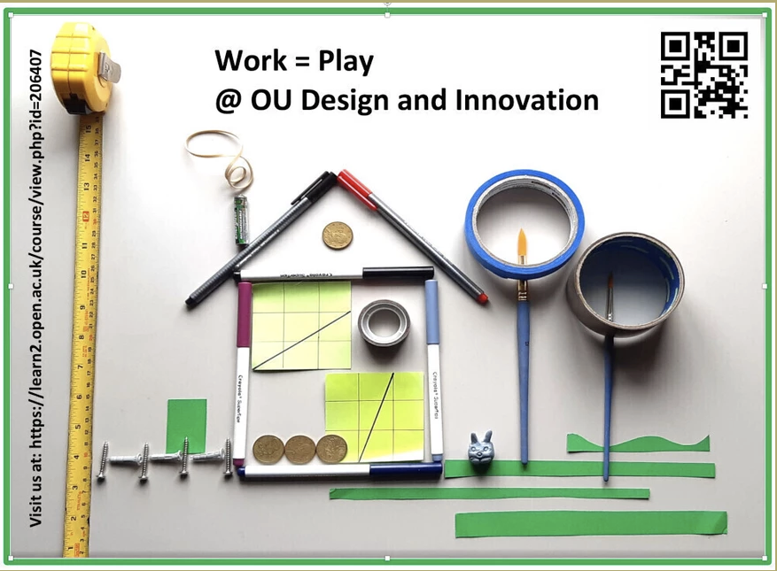
Rationale
The project ultimately is motivated by the need for timelier specialist student-led knowledge to maintain student engagement
To create a peer-peer concept which in the future could be rolled out across STEM, however, the initial pilot will be contained to run with U101 (E&I school).
The pilot trial will question whether this type of project can build bridges to support or add further barriers to ALs and their students. The module U101 was specifically targeted as the pilot module due to the number of DAR students over the last 2 years.
Added to this, U101 offers specific practical and project skills that may hold issues for students with poor mental health and disabilities.
Notes:
Lisa

Slide 4
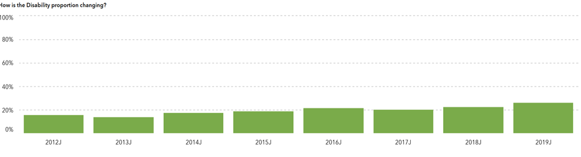
WHY?
Rising numbers disability DAR students joining U101
How is the disability data changing…?
Notes:
Lisa

Slide 5
WHY?
Students with declared mental health
(J presentation)
U101 J Presentation | Students with mental health as a declared disability | All students | Pass Rate Students with mental health as declared disability | Pass rate All Students
U101 12 J | Under 10 | 566 | 44% | 73.4%
U101 13 J | 11 | 508 | 20% | 66%
U101 14 J | 11 | 553 | 50% | 65%
U101 15 J | 17 | 559 | 46.2% | 59.2%
U101 16J | 32 | 627 | 28.6% | 60.4%
U101 17J | 33 | 564 | 45.2% | 60.4%
U101 18J | 43 | 547 | 32.4% | 54.8%
U101 19J | 68 | 775 | 49.2% | 61.2%
U101 20J | 84 | 997 | 34% | 59.5%
Notes:
Lisa

Slide 6
WHY?
Attainment gap
(J presentation)
Notes:
Mental health being more inconcistent than disability – but students in the intersection may not feature in the standard sets of data or may be left out completely.

Slide 7
What are the aims and objectives of the project?
to create a trial group of AL Disability Champions (DC’s) who will offer peer-to-peer assistance for disability or mental health teaching inquiries.
To provide support resources available from a macro/micro level using thorough training for DC’s throughout the project
Using a battery of resources which are often difficult to locate for individual time poor AL’s to fully exploit effectively.
To exploit the resources and training to respond to U101 tutors' peers’ day to day DAR teaching inquiries.
To improve the learning experience, retention and achievement of students with disabilities.
Notes:
One small group of champs who already owned a good deal of expertise and knowledge about ability needs,

Slide 8
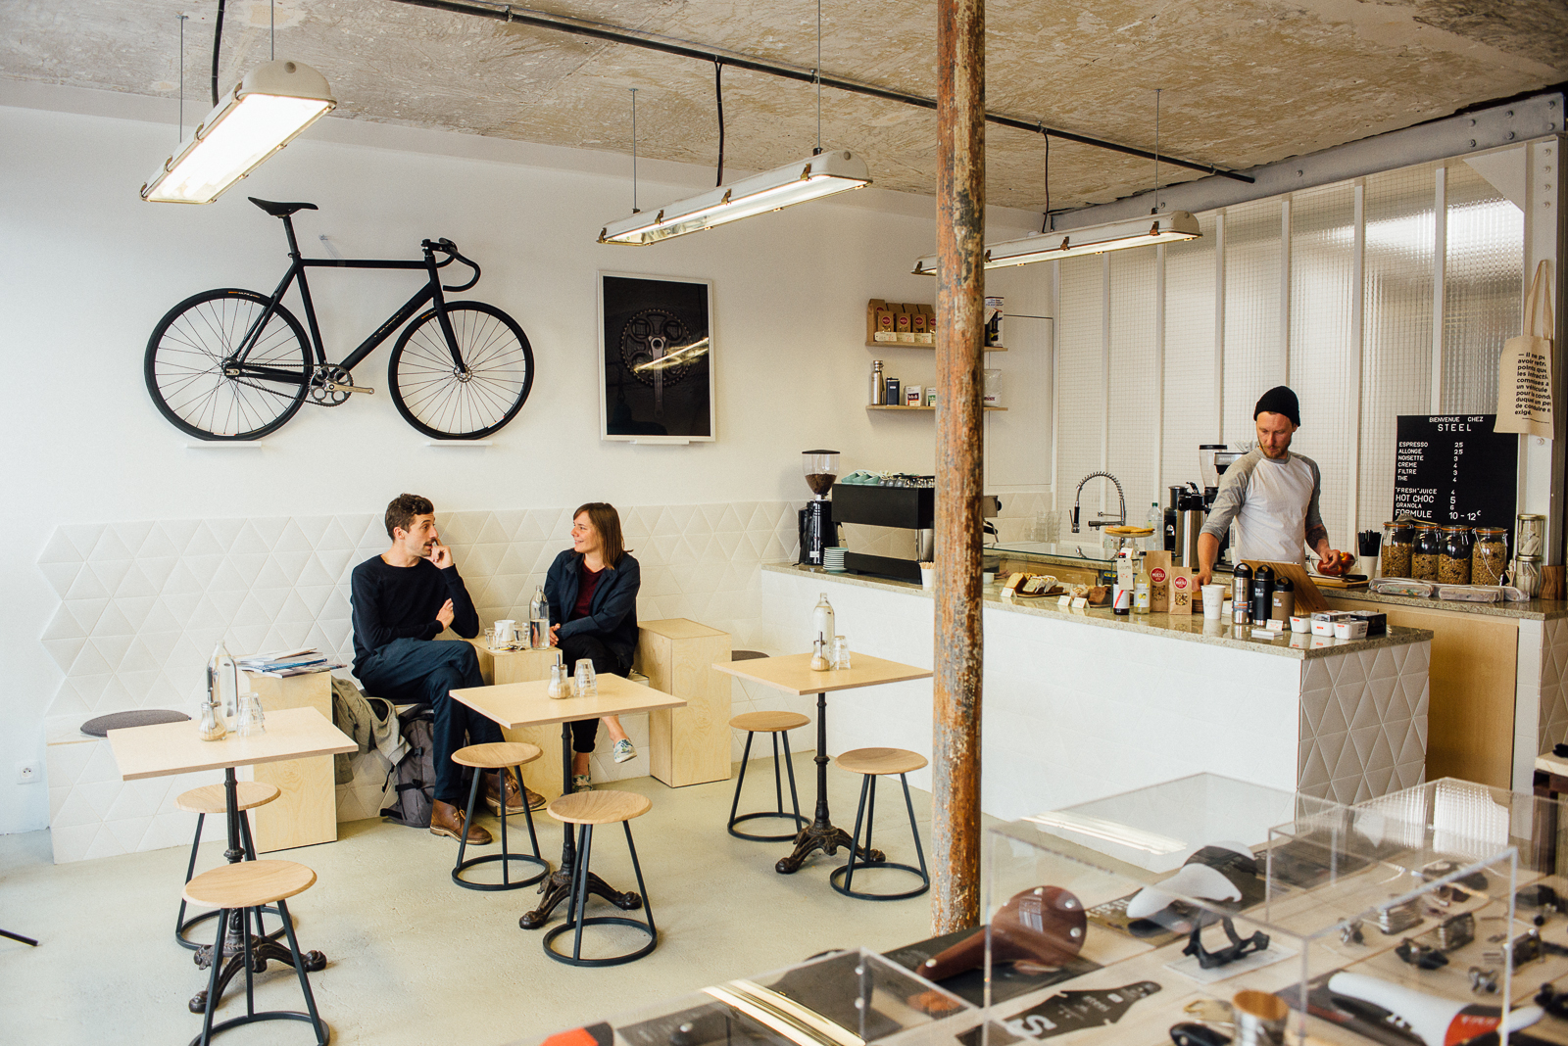
Tasks and Actions:
What have we done?
Initially set up an informal Café Forum to encourage sharing (this has evolved into a Help Desk Forum)
Established a rota to cover forum (although any DC can jump in at any time if they wish)
Training of Disability Champs:
MHFA (Mental Health First Aid)
Physical Disability training:
(Visual and hearing impaired, fatigue, mobility issues)
Additional learning needs:
(Dyslexia, dyscalculia, dyspraxia)
Notes:
Theo

Slide 9
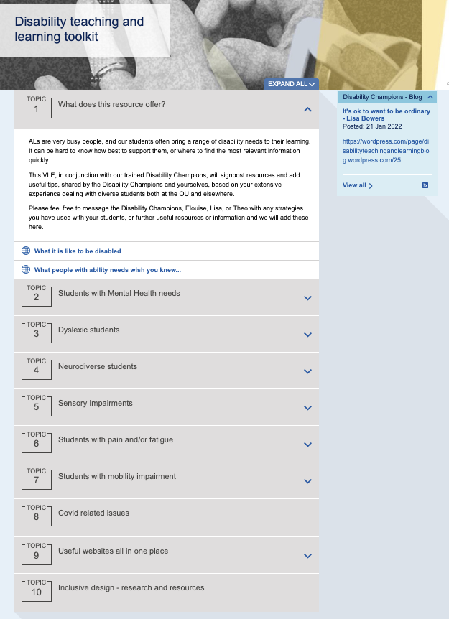
Sample of the Live - VLE Disability Champion Toolkit
Notes:
Theo

Slide 10
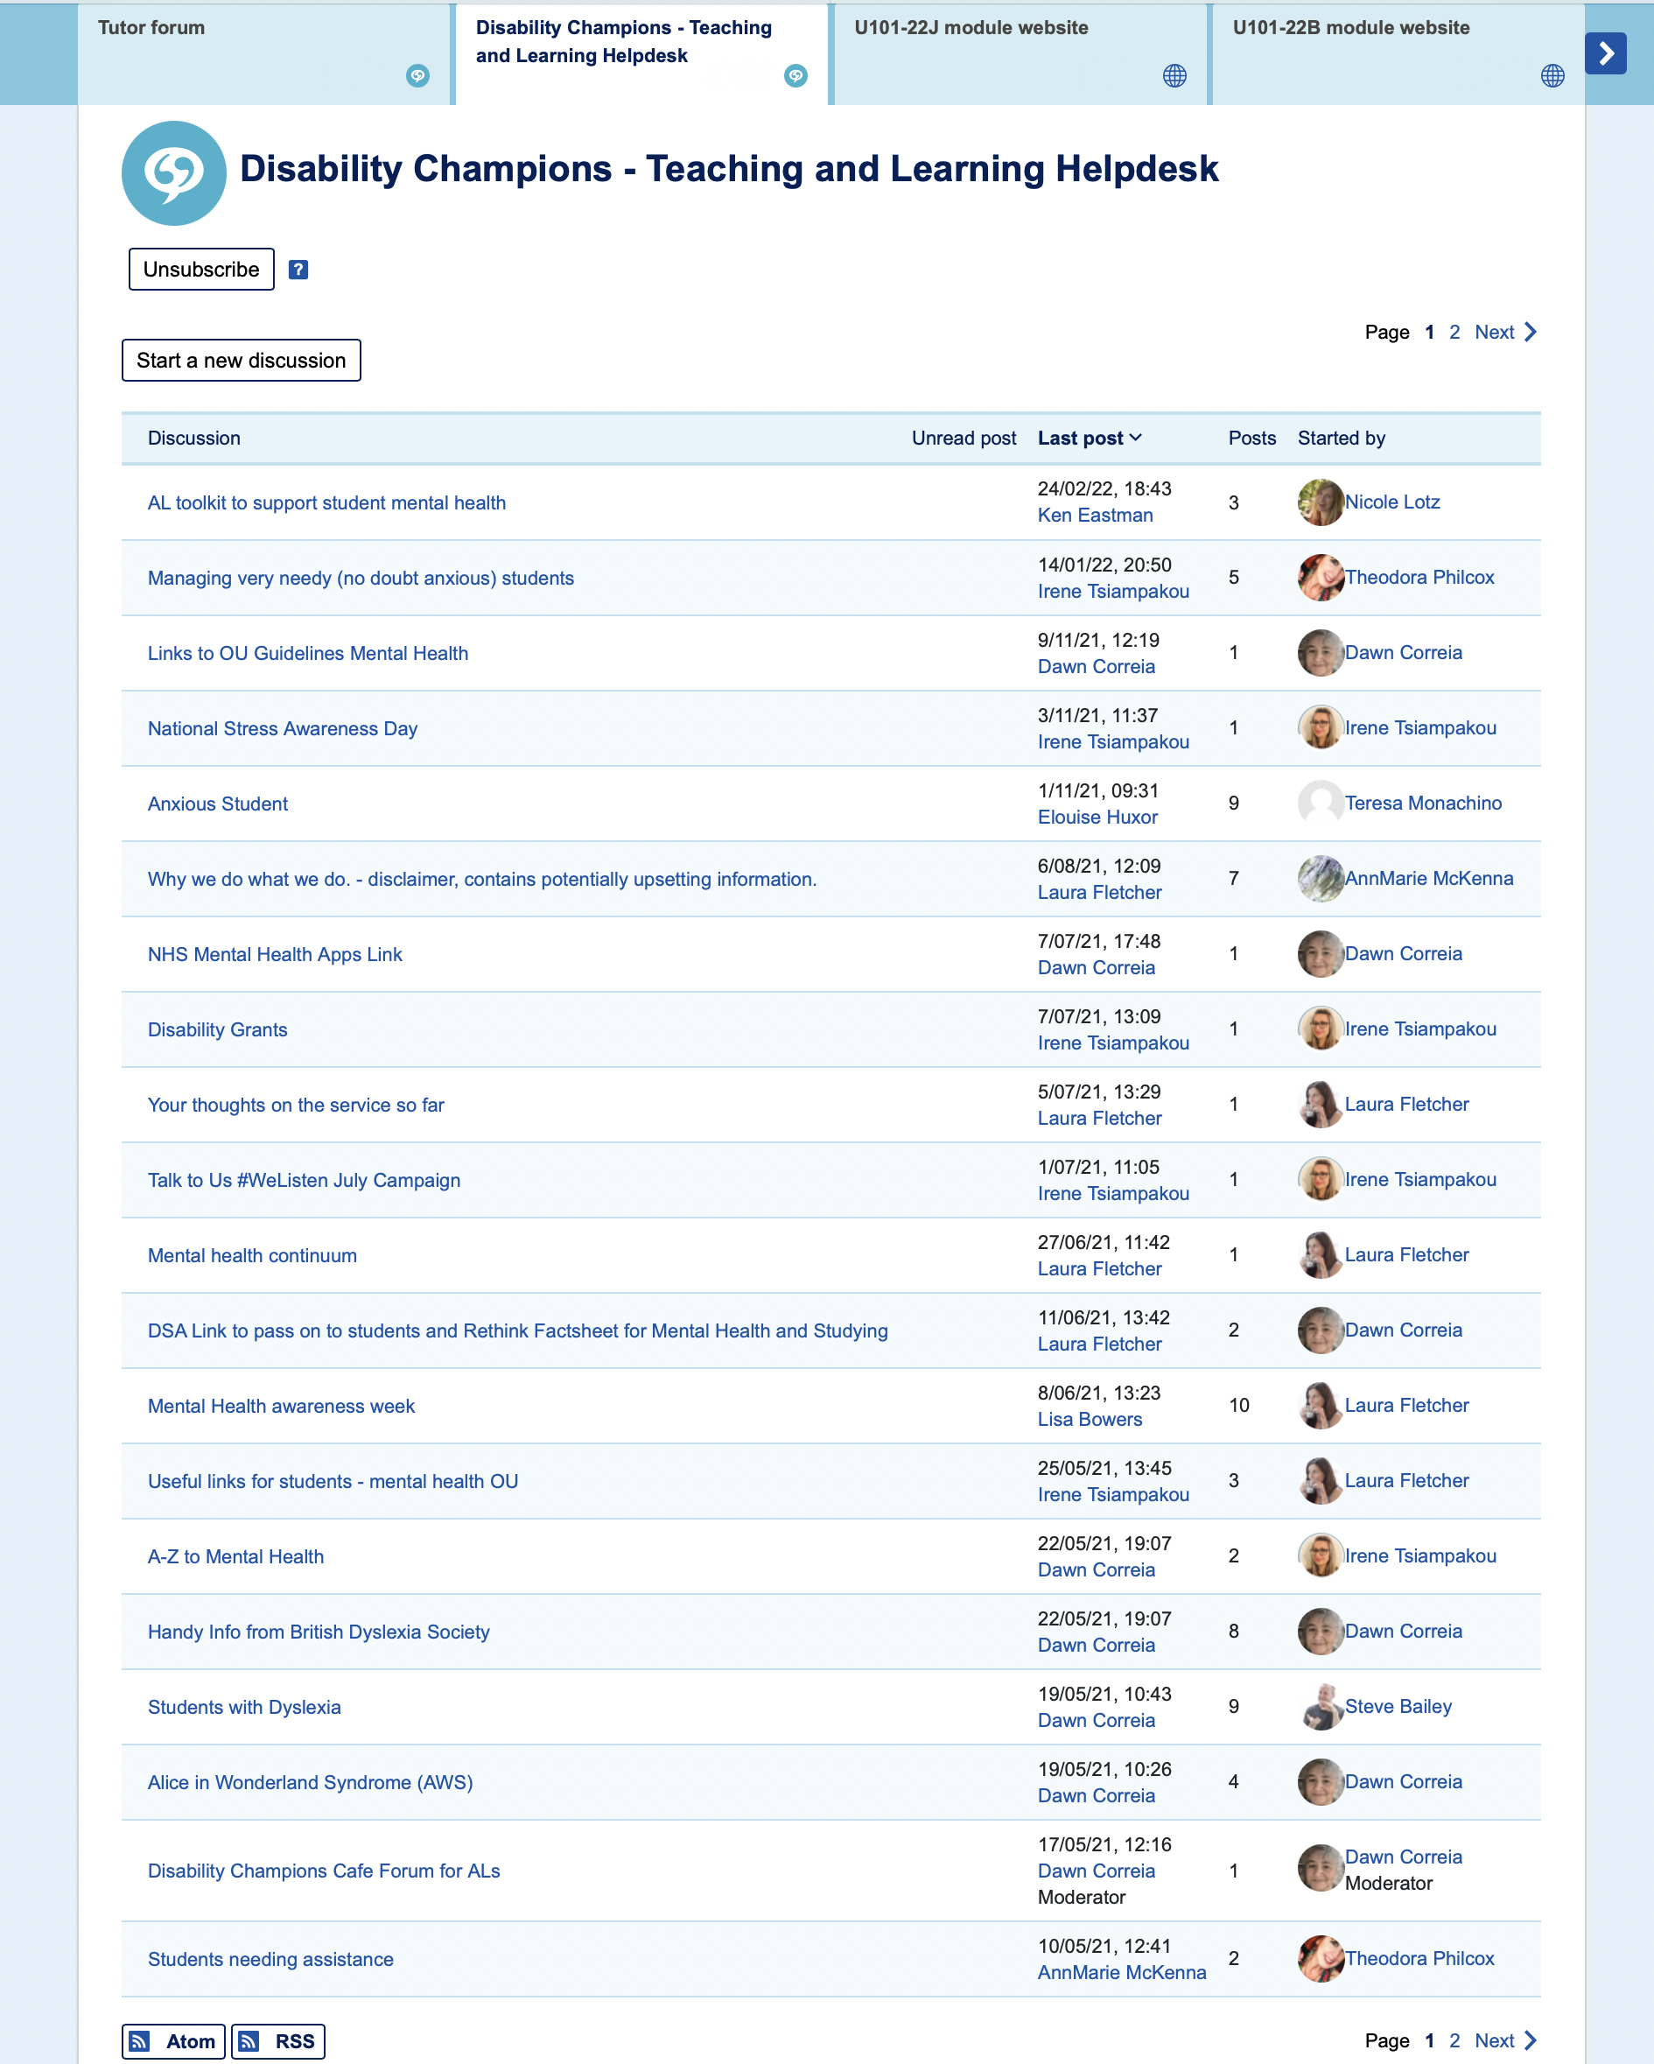
Notes:
Theo

Slide 11
Findings so far:
That other schools and faculties have found similar problems to us!
That there has been a lot of work going on concurrently in this field across the OU which confirms the need for easily accessible information and guidance.
We will be able to apply some of the recent research to our own project and build on this to support its particular focus which deals with practical skills and, in being a creative module, frequently subjective solutions.
Notes:
Theo

Slide 12
Findings from rolling out the Disability Champions project....
ALs have been reluctant to post on the forum:
Due to concerns about appearing less confident
Possibly also due to this adding more to their workload
They want information that's snappy, relevant, and easy to apply in practice
Case studies with strategies to apply to specific needs
Notes:
Theo

Slide 13
Disability Teaching & Learning Helpdesk
U101 tutor comments
‘There's lots of supportive and relevant content that I have read and learnt from resulting in not needing to’
‘No specific need just yet’
‘I haven't had a situation I've felt I need advice on’
‘I haven't felt that I have a contribution that hadn't already been covered. I must get there sooner and then perhaps I can say something of note’
‘Not had any reason to so far’
Notes:
Elouise

Slide 14
Toolkit
U101 tutor comments
  ‘It is varied through helpful links to wider support alongside shared strategies from tutors that work and helps me understand what we are all experiencing. It is good to see I already do some of these and how I can develop further supportive strategies.’
‘When I last looked, I thought it was great, and good to know about for when I need it.’
‘Seems like a good mix of useful ideas and help’
‘Looks helpful, some templates to help where to direct students which can help us with the right level tone with students would be useful too’
Notes:
Elouise

Slide 15
We asked tutors what topics that would like to see on the helpdesk in the future
Profiles and streamlined case studies – giving precise practical support
Covid related issues and support
How to make tutorials inclusive
Recommended tools and aids – such as Read&Write (Dyslexia) ZoomText (Vision impairment)
A way to share good practice
Notes:
Elouise - Shaped next steps moving forward to make it more relevant.

Slide 16
Ability needs - Student Personas
We created a suite of student personas with strategies to support teaching
    Highlight the ability needs
    Challenges to learning
    How tutors can help the student
Notes:
Theo

Slide 17
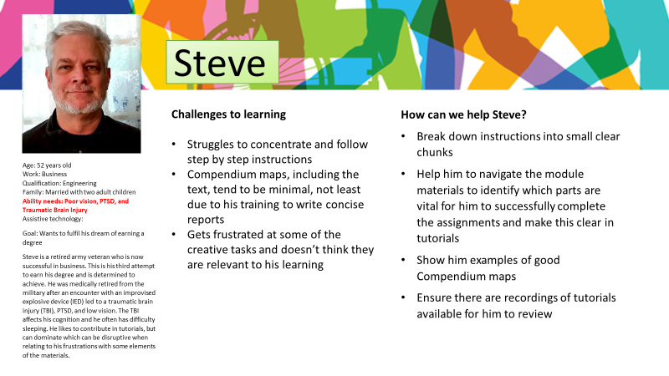
Notes:
Theo

Slide 18
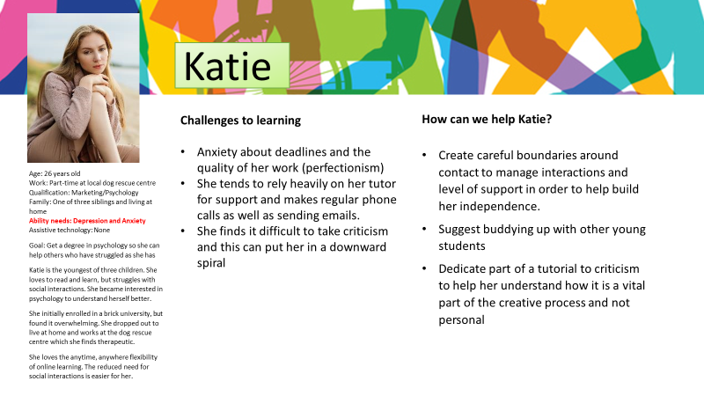
Notes:
Theo

Slide 19

What did you find helpful about the personas?
U101 tutor comments
‘help us to see the learning from the student's perspective and remind us that this may differ considerably across the cohort’
‘I can identify patterns of my own students’
Understanding that many students have very specific issues that can affect their working process and with some simple adjustments to how I communicate and guide students could make the difference to their confidence in studying and ability to succeed
Notes:
Elouise

Slide 20
What did you find helpful about the personas?
U101 tutor comments
‘There are strategies that I hadn’t thought about before such as having some form up buddying up system and careful boundaries with Katie’
‘How to help and give guidance.’
‘subject based suggestions for supporting students’
‘’the persona overview helps to give me insight into what a student might be experiencing. Then, reading the list of points of what I could do to facilitate the students study gives me ideas and a quick easy reference for ways to do this. It makes the process of guidance easier and fluid
‘Suggestions for how to best support students, by giving me starting points and ideas.’
Notes:
Elouise

Slide 21
How can we improve the personas?
U101 tutor comments
Include a greater variety of ability needs:
Dyslexia, Dyspraxia, Epilepsy, Visual, hearing and speech impairments
‘Speak to students/people who have these disabilities and ask for their ideas of what they feel would be helpful for them. … invite the student to explain any strategies they may use to help them study' as the first step as this can often reveal ways they use that tutors could work with to help. It also opens the door to positive communication and allows the student to feel empowered’
Include a resources section and describe tools that students are successfully using
‘include an additional reflective column … to report back with 'Did it work'?’
‘Perhaps a few words on motivations and interests, particularly creative interests’
Notes:
Elouise

Slide 22
How will we know if the project is successful?
Evaluation tools:
Usage: How busy was the forum?
Focus groups – ALs who have used the service, those who haven't and students with DAR flags
Questionnaires – Has confidence been built through using the service
Has retention of students improved during this presentation, especially for DAR flagged students?
Notes:
Lisa

Slide 23
Next steps……
Developing the (personas and profiles) and strategies to support teaching
Explore barriers to tutors seeking help
Evaluation of the more effective phase in the project e.g. Hot desk, VLE, Personas or combinations of phases.
Rolling out the AL Disability Champion concept to other schools across STEM.
Notes:
Lisa

Slide 24
Tutors will have quick and easy access to information and support in their teaching of students with a wide range of disability needs.
They will gain a deeper understanding of the impact of a range of disabilities on learning.
Through sharing good practice tutors will gain confidence in their ability to meet the learning needs of students with disabilities of all kinds.
Students will feel more effectively supported which we hope will have an impact on their levels of achievement.
Summary
Notes:
Lisa

Slide 25
Reading and resources
TutorHome - Guidelines on specific disabilities and further resources
TutorHome - Students with specific learning requirements
Website: AL toolkit to support student mental health (open.ac.uk)
Website: Disability teaching and learning toolkit (open.ac.uk)
Open Learn Mental Health Tips & Resources
Togetherall - Mental Health Community
Kaleidoscopeplus - Self Help Tool Box - postive mental health and wellbeing
NHS Every Mind Matters

Slide 26
Academic papers
1. The Role of Lecturers and Inclusive Education Molina, V. et al, Journal of Research into Special Educational Needs, 16 (S1): 1046–1049, 2016
2. Supporting students with disabilities within a UK university: Lecturer perspectives, Kendall, L, Innovations in Education and Teaching International, 55(6): 694–703, 2017
3. Daniell.S, and L. Waters (2019) Evaluation of D-flag students accessibility to and use of online tutorials and forums in L2 modules, eSTEeM project.
4. Dean.L,(2014) Learning and Development Needs of Autistic Adults Studying STEM Subjects via Distance Learning, eSTEeM project.
5. McPherson.E and Lister.K, (2018) Engaging students as experts in the trial and evaluation of Disability Language Guidance, eSTEeM project.
6. Slater.R, Campbell.A and McPherson.E (2019) Accessibility and inclusion in tuition (AccIT), eSTEeM project.
7. Collins.T and Davies.S, (2019) Disseminating inclusive field teaching – sharing resources and practices across disciplines and institutions, eSTEeM project.
8. Crighton, S, Potter, A (2019) Using Peer observation within a community of Associate Lecturers in Mathematics and Statistics, eSTEeM project.

Slide 27
THANK YOU

