Slide 1
Evaluating the Impact of Implementing Learning Design Approaches in STEM over 4 Years (July 2017 – July 2021)
Tom Olney
Senior Manager, Learning & Teaching
STEM Deanery
Carlton Wood
Senior Lecturer
EEES
Notes:
Introductions
Alison Edwards & Anne Higson

Slide 2
What does it mean to ‘do’ learning design in STEM?
Notes:
Firstly, just to establish the background to the work we needed to try and answer this question:

Slide 3
Learning Design as practice, product and/or process
Practice: The action of applying Learning Design concepts to the creation and implementation of a piece of teaching and learning.
Product: ‘A’ learning design – a plan or recorded sequence of teaching and learning activities
Process: One or more events or stages that are attended or completed to assist in the development of a piece of teaching and learning
When someone says, ‘Learning Design’, which of these do you think of first?
Notes:
One of issues with LD is that it has become one of those terms that is used a lot but not necessarily well understood?
It’s become a bit of a buzzword, some educational jargon that has kind of morphed and moved around a bit depending on who you talk to.
Term is used to describe product, process and practice?
Outline terms…
As an experiment, if someone says learning design…
Can you vote using the poll in the chat box.

Slide 4
Open University Learning Design Initiative (OULDI) - timeline
Part of the Institutional Approaches to Curriculum Design and Delivery programme which was co-funded by the Joint Information Systems Committee (JISC) and the European Union (EU).
The OULDI pilot conducted interviews across university to capture module design practice (2007-2012).
Findings led to recommendations and changes to processes for module production.
Recommendations piloted by the Learning Design Project team in Institute of Educational Technology (IET) working with all faculties (2013-2015).
Science faculty and Maths, Computing & Technology (MCT) faculties - existing practice.
Creation of STEM and creation of Learning Design team in LDS (2016).
Four new faculties: (STEM, WELs, FASS, FBL) + LDS-LD have evolved different approaches over the way they interpret and embed these principles into the faculty structures, governance and procedures designed to support module teams. (2016-present)
Notes:
Run through timeline to establish the background.
Before 2016 I was a member of the IET Learning Design Project team going out and about and establishing resources, etc.

Slide 5

What does it mean to do Learning Design at the OU?
Principles of…
1. Mechanisms to encourage design conversations across disciplines and expert roles
2. The use of tools and instruments as a means of describing and sharing designs
3. The use of information and data to inform the conceptual tools and frameworks that guide the decision-making process
Notes:
Learning Design was the subject of the first IET Quality Enhancement Report Series in 2015.
Rebecca Galley wrote this and it’s an interesting read about how OU has interpreted the OULDI brief etc.
Really clear how it is linked to attempting to improve quality and how LD can be used as part of a governance process. Stage gate process.
Establishes 3 principles…
Challenge for the LDS team and also for Carlton and I, has been setting up support structures that embed those principles but also that are actually practical and useful.
APPROACH HAS EVOLVED
I’m contacted by CM or STM – let’s have a conversation! Point them to the MTC Induction site
Meet with AD-SE and HCSG – MTC Production Induction meeting
Organise timing for a LDW
Agree an agenda
Have LDW
Continue work on module spec
Module spec to BoS
Module spec to SG
ful.

Slide 6
The research project
Notes:
SCOPE
Currently…. 2stages
Stage 1: supported by Deanery (me and AD-SE) – SG approval
Stage 2: supported by LDS-Learning Design

Slide 7
Research Questions
RQ1: How has STEM learning design impacted on module teams design practice, their collaborative ways of working and their perceptions of effectiveness?
RQ2: How has STEM learning design impacted the intended learning designs that are produced?
RQ3: How has STEM learning design impacted on internal STEM module approval processes?
RQ4: What ‘arrangements’ enable and constrain the enactment of learning design practice in STEM?
Notes:
3 x original research questions based on the 3 orientations. Next part I’m going to go through how we approached them and the data we collected.
1 extra to draw the ideas together – will describe this in more detail later

Slide 8
RQ1: learning design as practice
1. The MTC Induction meeting with the AD-Student Experience and Head of Curriculum, Strategy and Governance prepared me for my role and responsibilities during production.
2. The STEM MTC Induction Guidance (Production) website (https://learn3.open.ac.uk/course/view.php?id=300862) assisted me in preparing for production and, when referred to, contained the information I needed to know.
3. The agenda for the Learning Design Workshop provided an outline that met both the specific needs of the module team and also enabled participants to focus on the student experience.
4. The Learning Design workshop was useful as an opportunity to be more effective and more collaborative in the process of designing a student focused module.
5. The Learning Design workshop was useful as an opportunity to be more effective and more collaborative in the process of preparing the module specification (REP03) documentation for submission.
6. Visualizing the proposed module using the Activity Planner was useful as a way to be more effective and more collaborative in the process of designing a student focused module.
7. The visualization generated using the Activity Planner that was submitted with the REP03 will accurately reflect the student experience in the final module design.
8. General comments
Notes:
7 statements on a Likert scale with four options to record level of agreement over time
Statements were based on the 3 principles established in the QE paper i.e. design conversations and collaborating, but also specifically about the tools and instruments that were used e.g. MTC Induction meeting, website, LDW, activity planner .
Sent survey after approval of module at Scrutiny Group to MTCs and CMs.
First module approved SG = July 2017, Last module approved SG = Mar 2021
Total modules = 28
Total surveys sent = 58 (CM = 28, MTC = 30), Survey responses = 43 (CM = 21, MTC= 22)
Response rate = 74%

Slide 9
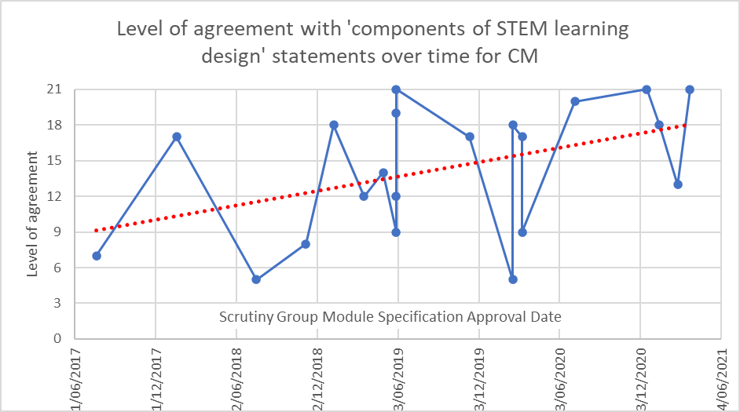
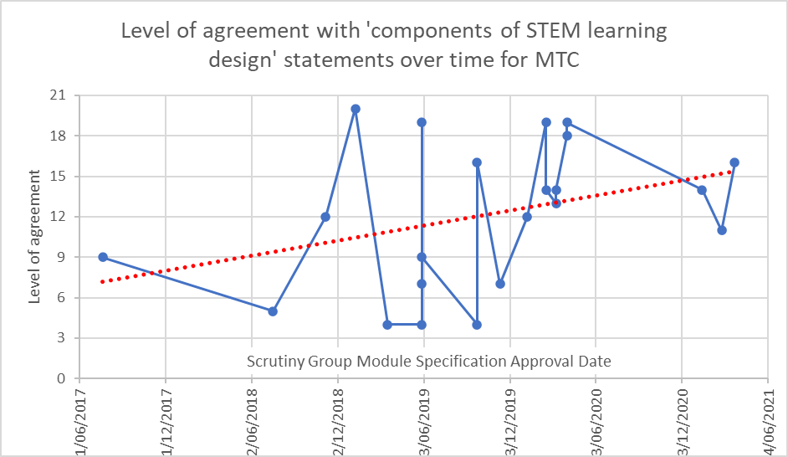
RQ1: learning design as practice
Notes:
Allocated values to the Likert scale level of responses and plotted them against date of SG approval to give a sense of possible improvement over time.
Separated by job role.
CM first,
then MTC.
Improvement over time.

Slide 10
RQ1: learning design as practice
Notes:
The other thing I did with this data was to plot this level of agreement against iming
43 responses (CM 21, academics 22). CMs slightly more positive.
Seems like optimum time is 2-6 months before approval.

Slide 11
RQ2: learning design as product
Notes:
Thinking about LD as a PRODUCT - Activity Planner findings.
At LDW idea of using 7 Activity Type categories is introduced to create design intention.
Idea is to encourage designers to consider all kinds of activities for students – reflect University strategies around reducing assessment and more interactivity.
Required to submit to SG. Downloaded them here. Perfect design – wide variety – that’s OK because each has it’s own context etc…
Does allow for some comparison though.
IET did some analysis in 2015/2016 of the learning designs that were held in the online LD Tool and found these averages for the categories (blue bars)
I’ve just compared those against the averages for these STEM modules here (orange bars)
Intended designs do reflect that change in emphasis. Assimilative and assessment down, but other more active types up.
Pretty broad, but I find it interesting.
Over to Paul.

Slide 12
RQ3: learning design as process
14 interviews with Board of Studies (Academic 2, Professional 3) or Scrutiny Group (Academic 4, Professional 5) members past and present. 9 had attended LDW.
Focus on changes in quality of module specifications, confidence in MTs readiness for production, and efficiency of process over time from learning design activity.
Difficulties articulating a direct link between LD support and change in these areas. Memory issues!
Experience of MT a substantial contributing factor to all three areas.
Perception of change to quality of spec: quality declined = 0, no change to quality = 9 quality improved = 5.
Perception of change in confidence that MTs ready for production: less confident =3*, no change = 5, more confident = 6
Perception of change to efficiency of process: less efficient = 0, no change = 9, improved = 3, declined = 2
Lots of very positive comments centred on ringfencing/protecting time to focus on student experience (learning outcomes/student workload) over content. Removal of ‘blank cheque’.
Some negative perceptions focused on LD as ‘hurdle’, ‘step in process/tick box exercise’
Notes:
Many positive comments and areas of impact associated with the learning design support provided were identified by the interviewees. These included reducing student workload [02] [12], learning outcomes [08] [14], developing a coherent rationale [05] and thinking about what the student experience would be, irrespective of the content [03] [05] [08] [10] [11] [12]. Interviewees explained they perceived the value of the support was in being able to ‘ringfence’ or ‘protect’ time [08] [10] in order to have ‘a very productive conversation’ [02] about elements of the student experience that were not content driven but needed to be ‘directly questioned’ [12], ‘challenged’ [10] or addressed [06] as a ‘step in the process’ [07]. One interviewee highlighted how they felt they were now, ‘less in the position of signing a blank cheque of approving a module where there are lots of unknowns’ [03] whilst for another learning design support, ‘meant that they [the academics] just had a clearer idea about what they were going to produce’ [09]. Despite 5 of the interviewees having never attended a LDW their perceptions of the activities that took place there were broadly accurate, specifically referencing the development of learning outcomes [01] [05] assessment strategies [01] and ‘how to teach’ [13] as being amongst the expected activities.

Slide 13
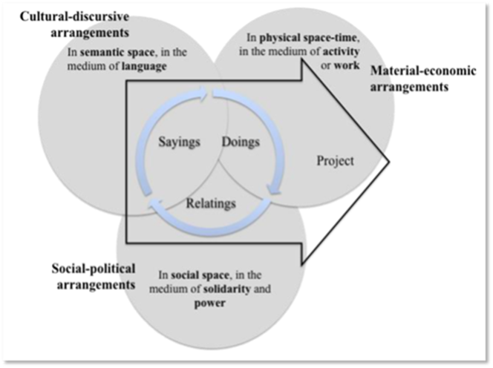
RQ4: the ‘arrangements’ that enable and constrain practice
Notes:
Theory of Practice Architectures (TPA) provides a means to establish: ‘an account of what practices are composed of and how practices shape and are shaped by the arrangements with which they are enmeshed in a site of practice’.
‘Arrangements’ categorised into ‘doings’, ‘relatings’, ‘sayings’
Recommended by some leading LD researchers to be applied to LD in order to ensure ‘sustainable change’ occurs.
Organised all our data in Nivo12 and then used TPA as coding framework.

Slide 14
Recommendations
1. Time - optimum time between LDW and SG approval 2-5 months
2. Contextualisation – concentrate on the adaptability of LD for different contexts
3. Experience – mechanism for sharing experiences
4. Re-orientation of LD – away from an association with process, towards an association with practice and/or product
Notes:
Time – ideas to percolate and develop! Questions raised
Contextualization – agenda at LDW, might be a language problem, toolbox of offers?
Experience – Cloudworks discontinued, research says support was ‘inherently social’, f2f, establish a ‘MTC in production’ group?
Re-orientation – Stagegate, LD done ‘to them’, rather than ‘with them’ is pervasive, emphasize all 3 orientations, embed in practice?

Slide 15
Discussion:
How should Learning Design be supported in STEM?
What are your thoughts?
What are your experiences of LD at the OU or elsewhere?
What types of support would you like to see developed?
What kinds of evaluation/research projects would you like to see?

Slide 16
References
Conole G. (2013) Designing for Learning in an Open World. Explorations in the Learning Sciences, Instructional Systems and Performance Technologies, vol. 4: New York: Springer.
Dagnino F, Dimitriadis Y, Pozzi F, Asensio-Pérez J & Rubia-Avi B (2018) Exploring teachers’ needs and the existing barriers to the adoption of Learning Design methods and tools: A literature survey British Journal of Educational Technology Vol 49 No 6 2018 998–1013 http://dx.doi:10.1111/bjet.12695
Dalziel, J., Conole, G., Wills, S., Walker, S., Bennett, S., Dobozy, E., Cameron, L.,Badilescu-Buga, E., & Bower, M. (2016). The Larnaca Declaration on Learning Design. Journal of Interactive Media in Education. 7, pp.1-24, doi.org/10.5334/jime.407
Galley R (2015) Learning Design at the Open University: introducing methods for enhancing curriculum innovation and quality. Quality Enhancement Report (1) The Open University
Kantirou M (2016) A learning design approach for MCT. OU Internal report (https://learn3.open.ac.uk/pluginfile.php/148524/mod_resource/content/2/LD_in_MCT_Aug2016.pdf retrieved 27/02/20)
Godsk, M (2017) Improving STEM Undergraduate Education with Efficient Learning Design. EdD thesis. The Open University.
Rienties B & Toetenel L (2016) The impact of learning design on student behaviour, satisfaction and performance: A cross-institutional comparison across 151 modules. Computers in Human Behavior. 60: pp.333-341 https://doi.org/10.1016/j.chb.2016.02.074
Mahon K., Kemmis S., Francisco S., Lloyd A. (2017) Introduction: Practice Theory and the Theory of Practice Architectures. In: Mahon K., Francisco S., Kemmis S. (eds) Exploring Education and Professional Practice. Springer, Singapore. https://doi.org/10.1007/978-981-10-2219-7_1

