Slide 1
Infrastructure for an Online Computing Lab
11th eSTEeM Annual Conference 2022
Mark M Hall and Soraya Kouadri

Slide 2
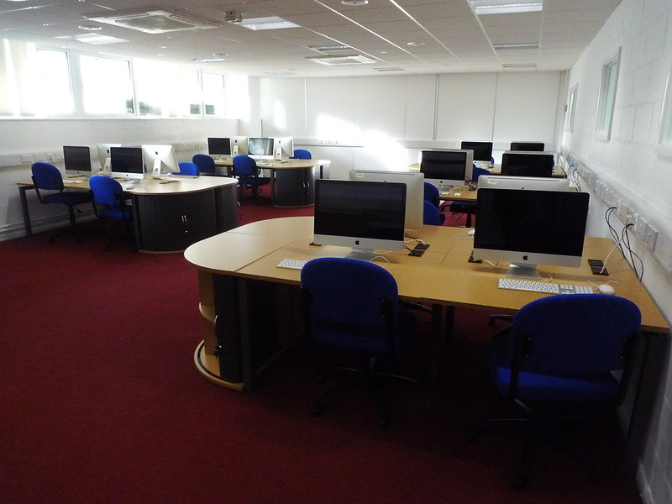
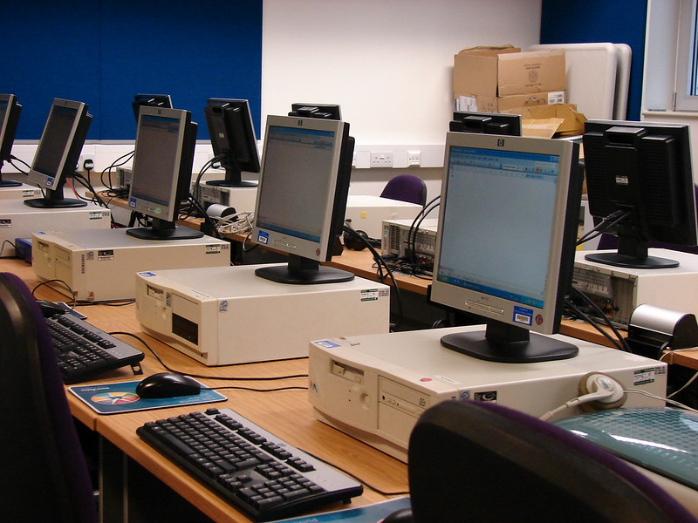
Computing Labs
Computing Labs
==
Testable Infrastructure
Jon Crel - https://flic.kr/p/dirPPt
Jisc infoNet - https://flic.kr/p/rqNCt

Slide 3
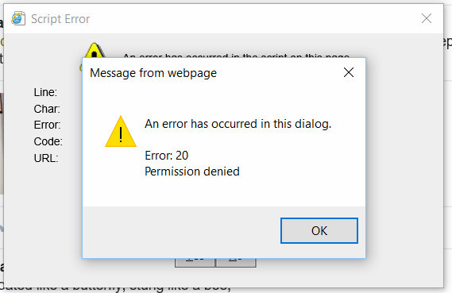
Distance Computing Labs
Need to support different hardware setups
Need to support different software setups
Impossible to test all combinations!
Generates a significant amount of staff work in preparation
Generates a significant amount of staff work in ongoing support
Generates a significant amount of student dissatisfaction
John Smith - https://flic.kr/p/HMkArf

Slide 4
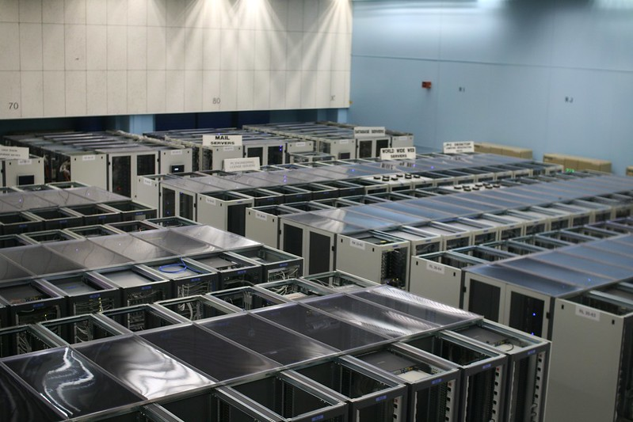
Distance Computing Lab
Stick it in the cloud
Provide access via the web-browser
Use off-the-shelf software as much as possible
Provide a testable, controlled environment
Nicolas Nova - https://flic.kr/p/7Zygk9
Modern Container-based Learning Interface and Delivery Infrastructure
eSTEeM
Project

Slide 5
Aspects that MCLIDI covers
Delivery
Interfaces / Content
Development

Slide 6


Delivery Infrastructure
Computing Hardware
Cloud Orchestration Software
Launch Software
Module-specific Containers
Storage Hardware

Slide 7
Development Infrastructure
Container Builder
Supports the process of creating the container images
Configured via a single configuration file
Includes pre-built configurations
Includes content into the container
Can be run in a fully automated environment
Container Content
Ensures content is distributed to students
Ensures content is updated when appropriate
Ensures required services are started in the container
Runs startup / shutdown scripts
Handles both cloud and local scenarios

Slide 8
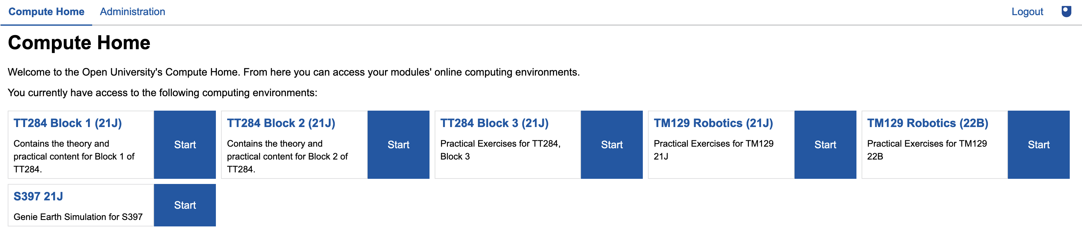
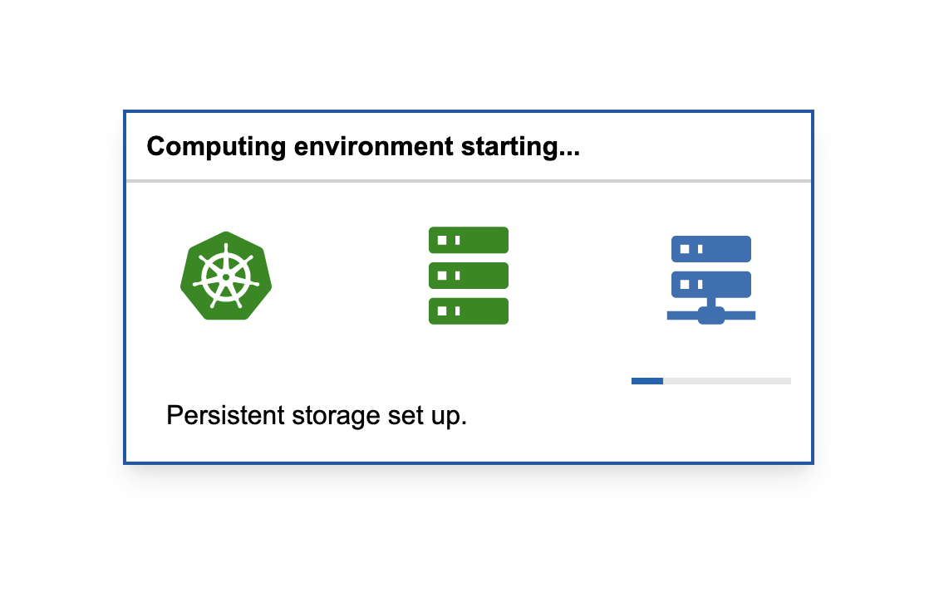
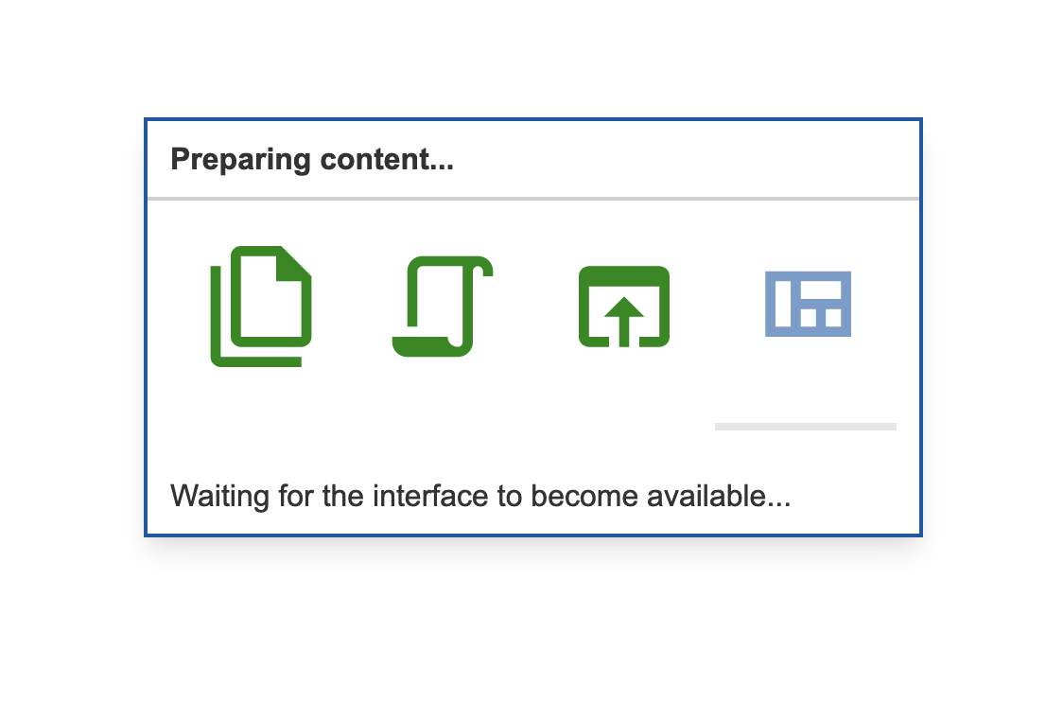
Interfaces and Content

Slide 9
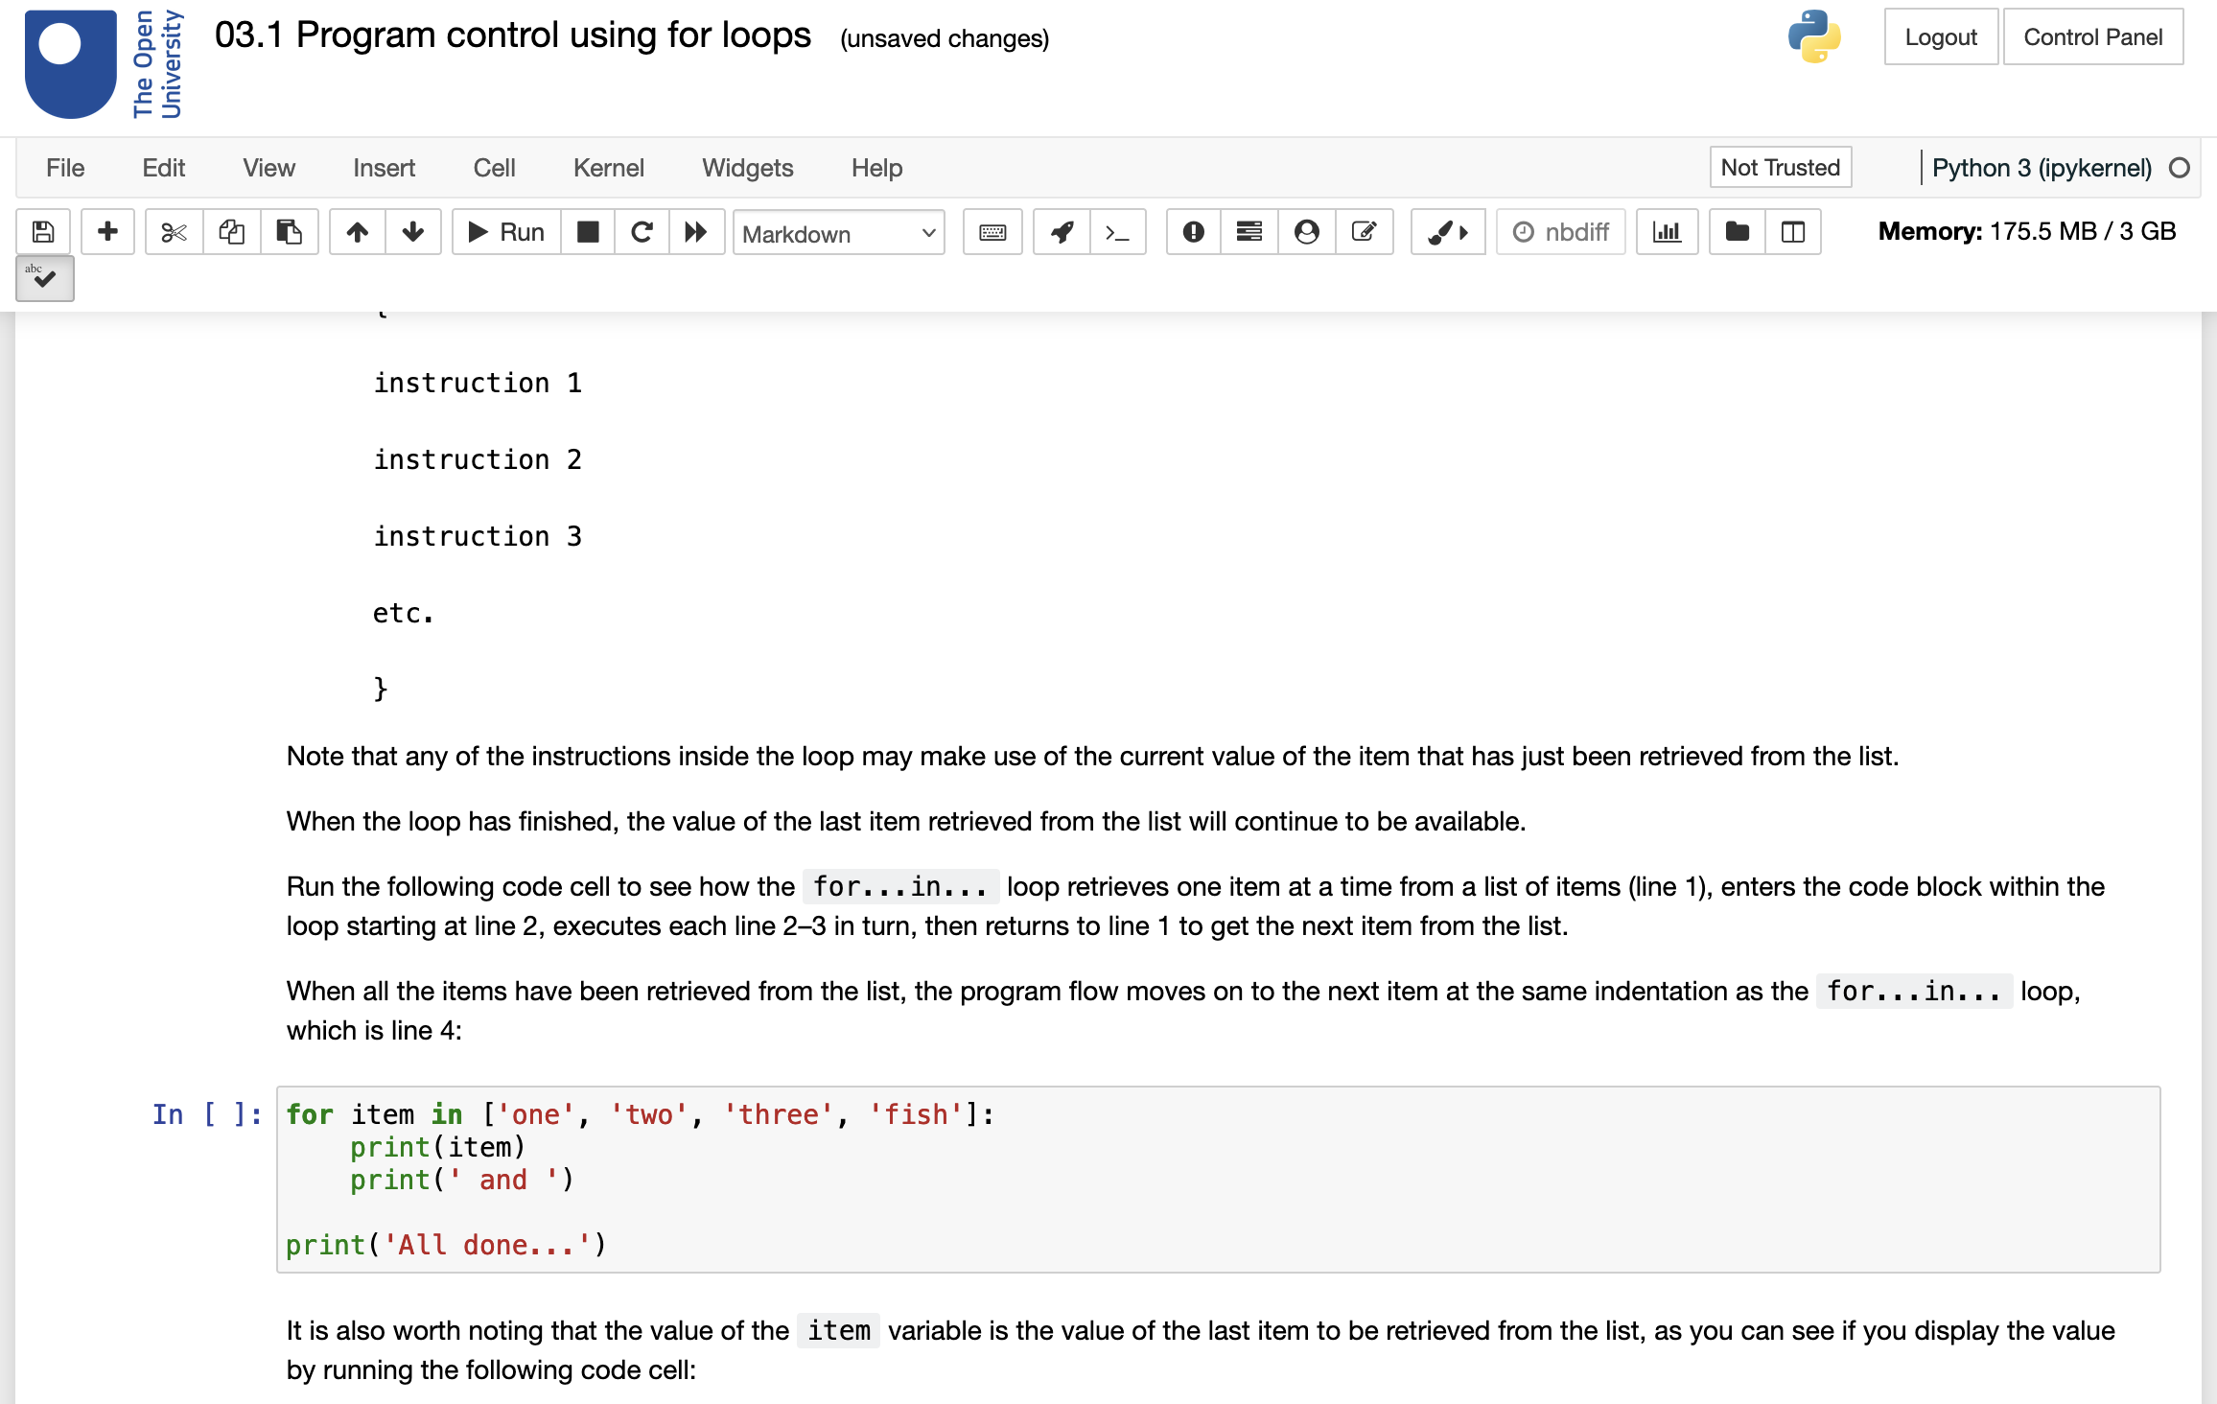
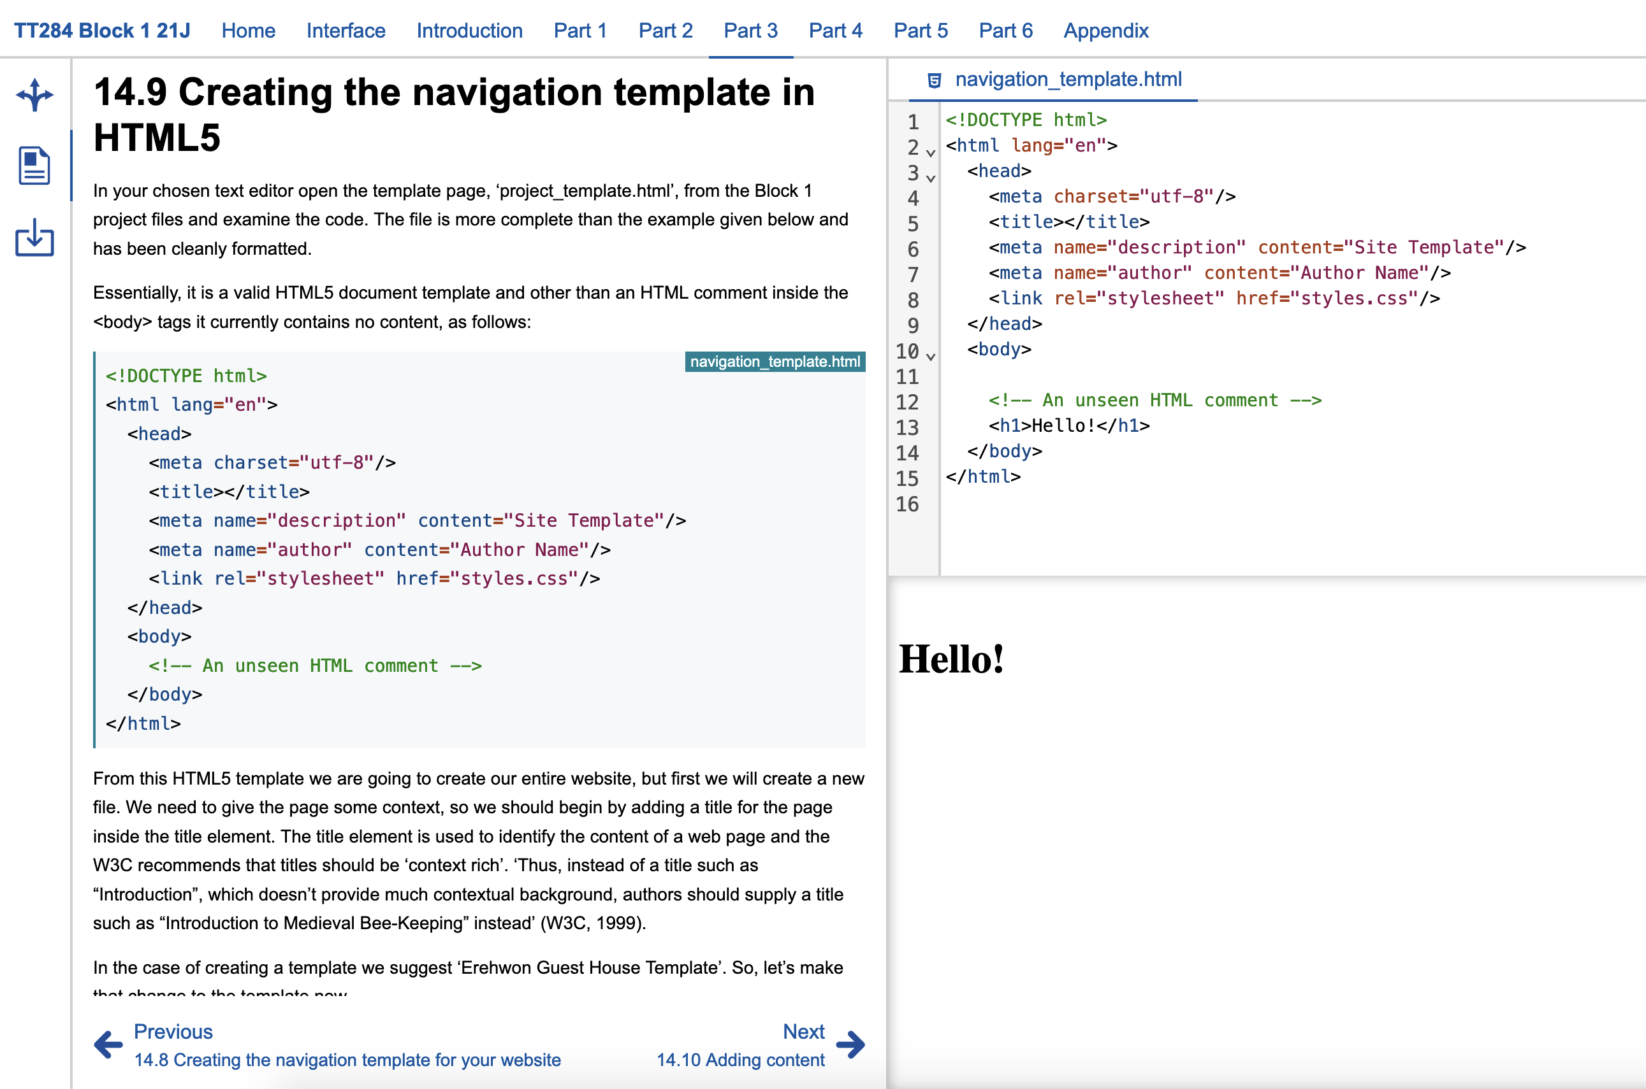
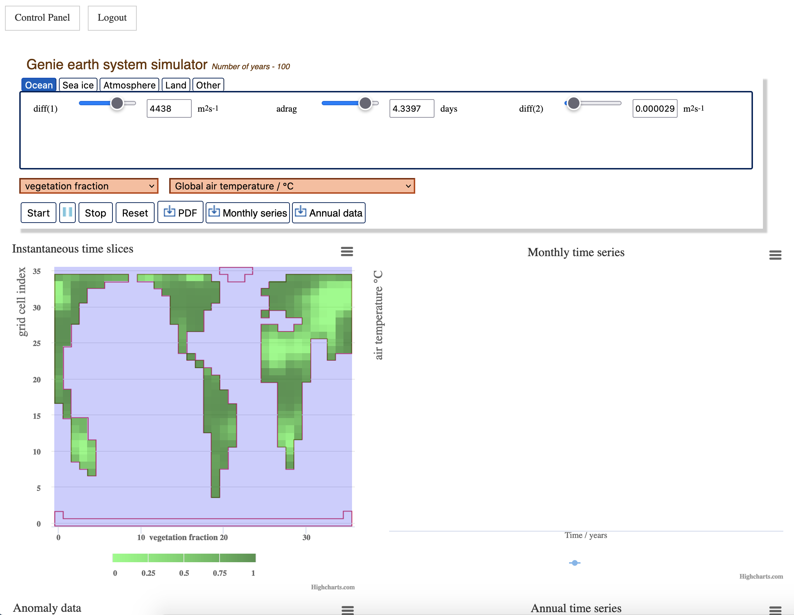
Interfaces and Content

Slide 10
Some experiences
TT284
TM129
S397

Slide 11


Some Experiences
1000+ students with 8500+ sessions
25 – 70 minutes median duration per session
£6700 so far
11 months system uptime
1 Infrastructure Bug affecting ~10 users
2 Container Issues affecting ~25 users

Slide 12
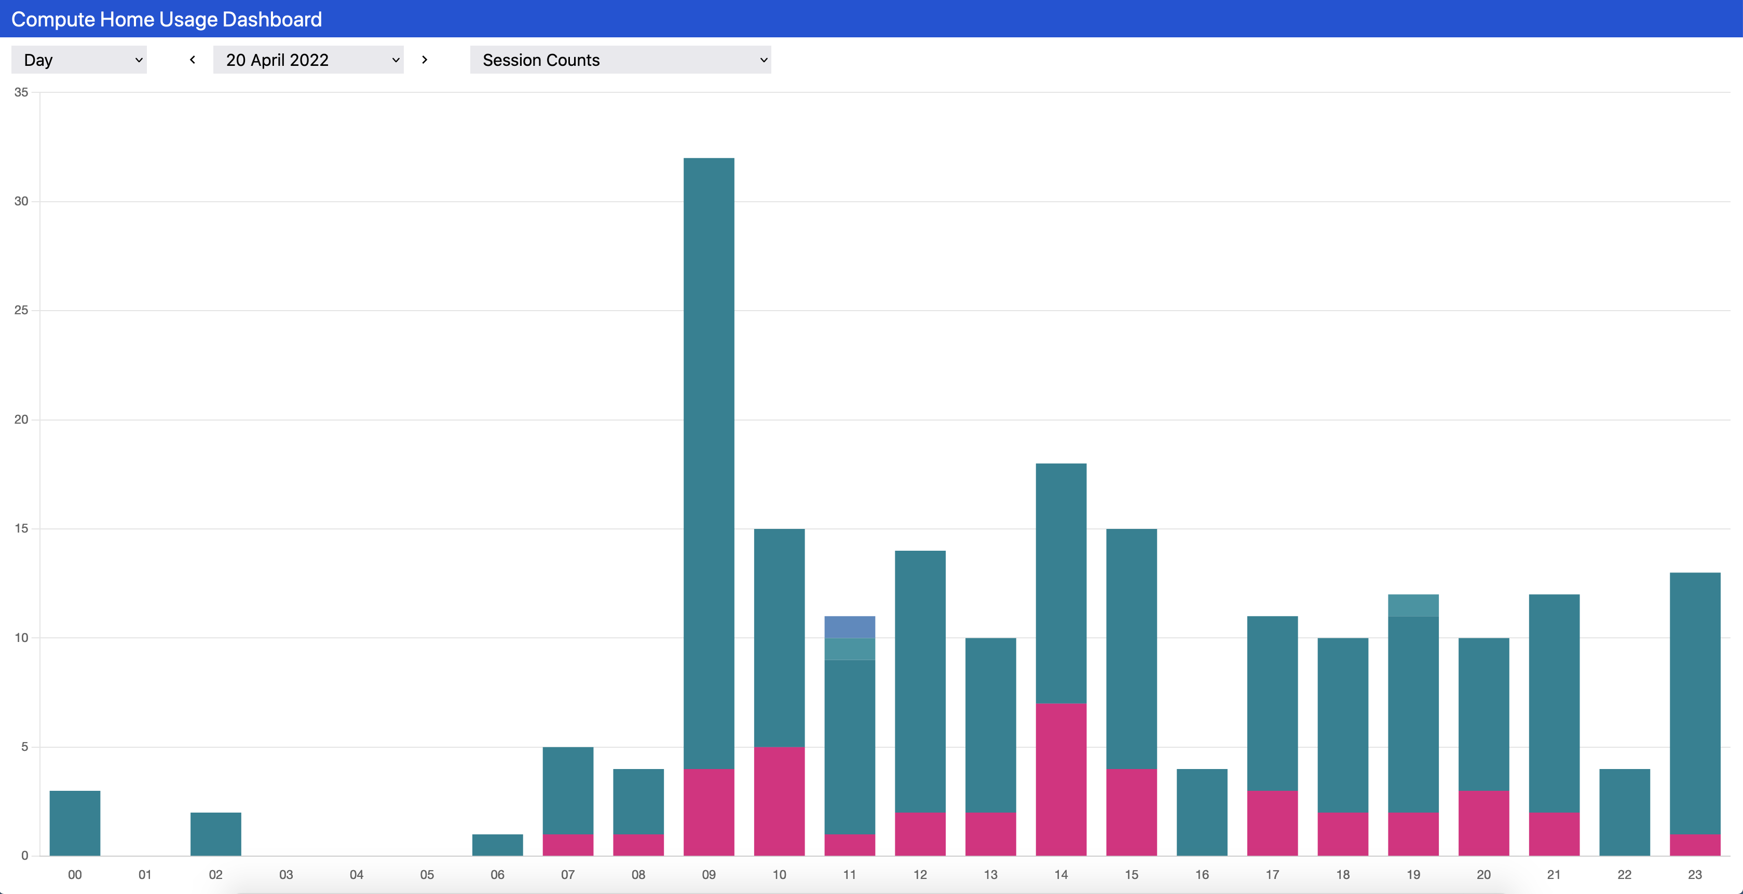
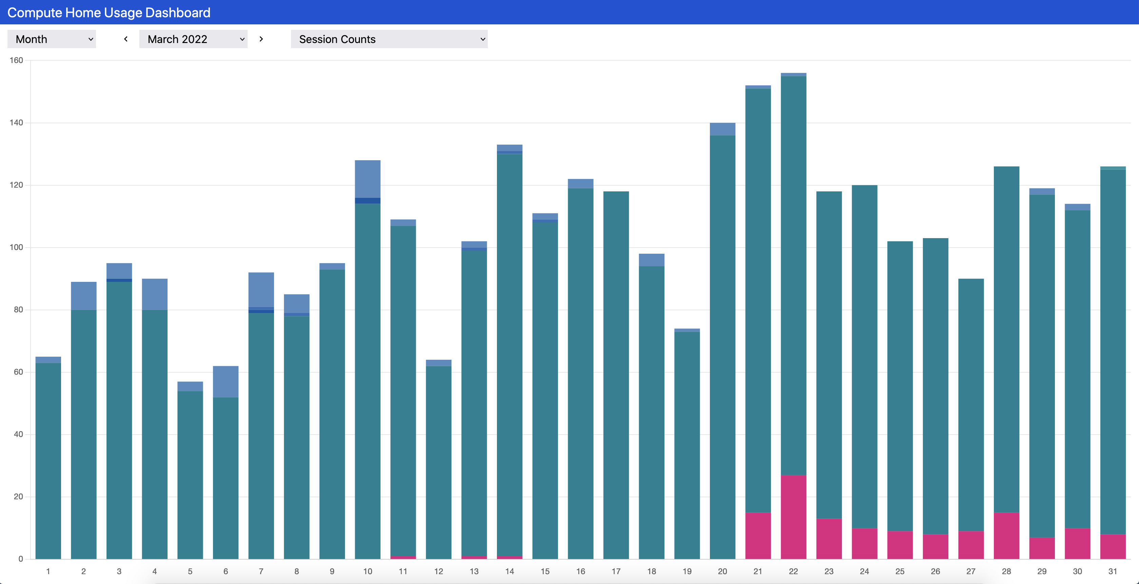
Some Experiences
Significant system use between 10:00 and 24:00
First users turn up at 07:00
Lowest use is generally on Saturday or Sunday

Slide 13
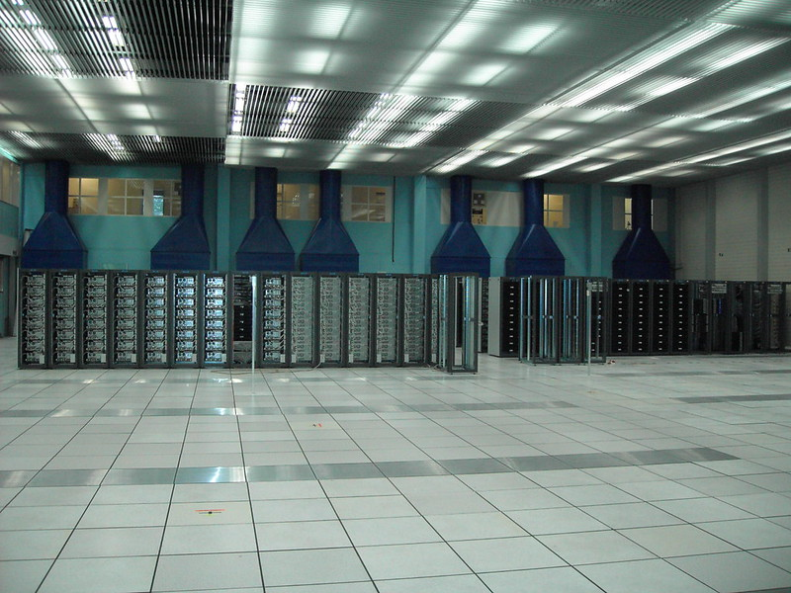
Where next?
User survey in progress
We have our own in-house infrastructure
We can support more modules
Contribute financially to grow / maintain the infrastructure
Talk to me if you are interested in making use of this
Faber - https://flic.kr/p/nUMZq

Slide 14
Questions.

