Slide 1
Decolonising Computing:
Resources for Educators
eSTEeM Conference 12th May 2022

Slide 2
About the Project
The aim of the project is to raise awareness about the legacy systemic effects of colonialism in computing and develop guidance for computing educators about how to effect redress and prevent its (re-)introduction in computing material.
It will do this by investigating and reporting on the meaning, scope, limits, and implications of decolonisation in the context of computing in general, and the C&C curriculum specifically, through a critical, participatory approach.

Slide 3
The Team
Mustafa Ali
Ray Corrigan
Clem Herman
Andy Hollyhead
Magnus Ramage
Zoe Tompkins
Steve Walker
School of Computing and Communications

Slide 4
What we’ve done
Initial Scoping Document
  What do we mean by decolonising computing
  Compiling core and supplementary reading lists
Methodology Document (to inform the workshops)
Decolonisation Criteria Document
  how to approach decolonisation of the computing curriculum
AL workshop/staff development

Slide 5
Beyond the Inclusive Curriculum
.
An inclusive curriculum as one that is:
“designed and delivered to engage students in learning that is meaningful, relevant and accessible to all. It embraces a view of the individual and individual difference as the source of diversity that can enrich the lives and learning of others” (Moody, Advance HE, 2020).
“universal and intended to improve the experience, skills and attainment of all students including those in protected characteristic groups” (Advance HE,
2020).

Slide 6
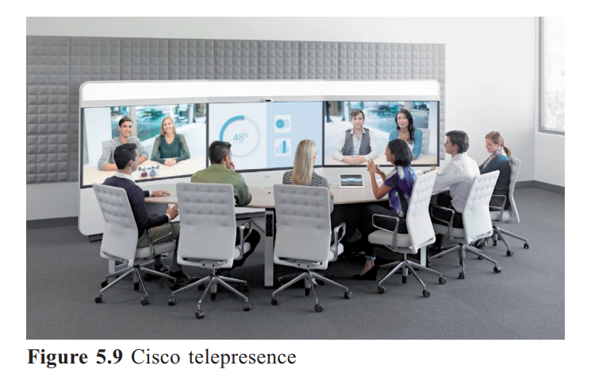
Representation – who is around the table?
Notes:
TM111

Slide 7
Inclusive vs Decolonised Curricula
an inclusive curriculum upholds the current power structures without addressing the legacy of colonialism.
“Our curriculum posits the knowledge and traditions of white men from the Global North as intellectually superior. Decolonising the curriculum seeks to question and transform this way of thinking as well as review how we teach within our University” (Keele, 2021).
Both inclusive and decolonised curricula include the contribution of scholars from the Global South to knowledge. Both would recognise the important contribution of the Indian mathematician Srinivasa Ramanujan. However, only a decolonised curriculum would address why Ramanujan’s contribution to maths and science was largely unacknowledged in the West until recently.

Slide 8

Until lions have their own historians, tales of the hunt shall always glorify the hunter’ (African proverb cited by Chinua Achebe)

Slide 9
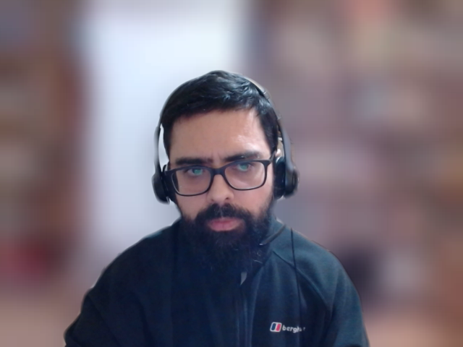
“[We can trace the ] global life cycle of a typical laptop computer or cell phone from its material origins in rare earth element mines in Africa and South America, to its manufacture and assembly in the factory cities of China, through its transportation and distribution to retail stores and households across America, and finally to its eventual disposal in places like the slums of Agbogbloshie, Ghana…”
(Ensmenger 2013, p.80)
From the core (demand, design) to the periphery (supply,
sourcing and construction) to the core (consumption)
to the periphery (disposal)
SOURCE: Ensmenger, N. (2013) Computation, Materiality, and the Global Environment.
IEEE Annals of the History of Computing. July 2013 https://doi.org/10.1109/MAHC.2013.33
Notes:
In this connection, consider resource extraction in the Congo which has gone on for centuries, and which continues to power computing in the Global North, commencing with the extraction of copper for computing systems during the Cold War, and more recently Cobalt for Lithium-ion batteries and Coltan for mobile devices. Tracking supply chains under racial capitalism affords us an insight into the coloniality of computing as resources, patterns of consumption, and the production of waste create circuits involving the core and periphery of the world system.

Slide 10
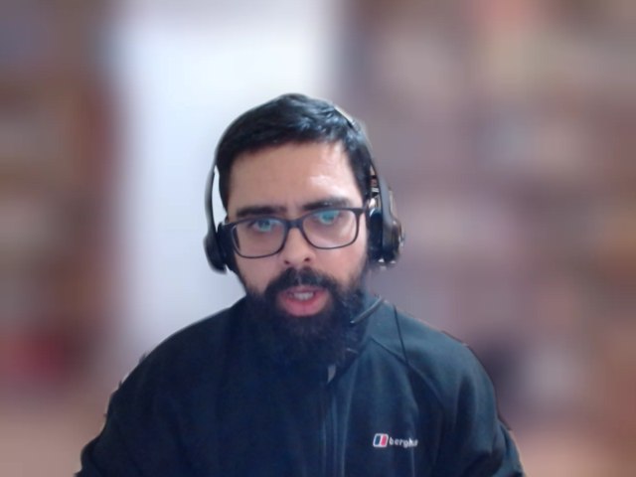
Decolonial Computing
Practitioners and researchers adopting a decolonial computing perspective are required, at a minimum, to do the following:
  Consider their positionality (who we are, where we are located) when designing, building, researching or theorizing about computing and ICT
  Embrace the ‘decolonial option’ - attempting to think through what it might mean to design and build computing systems with and for those situated at the peripheries of the world system, ‘decentering’ of Eurocentric / West-centric perspectives.
Notes:
Researchers and practitioners adopting a ‘decolonial computing’ perspective are required, at a minimum, to do the following: firstly, consider their positionality – both in terms of who they are and where they are located – when designing, building, researching, or theorizing about computing and ICT phenomena; secondly, embrace the ‘decolonial option’ as a political-ethical stance, attempting to think through what it might mean to design, build, maintain and use computing and ICT systems with and for those situated at the peripheries of the world system with a view to undermining the asymmetry of local-global power relationships.

Slide 11
Every time we see the latest technology being hyped, we need to be alert to
the bias, discrimination and inequity it may hide.
The surveillance industrial complex, including face recognition
Tech software is bad at recognising black faces. Facial recognition deployment is a threat to democracy, society and basic rights that far outweighs the claims for its potential benefits. The face recognition tech used by the Metropolitan Police in London was found to be inaccurate in 98% of cases in 2018. The UK’s Biometrics Commissioner, Paul Wiles declared it not fit for use at the time. It is banned in many places and normalized in many others, routinely used for border control and social services. The EU parliament, last year, called for a ban on the deployment of face recognition technology and a ban on private facial recognition databases, like the ones used by Clearview AI.

Slide 12
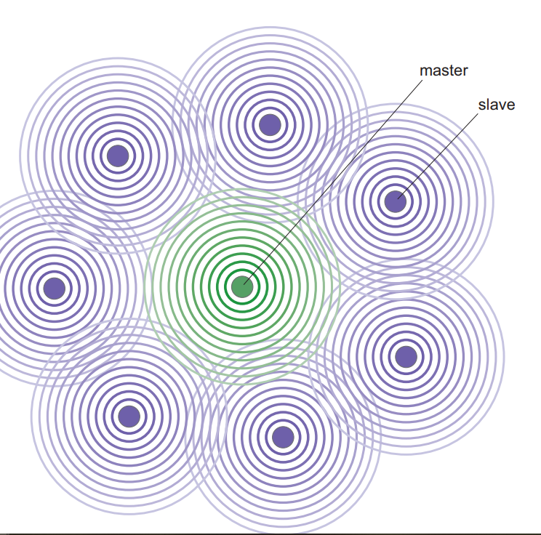
Examples from computing and IT curriculum
Notes:
TM111
Block 3, p.148, Fig 3.28

Slide 13
AL workshop discussion
 | Master/ slave terminology This has a technical meaning and is widely used in computing. This is a term that we tend to use as one component is in control and one isn’t. If we change the terminology, we are avoiding terms that are industry embedded and are not preparing students for the work environment. White-lists and black-lists are terms often used with respect to cyber security. | Possible changes to make: Take the terms out. Refer to the potential issue with these terms and make them aware that while they are common usage, using them can cause offense and/or harm. Give examples of how tech companies are reviewing and changing practices. For example, Twitter has dropped the terms "master", "slave" and "blacklist" in favour of more inclusive language in its programming.

Slide 14
Curriculum audit – Level 1
Western centric focus of the content .. presumes a particular profile and orientation as the content uses concepts, ideas and perspectives that centre or normalise constructions of ‘Westernness’ or ‘whiteness’’ as basic reference points for human society. There is no other view presented. ​
UK/US dominance in the narrative with many examples with a focus on the UK in the 1950’s. This continues in 1.3, with the reference to the Industrial Revolution and the use of only US and UK data sources. For example, The Associated Press is American, Fig 4 uses Ofcom data​
Notes:
'Introducing Computing and IT', section 1 to 1.4.

Slide 15
What’s next?
SRPP approval
Full HREC review submitted (04/05/22)
Online Student Questionnaire Survey
Student Discussion Workshop
Horizons in STEM HE conference @ UCL
Any questions?

